Slide 1

Myton Park Primary School
A look at how we can work in even closer partnership, to ensure that our children with additional needs reach their potential whilst maintaining a positive image of themselves.

Slide 2
The SEN code of practice
Our vision for children with special educational needs and disabilities is the same as for all children and young people – that they achieve well in their early years, at school and in college, and lead happy and fulfilled lives.

Slide 3
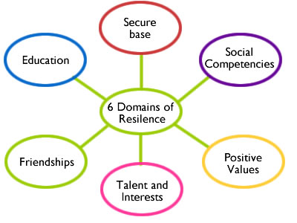
What do we need to consider?
Self-esteem and Resilience
In psychology, the term self-esteem is used to describe a person's overall sense of self-worth or personal value. Self-esteem is often seen as a personality trait, which means that it tends to be stable and enduring. Self-esteem can involve a variety of beliefs about the self, such as the appraisal of one's own appearance, beliefs, emotions, and behaviours.
Resilience is a key factor in protecting and promoting good mental health. It is the quality of being able to deal with the ups and downs of life, and is based on self esteem.
We look into many different factors that affect resilience:
secure early attachments
confidence of being loved and valued by one’s family and friends
clear sense of self-identity (personal, cultural and spiritual)
sense of self-efficacy (being able to make decisions and act independently)
confidence to set goals and attempt to achieve them.

Slide 4
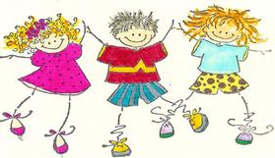


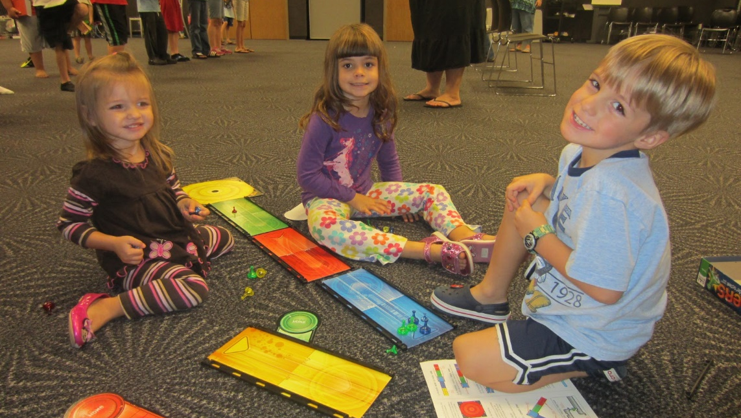
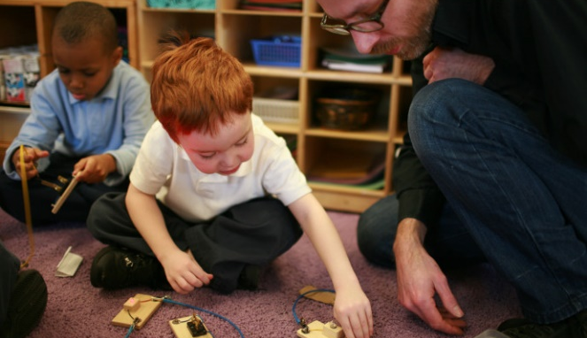

Slide 5
Individual Learning Plan
In 2015 we did some work with some parents to look at our ILP’s.
Historically, across many schools, these did not look at the child as a whole – but the complete focus was on what they struggle with.
For parents and children – this can be difficult. It does not give the right messages about our approach.
Why did we change?
As a staff, it was important that our ILPs reflected our main priorities and supported our work in seeing the whole child – in helping them to appreciate their strengths and in helping us see them from a broader perspective; we only see them in school and you see so much more of them.
It is also important, we talk about attitude. The reality of children on the SEN register is that they will need to try really hard all of the time. How can we facilitate this? We can let them know that we know it’s hard, we know it is difficult – but they need to keep trying hard so they can reach their potential.

Slide 6
The ILP
We want to see your child in the ILP. Their likes, their dislikes. What makes them tick?
What makes them worry?
What makes them happy?
How can we help them?
What barriers do they need to overcome?
What concerns do you have about your child?
What priorities do you have for them?
Be brave – use it as your opportunity to challenge yourself.
What do you need support with?
How can we facilitate this?
What else can we help you with?
Are there aspect you would like to share that you wouldn’t want to write on the ILP? Arrange an appointment with the teacher.

Slide 7
Questions on the ILP
Specific Difficulty:
Things I need extra help with:
Things I really enjoy:
What else I want you to know:

Slide 8

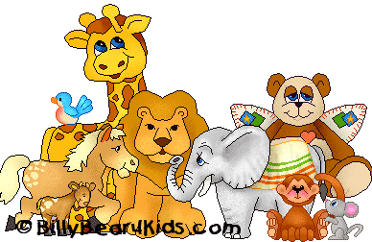
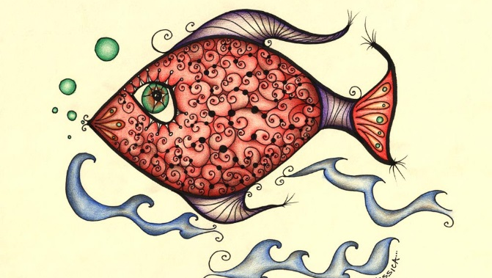
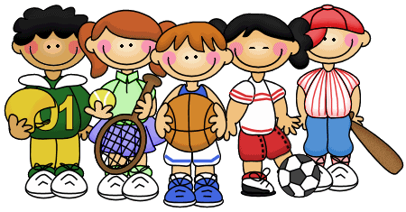
Interests, passions! When are they at their most relaxed?
NOTE:
To change images on this slide, select a picture and delete it. Then click the Insert Picture icon
in the placeholder to insert your own image.
What I like to do to learn:

Slide 9
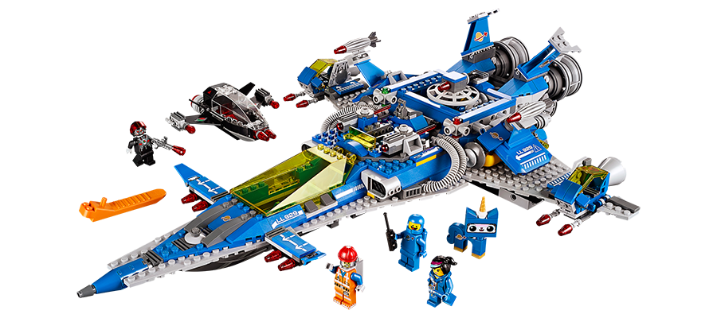
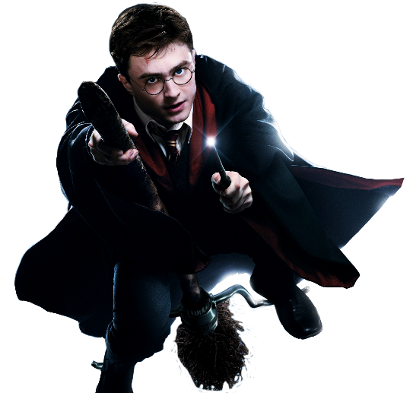
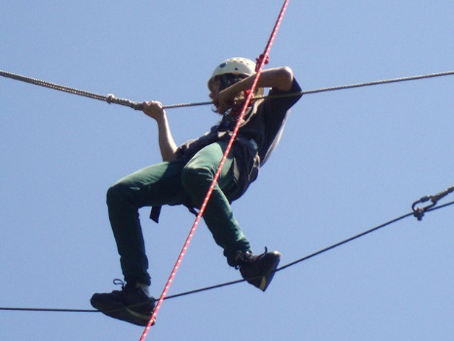




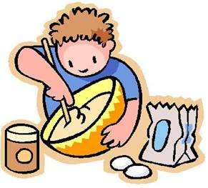

NOTE:
To change images on this slide, select a picture and delete it. Then click the Insert Picture icon
in the placeholder to insert your own image.
What does your child want us to know?
This is your child’s chance to tell us all about themselves! It does not have to be school related. Many children with additional needs lack confidence and may not readily share information which can help us to interact with them and show them we value them as people. We need to help them see themselves as individuals with something to say and who have worth. Show and Tell helps with this in the younger classes.

Slide 10

NOTE:
To change images on this slide, select a picture and delete it. Then click the Insert Picture icon
in the placeholder to insert your own image.
I’m trying to get better at:
To get better at this I need to:
Adults are looking for:
SMART
Tools I can use: Ideas for learning:

Slide 11
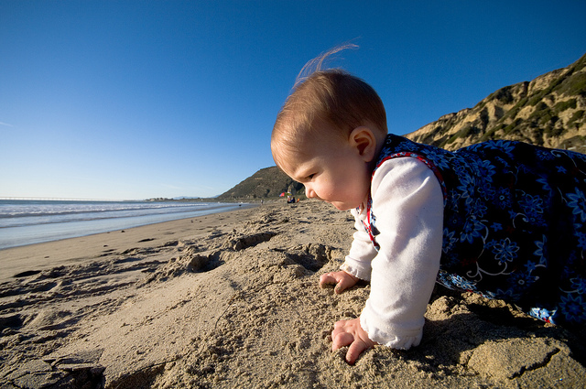

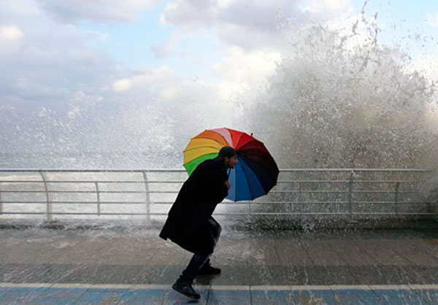
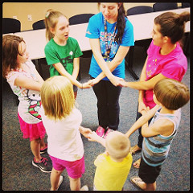
NOTE:
To change images on this slide, select a picture and delete it. Then click the Insert Picture icon
in the placeholder to insert your own image.
Happy
Determined
?
Resilient
Included

Slide 12
Feedback
Parental Workshops
What would you find helpful?

Slide 13
Please complete the form provided at the back of your handout.
The information you provide will be treated in the strictest of confidence.
Please do let me know what types of workshops you would be interested in.
It may take a while to get through all of the suggestions – so please do be patient.
Each workshop will be posted on the website as they are delivered.
If you come across any useful websites or information – then please do forward to school and we can put them onto our website to support other parents if we deemed it to be appropriate.
Please do understand that by placing information about organisations on our website, that does not mean that we would be endorsing them. In some circumstances we would need to seek some advice from the LA.

