Slide 1
Welcome to Myton Park Primary School
We look forward to developing a strong partnership with you to help your child thrive;
to develop their potential, independence and resilience

Slide 2
School Aims
For Myton Park Primary School to be a happy, caring school
Offer the best educational opportunities for the children within our care
To offer an excellent, broad, balanced, rich and differentiated curriculum
To create a calm, positive, interesting and stimulating environment in which children can achieve their full potential
To develop the intellectual, physical, moral, spiritual and creative aspects of our children through enlivening experiences

Slide 3
To foster good relationships with children and adults
For parents to be positively involved in their child’s education in a partnership
To value experiences gained from the different family backgrounds, which will help our children as they grow up to live and work in our community
To encourage a sense of pride in our school and of ourselves
To ensure that our children are happy, interested and confident enough to continue learning after they leave Myton Park
To ensure that our children know how to be safe, and live a healthy lifestyle
To ensure that our children understand how to be a good citizen

Slide 4
We are here for each other and the children in our care
We demonstrate good manners at all times
We talk with each other
We listen to each other
We make time for each other
We meet each other
We inform each other
We are honest with each other
We support each other
We respect each other
We celebrate and share our different strengths

Slide 5
Our Curriculum
At Myton Park we have adopted the Cornerstones Curriculum.
Within this the children will have the opportunity to explore an interesting range of topics, and embrace all aspects of the Early Learning Goals of
Communication and Language
Physical Development
Personal, Social and Emotional Development
Literacy
Mathematics
Understanding the World
Expressive Arts & Design

Slide 6
Cornerstones works with 4 stages of learning;
Engage, Develop, Innovate, Express
Engage; Hooks them in with memorable experiences and poses questions to provoke thought and interest
Develop; Teaches knowledge for depth of understanding.
Innovate; Imaginative scenarios for creative thinking and opportunities to make and do
Express; Encourage reflective talk by asking questions, to celebrate success and identify the next steps for learning.

Slide 7
School Day
Reception
8.50am – 11.45am
1.00pm – 3.20pm
Enter by the Nursery Playground. Please do not enter the playground until a member of staff has opened the gate and do not allow your children to play on the school equipment.
Exit from the same door – parents to come to the door, children will be seated in the classroom and called to the door one at a time. Adults picking up MUST be known to school, or you should follow the additional adult procedure. ( See prospectus). Again, do not enter the playground until a member of staff has opened the gate.
Any change in arrangements – please let school know.
Children should bring a water bottle
On their PE days, Tuesday and Thursday, the children should come to school in their PE kit.

Slide 8
Attendance Matters
1 day = 2 sessions. Minimum Target is 95%.
100%
Excellent ATTENDANCE! Your child is able to access all of their learning, form friendships and get into good attendance habits. Children with excellent attendance are usually more settled in school and are able to enjoy all areas of school life. Children who have greater attendance are more likely to gain better qualifications and potentially earn more in the future.

Slide 9
95% and above
Very good attendance! Nationally, all schools and children are expected to achieve at least 95% attendance. Children are able to access most of their learning and are still likely to achieve good qualifications when they are older.
90%
At 90% attendance, research shows that missing 10% of school can result in children dropping a whole grade/level in achievement. 90% is equivalent to missing half a day of school each week and 4 weeks of school in an academic year. So, 90% may not be as good as it first seems!
85% and below
Any child in a school in Stockton-On-Tees who has 85% attendance and below will be highlighted on a register check by the Attendance Officer, who will investigate why attendance is so low. At this point school can refer parents to the Attendance Officer for attendance purposes.

Slide 10
Absence from School
Absence from school
If children are to achieve their potential, they will need to attend school regularly and punctually. If your child is absent, a letter, personal contact or telephone call are needed stating the reason. Our school has an Attendance Officer designated to follow up significant absences and lateness.
We ask parents, where possible, not to make appointments, which are not school related during school time as this disrupts the child’s education.
We also require notification in advance if your child has to be taken out of school during school hours and he/she must be collected by a responsible adult.
Illness and Emergency
Should your child become ill, or have an accident at school and we judge it necessary for him/her to go home, we will contact you as soon as we can.
We ask all parents to complete the information form at the beginning of the year detailing the Emergency Contact arrangements for your child/ren. Should these change during the year, please contact school, as this essential information must be updated. If we are unable to contact you, the Head Teacher or Senior Staff will take any necessary action within our “loco parentis” role.
We do not authorise holidays.

Slide 11
Uniform
The Governing Body has approved a school uniform and we expect children to be neat and tidy and to take pride in their own appearance. Some current fashion trends in hairstyles and adornments, designer clothing and footwear are inappropriate for school on health and safety grounds. Flat shoes must be worn.
The following items are required: -
Burgundy/grey sweaters or cardigans embroidered with the school logo and the child’s initials (Reception to Y6)
Grey skirt/pinafore/trousers
White shirt/blouse/polo shirt
Grey tights
Plain grey, white or black socks
Flat black shoes
School book bag/satchel
Summer uniform
Yellow gingham dress/school cardigan
Grey shorts
Flat summer shoes in black/white
White tights/socks

Slide 12
PE Uniform
Plain white t-shirt
Plain navy blue/black shorts
Drawstring bag
Outside
Plain white t-shirt
Plain navy blue jogging trousers and warm top
We would ask that all items of uniform/school wear be clearly labelled with your child’s name to avoid any unnecessary upset or confusion.
Footwear
On wet days children will need a change of footwear if Wellingtons/boots are worn to school. We do not allow the wearing of open toe shoes as this can make the use of our outdoor play facilities very dangerous.

Slide 13
We believe that parents have a fundamental role to play in helping children to learn. We do all we can to inform and include parents with their child’s learning:
by providing access to your child’ learning portal to allow you to upload aspects of learning that may take place outside of school and to check on what is happening in school on a regular basis.
by holding parents’ evenings to explain our school strategies for literacy, numeracy and health education;
by sending information to parents, at the start of each term, which outlines the topics that the children will be studying during that term at school;
by sending parents regular reports in which we explain the progress made by each child, and indicate how the child can improve further;

Slide 14
explaining to parents how they can support their children with homework, and suggesting, for example, regular shared reading with very young children, and support for older children with their projects and investigative work.
Encourage you to read with your child regularly and help them to learn their phonics and key words – this is essential to future success.
put information onto the school website about the curriculum, how we support children with additional needs and information about school events.

Slide 15
Top Ten for Parents
We believe that parents have the responsibility to support their children and the school in implementing school policies. In consultation we have devised a set of “Top Ten” priorities for parents to support their children in their learning;
We would therefore like parents:
Promote positive values based on tolerance and understanding
Ensure their child has excellent attendance and is well prepared for school (equipment, uniform, good night’s sleep and a good breakfast)
Help their child to develop a love of reading
Provide their children with a rich diet of real life experiences –
Develop positive relationships with staff and communicate with them positively
Nurture and support an enquiring mind
Be consistent with rules and boundaries
Appreciate that as a school, we need to consider the needs of many
Support with the recall of basic skills and completing homework to a high standard
Encourage resilience and independence

Slide 16
What our School Council think parents should do
Ensure your child attends school every day and is punctual
Make sure your child gets enough sleep and is out of bed on time
Ensure your child has a sensible breakfast so child is ready for learning
Support your child in doing their homework and ensure it is completed in time, but don’t do it for them. Check homework and ensure it is returned.
Make sure your child reads at home daily – this could be reading books or comics.
Make sure you sign reading records regularly so books can be changed
Make sure letters are read and returned when needed.
Attend parents evening
Ensure your child has a proper uniform which is correctly, fitting, clean and labelled.
Make sure you child has everything they need for school – including a full PE kit.
Make sure you know what is happening in school by reading newsletters, checking the website and messages/alerts.
If your child has a packed lunch ensure it contains suitable healthy foods which will fill and nourish.

Slide 17
Early Reading & Writing
Dough Disco
Rhymes & Songs
Stories
Phonics
RWI
Reading with your child

Slide 18
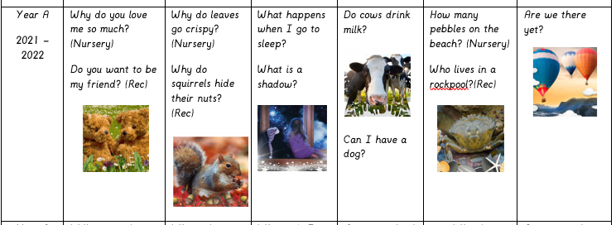

Slide 19
We use Read Write Inc. to learn phonics

Slide 20
Expected standard for writing by the end of Reception

Slide 21
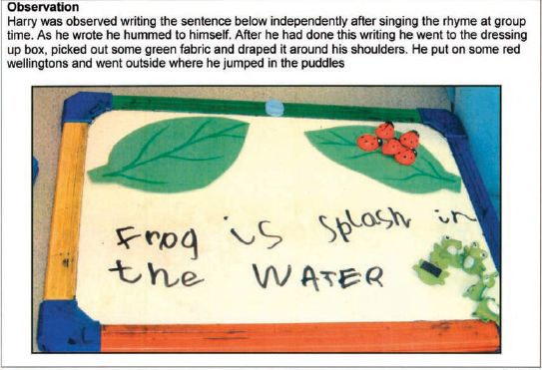
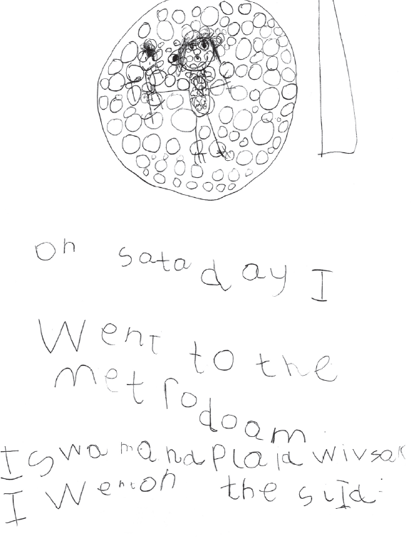
Expected standard for writing by the end of Reception

Slide 22
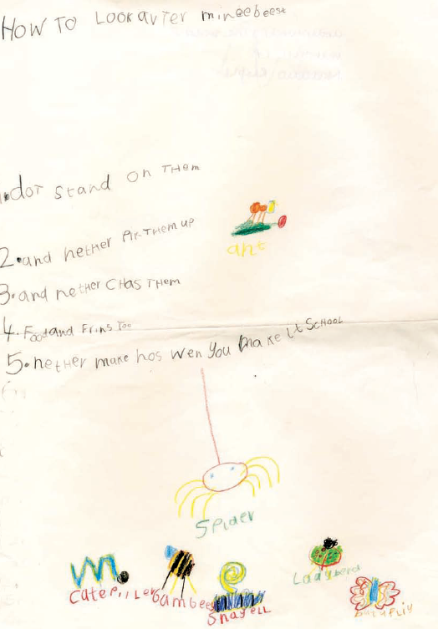
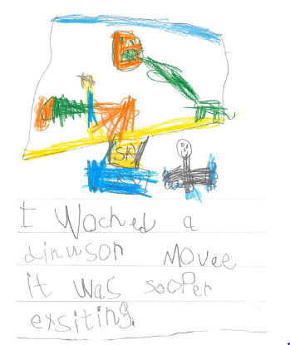

Slide 23
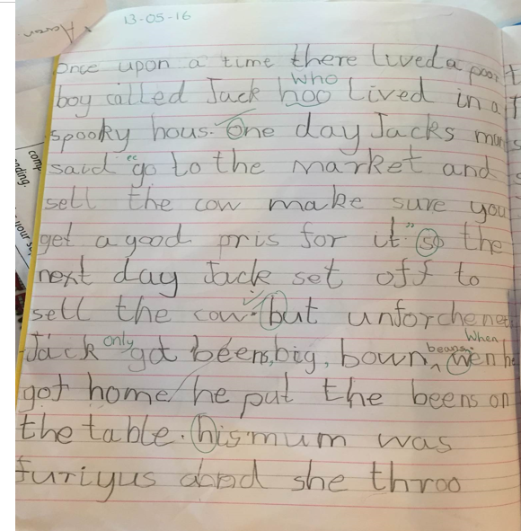
Exceeding standard for writing by the end of Reception

Slide 24
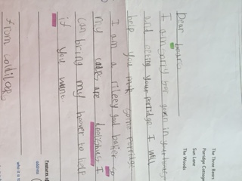
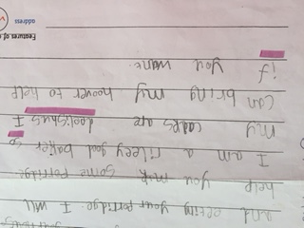

Slide 25
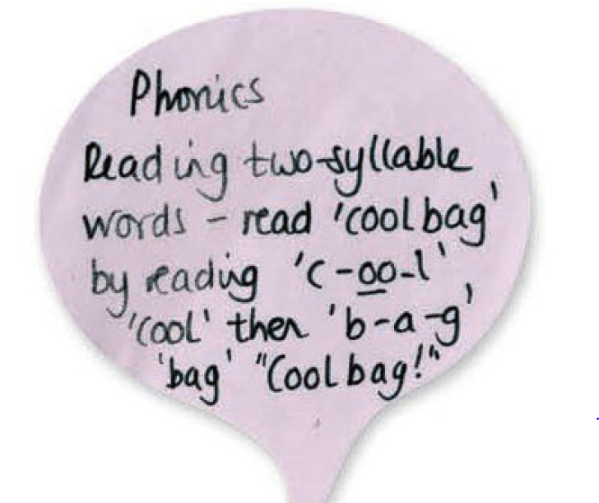
Expected standard for reading by the end of Reception

Slide 26
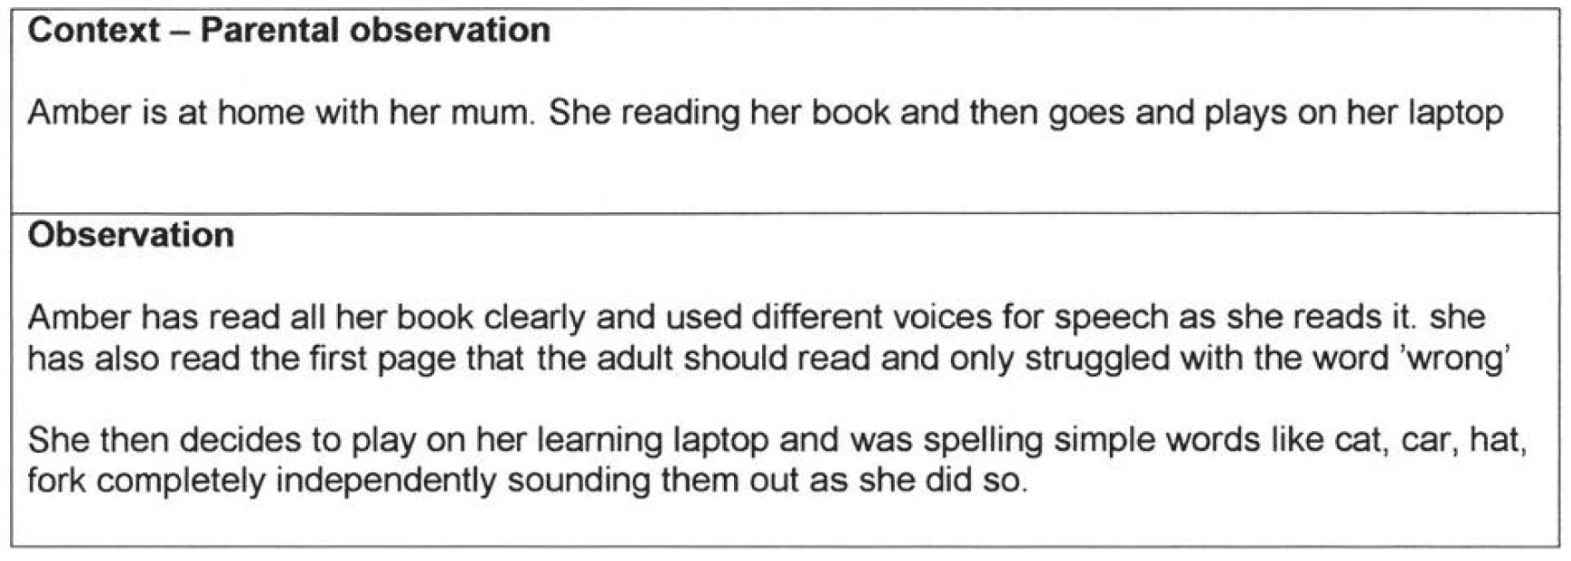
Expected standard for reading by the end of Reception

Slide 27
Read Write Inc
Read Write Inc is used by more than a quarter of the UK's primary schools and is designed to create fluent readers, confident speakers and willing writers.
It includes phonics, integrated comprehension, writing, grammar, spelling, vocabulary and handwriting, engaging partner work, role-play and drama so every child participates in the whole lesson.
It uses simple and effective assessment and clear tracking to accelerate every child's progress and prepare them for the National Curriculum Tests.
Children are grouped so every child learns rapidly at the right level

Slide 28
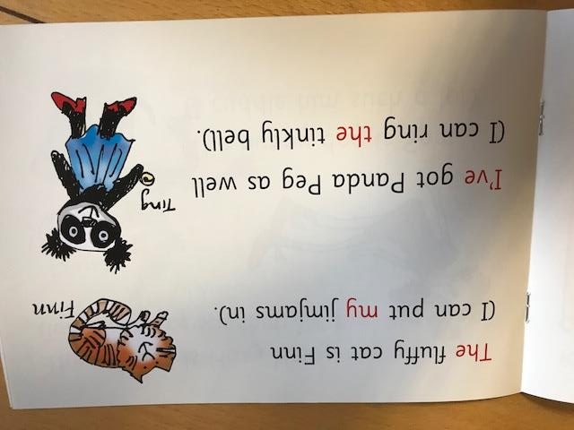
Expected standard for reading by the end of Reception

Slide 29
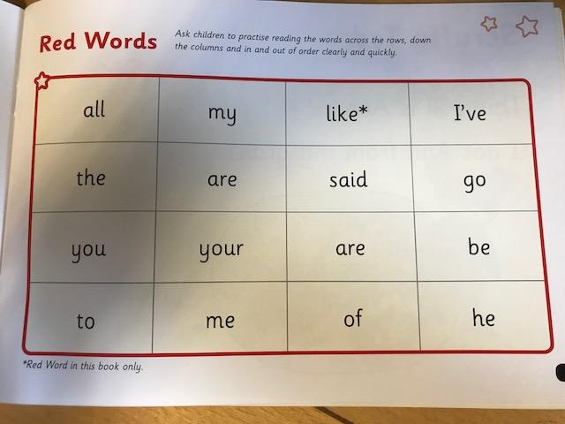
Expected standard for reading by the end of Reception

Slide 30
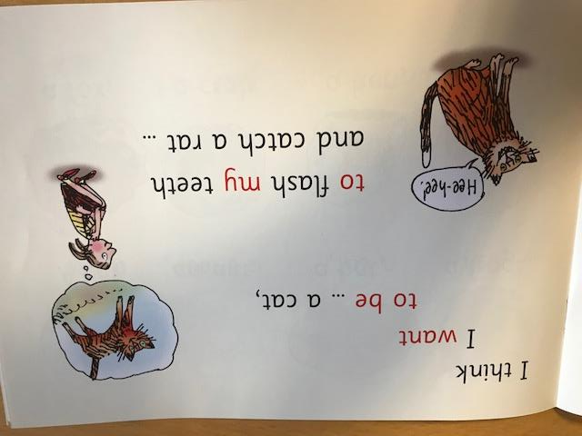
Exceeding standard for reading by the end of Reception

Slide 31
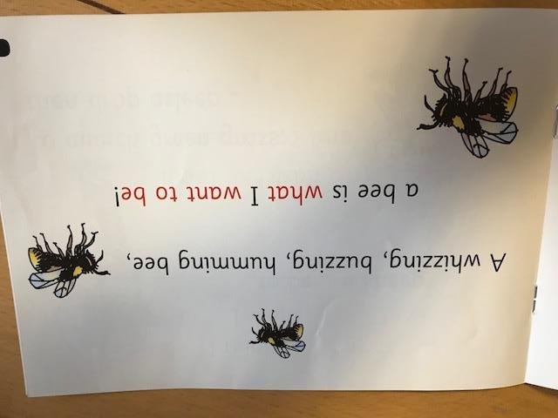
Exceeding standard for reading by the end of Reception

Slide 32
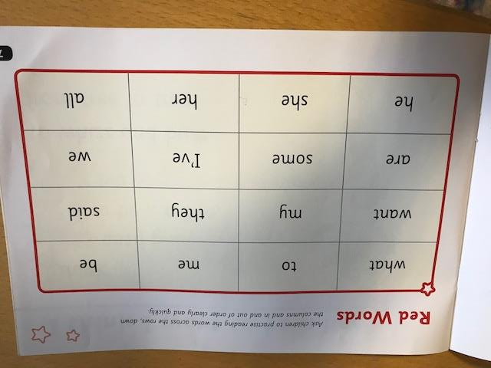
Exceeding standard for reading by the end of Reception

Slide 33
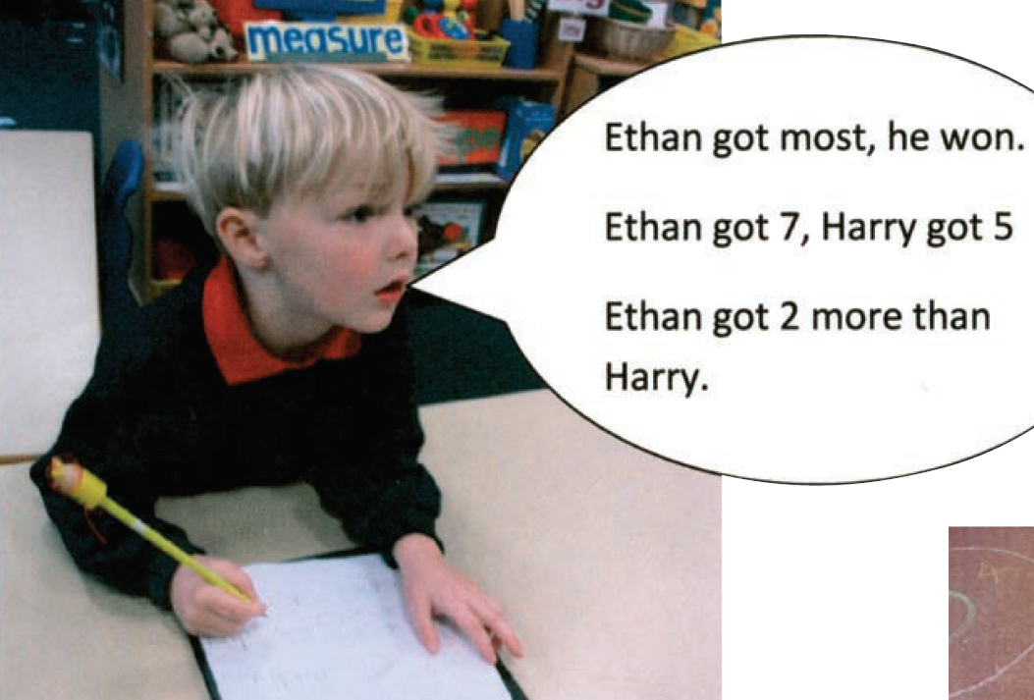
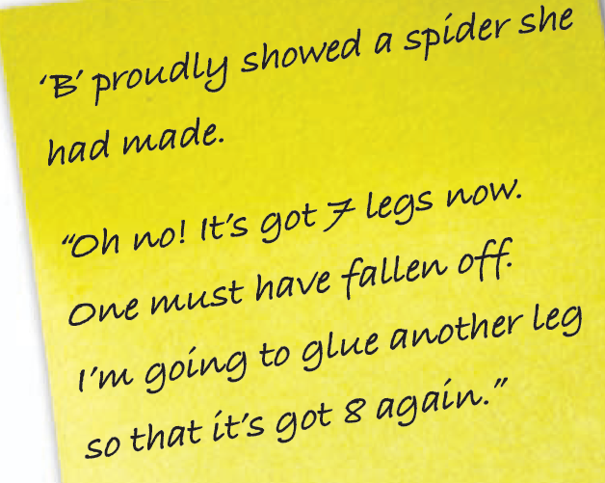
Expected standard for number by the end of Reception

Slide 34
Concrete Apparatus
Throughout school, the children use numerous concrete apparatus in maths to support them with their learning. These apparatus build up their conceptual understanding and support them in finding solutions to mathematical problems. By allowing the children to handle objects, an abstract question or problem is brought to life.

Slide 35
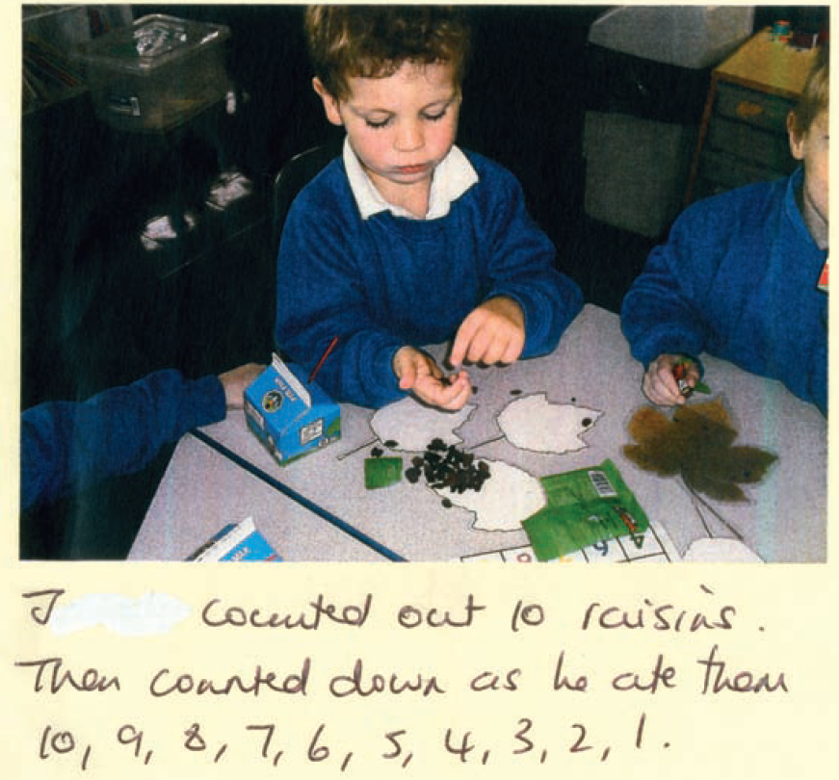
Expected standard for number by the end of Reception

Slide 36
Expected standard for number by the end of Reception

Slide 37
Questions
If you have any questions about any part of this power point, please don’t hesitate to speak to the class teacher, Miss Palmer.
Thank you for taking the time to look at the power point.

