Slide 1
Welcome to year 4

Slide 2
Introduction to the Team
Mr Lamb
Mrs MacFarlane
Mr Busby

Slide 3
Our new cornerstones Curriculum
Cornerstones
Maths mastery
Focus on Spelling, Punctuation, Grammar and Times Tables.

Slide 4
Our cornerstones Curriculum
At Myton Park Primary we have designed our curriculum with the intent that children must have the building blocks to become global citizens who contribute positively to society and have an awareness of the world in which they live; to recognise how their learning links to the real world and how it will affect future opportunities. Our curriculum will inspire them to achieve to the best of their abilities, be moral citizens and take opportunities to extend their horizons.
These themes are fundamental to our vision of the journey children will take though school and is captioned in our strapline of:
Together, we Nurture, Inspire, Achieve

Slide 5
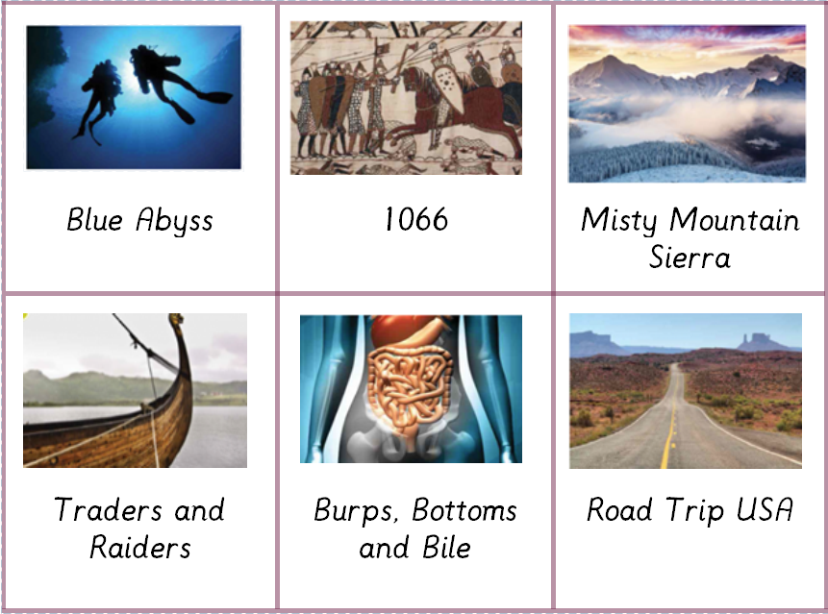
Year group topics

Slide 6
Expectations
Non negotiables
Cursive handwriting

Slide 8
What can you do at home?
Times tables – Children are expected to know all of their times tables by the end of year 4. This includes the division facts (6x4 = 24) (24 / 6 = 4)
Multiplication table check!
Times Table Rock stars – Huge impact on TT fluency last year
Spelling (Purple mash) (spelling strategies) Children will get 10 spellings to learn per week
Reading – Class reading challenge. Collect 10 stamps and receive a small prize. Expectation is that children read at home at least 4 times per week. Reading journals are an important record of your child’s reading at home and at school
Homework – sent home on a Tuesday to be completed by the following Monday. Children will receive a Maths or English task plus spellings

Slide 9
The Importance of reading…
Reading for pleasure is more important for children's cognitive development than their parents' level of education and is a more powerful factor in life achievement than socio-economic background. [Sullivan and Brown (2013) Social inequalities in cognitive scores at age 16: The role of reading]
Children who read books often at age 10 (and more than once a week at age 16) gain higher results in maths, vocabulary and spelling tests at age 16 than those who read less regularly. [OECD (2010) PISA 2009 Results: Learning to Learn: Student Engagement, Strategies and Practices

Slide 10
Communication
Please see the adult on the door on a morning who will make an appointment with the class teacher
Telephone- please be aware of teaching times
Smart School Parent APP
Most information can be found on the school website
If you have any concerns please email the office or Mr Lamb directly.
Office: mytonpark@mytonpark.org.uk
Mr Lamb: MPALamb@mytonpark.org.uk

Slide 11
Uniform
It is lovely to see our children looking so smart. Thank you.
Reminders:
Please label all uniform
No large hair adornments
no nail varnish, make up or fake tan
Silver or Gold stud earrings only. Children must be able to remove earrings themselves for P.E.
PE Plain white t-shirts only
Smart boots only for winter to come to school into. They must change into shoes.
School book bags only - no backpacks and branded book bags. Only one keyring please

Slide 12
Thank you

