Slide 1
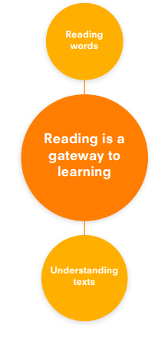
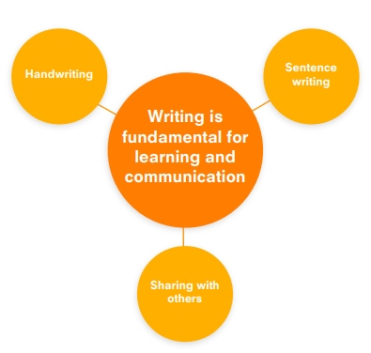
Literacy | Nursery | Reception 1 | Reception 2 | ELG
 | Pretends to read books. Understands how books should be handled. Names some objects in a book. Talks about characters in books. Is able to fill in gaps in familiar books. Listens to stories. Asks adults to read or write with them. Begins to pay attention to specific print such as the first letters of their names. Enjoys writing on different surfaces, e.g. paper, screens, in sand and with shaving foam. Can distinguish between the different marks they make. Draws wavy lines across the page that look like lines of text from a book. Is beginning to make some letter-like forms. Makes marks on their pictures to represent their name. | Enjoys listening to and joining in with stories. Uses language from stories. Understands that print carries a message. Understands that print is read left to right and top to bottom. Makes attempts to read and write. Identifies familiar signs and labels. Participates in rhyming games. Can count or clap syllables. Recognises initial sounds. Says the sounds for individual letters. Scribbles with a purpose (trying to write or draw something). Produces some letter-like forms and scribbles that resemble, in some way, writing. Makes distinct marks that look like letters and that are separated from each other. Writes some actual letters, especially the letters in their name. May try different kinds of writing, e.g. writing a list or a greeting card. May start to draw pictures and label them using letters or letter-like marks. | Reads simple phrases and sentences. Enjoys a range of books. Knows that information can be retrieved from books. Retells simple stories. Can describe settings, events and characters in some detail. Uses vocabulary they have heard in books. Is developing phonological awareness. Shows familiarity with rhyming and beginning sounds. Reads some high-frequency words. Is beginning to blend and segment sounds. Enjoys writing for a variety of purposes. May write their name. Holds pencil correctly and is beginning to form letters accurately. Knows the sounds letters make and is beginning to spell words based on how they sound. Labels pictures with a few words and later on begins to write simple sentences with correct grammar | Reading – comprehension Demonstrate understanding of what has been read to them by retelling stories and narratives using their own words and recently introduced vocabulary. Anticipate – where appropriate – key events in stories. Use and understand recently introduced vocabulary during discussions about stories, non-fiction, rhymes and poems and during role-play. Reading – word reading Say a sound for each letter in the alphabet and at least 10 digraphs. Read words consistent with their phonic knowledge by sound-blending. Read aloud simple sentences and books that are consistent with their phonic knowledge, including some common exception words. Writing Write recognisable letters, most of which are correctly formed. Spell words by identifying sounds in them and representing the sounds with a letter or letters. Write simple phrases and sentences that can be read by others.

