Slide 1
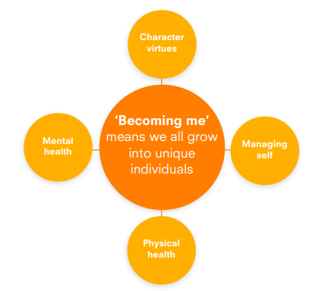
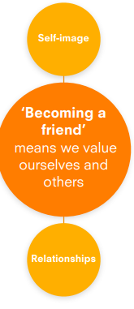
Personal and social development | Nursery | Reception 1 | Reception 2 | ELG
 | Is beginning to use language rather than physical outbursts to express themselves. Is beginning to use appropriate behaviour for different settings, e.g. indoor voices. Can name some basic feelings, e.g. happy, sad, angry and scared. Identifies basic character virtues, e.g. kindness. Uses the toilet independently. Takes turns and shares (not consistently). Seeks the approval of an adult. Enjoys make-believe play. Has a set of feelings about themselves. How they feel about themselves is influenced by their relationships with people around them | Is becoming confident and self assured. Enjoys dramatic play. Can cope with delays in having needs met. Demonstrates persistence and some emotional control. Is able to identify basic character virtues and opportunities to use them. Identifies basic feelings and some strategies to manage them. Follows basic hygiene rule Is sociable and enjoys silly talk. May have a best friend. Plays with a group. Has a stable self-concept. Is beginning to identify what makes them special | Is able to complete tasks. Identifies more complex feelings and begins to recognise them in others. Has a stable view of themselves. Demonstrates some basic character virtues. Manages own needs. Takes responsibility for washing, dressing and using the toilet independently. Is developing a sense of social rules. Prefers games of rivalry. Enjoys cooperative play, often relying on an adult to sort out conflicts. Shows sensitivity to the needs of others. Much of their personality is established. Is beginning to recognise differences between themselves and others. | Managing self Be confident to try new activities and show independence, resilience and perseverance in the face of challenge; Explain the reasons for rules, know right from wrong and try to behave accordingly; Manage their own basic hygiene and personal needs, including dressing, going to the toilet and understanding the importance of healthy food choices. Self regulation Show an understanding of their own feelings and those of others, and begin to regulate their behaviour accordingly; - Set and work towards simple goals, being able to wait for what they want and control their immediate impulses when appropriate; Give focused attention to what the teacher says, responding appropriately even when engaged in activity, and show an ability to follow instructions involving several ideas or actions.

Slide 2
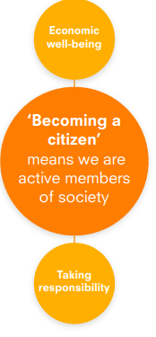
Personal and social development | Nursery | Reception 1 | Reception 2 | ELG
 | Is beginning to follow rules. Takes interest in roles in the home, e.g. who makes their meals, who reads their bedtime stories. Can describe their local environment. Knows that money is used to buy things. | Helps to create rules. Takes notice of roles performed by members of their family outside the home. Knows that people earn money by working. Can describe what they like and don’t like about their environment. | Follows negotiated rules and uses strategies to manage non-compliance. Takes notice of roles performed outside their family, e.g. doctors, firefighters, teachers, police officers. Knows that to buy some things you may have to save up money. Can describe what might be done to care for their environment | Building relationships Work and play cooperatively and take turns with others; Form positive attachments to adults and friendships with peers; Show sensitivity to their own and to others’ needs.

