Slide 1
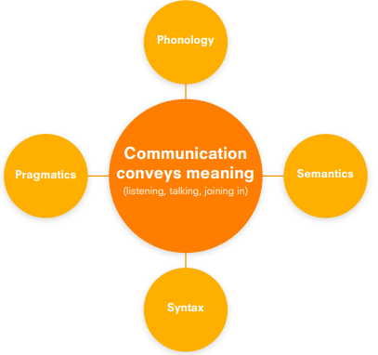
Communication and Language | Nursery | Reception 1 | Reception 2 | ELG
 | Enjoys listening to stories. Uses sentences of around 4–6 words. Talks to themselves when playing (using language to think). Speaks differently in different contexts (apparent in imaginative play). Can describe what is happening, express ideas and start conversations. Communication is developing but may have problems with irregular tenses and plurals. May have problems pronouncing the phonemes r, j, th, w, ch and sh. Generally uses pronouns correctly. Asks lots of questions. Enjoys rhymes and songs | Understands the importance of listening. Has an extensive vocabulary. Sometimes joins longer sentences with because (cause and effect). Retells stories and sequences events. Often gives a running commentary during play. Sometimes blurs boundaries between fact and fiction. Speech is generally fully intelligible but there may be some incorrect pronunciation. Enjoys non-fiction books, especially an area they are interested in, e.g. dinosaurs. Asks a large number of questions. Uses language for a variety of purposes: to share, take turns, compare, predict, explain. | Uses a wide range of vocabulary appropriately. In general, structures sentences correctly (grammar is sometimes incorrect). Picks up and uses language from TV shows and books. Questions are usually precise. Offers opinions. Is still learning about the more subtle uses of language, e.g. metaphor and irony | Listen attentively and respond to what they hear with relevant questions, comments and actions when being read to and during whole class discussions and small group interactions. Make comments about what they have heard and ask questions to clarify their understanding. Hold conversation when engaged in back-and-forth exchanges with their teacher and peers. Speaking Participate in small group, class and one-to-one discussions, offering their own ideas, using recently introduced vocabulary. Offer explanations for why things might happen, making use of recently introduced vocabulary from stories, non-fiction, rhymes and poems when appropriate. Express their ideas and feelings about their experiences using full sentences, including use of past, present and future tenses and making use of conjunctions, with modelling and support from their teacher.

