Slide 1
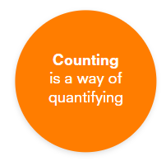
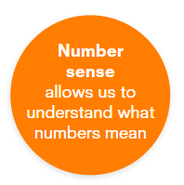
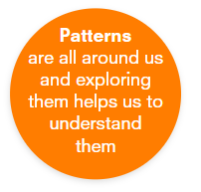
 | Nursery | Reception 1 | Reception 2 | ELG
 | Verbally counts with separate words, but not necessarily in the correct order. Verbally counts to ten with some correspondence with objects. May point to objects to count a few items but then loses track | Keeps one-to-one correspondence for small groups of objects in a line. Answers ‘How many?’ by counting again. Accurately counts to five and can answer ‘How many?’ by using the last number (e.g. ‘One, two, three, four. There are four.’). Is beginning to demonstrate cardinality. Can count to ten and may write or draw the numeral 5 | Counts objects up to five. Shows a group of four objects. Counts structured arrangements to ten. Draws or writes numerals to ten. Accurately counts a line of objects and says how many. Says what becomes before or after a number by counting up from one. Counts beyond 20.
 | Subitises up to three or four objects quickly. Identifies first and second. Matches numeral to quantity up to five. Can place numeral cards in order up to five. | Subitises to five in familiar arrangements. Identifies first to fifth. Can place numbers on a blank number line to ten | Subitises to six in familiar and non-familiar arrangements, describing how they see the number. Identifies first to tenth. Can place numbers on a blank number line to 20. Can place numbers on a vertical number line (which includes zero and negative numbers).
 | Recognises, describes and builds A B repeating patterns, e.g. A B; A B; A B. Fills in the missing element of an A B pattern. Duplicates an A B pattern when the model is close by | Recognises, describes and builds more complex patterns, e.g. A A B, A B C and A B B C. Fills in the missing elements of a pattern. Extends a pattern if it ends with a whole unit within the pattern, e.g. Red, Red, Blue ; Red, Red, Blue ; Red, Red, Blue (where Red, Red, Blue is a whole unit). | Can translate patterns by using new materials or actions to represent a pattern, e.g. blue button, red button, yellow button might become cube, circle, triangle. Recognises core units of a pattern, e.g. cube, circle, triangle is a unit within a pattern, followed by another unit of cube, circle, triangle. Is able to extend a pattern even if it ends in a partial unit, e.g. cube, circle, triangle; cube, circle. Creates their own patterns.

Slide 2
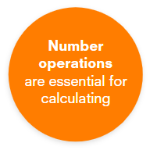
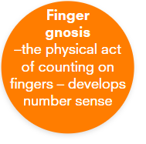
 | Nursery | Reception 1 | Reception 2 | ELG
 | Finds answers to ‘result unknown’ problems up to five, by counting with objects, e.g. ‘You have two books and get one more. How many are there altogether?’ (Counts out two, then one and then counts all three.) Matches sets by lining them up with one-to-one correspondence. Knows a whole is bigger than the parts but may not accurately quantify each. | Finds answers to ‘result unknown’ problems up to ten, by counting with objects, e.g. ‘You have six toys and are given three more. How many are there altogether?’ (Counts out six, then three and then counts all nine.) Solves subtraction problems by separating objects, e.g. 'You have six balls and you give Mustafa two. How many balls do you have left?’ (Counts out six, then takes away two and counts the remaining four.) Compares by counting with groups up to five. Quickly names parts of a set up to six | Counts on from the first set, rather than counting the whole, e.g. 5; 6, 7, 8. Solves ‘change unknown’ problems, e.g. ‘You have six sweets. Taylor gives you some more so now you have eight. How many did he give you?’ When subtracting, counts back from first number, keeping track of counts. Compares larger sets by counting and says which has more or less. Can compose and decompose numbers to ten
 | Shares by dealing out a group of objects between two people. Engages in rhythmic counting, emphasising alternate numbers, e.g. one, two, one, two. | Makes small equal groups (up to six) in the context of sharing fairly. Skips one-to-one counting, saying ‘two, four, six’, missing out, or counting internally, the other numbers | Solves sharing problems using concrete objects up to 20 and between two and five people. Solves small number multiplication problems by sorting objects into small groups.
 | Uses fingers during fine motor skills activities. Takes part in finger rhymes. | Identifies different fingers especially in songs like ‘Peter Pointer' and 'Baby Small’. Matches finger symbols to collections of objects | Shows numbers with fingers. Follows lines on a maze with different fingers

Slide 3
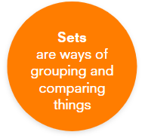
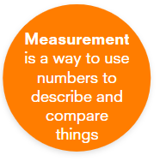
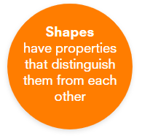
 | Nursery | Reception 1 | Reception 2 | ELG
 | Recognises and identifies objects that are alike, e.g. red objects. Sorts by using a single attribute, e.g. ‘I picked out all the heart-shaped pieces.’ | Uses binary sorting: dividing a collection into two groups, ones with a specific attribute and ones without. Comes up with their own criteria for sorting | Uses multiple set sorting by focusing on different attributes, e.g. red gloves and mittens can become large red gloves and large red mittens. Compares and orders sets by using specifically mathematical attributes, e.g. the set that has the most (quantity) and the set that has the the biggest objects (magnitude).
 | Identifies length, weight and capacity as attributes. Explores differences in size, weight and length. Can compare the capacity of two containers by pouring from one to the other. Understands recent past and future. Is beginning to anticipate times of the day, e.g. lunch time, home time. Describes length or height measurements as big or small | Makes comparisons between objects relative to size, length, weight and capacity. Physically aligns two objects to see which is longer. Packs cubes into a box in an organised way. Can order up to five objects by length. Uses ‘than’ to compare objects. Remembers the sequence of events in a book or in real life. Uses non-standard measuring tools | Describes measurable attributes of objects. Enjoys predicting and discussing comparisons of attributes. Focuses on fairness and accuracy. Uses a variety of measuring tools. Compares the length of two objects by using a third object (a measuring tool). Estimates how many cubes will fill a space. Sequences and orders events. Is beginning to use a timer and a calendar. Uses an increasing amount of measurement vocabulary. Is beginning to use some indirect comparison, e.g. turning a circumference into a length using string.
 | Uses names of 2D shapes as labels, with no reference to attributes. May physically rotate shapes to match a prototype shape. Uses everyday language for 3D shapes, e.g. ball or block. Is beginning to see shapes in the environment, e.g. a house is seen as a square with a triangle roof. Uses blocks to build structures. | Is beginning to use attributes to describe shapes. Recognises corners. Describes 3D shapes using 2D names, e.g. a cuboid is called a rectangle. Recognises edges and sides. Can make a picture using 2D shapes. Can build structures with arches, roofs and gaps for windows. | Uses attributes to identify some unusual shapes. May recognise a right-angled triangle. Recognises most familiar shapes and typical examples of other shapes, e.g. a hexagon or a rhombus. Ignores the orientation of shapes when identifying them. Describes the faces on a 3D shape. Names some common 3D shapes, e.g. a sphere or cube. Puts 2D shapes together to make part of a picture, e.g. triangles and a circle to make a flower. Builds more complex structures, substituting combinations for another shape.

Slide 4
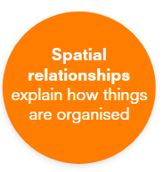
 | Nursery | Reception 1 | Reception 2 | ELG
 | Responds to and uses some spatial language. Walks different routes and points out landmarks. Uses trial and error to move and rotate objects to fit spaces | Describes the position of an object. Follows/gives verbal directions to find something using spatial language. Follows a simple map | Describes where an object is, using spatial language. Follows a sequence of directions. Plans and discusses different routes. Rotates and flips objects to make shapes fit, using spatial reasoning. Enjoys making simple maps.
 | Recognises and identifies objects that are alike. Sorts by using a single attribute, e.g. colour, shape or function. Interprets a realia graph by saying which has more or less | Sorts objects by a single attribute and is able to say how many. Interprets a realia graph and pictogram with some adult guidance. | Sorts objects for a reason. Creates realia graphs and pictograms. Can say which has more and which less on a bar graph. Makes labels for a graph.

