Slide 1
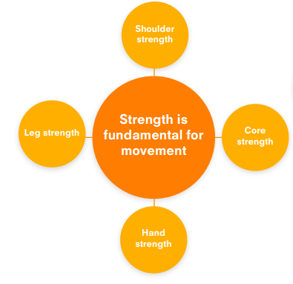
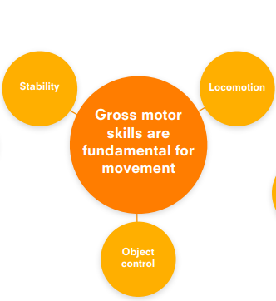
Physical Development | Nursery | Reception 1 | Reception 2 | ELG
 | Takes weight on hands and knees, tummy down, like a table. Can lift up one foot or hand at a time. Hangs on a bar using hands. Stands on a floor marker on two feet, bends down and picks up an object from the floor. Can push a tyre along the ground. Jumps with two feet along a line of floor markers. Passes a balloon from hands to feet and back again while lying on back. | Takes weight on hands and feet, tummy up (back straight, no sagging). Can lift up one foot or hand at a time. Hangs on a bar and lifts up a bent leg. Stands on a floor marker on one leg, bends down and picks up an object from the floor. Picks up a tyre and pushes it along the floor. Jumps from side to side along a skipping rope. Passes a beach ball from hands to feet and back again while lying on back | Takes a tummy-up position with hands and feet on the floor, moving around the space. Hangs on a bar and lifts up alternate legs, like marching in the air. Stands on a floor marker while bending down to pick up objects placed in different positions at varying distances from the marker. Can flick over a tyre and repeat, moving it from one end of a small space to another. Can play french skipping over an elastic band. Can walk a large therapy ball up and down a wall with feet while lying on back (knees bent). | Children negotiate space and obstacles safely, with consideration for themselves and others. Children demonstrate strength, balance and coordination when playing. Children move energetically, such as running, jumping, dancing, hopping, skipping and climbing.
 | Can walk backwards and sideways. Shows good spatial awareness. Walks up stairs, putting one foot on each step. Can jump on two feet. Pedals a tricycle. Can catch a balloon. | Climbs on play equipment. Walks up and down stairs, with one foot on each step. Claps in time to music. Can catch, kick, throw and bounce a ball. Can use a balance bike. Can hop and march. Uses a variety of different playground equipment. | Can balance on one foot for a short time. Plays ball games. Is able to gallop. Walks along a low balance beam. Is able to skip. Can ride a bike without stabilisers. Uses core muscle strength to sit up straight at a table.

Slide 2
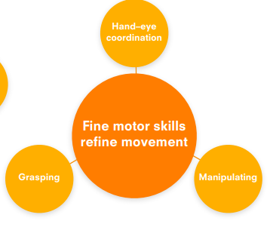
Physical Development | Nursery | Reception 1 | Reception 2 | ELG
 | Holds a pencil with fingers in proper position. Paints with a crayon or brush, often covering the whole page. Cuts with scissors but not always in a straight line. Can thread large beads onto a lace. Builds a tower with six or more blocks. Can copy a circle. Enjoys floor play with bricks, boxes, trains, cars and small world figures | Threads small beads onto a lace. Builds a tower of ten or more bricks. Can build with other construction toys. Draws a house. Copies the capital letters O, V and H. Is beginning to fasten buttons and zips. Draws a person with head, legs, body and (usually) arms and fingers. | Threads a large needle and stitches real stitches. Copies the capital letters V, T, H, O, X, L, A, C, U and Y. Uses brushes, crayons and pencils with control. Uses a knife and fork competently. | Children hold a pencil effectively in preparation for fluent writing – using the tripod grip in almost all cases Children using a range of small tools, including scissors, paint brushes and cutlery. Children begin to show accuracy and care with drawing.

