Slide 1
Key Stage 1 Art Curriculum
Together we Nurture, Inspire and Achieve

Slide 2
Art topics overview
Art topics are organised and referenced around an artistic schema. Each topic either introduces an aspect of the schema or references previous instances of it. Below is an overview of the topics we teach and which aspects of the schema it strengthens:
ts
At the seaside |  | * |  | * |  | * |  |  | *
Claude Monet |  | * | * |  |  |  | * | *
In the jungle | * |  |  | * | * |  | *
Henry Rousseau |  | * | * |  |  | * |  | *
Food |  |  |  |  | * | * | * |  | *
Paul Cezanne |  | * | * |  |  |  | * | *
Weather |  | * |  | * | * |  | *
J M W Turner |  | * |  |  |  |  | * | * | *
Portraits | * |  |  |  | * | * |  |  | *
Thomas Gainsborough |  | * | * | * |  |  | *
Love for landscapes |  |  | * |  |  | * | * |  | *
John Constable | * |  |  | * |  |  | * | *
Beauty of Flowers | * |  |  |  | * | * |  | *
Georgia O’Keffe |  | * | * |  |  |  |  | * | *
Time for play |  | * |  |  | * | * |  |  | *
Georges Seurat |  | * |  | * | * |  |  | *

Slide 3
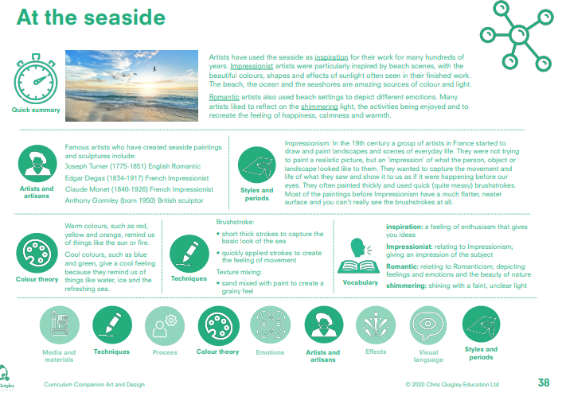

Slide 4
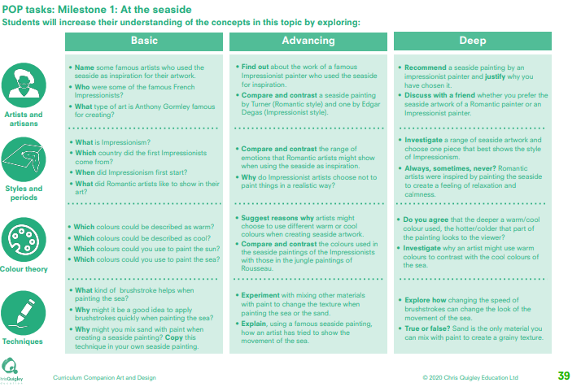

Slide 5
At the seaside
This table shows the knowledge that will be taught in each lesson
Year 1 | What type of brushstroke helps when painting the sea? Why might it be a good idea to apply brushstrokes quickly when painting the sea? Why might you mix sand with paint when creating a seaside painting? Copy the technique in your own seaside painting. | Which colours could be described as warm? Which colours could be described as cool? Which colours would you use to paint the sun? Which colours would you use to paint the sea? | Name some famous artists who used the seaside as inspiration for their work. Who were some of the famous French impressionists? What type of work does Anthony Gormley create? | What is impressionism? Which country did the first impressionists come from? When did impressionism first start? What did Romantic artists like to show in their art?
Year 2 | Experiment with mixing other materials with paint to change the texture when painting the sea or sand. Explain, using a famous seaside painting how the artist has tried to show the movement of the sea. Explore how changing the speed of brushstrokes can change the look of the movement of the sea. True or false? Sand is the only material you can mix with paint to create a grainy texture | Suggest reasons why artists might use different warm and cool colours when creating seaside artwork. Compare and contrast the colours used in the seaside paintings of the impressionists with those of the jungle paintings of Rousseau. Do you agree that the deeper a warm/cool colour used, the hotter/colder that part of the painting looks to the viewer? Investigate why an artist might use warm colours to contrast with the cool colours of the sea | Find out about the work of a famous impressionist painter who used the seaside as inspiration. Compare and contrast a seaside painting by Turner (Romantic style) with Edgar Degas (Impressionist style) Recommend a seaside painting by an impressionist painter and justify why you have chosen it. Discuss with a friend whether you prefer the seaside artwork of a Romantic painter or an Impressionist painter | Compare and contrast the range of emotions that Romantic artists might show when using the seaside as inspiration? Why do impressionist artists choose not to pint things in a realistic way? Investigate a range of seaside artwork and choose one piece that best shows the style of Impressionism. Always, sometimes, never? Romantic artists were inspired by painting the seaside to create a feeling of relaxation and calmness

Slide 6
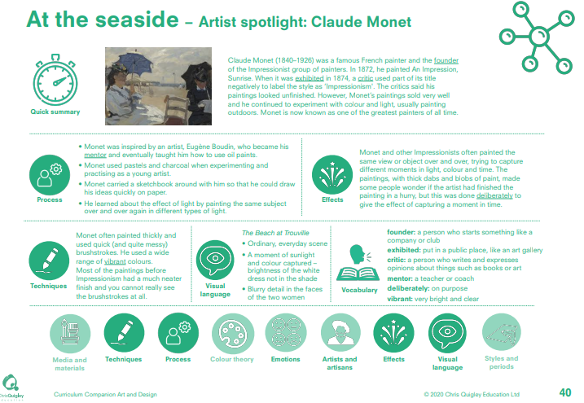

Slide 7
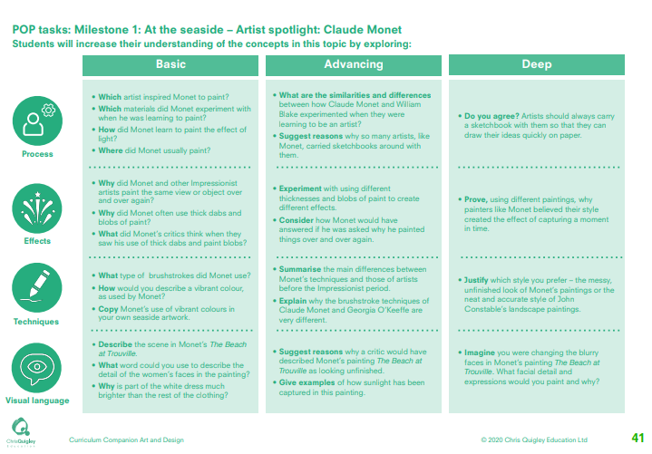

Slide 8
At the seaside – Claude Monet
This table shows the knowledge that will be taught in each lesson
Year 1 | Which artist inspired Monet to paint? Which materials did Monet experiment with when he was learning to paint? How did Monet learn to paint the effect of light? Where did Monet usually paint? | Why did Monet and other Impressionist artists paint the same object or view over and over again? Why did Monet use thick dabs and blobs of paint? What did Monet’s critics think when they saw his use of thick dabs and blobs of paint? | What type of brushstroke did Monet use? How would you describe a vibrant colour as used by Monet? Copy Monet’s use of vibrant colours in your own seaside artwork. | Describe the scene in Monet’s The beach at Trouville. What word could you use to describe the detail in the women’s faces in the painting? Why is the white dress much brighter than the rest of the clothing?
Year 2 | What are the similarities and differences between how Claude Monet and William Blake experimented when they were learning to be an artist? Suggest reasons why so many artists like Monet carried sketchbooks around with them. Do you agree? Artists should always carry a sketchbook with them so that they can draw their ideas quickly on paper. | Experiment with using different thicknesses and blobs of paint to create different effects. Consider how Monet would have answered if he was asked why he painted things over and over again. Prove, using different paintings, why painters like Monet believed their style created the effect of capturing a moment in time | Summarise the main differences between Monet’s techniques and those of artists before the Impressionist period. Explain why the brushstroke techniques of Claude Monet and Georgia O’Keeffe are very different. Justify which style you prefer – the messy, unfinished look of Monet’s paintings or the neat and accurate style of John Constable’s landscape paintings. | Suggest reasons why a critic would describe Monet’s painting of ‘The beach at Trouville’ as looking unfinished. Give examples of how sunlight has been captured in this painting. Imagine you were changing the blurry faces in Monet’s painting The Beach at Trouville. What facial detail and expressions would you paint and why?

Slide 10
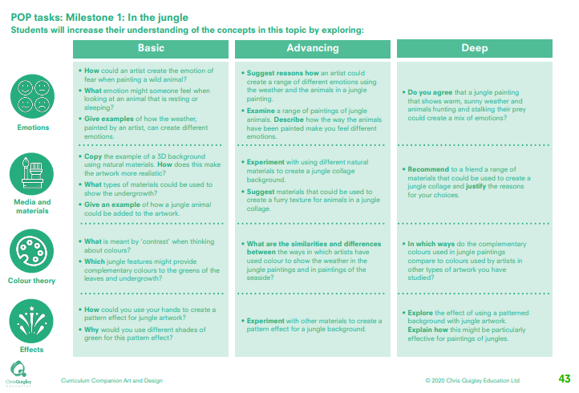

Slide 11
In the jungle
This table shows the knowledge that will be taught in each lesson
Year 1 | How could an artist create the emotion of fear when painting a wild animal? What emotion might someone feel when looking at an animal that is resting or sleeping? Give examples of how the weather, painted by an artist can create different emotions? | Copy the example of a 3D background using natural materials. How does this make the artwork more realistic? What types of materials could be used to show the undergrowth? Give an example of how a jungle animal could be added to the artwork. | What is meant by contrast when thinking about colours? Which jungle features might provide complimentary colours to the greens of the leaves and the undergrowth? | How could you use your hands to create a pattern effect for jungle artwork? Why would you use different shades of green for this pattern effect?
Year 2 | Suggest reasons for how an artist could create a range of different emotions using the weather and the animals in a jungle painting. Examine a range of paintings of jungle animals. Describe how the animals have been painted make you feel different emotions. Do you agree that a jungle painting that shows warm, sunny weather and animals hunting and stalking their prey could create a mix of emotions? | Experiment with using different natural materials to create a jungle background. Suggest materials that could be used to create a furry texture for animals in a jungle collage. Recommend to a friend a range of materials that could be used to create a jungle collage and justify the reasons for your choices. | What are the similarities and differences between the ways in which artists have used colour to show the weather in the jungle paintings and in paintings of the seaside In which ways do the complementary colours used in jungle paintings compare to colours used by artists in other types of artwork you have studied | Experiment with other materials to create a pattern effect for a jungle background Explore the effect of using a patterned background with jungle artwork. Explain how this might be particularly effective for paintings of jungles.

Slide 13
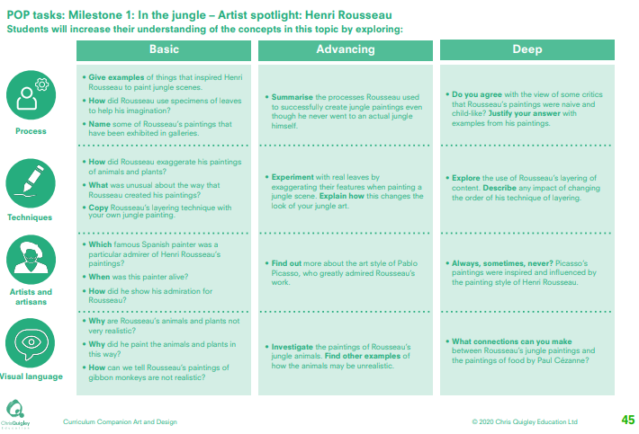

Slide 14
In the jungle – Henry Rousseau
This table shows the knowledge that will be taught in each lesson
Year 1 | Give examples of things that inspired Henri Rousseau to paint jungle scenes. How did Rousseau use specimens of leaves to help his imagination? Name some of Rousseau’s paintings that have been exhibited in galleries. | How did Rousseau exaggerate his paintings of animals and plants? What was unusual about the way that Rousseau created his paintings? Copy Rousseau’s layering technique with your own jungle painting. | Which famous Spanish painter was a particular admirer of Henri Rousseau’s paintings? When was this painter alive? How did he show his admiration for Rousseau? | Why are Rousseau’s animals and plants not very realistic? Why did he paint the animals and plants in this way? How can we tell Rousseau’s paintings of gibbon monkeys are not realistic?
Year 2 | Summarise the processes Rousseau used to successfully create jungle paintings even though he never went to an actual jungle himself Do you agree with the view of some critics that Rousseau’s paintings were naive and child-like? Justify your answer with examples from his paintings. | Experiment with real leaves by exaggerating their features when painting a jungle scene. Explain how this changes the look of your jungle art. Explore the use of Rousseau’s layering of content. Describe any impact of changing the order of his technique of layering | Find out more about the art style of Pablo Picasso, who greatly admired Rousseau’s work. Always, sometimes, never? Picasso’s paintings were inspired and influenced by the painting style of Henri Rousseau. | Investigate the paintings of Rousseau’s jungle animals. Find other examples of how the animals may be unrealistic. What connections can you make between Rousseau’s jungle paintings and the paintings of food by Paul Cézanne?

Slide 15
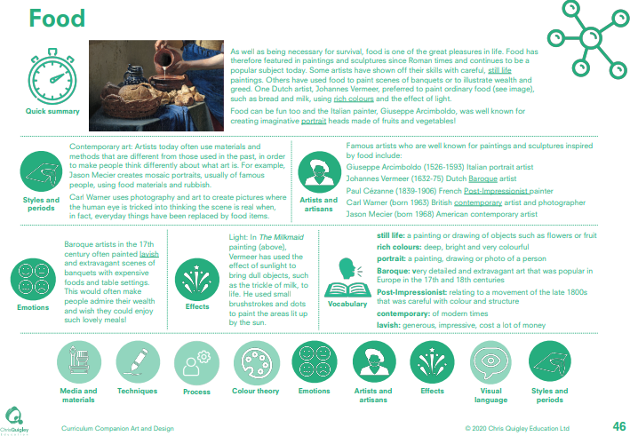

Slide 16
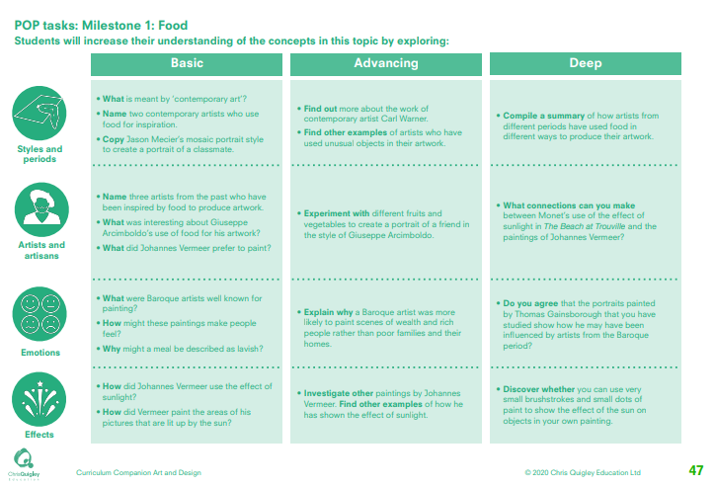

Slide 17
Food
This table shows the knowledge that will be taught in each lesson
Year 1 | What is meant by ‘contemporary art’? Name two contemporary artists who use food for inspiration. Copy Jason Mecier’s mosaic portrait style to create a portrait of a classmate. | Name three artists from the past who have been inspired by food to produce artwork. What was interesting about Giuseppe Arcimboldo’s use of food for his artwork? What did Johannes Vermeer prefer to paint? | What were Baroque artists well known for painting? How might these paintings make people feel? Why might a meal be described as lavish? | How did Johannes Vermeer use the effect of sunlight? How did Vermeer paint the areas of his pictures that are lit up by the sun?
Year 2 | Find out more about the work of contemporary artist Carl Warner. Find other examples of artists who have used unusual objects in their artwork Compile a summary of how artists from different periods have used food in different ways to produce their artwork. | Experiment with different fruits and vegetables to create a portrait of a friend in the style of Giuseppe Arcimboldo. What connections can you make between Monet’s use of the effect of sunlight in The Beach at Trouville and the paintings of Johannes Vermeer? | Explain why a Baroque artist was more likely to paint scenes of wealth and rich people rather than poor families and their homes Do you agree that the portraits painted by Thomas Gainsborough that you have studied show how he may have been influenced by artists from the Baroque period | Investigate other paintings by Johannes Vermeer. Find other examples of how he has shown the effect of sunlight Discover whether you can use very small brushstrokes and small dots of paint to show the effect of the sun on objects in your own painting

Slide 18
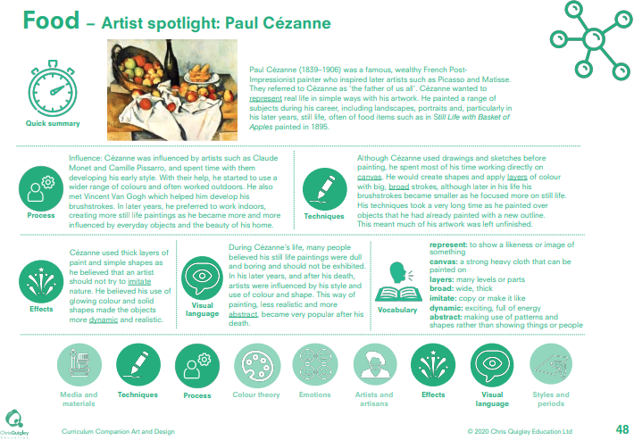

Slide 19
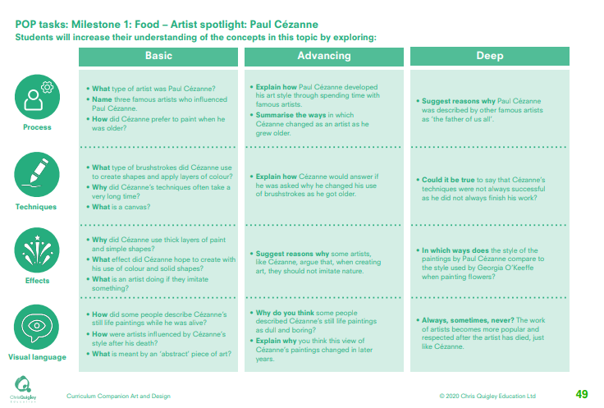

Slide 20
Food – Paul Cezanne
This table shows the knowledge that will be taught in each lesson
Year 1 | What type of artist was Paul Cézanne? Name three famous artists who influenced Paul Cézanne. How did Cézanne prefer to paint when he was older? | What type of brushstrokes did Cézanne use to create shapes and apply layers of colour? Why did Cézanne’s techniques often take a very long time? What is a canvas? | Why did Cézanne use thick layers of paint and simple shapes? What effect did Cézanne hope to create with his use of colour and solid shapes? What is an artist doing if they imitate something? | How did some people describe Cézanne’s still life paintings while he was alive? How were artists influenced by Cézanne’s style after his death? What is meant by an ‘abstract’ piece of art?
Year 2 | Explain how Paul Cézanne developed his art style through spending time with famous artists. Summarise the ways in which Cézanne changed as an artist as he grew older. Suggest reasons why Paul Cézanne was described by other famous artists as ‘the father of us all’. | Explain how Cézanne would answer if he was asked why he changed his use of brushstrokes as he got older. Could it be true to say that Cézanne’s techniques were not always successful as he did not always finish his work? | Suggest reasons why some artists, like Cézanne, argue that, when creating art, they should not imitate nature. In which ways does the style of the paintings by Paul Cézanne compare to the style used by Georgia O’Keeffe when painting flowers? | Why do you think some people described Cézanne’s still life paintings as dull and boring? Explain why you think this view of Cézanne’s paintings changed in later years Always, sometimes, never? The work of artists becomes more popular and respected after the artist has died, just like Cézanne

Slide 21
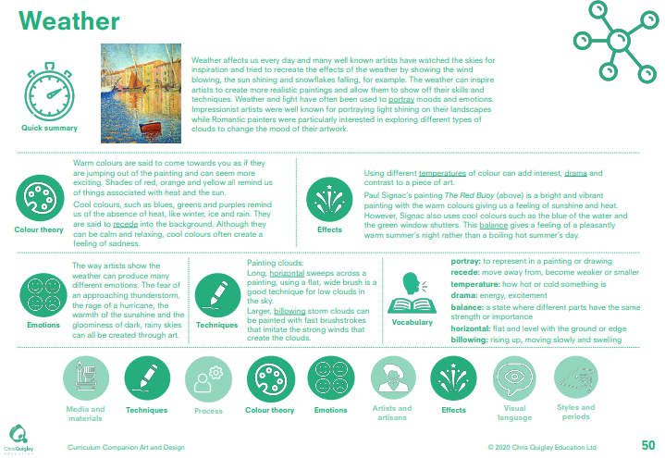

Slide 22
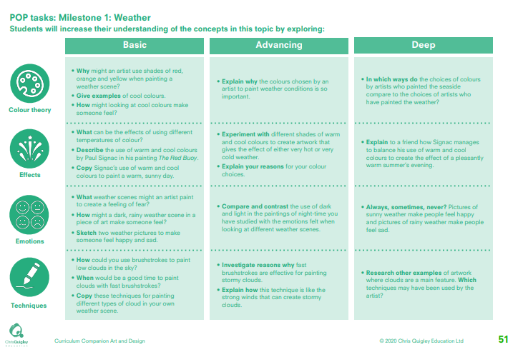

Slide 23
Weather
This table shows the knowledge that will be taught in each lesson
Year 1 | Why might an artist use shades of red, orange and yellow when painting a weather scene? Give examples of cool colours. How might looking at cool colours make someone feel? | What can be the effects of using different temperatures of colour? Describe the use of warm and cool colours by Paul Signac in his painting The Red Buoy. Copy Signac’s use of warm and cool colours to paint a warm, sunny day. | What weather scenes might an artist paint to create a feeling of fear? How might a dark, rainy weather scene in a piece of art make someone feel? Sketch two weather pictures to make someone feel happy and sad | How could you use brushstrokes to paint low clouds in the sky? When would be a good time to paint clouds with fast brushstrokes? Copy these techniques for painting different types of cloud in your own weather scene.
Year 2 | Explain why the colours chosen by an artist to paint weather conditions is so important. In which ways do the choices of colours by artists who painted the seaside compare to the choices of artists who have painted the weather? | Experiment with different shades of warm and cool colours to create artwork that gives the effect of either very hot or very cold weather. Explain your reasons for your colour choices. Explain to a friend how Signac manages to balance his use of warm and cool colours to create the effect of a pleasantly warm summer’s evening. | Compare and contrast the use of dark and light in the paintings of night-time you have studied with the emotions felt when looking at different weather scenes. Always, sometimes, never? Pictures of sunny weather make people feel happy and pictures of rainy weather make people feel sad | Investigate reasons why fast brushstrokes are effective for painting stormy clouds. Explain how this technique is like the strong winds that can create stormy clouds. Research other examples of artwork where clouds are a main feature. Which techniques may have been used by the artist

Slide 24
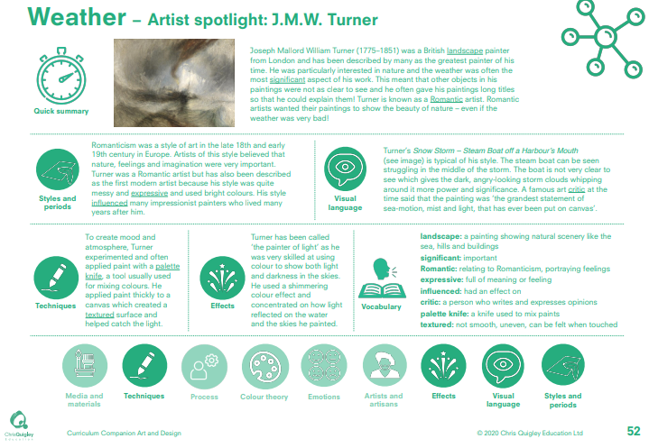

Slide 25
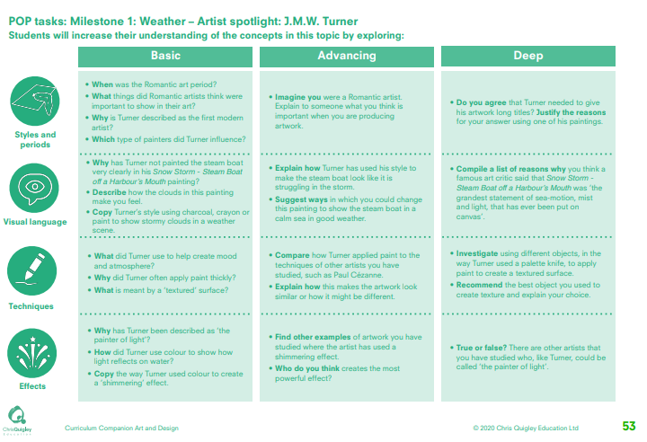

Slide 26
Weather – J. M. W. Turner
This table shows the knowledge that will be taught in each lesson
Year 1 | When was the Romantic art period? What things did Romantic artists think were important to show in their art? Why is Turner described as the first modern artist? Which type of painters did Turner influence? | Why has Turner not painted the steam boat very clearly in his Snow Storm - Steam Boat off a Harbour’s Mouth painting? Describe how the clouds in this painting make you feel. Copy Turner’s style using charcoal, crayon or paint to show stormy clouds in a weather scene | What did Turner use to help create mood and atmosphere? Why did Turner often apply paint thickly? What is meant by a ‘textured’ surface? | Why has Turner been described as ‘the painter of light’? How did Turner use colour to show how light reflects on water? Copy the way Turner used colour to create a ‘shimmering’ effect
Year 2 | Imagine you were a Romantic artist. Explain to someone what you think is important when you are producing artwork. Do you agree that Turner needed to give his artwork long titles? Justify the reasons for your answer using one of his paintings. | Explain how Turner has used his style to make the steam boat look like it is struggling in the storm. Suggest ways in which you could change this painting to show the steam boat in a calm sea in good weather Compile a list of reasons why you think a famous art critic said that Snow Storm - Steam Boat off a Harbour’s Mouth was ‘the grandest statement of sea-motion, mist and light, that has ever been put on canvas’ | Compare how Turner applied paint to the techniques of other artists you have studied, such as Paul Cézanne. Explain how this makes the artwork look similar or how it might be different. Investigate using different objects, in the way Turner used a palette knife, to apply paint to create a textured surface. • Recommend the best object you used to create texture and explain your choice. | Find other examples of artwork you have studied where the artist has used a shimmering effect. Who do you think creates the most powerful effect? True or false? There are other artists that you have studied who, like Turner, could be called ‘the painter of light’

Slide 27
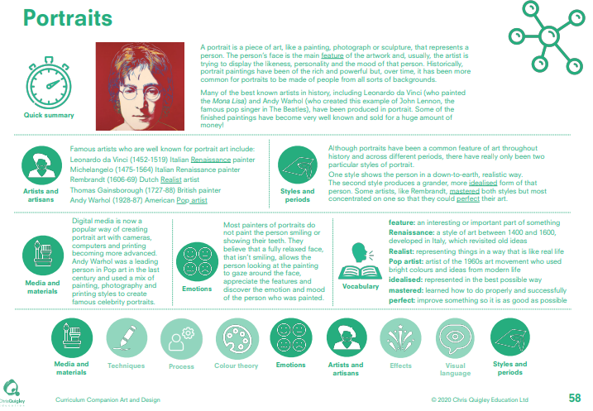

Slide 28
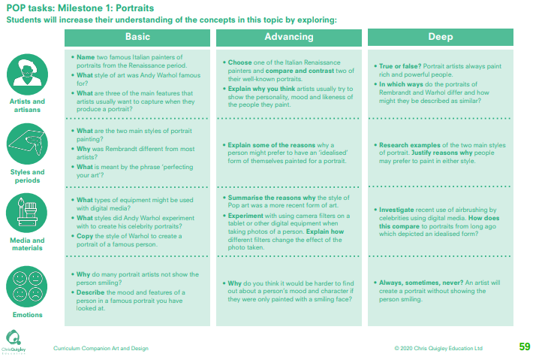

Slide 29
Portraits
This table shows the knowledge that will be taught in each lesson
Year 1 | Name two famous Italian painters of portraits from the Renaissance period. What style of art was Andy Warhol famous for? What are three of the main features that artists usually want to capture when they produce a portrait | What are the two main styles of portrait painting? Why was Rembrandt different from most artists? What is meant by the phrase ‘perfecting your art’? | What types of equipment might be used with digital media? What styles did Andy Warhol experiment with to create his celebrity portraits? Copy the style of Warhol to create a portrait of a famous person. | Why do many portrait artists not show the person smiling? Describe the mood and features of a person in a famous portrait you have looked at
Year 2 | Choose one of the Italian Renaissance painters and compare and contrast two of their well-known portraits. Explain why you think artists usually try to show the personality, mood and likeness of the people they paint. True or false? Portrait artists always paint rich and powerful people. In which ways do the portraits of Rembrandt and Warhol differ and how might they be described as similar? | Explain some of the reasons why a person might prefer to have an ‘idealised’ form of themselves painted for a portrait. Research examples of the two main styles of portrait. Justify reasons why people may prefer to paint in either style. | Summarise the reasons why the style of Pop art was a more recent form of art. Experiment with using camera filters on a tablet or other digital equipment when taking photos of a person. Explain how different filters change the effect of the photo taken. Investigate recent use of airbrushing by celebrities using digital media. How does this compare to portraits from long ago which depicted an idealised form? | Why do you think it would be harder to find out about a person’s mood and character if they were only painted with a smiling face? Always, sometimes, never? An artist will create a portrait without showing the person smiling.

Slide 30
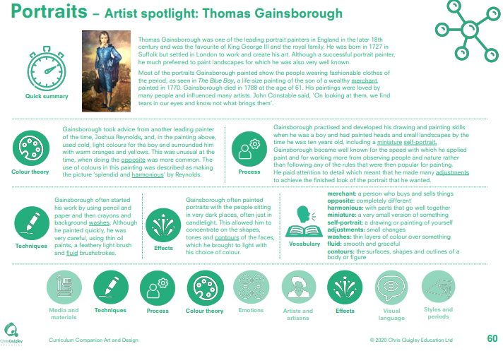

Slide 31
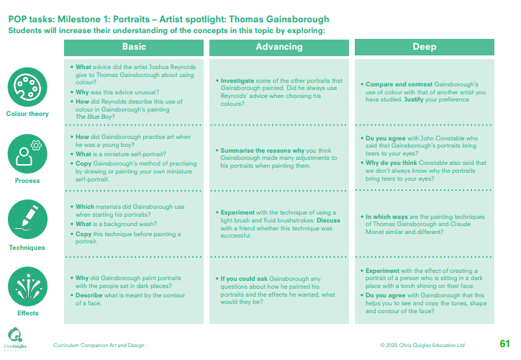

Slide 32
Portraits – Thomas Gainsborough
This table shows the knowledge that will be taught in each lesson
Year 1 | What advice did the artist Joshua Reynolds give to Thomas Gainsborough about using colour? Why was this advice unusual? How did Reynolds describe this use of colour in Gainsborough’s painting The Blue Boy? | How did Gainsborough practise art when he was a young boy? What is a miniature self-portrait? Copy Gainsborough’s method of practising by drawing or painting y. | Which materials did Gainsborough use when starting his portraits? What is a background wash? Copy this technique before painting a portrait | Why did Gainsborough paint portraits with the people sat in dark places? Describe what is meant by the contour of a face
Year 2 | Investigate some of the other portraits that Gainsborough painted. Did he always use Reynolds’ advice when choosing his colours Compare and contrast Gainsborough’s use of colour with that of another artist you have studied. Justify your preference. | Summarise the reasons why you think Gainsborough made many adjustments to his portraits when painting them. Do you agree with John Constable who said that Gainsborough’s portraits bring tears to your eyes? Why do you think Constable also said that we don’t always know why the portraits bring tears to your eyes? | Experiment with the technique of using a light brush and fluid brushstrokes. Discuss with a friend whether this technique was successful. In which ways are the painting techniques of Thomas Gainsborough and Claude Monet similar and different | If you could ask Gainsborough any questions about how he painted his portraits and the effects he wanted, what would they be? Experiment with the effect of creating a portrait of a person who is sitting in a dark place with a torch shining on their face. Do you agree with Gainsborough that this helps you to see and copy the tones, shape and contour of the face?

Slide 34
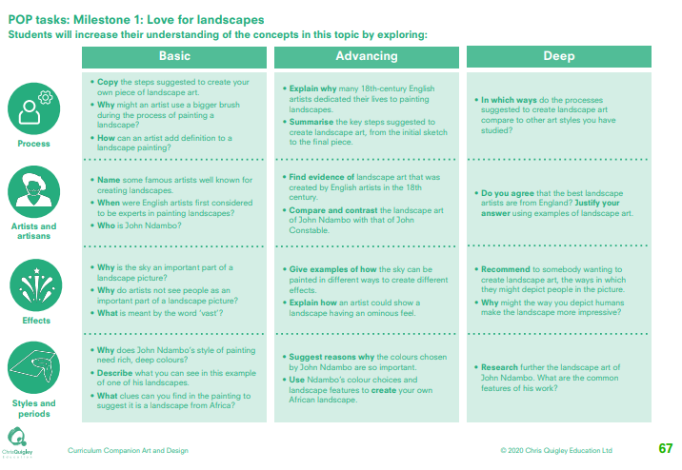

Slide 35
Love for landscapes
This table shows the knowledge that will be taught in each lesson
Year 1 | Copy the steps suggested to create your own piece of landscape art. Why might an artist use a bigger brush during the process of painting a landscape? How can an artist add definition to a landscape painting? | Name some famous artists well known for creating landscapes. When were English artists first considered to be experts in painting landscapes? Who is John Ndambo? | Why is the sky an important part of a landscape picture? Why do artists not see people as an important part of a landscape picture? What is meant by the word ‘vast’? | Why does John Ndambo’s style of painting need rich, deep colours? Describe what you can see in this example of one of his landscapes. What clues can you find in the painting to suggest it is a landscape from Africa?
Year 2 | Explain why many 18th-century English artists dedicated their lives to painting landscapes. Summarise the key steps suggested to create landscape art, from the initial sketch to the final piece. In which ways do the processes suggested to create landscape art compare to other art styles you have studied? | Find evidence of landscape art that was created by English artists in the 18th century. Compare and contrast the landscape art of John Ndambo with that of John Constable. Do you agree that the best landscape artists are from England? Justify your answer using examples of landscape art. | Give examples of how the sky can be painted in different ways to create different effects. Explain how an artist could show a landscape having an ominous feel. Recommend to somebody wanting to create landscape art, the ways in which they might depict people in the picture. Why might the way you depict humans make the landscape more impressive? | Suggest reasons why the colours chosen by John Ndambo are so important. Use Ndambo’s colour choices and landscape features to create your own African landscape. Research further the landscape art of John Ndambo. What are the common features of his work?

Slide 36
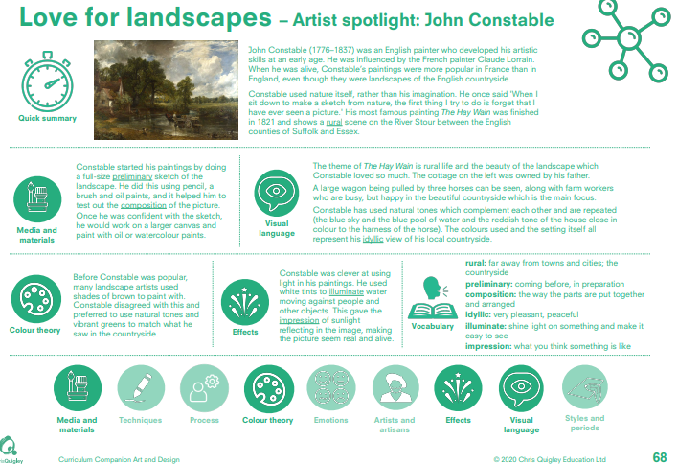

Slide 37
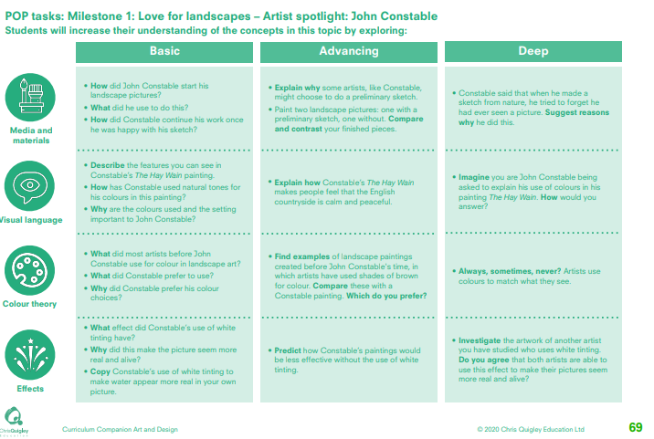

Slide 38
Love for landscapes
This table shows the knowledge that will be taught in each lesson
Year 1 | How did John Constable start his landscape pictures? What did he use to do this? How did Constable continue his work once he was happy with his sketch? | Describe the features you can see in Constable’s The Hay Wain painting. How has Constable used natural tones for his colours in this painting? Why are the colours used and the setting important to John Constable | What did most artists before John Constable use for colour in landscape art? What did Constable prefer to use? Why did Constable prefer his colour choices? | What effect did Constable’s use of white tinting have? Why did this make the picture seem more real and alive? Copy Constable’s use of white tinting to make water appear more real in your own picture.
Year 2 | Explain why some artists, like Constable, might choose to do a preliminary sketch. Paint two landscape pictures: one with a preliminary sketch, one without. Compare and contrast your finished pieces. Constable said that when he made a sketch from nature, he tried to forget he had ever seen a picture. Suggest reasons why he did this. | Explain how Constable’s The Hay Wain makes people feel that the English countryside is calm and peaceful. Imagine you are John Constable being asked to explain his use of colours in his painting The Hay Wain. How would you answer? | Find examples of landscape paintings created before John Constable's time, in which artists have used shades of brown for colour. Compare these with a Constable painting. Which do you prefer? Always, sometimes, never? Artists use colours to match what they see. | Predict how Constable’s paintings would be less effective without the use of white tinting. Investigate the artwork of another artist you have studied who uses white tinting. Do you agree that both artists are able to use this effect to make their pictures seem more real and alive?

Slide 39
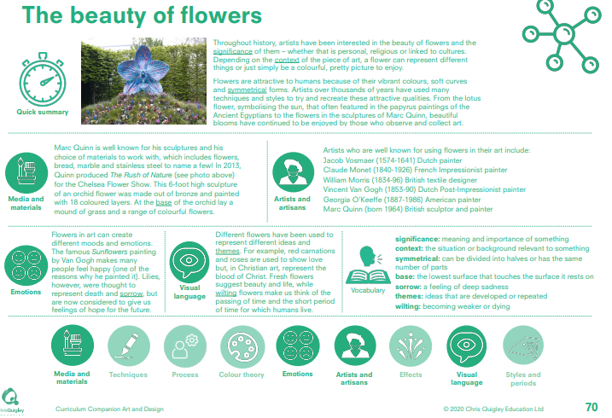

Slide 40
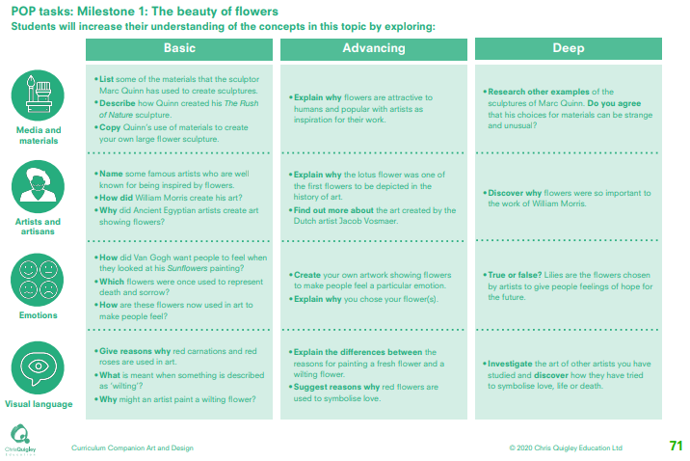

Slide 41
The beauty of flowers
This table shows the knowledge that will be taught in each lesson
Year 1 | List some of the materials that the sculptor Marc Quinn has used to create sculptures. Describe how Quinn created his The Rush of Nature sculpture. Copy Quinn’s use of materials to create your own large flower sculpture. | Name some famous artists who are well known for being inspired by flowers. How did William Morris create his art? Why did Ancient Egyptian artists create art showing flowers? | How did Van Gogh want people to feel when they looked at his Sunflowers painting? Which flowers were once used to represent death and sorrow? How are these flowers now used in art to make people feel? | Give reasons why red carnations and red roses are used in art. What is meant when something is described as ‘wilting’? Why might an artist paint a wilting flower?
Year 2 | Explain why flowers are attractive to humans and popular with artists as inspiration for their work. Research other examples of the sculptures of Marc Quinn. Do you agree that his choices for materials can be strange and unusual? | •Explain why the lotus flower was one of the first flowers to be depicted in the history of art. Find out more about the art created by the Dutch artist Jacob Vosmaer. Discover why flowers were so important to the work of William Morris. | Create your own artwork showing flowers to make people feel a particular emotion. Explain why you chose your flower(s). True or false? Lilies are the flowers chosen by artists to give people feelings of hope for the future. | Explain the differences between the reasons for painting a fresh flower and a wilting flower. Suggest reasons why red flowers are used to symbolise love. Investigate the art of other artists you have studied and discover how they have tried to symbolise love, life or death.

Slide 42
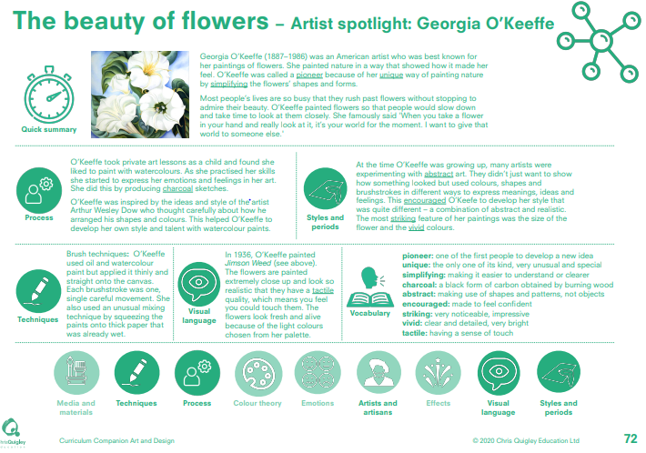

Slide 43
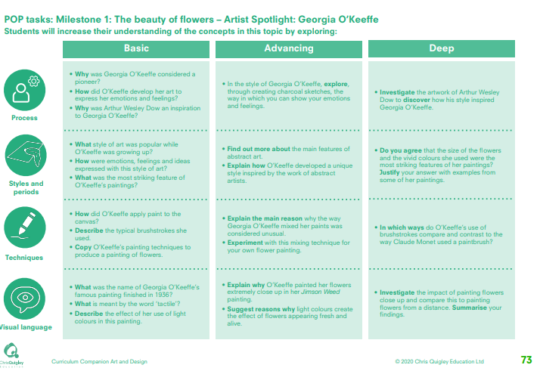

Slide 44
The beauty of flowers – Georgia O’Keeffe
This table shows the knowledge that will be taught in each lesson
Year 1 | Why was Georgia O’Keeffe considered a pioneer? How did O’Keeffe develop her art to express her emotions and feelings? Why was Arthur Wesley Dow an inspiration to Georgia O’Keeffe? | What style of art was popular while O’Keeffe was growing up? How were emotions, feelings and ideas expressed with this style of art? What was the most striking feature of O’Keeffe’s paintings? | How did O’Keeffe apply paint to the canvas? Describe the typical brushstrokes she used. Copy O’Keeffe’s painting techniques to produce a painting of flowers. | What was the name of Georgia O’Keeffe’s famous painting finished in 1936? What is meant by the word ‘tactile’? Describe the effect of her use of light colours in this painting.
Year 2 | In the style of Georgia O’Keeffe, explore, through creating charcoal sketches, the way in which you can show your emotions and feelings. Investigate the artwork of Arthur Wesley Dow to discover how his style inspired Georgia O’Keeffe. | Find out more about the main features of abstract art. Explain how O’Keeffe developed a unique style inspired by the work of abstract artists. Do you agree that the size of the flowers and the vivid colours she used were the most striking features of her paintings? Justify your answer with examples from some of her paintings. | Explain the main reason why the way Georgia O’Keeffe mixed her paints was considered unusual. Experiment with this mixing technique for your own flower painting. In which ways do O’Keeffe’s use of brushstrokes compare and contrast to the way Claude Monet used a paintbrush? | Explain why O’Keeffe painted her flowers extremely close up in her Jimson Weed painting. Suggest reasons why light colours create the effect of flowers appearing fresh and alive. Investigate the impact of painting flowers close up and compare this to painting flowers from a distance. Summarise your findings.

Slide 46
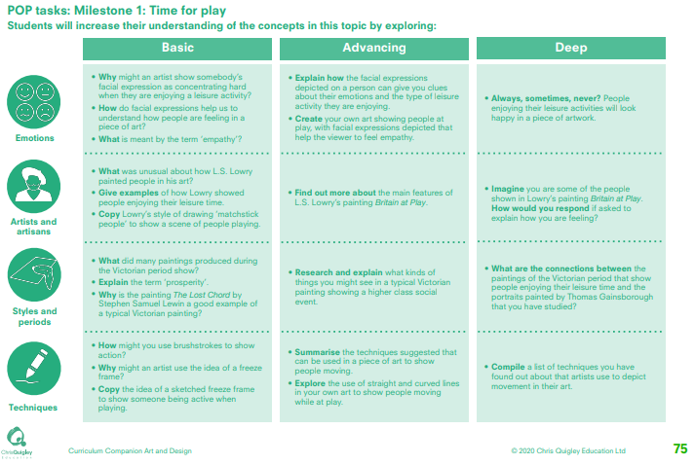

Slide 47
Time for play
This table shows the knowledge that will be taught in each lesson
Year 1 | Why might an artist show somebody’s facial expression as concentrating hard when they are enjoying a leisure activity? How do facial expressions help us to understand how people are feeling in a piece of art? What is meant by the term ‘empathy’? | What was unusual about how L.S. Lowry painted people in his art? Give examples of how Lowry showed people enjoying their leisure time. • Copy Lowry’s style of drawing ‘matchstick people’ to show a scene of people playing. | What did many paintings produced during the Victorian period show? Explain the term ‘prosperity’. Why is the painting The Lost Chord by Stephen Samuel Lewin a good example of a typical Victorian painting? | How might you use brushstrokes to show action? Why might an artist use the idea of a freeze frame? Copy the idea of a sketched freeze frame to show someone being active when playing
Year 2 | Explain how the facial expressions depicted on a person can give you clues about their emotions and the type of leisure activity they are enjoying. Create your own art showing people at play, with facial expressions depicted that help the viewer to feel empathy. Always, sometimes, never? People enjoying their leisure activities will look happy in a piece of artwork. | Find out more about the main features of L.S. Lowry’s painting Britain at Play. Imagine you are some of the people shown in Lowry’s painting Britain at Play. How would you respond if asked to explain how you are feeling? | Research and explain what kinds of things you might see in a typical Victorian painting showing a higher class social event. What are the connections between the paintings of the Victorian period that show people enjoying their leisure time and the portraits painted by Thomas Gainsborough that you have studied? | Summarise the techniques suggested that can be used in a piece of art to show people moving. Explore the use of straight and curved lines in your own art to show people moving while at play. Compile a list of techniques you have found out about that artists use to depict movement in their art.

Slide 48
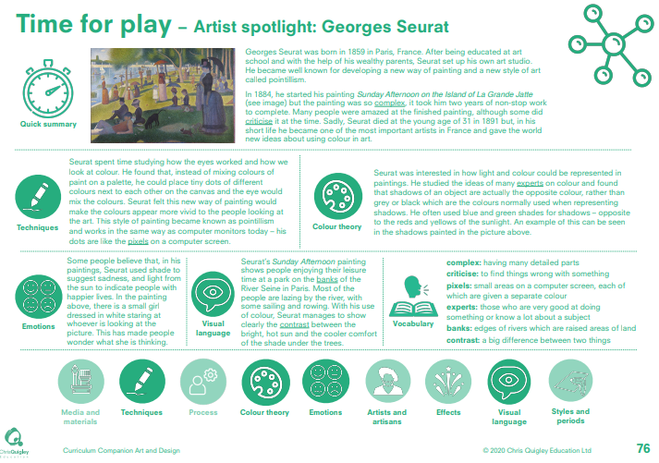

Slide 49
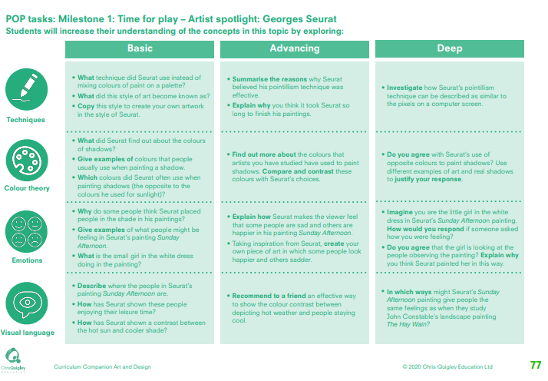

Slide 50
Time to play – Georges Seurat
This table shows the knowledge that will be taught in each lesson
Year 1 | What technique did Seurat use instead of mixing colours of paint on a palette? What did this style of art become known as? Copy this style to create your own artwork in the style of Seurat | What did Seurat find out about the colours of shadows? Give examples of colours that people usually use when painting a shadow. Which colours did Seurat often use when painting shadows (the opposite to the colours he used for sunlight)? | Why do some people think Seurat placed people in the shade in his paintings? Give examples of what people might be feeling in Seurat’s painting Sunday Afternoon. What is the small girl in the white dress doing in the painting? | Describe where the people in Seurat’s painting Sunday Afternoon are. How has Seurat shown these people enjoying their leisure time? How has Seurat shown a contrast between the hot sun and cooler shade?
Year 2 | Summarise the reasons why Seurat believed his pointillism technique was effective. Explain why you think it took Seurat so long to finish his paintings. Investigate how Seurat’s pointillism technique can be described as similar to the pixels on a computer screen. | Find out more about the colours that artists you have studied have used to paint shadows. Compare and contrast these colours with Seurat’s choices. Do you agree with Seurat’s use of opposite colours to paint shadows? Use different examples of art and real shadows to justify your response. | Explain how Seurat makes the viewer feel that some people are sad and others are happier in his painting Sunday Afternoon. Taking inspiration from Seurat, create your own piece of art in which some people look happier and others sadder. Imagine you are the little girl in the white dress in Seurat’s Sunday Afternoon painting. How would you respond if someone asked how you were feeling? Do you agree that the girl is looking at the people observing the painting? Explain why you think Seurat painted her in this way. | Recommend to a friend an effective way to show the colour contrast between depicting hot weather and people staying cool. In which ways might Seurat’s Sunday Afternoon painting give people the same feelings as when they study John Constable’s landscape painting The Hay Wain?

