Slide 1
Key Stage 1 Geography Curriculum
Together we Nurture, Inspire and Achieve

Slide 2
Geography topics overview
Geography topics are organised and referenced around a geographical schema. Each topic either introduces an aspect of the schema or references previous instances of it. Below is an overview of the topics we teach and which aspects of the schema it strengthens:
Location
Physical
features
Human features
Diversity
Physical
processes
Human
processes
Techniques
Mapping the World |  |  |  |  |  |  | .
Describing Maps of The World 1 and 2 |  |  |  |  |  |  | .
Continents of the Ocean | . | . | .
The United Kingdom | .
The United Kingdom-England | . | . | . | .
The United Kingdom-Scotland | . | . | . | .
The United Kingdom-Wales | . | . | . |  |  | .
The United Kingdom-Northern Ireland | . | . | . | .
England-London | . | . | . | .
Edinburgh, Cardiff, Belfast | . | . | . |  |  | .
Australia | . | . | .
Australia-Sydney | . | . | .
Australia-animals |  |  | . | .
Australia-Great Barrier Reef |  |  | . | .
Climate | . | .
Weather and Extreme Weather |  |  |  |  | .

Slide 3
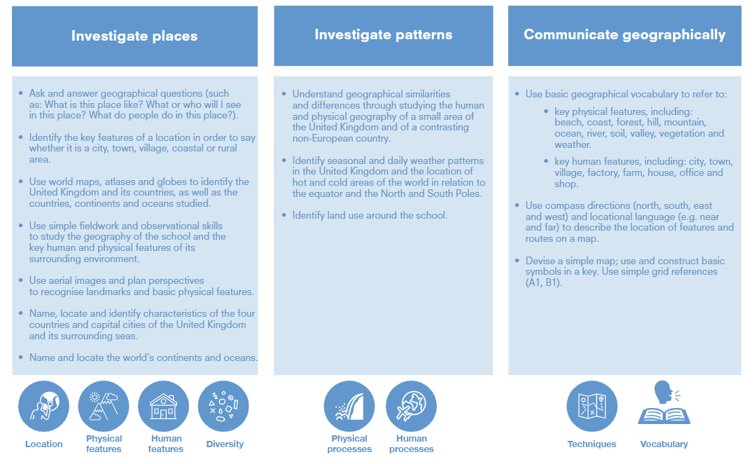

Slide 5
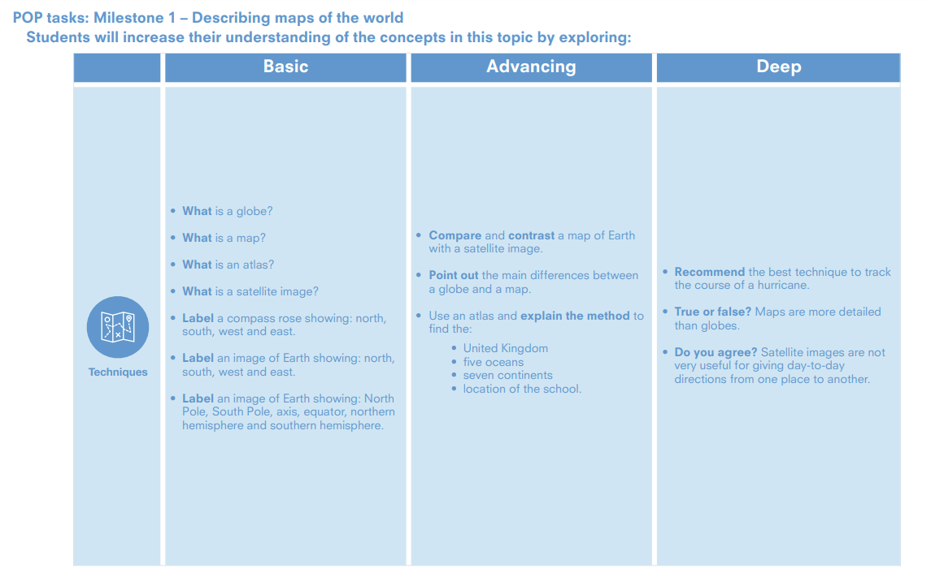
Mapping the World
Below is a summary of what students should be taught. All of the answers are on the knowledge web and should be taught with appropriate activities.

Slide 6
Mapping the World
Decide how many lessons you will spend on the topic and use the information on the knowledge web to create the take-aways for each lesson​
This table shows the knowledge that will be taught in each lesson.
Techniques
Year 1 | What is a globe? What is a map? What is an atlas? What is a satellite image? Label a compass rose showing: north, south, west and east. Label an image of Earth showing: north, south, west and east. Label an image of Earth showing: North Pole, South Pole, axis, equator, northern hemisphere and southern hemisphere.
Year 2 | Compare and contrast a map of Earth with a satellite image Point out the main differences between a globe and a map. Use an atlas and explain the method to find the: United Kingdom five oceans Seven continents location of the school. • Recommend the best technique to track the course of a hurricane. • True or false? Maps are more detailed than globes. • Do you agree? Satellite images are not very useful for giving day-to-day directions from one place to another.

Slide 8
Describing Maps of the World: 1
Below is a summary of what students should be taught. All of the answers are on the knowledge web and should be taught with appropriate activities.

Slide 9
Describing maps of the world:1
Decide how many lessons you will spend on the topic and use the information on the knowledge web to create the take-aways for each lesson​
This table shows the knowledge that will be taught in each lesson.
Techniques
Year 1 | What is a globe? What is a map? What is an atlas? What is a satellite image? Label a compass rose showing: north, south, west and east. Label an image of Earth showing: north, south, west and east. Label an image of Earth showing: North Pole, South Pole, axis, equator, northern hemisphere and southern hemisphere.
Year 2 | Compare and contrast a map of Earth with a satellite image Point out the main differences between a globe and a map. Use an atlas and explain the method to find the: United Kingdom five oceans Seven continents location of the school.

Slide 11
Describing Maps of the World
Below is a summary of what students should be taught. All of the answers are on the knowledge web and should be taught with appropriate activities.

Slide 12
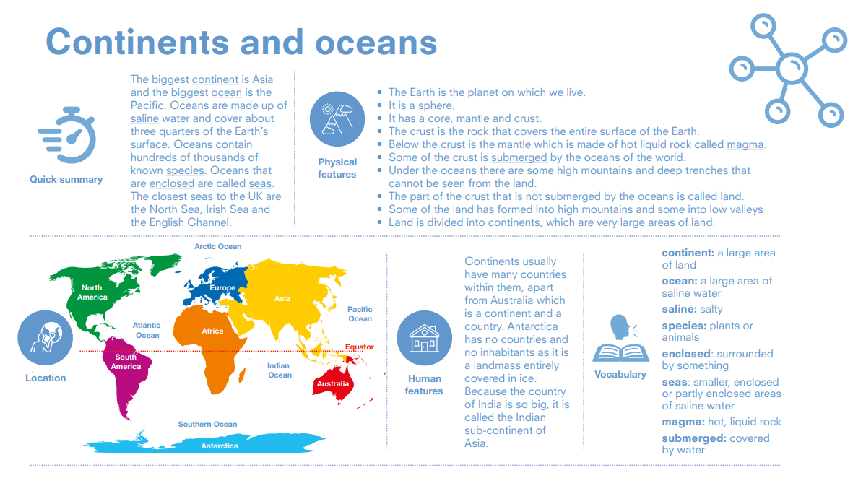

Slide 13
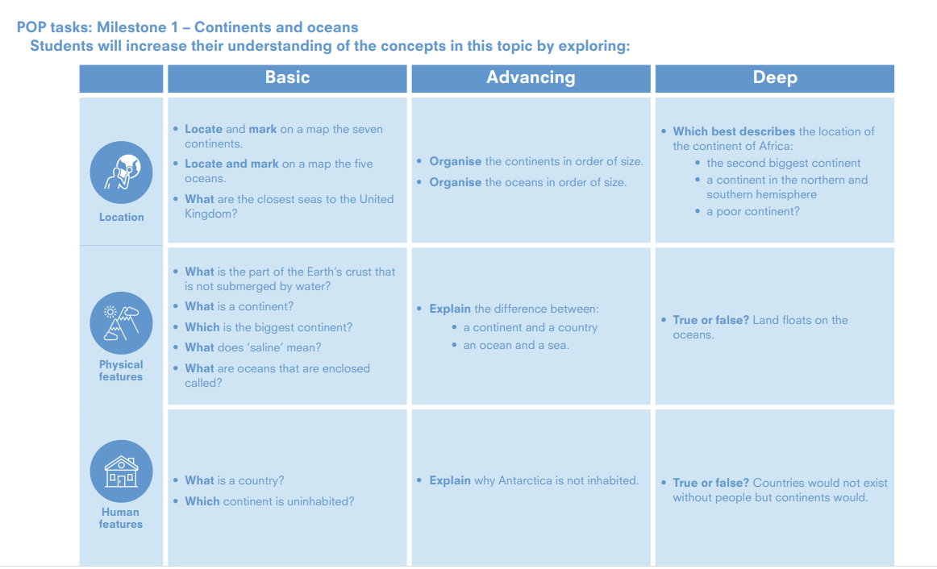

Slide 14
Continents and oceans
Location
Physical
features
Human features
Year 1 | • Locate and mark on a map the seven continents. • Locate and mark on a map the five oceans. • What are the closest seas to the United Kingdom? | • What is the part of the Earth’s crust that is not submerged by water? • What is a continent? • Which is the biggest continent? • What does ‘saline’ mean? • What are | • What is a country? • Which continent is uninhabited?
Year 2 | • Organise the continents in order of size. • Organise the oceans in order of size. • Which best describes the location of the continent of Africa: • the second biggest continent • a continent in the northern and southern hemisphere • a poor continent | • Explain the difference between: • a continent and a country • an ocean and a sea. • True or false? Land floats on the oceans. | • Explain why Antarctica is not inhabited True or false? Countries would not exist without people but continents would.

Slide 15
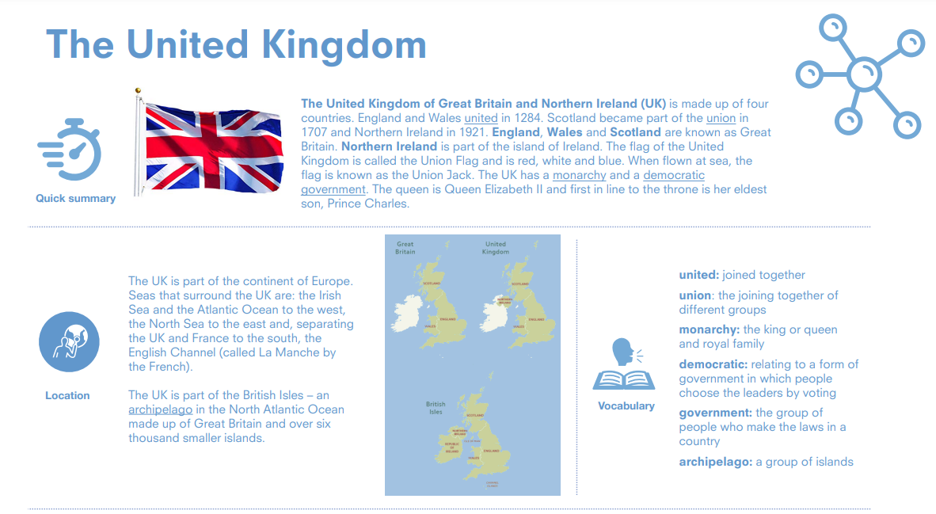

Slide 16
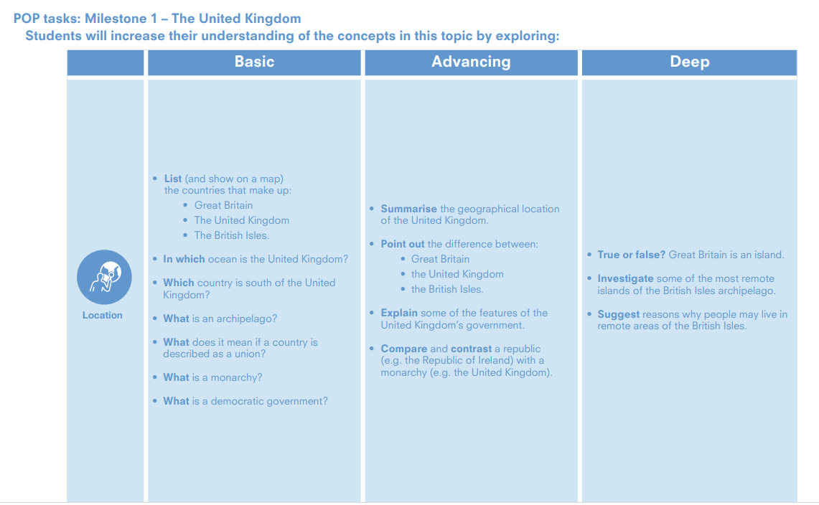

Slide 17
The United Kingdom
Location
Year 1 | • List (and show on a map) the countries that make up: • Great Britain • The United Kingdom • The British Isles. • In which ocean is the United Kingdom? • Which country is south of the United Kingdom? • What is an archipelago? • What does it mean if a country is described as a union? • What is a monarchy? • What is a democratic government?
Year 2 | • Summarise the geographical location of the United Kingdom. • Point out the difference between: • Great Britain • the United Kingdom • the British Isles. • Explain some of the features of the United Kingdom’s government. • True or false? Great Britain is an island. • Investigate some of the most remote islands of the British Isles archipelago. • Suggest reasons why people may live in remote areas of the British Isles.ompare and contrast a republic (e.g. the Republic of Ireland) with a monarchy (e.g. the United Kingdom).

Slide 19
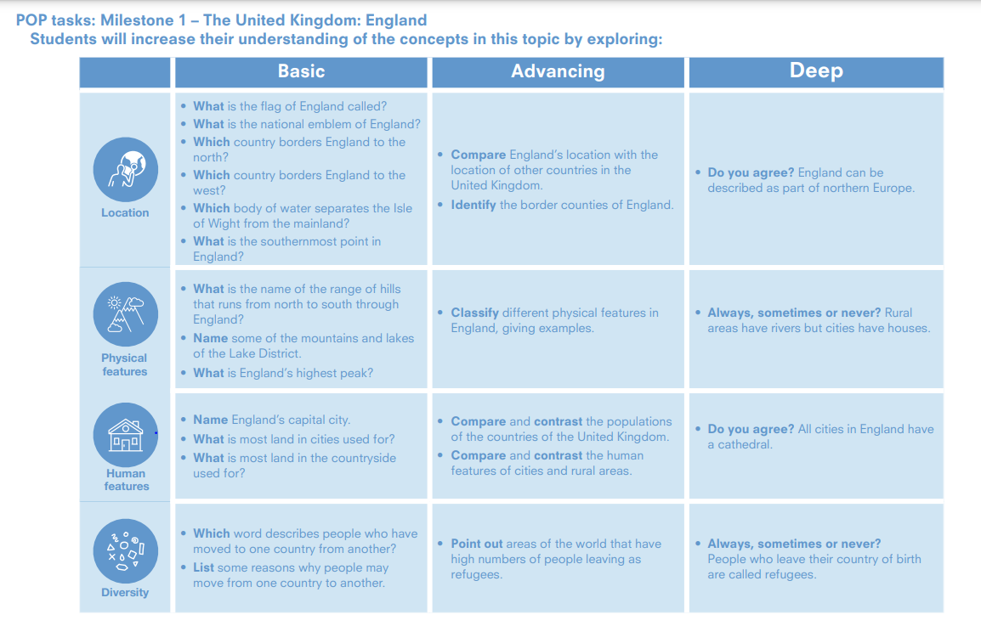

Slide 20
The United Kingdom: England
Location
Physical
features
Human features
Diversity
Year 1 | • What is the flag of England called? • What is the national emblem of England? • Which country borders England to the north? • Which country borders England to the west? • Which body of water separates the Isle of Wight from the mainland? • What is the southernmost point in England? | • What is the name of the range of hills that runs from north to south through England? • Name some of the mountains and lakes of the Lake District. • What is England’s highest peak? | • Name England’s capital city. • What is most land in cities used for? • What is most land in the countryside used for? | • Which word describes people who have moved to one country from another? • List some reasons why people may move from one country to another.
Year 2 | • Compare England’s location with the location of other countries in the United Kingdom. • Identify the border counties of England. • Do you agree? England can be described as part of northern Europe. | • Classify different physical features in England, giving examples. • Always, sometimes or never? Rural areas have rivers but cities have houses | • Compare and contrast the populations of the countries of the United Kingdom. • Compare and contrast the human features of cities and rural areas. • Do you agree? All cities in England have a cathedral. | • Point out areas of the world that have high numbers of people leaving as refugees. • Always, sometimes or never? People who leave their country of birth are called refugees.

Slide 21
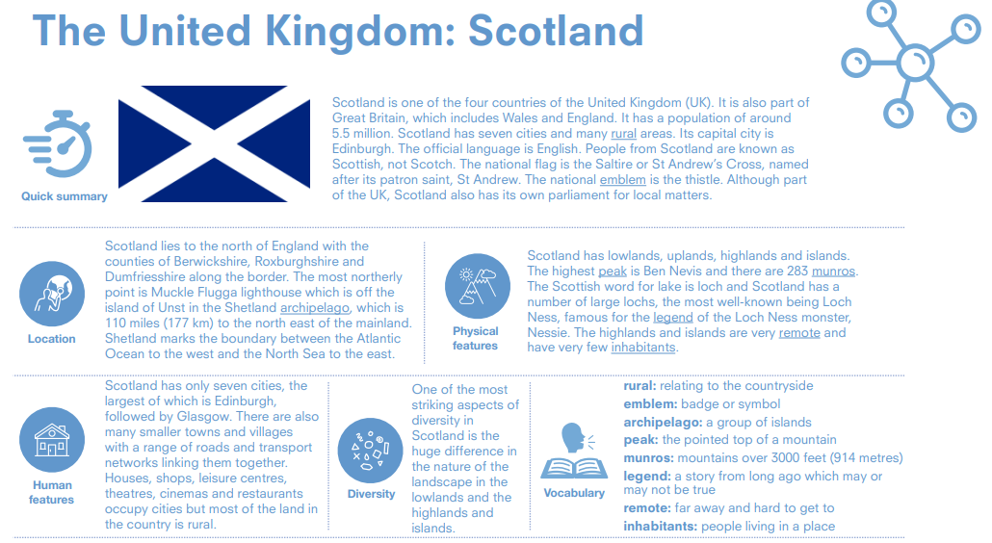

Slide 22
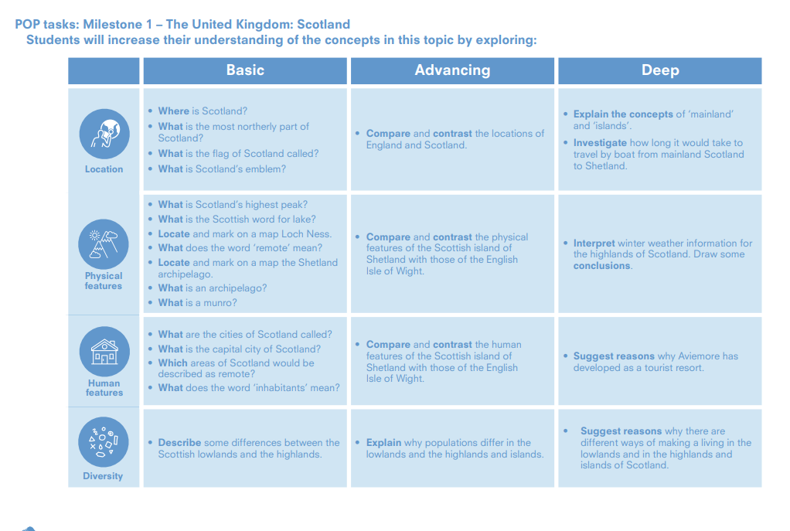

Slide 23
The United Kingdom: Scotland
Location
Physical
features
Human features
Diversity
Year 1 | • Where is Scotland? • What is the most northerly part of Scotland? • What is the flag of Scotland called? • What is Scotland’s emblem? | • What is Scotland’s highest peak? • What is the Scottish word for lake? • Locate and mark on a map Loch Ness. • What does the word ‘remote’ mean? • Locate and mark on a map the Shetland archipelago. • What is an archipelago? • What is a munro? | • What are the cities of Scotland called? • What is the capital city of Scotland? • Which areas of Scotland would be described as remote? • What does the word ‘inhabitants’ mean? | Describe some differences between the Scottish lowlands and the highlands.
Year 2 | • Compare and contrast the locations of England and Scotland. • Explain the concepts of ‘mainland’ and ‘islands’. • Investigate how long it would take to travel by boat from mainland Scotland to Shetland. | • Compare and contrast the physical features of the Scottish island of Shetland with those of the English Isle of Wight • Interpret winter weather information for the highlands of Scotland. Draw some conclusions. | • Compare and contrast the human features of the Scottish island of Shetland with those of the English Isle of Wight. • Suggest reasons why Aviemore has developed as a tourist resort. | • Explain why populations differ in the lowlands and the highlands and islands. • Suggest reasons why there are different ways of making a living in the lowlands and in the highlands and islands of Scotland.

Slide 24
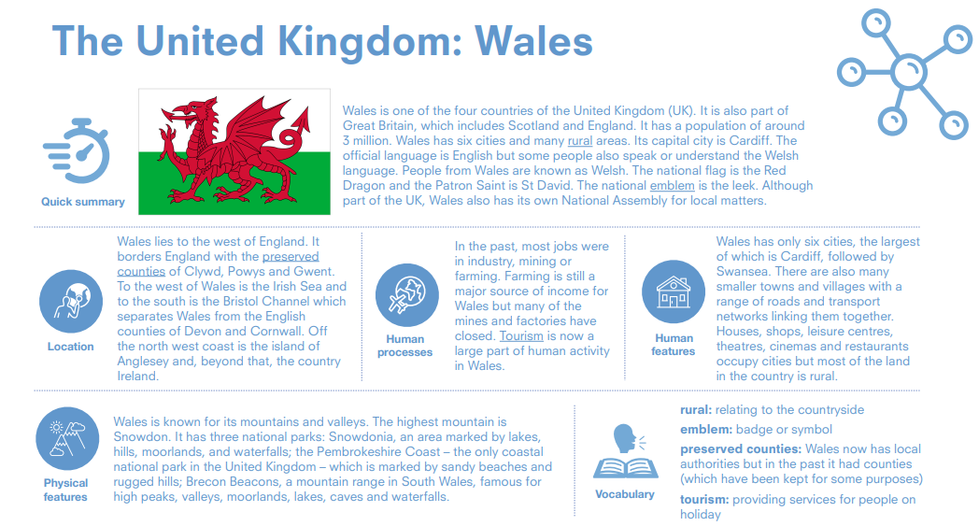

Slide 25
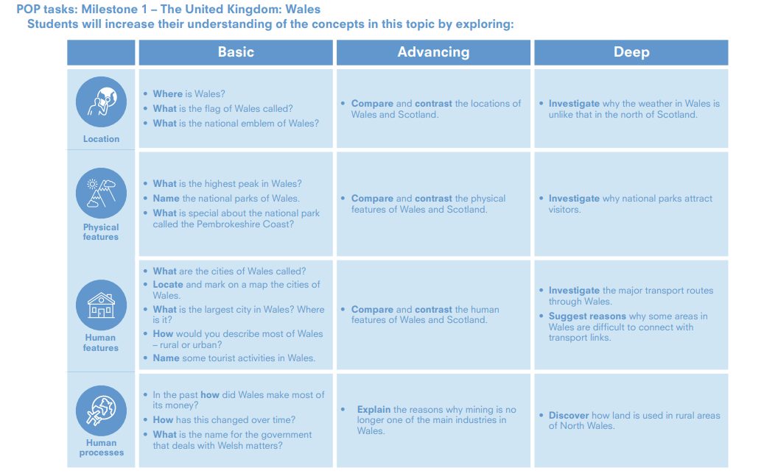

Slide 26
The United Kingdom: Wales
Location
Physical
features
Human features
Human
processes
Year 1 | • Where is Wales? • What is the flag of Wales called? • What is the national emblem of Wales? | What is the highest peak in Wales? • Name the national parks of Wales. • What is special about the national park called the Pembrokeshire Coast? | • What are the cities of Wales called? • Locate and mark on a map the cities of Wales. • What is the largest city in Wales? Where is it? • How would you describe most of Wales – rural or urban? • Name some tourist activities in Wales. | • In the past how did Wales make most of its money? • How has this changed over time? • What is the name for the government that deals with Welsh matters?
Year 2 | • Compare and contrast the locations of Wales and Scotland. • Investigate why the weather in Wales is unlike that in the north of Scotland. | • Compare and contrast the physical features of Wales and Scotland. • Investigate why national parks attract visitors. | • Compare and contrast the human features of Wales and Scotland. • Investigate the major transport routes through Wales. • Suggest reasons why some areas in Wales are difficult to connect with transport links. | • Explain the reasons why mining is no longer one of the main industries in Wales. • Discover how land is used in rural areas of North Wales.

Slide 28
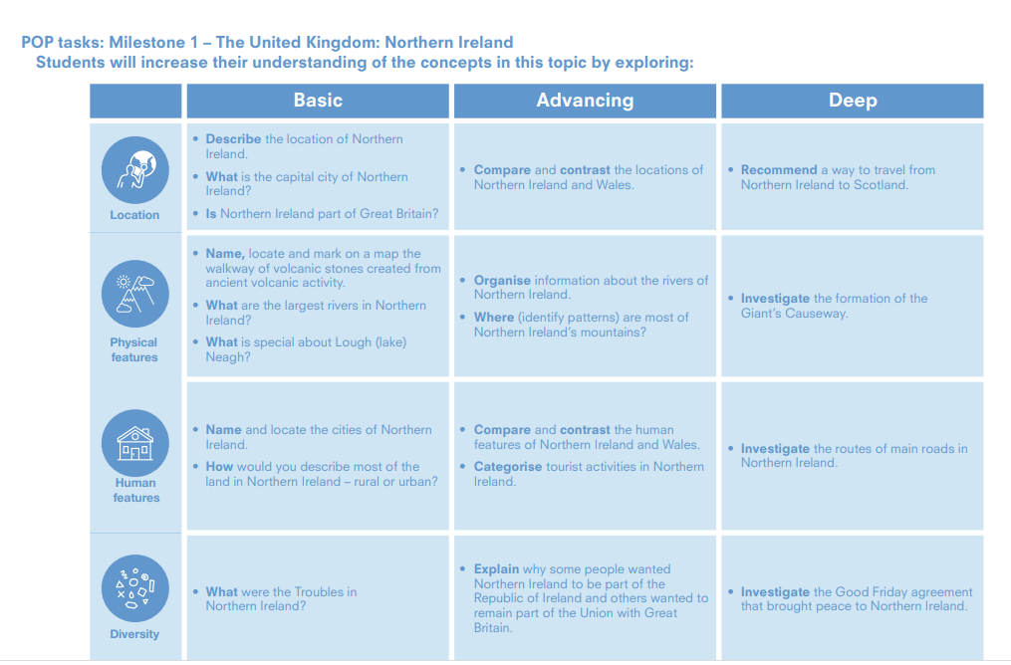

Slide 29
The United Kingdom: Northern Ireland
Location
Physical
features
Human features
Diversity
Year 1 | • Describe the location of Northern Ireland. • What is the capital city of Northern Ireland? • Is Northern Ireland part of Great Britain? | • Name, locate and mark on a map the walkway of volcanic stones created from ancient volcanic activity. • What are the largest rivers in Northern Ireland? • What is special about Lough (lake) Neagh? | • Name and locate the cities of Northern Ireland. • How would you describe most of the land in Northern Ireland – rural or urban? | • What were the Troubles in Northern Ireland?
Year 2 | • Compare and contrast the locations of Northern Ireland and Wales. • Recommend a way to travel from Northern Ireland to Scotland. | • Organise information about the rivers of Northern Ireland. • Where (identify patterns) are most of Northern Ireland’s mountains? • Investigate the formation of the Giant’s Causeway. | • Compare and contrast the human features of Northern Ireland and Wales. • Categorise tourist activities in Northern Ireland. • Investigate the routes of main roads in Northern Ireland. | • Explain why some people wanted Northern Ireland to be part of the Republic of Ireland and others wanted to remain part of the Union with Great Britain. • Investigate the Good Friday agreement that brought peace to Northern Ireland.

Slide 31
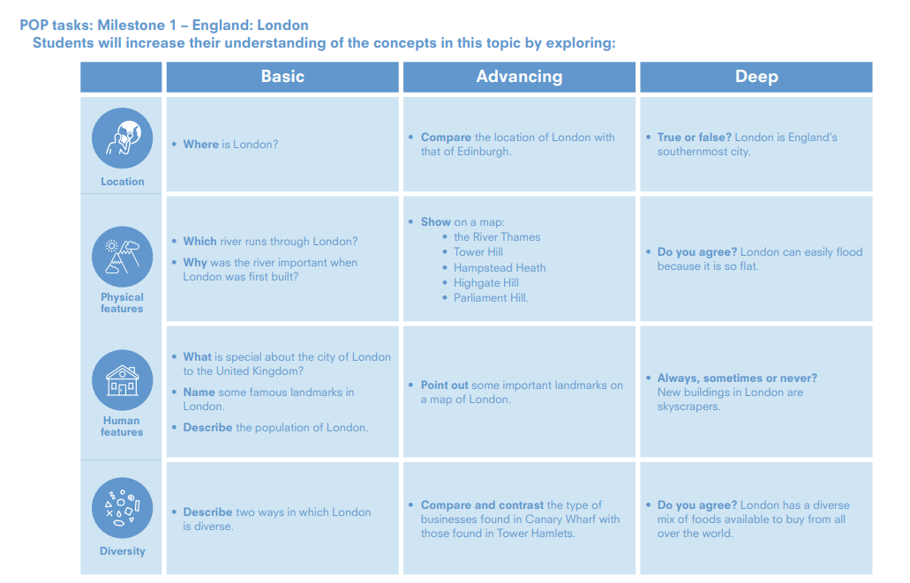

Slide 32
England: London
Location
Physical
features
Human features
Diversity
Year 1 | • Where is London? | • Which river runs through London? • Why was the river important when London was first built? | • What is special about the city of London to the United Kingdom? • Name some famous landmarks in London. • Describe the population of London. | • Describe two ways in which London is diverse.
Year 2 | • Compare the location of London with that of Edinburgh True or false? London is England’s southernmost city. | • Show on a map: • the River Thames • Tower Hill • Hampstead Heath • Highgate Hill • Parliament Hill • Do you agree? London can easily flood because it is so flat. | • Point out some important landmarks on a map of London. • Always, sometimes or never? New buildings in London are skyscrapers. | • Compare and contrast the type of businesses found in Canary Wharf with those found in Tower Hamlets. • Do you agree? London has a diverse mix of foods available to buy from all over the world.

Slide 34
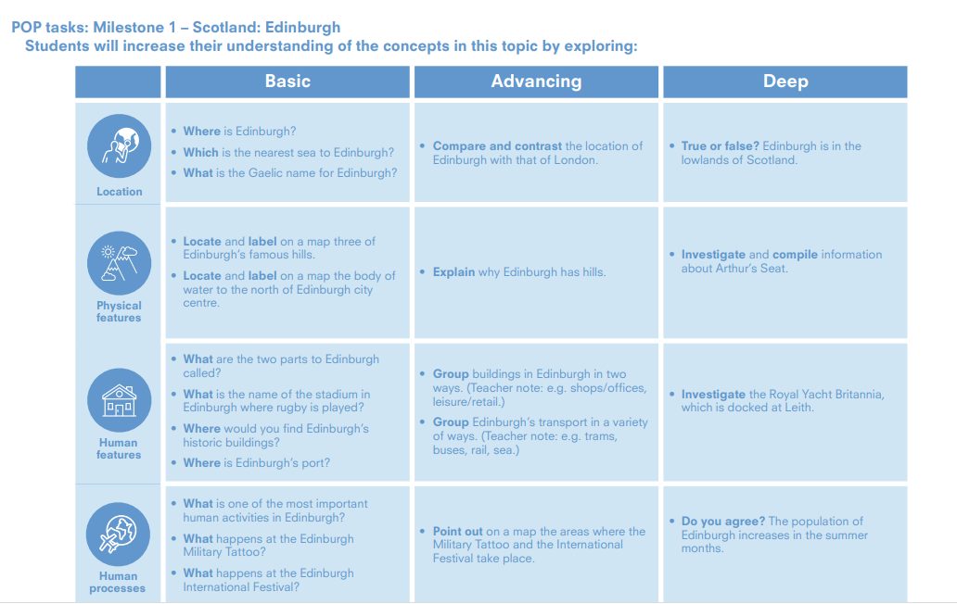

Slide 35
Scotland: Edinburgh
Location
Human
processes
Year 1 | • Where is Edinburgh? • Which is the nearest sea to Edinburgh? • What is the Gaelic name for Edinburgh? | • Locate and label on a map three of Edinburgh’s famous hills. • Locate and label on a map the body of water to the north of Edinburgh city centre. | What are the two parts to Edinburgh called? • What is the name of the stadium in Edinburgh where rugby is played? • Where would you find Edinburgh’s historic buildings? • Where is Edinburgh’s port? | • What is one of the most important human activities in Edinburgh? • What happens at the Edinburgh Military Tattoo? • What happens at the Edinburgh International Festival?
Year 2 | Compare and contrast the location of Edinburgh with that of London. • True or false? Edinburgh is in the lowlands of Scotland. | • Explain why Edinburgh has hills Investigate and compile information about Arthur’s Seat. | Group buildings in Edinburgh in two ways. (Teacher note: e.g. shops/offices, leisure/retail.) • Group Edinburgh’s transport in a variety of ways. (Teacher note: e.g. trams, buses, rail, sea.) • Investigate the Royal Yacht Britannia, which is docked at Leith | • Point out on a map the areas where the Military Tattoo and the International Festival take place. • Do you agree? The population of Edinburgh increases in the summer months.

Slide 36
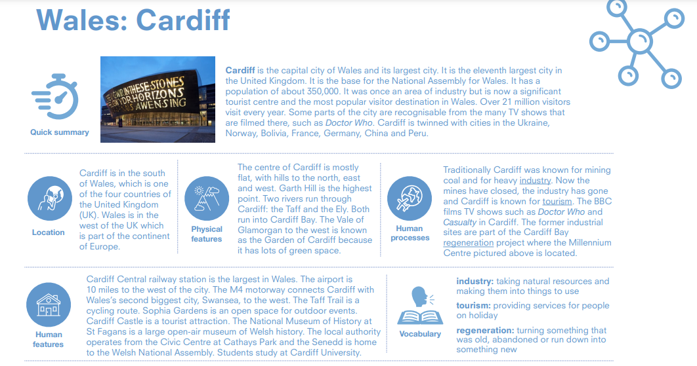

Slide 37
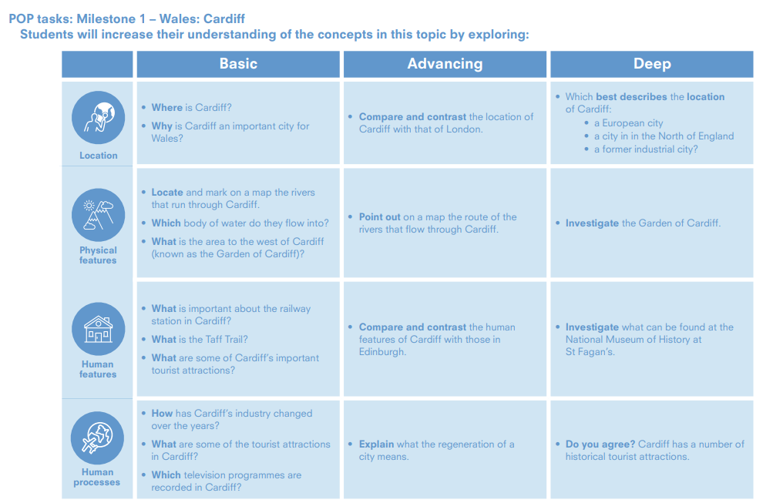

Slide 38
Wales: Cardiff
Location
Human
processes
Year 1 | • Where is Cardiff? • Why is Cardiff an important city for Wales? | • Locate and mark on a map the rivers that run through Cardiff. • Which body of water do they flow into? • What is the area to the west of Cardiff (known as the Garden of Cardiff)? | • What is important about the railway station in Cardiff? • What is the Taff Trail? • What are some of Cardiff’s important tourist attractions? | • How has Cardiff’s industry changed over the years? • What are some of the tourist attractions in Cardiff? • Which television programmes are recorded in Cardiff?
Year 2 | • Compare and contrast the location of Cardiff with that of London. • Which best describes the location of Cardiff: • a European city • a city in in the North of England • a former industrial city? | • Point out on a map the route of the rivers that flow through Cardiff. Investigate the Garden of Cardiff. | • Compare and contrast the human features of Cardiff with those in Edinburgh. • Investigate what can be found at the National Museum of History at St Fagan’s. | • Explain what the regeneration of a city means. • Do you agree? Cardiff has a number of historical tourist attractions.

Slide 40
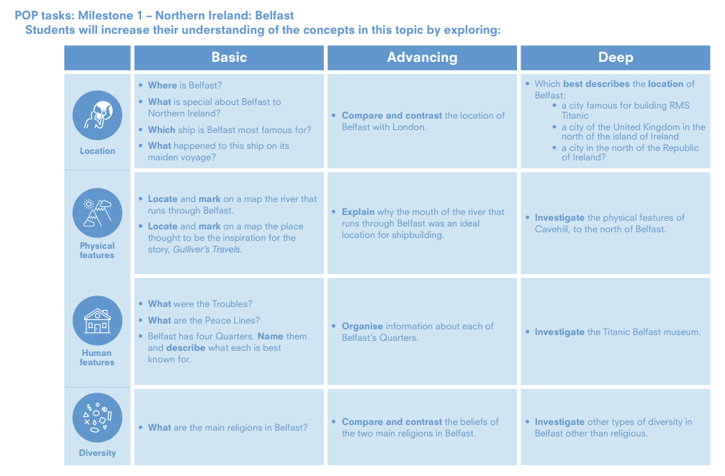

Slide 41
Northern Ireland:Belfast
Location
Physical
features
Human features
Diversity
Year 1 | Where is Cardiff? • Why is Cardiff an important city for Wales? | • Locate and mark on a map the rivers that run through Cardiff. • Which body of water do they flow into? • What is the area to the west of Cardiff (known as the Garden of Cardiff)? | • What is important about the railway station in Cardiff? • What is the Taff Trail? • What are some of Cardiff’s important tourist attractions? | • How has Cardiff’s industry changed over the years? • What are some of the tourist attractions in Cardiff? • Which television programmes are recorded in Cardiff?
Year 2 | • Compare and contrast the location of Cardiff with that of London. • Which best describes the location of Cardiff: • a European city • a city in in the North of England • a former industrial city? | • Point out on a map the route of the rivers that flow through Cardiff. • Investigate the Garden of Cardiff. | • Compare and contrast the human features of Cardiff with those in Edinburgh. Investigate what can be found at the National Museum of History at St Fagan’s. | • Explain what the regeneration of a city means. • Do you agree? Cardiff has a number of historical tourist attractions

Slide 43
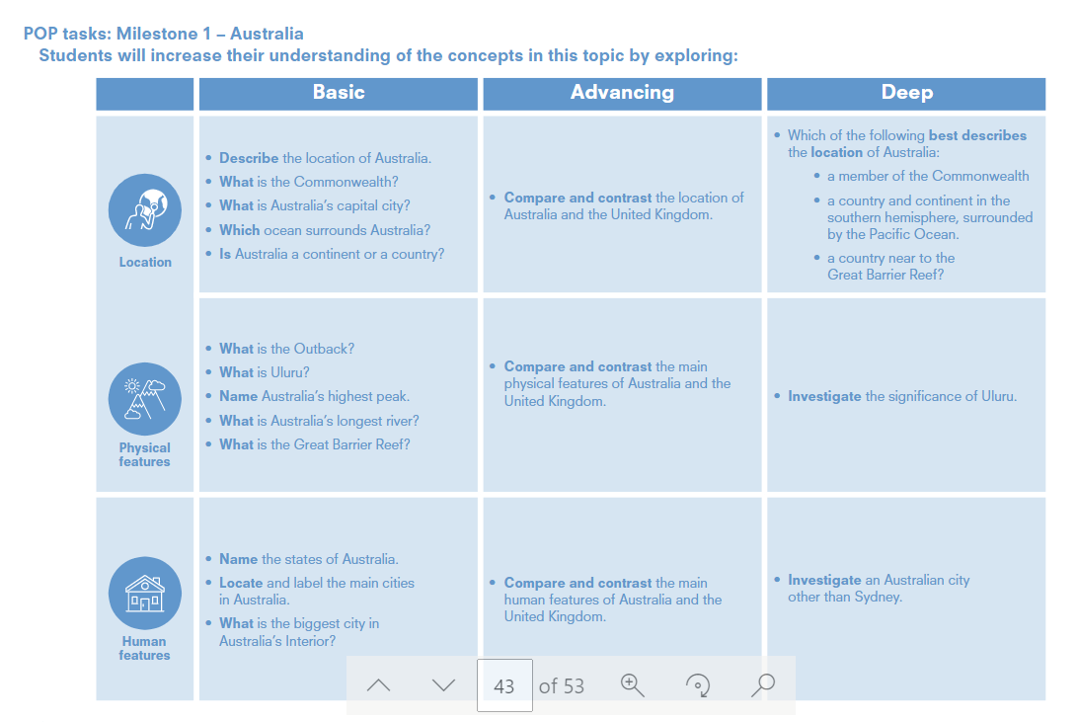

Slide 44
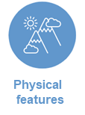
Australia
Location
Year 1 | • Describe the location of Australia. • What is the Commonwealth? • What is Australia’s capital city? • Which ocean surrounds Australia? • Is Australia a continent or a country? | • What is the Outback? • What is Uluru? • Name Australia’s highest peak. • What is Australia’s longest river? • What is the Great Barrier Reef? | Name the states of Australia. • Locate and label the main cities in Australia. • What is the biggest city in Australia’s Interior?
Year 2 | • Compare and contrast the location of Australia and the United Kingdom Which of the following best describes the location of Australia: • a member of the Commonwealth • a country and continent in the southern hemisphere, surrounded by the Pacific Ocean. • a country near to the Great Barrier Reef? | • Compare and contrast the main physical features of Australia and the United Kingdom. • Investigate the significance of Uluru | • Compare and contrast the main human features of Australia and the United Kingdom. • Investigate an Australian city other than Sydney.

Slide 46
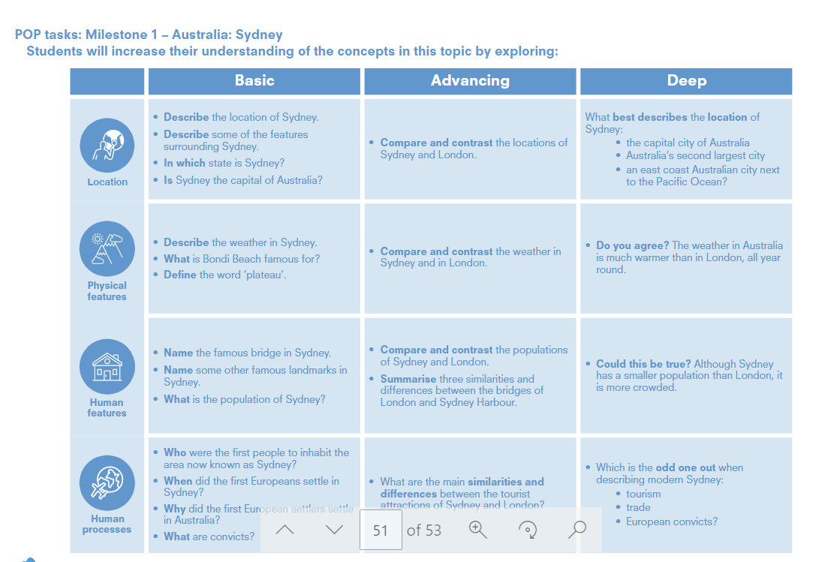

Slide 47
Australia: Sydney
Location
Year 1 | • Describe the location of Sydney. • Describe some of the features surrounding Sydney. • In which state is Sydney? • Is Sydney the capital of Australia? | Describe the weather in Sydney. • What is Bondi Beach famous for? • Define the word ‘plateau’. | • Name the famous bridge in Sydney. • Name some other famous landmarks in Sydney. • What is the population of Sydney? | Who were the first people to inhabit the area now known as Sydney? • When did the first Europeans settle in Sydney? • Why did the first European settlers settle in Australia? • What are convicts?
Year 2 | Compare and contrast the locations of Sydney and London. What best describes the location of Sydney: • the capital city of Australia • Australia’s second largest city • an east coast Australian city next to the Pacific Ocean? | Compare and contrast the weather in Sydney and in London. • Do you agree? The weather in Australia is much warmer than in London, all year round. | • Compare and contrast the populations of Sydney and London. • Summarise three similarities and differences between the bridges of London and Sydney Harbour. Could this be true? Although Sydney has a smaller population than London, it is more crowded. | What are the main similarities and differences between the tourist attractions of Sydney and London? Which is the odd one out when describing modern Sydney: • tourism • trade • European convicts?

Slide 49
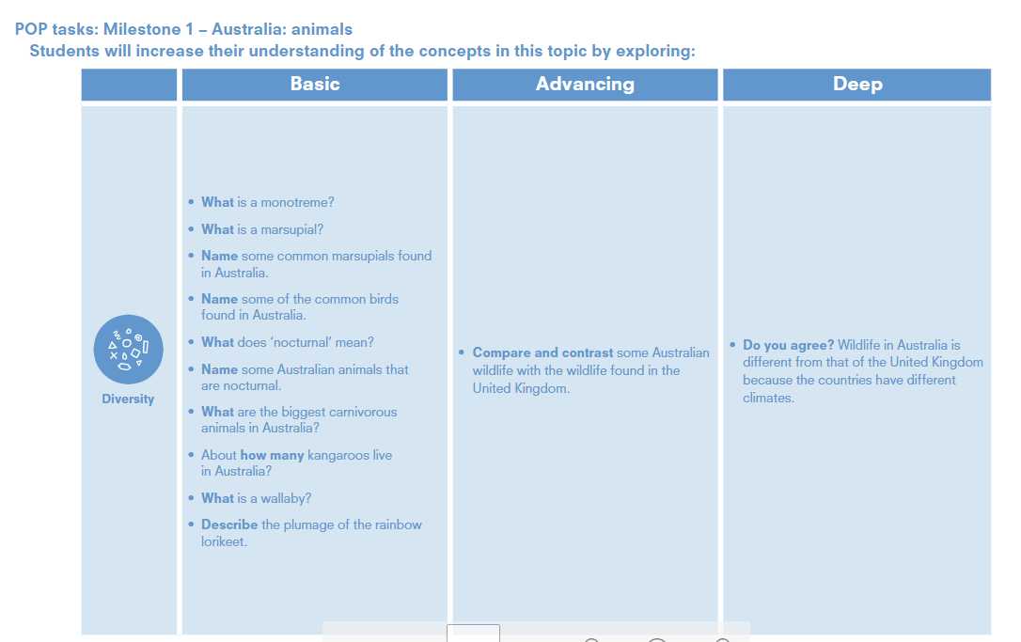

Slide 50
Australia: Animals
Diversity
Year 1 | • What is a monotreme? • What is a marsupial? • Name some common marsupials found in Australia. • Name some of the common birds found in Australia. • What does ‘nocturnal’ mean? • Name some Australian animals that are nocturnal. • What are the biggest carnivorous animals in Australia? • About how many kangaroos live in Australia? • What is a wallaby? • Describe the plumage of the rainbow lorikeet
Year 2 | Compare and contrast some Australiannwildlife with the wildlife found in theUnited Kingdom. • Do you agree? Wildlife in Australia isdifferent from that of the United Kingdom because the countries have different climates.

Slide 52
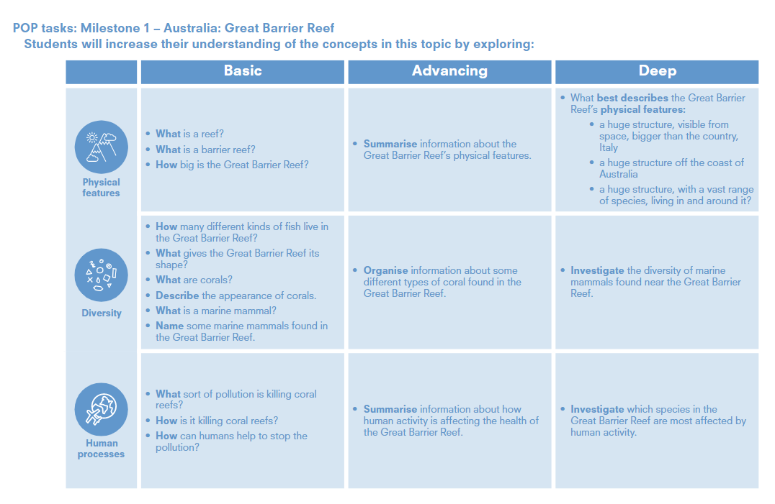

Slide 53
Australia: Great Barrier Reef
Year 1 | What is a reef? • What is a barrier reef? • How big is the Great Barrier Reef? | • How many different kinds of fish live in the Great Barrier Reef? • What gives the Great Barrier Reef its shape? • What are corals? • Describe the appearance of corals. • What is a marine mammal? • Name some marine mammals found in the Great Barrier Reef. | What sort of pollution is killing coral reefs? • How is it killing coral reefs? • How can humans help to stop the pollution?
Year 2 | • Summarise information about the Great Barrier Reef’s physical features. • What best describes the Great Barrier Reef’s physical features: • a huge structure, visible from space, bigger than the country, Italy • a huge structure off the coast of Australia • a huge structure, with a vast range of species, living in and around it? | • Organise information about some different types of coral found in the Great Barrier Reef. Investigate the diversity of marine mammals found near the Great Barrier Reef. | • Summarise information about how human activity is affecting the health of the Great Barrier Reef Investigate which species in the Great Barrier Reef are most affected by human activity.

Slide 54
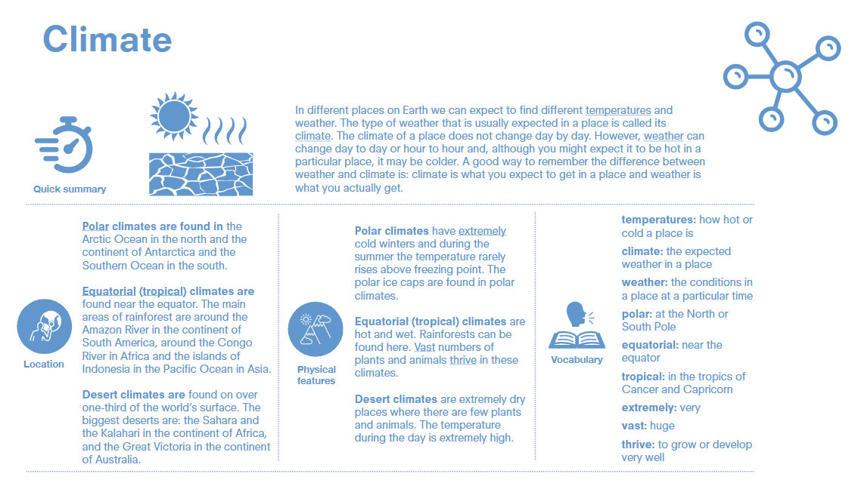

Slide 55
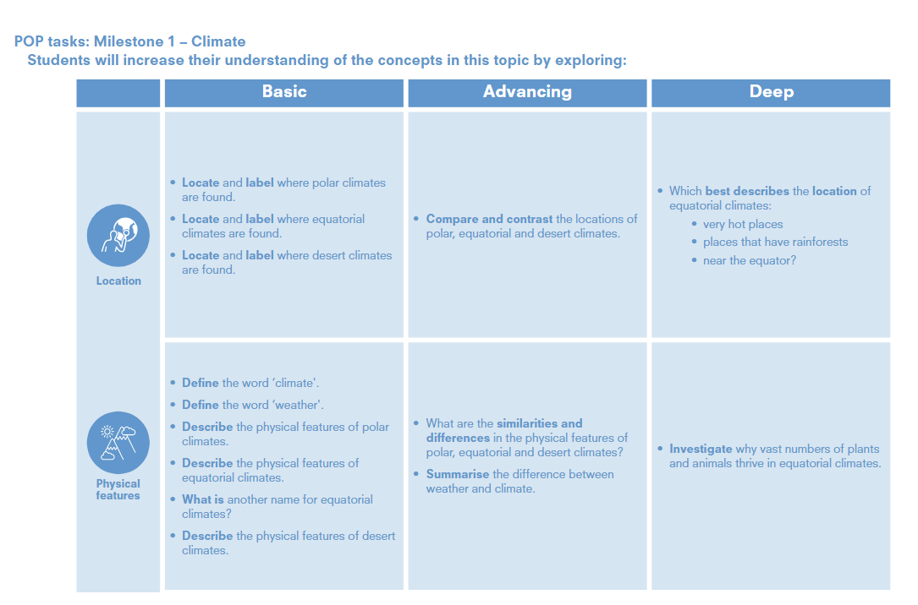

Slide 56
Climate
Location
Year 1 | Locate and label where polar climates are found. • Locate and label where equatorial climates are found. • Locate and label where desert climates are found. | Define the word ‘climate'. • Define the word ‘weather'. • Describe the physical features of polar climates. • Describe the physical features of equatorial climates. • What is another name for equatorial climates? • Describe the physical features of desert climates.
Year 2 | • Compare and contrast the locations of polar, equatorial and desert climates. • Which best describes the location of equatorial climates: • very hot places • places that have rainforests • near the equator? | • What are the similarities anddifferences in the physical features of polar, equatorial and desert climates? • Summarise the difference between weather and climate. • Investigate why vast numbers of plants and animals thrive in equatorial climates.

Slide 57
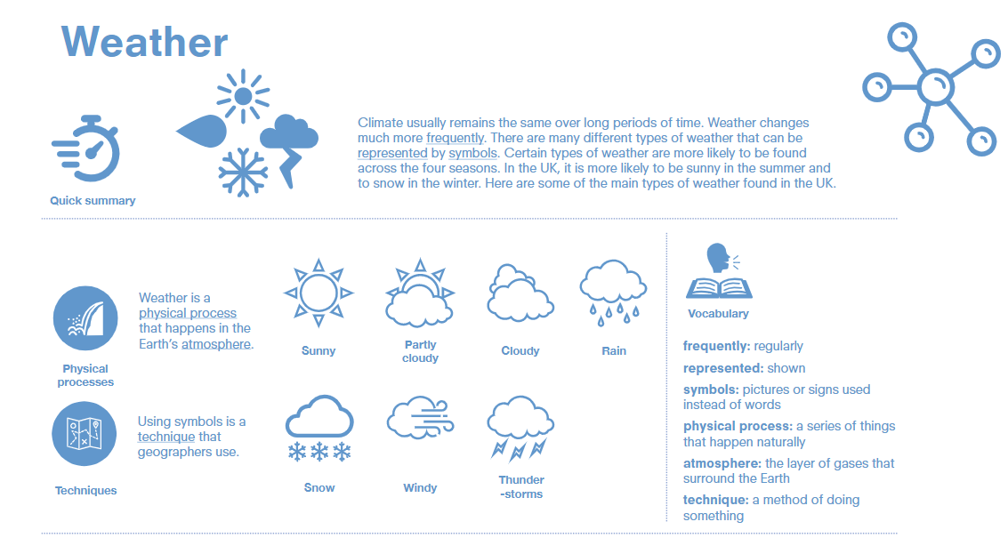

Slide 59
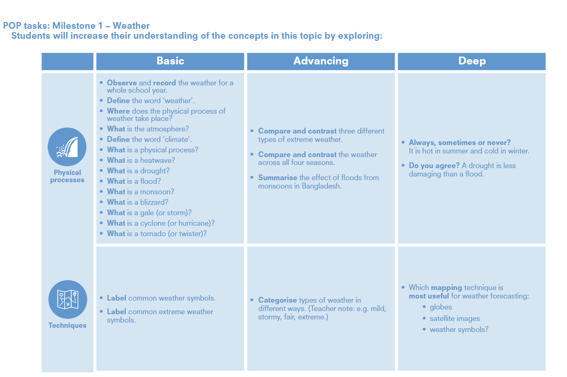

Slide 60
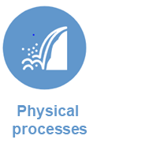
Weather & Extreme weather
Year 1 | • Observe and record the weather for a whole school year. • Define the word ‘weather’. • Where does the physical process of weather take place? • What is the atmosphere? • Define the word ‘climate’. • What is a physical process? • What is a heatwave? • What is a drought? • What is a flood? • What is a monsoon? • What is a blizzard? • What is a gale (or storm)? • What is a cyclone (or hurricane)? • What is a tornado (or twister)? | • Label common weather symbols. • Label common extreme weather symbols.
Year 2 | • Compare and contrast three different types of extreme weather. • Compare and contrast the weather across all four seasons. • Summarise the effect of floods from monsoons in Bangladesh. • Always, sometimes or never? It is hot in summer and cold in winter. • Do you agree? A drought is less damaging than a flood. | Categorise types of weather in different ways. (Teacher note: e.g. mild, stormy, fair, extreme.) • Which mapping technique is most useful for weather forecasting: • globes • satellite images • weather symbols?

