Slide 1
Key Stage 1 Physical Education Curriculum
Together we Nurture, Inspire and Achieve

Slide 2
Physical Education topics overview
Physical Education topics are organised and referenced around a Physical Education schema. Each topic either introduces an aspect of the schema or references previous instances of it. Below is an overview of the topics we teach and which aspects of the schema it strengthens:
Target: Fair and square
Target: Python
Target: Beanbag bocce
Tag: Mr Wolf
Striking and fielding: Give me five
Striking and fielding: All together now
Striking and fielding: Plank and weave
Net and wall: Racket fun
Net and wall: On the spot
Net and wall: Throwing tennis

Slide 3
Invasion: Triangle passing
Invasion: Two on one
Invasion: Dribble and score
Gymnastics: Simple sequence
Gymnastics: Vault
Gymnastics: Apparatus
Dance: Based on a book
Dance: Mystery dance
Dance: Superheroes

Slide 5
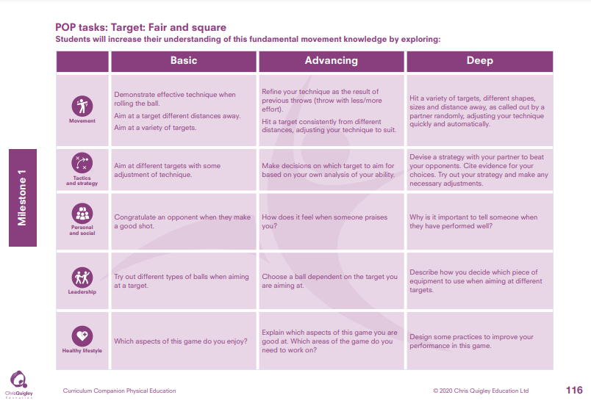

Slide 6
Target: Fair and square
Decide how many lessons you will spend on the topic and use the information on the knowledge web to create the take-aways for each lesson
This table shows the knowledge that will be taught in each lesson
Year 1 | Demonstrate effective technique when rolling the ball. Aim at a target different distances away. Aim at a variety of targets. | Aim at different targets with some adjustment of technique. | Congratulate an opponent when they make a good shot. | Try out different types of balls when aiming at a target. | Which aspects of this game do you enjoy?
Year 2 | Refine your technique as the result of previous throws (throw with less/more effort). Hit a target consistently from different distances, adjusting your technique to suit. Hit a variety of targets, different shapes, sizes and distance away, as called out by a partner randomly, adjusting your technique quickly and automatically. | Make decisions on which target to aim for based on your own analysis of your ability. Devise a strategy with your partner to beat your opponents. Cite evidence for your choices. Try out your strategy and make any necessary adjustments. | How does it feel when someone praises you? Why is it important to tell someone when they have performed well? | Choose a ball dependent on the target you are aiming at. Describe how you decide which piece of equipment to use when aiming at different targets. | Explain which aspects of this game you are good at. Which areas of the game do you need to work on? Design some practices to improve your performance in this game.

Slide 8
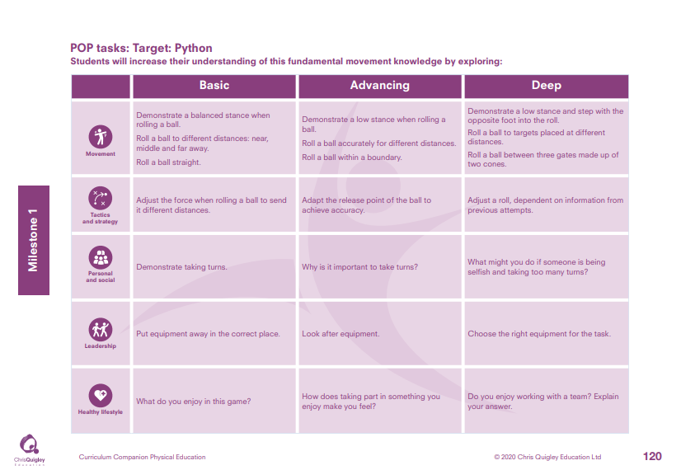

Slide 9
Target: Python
Decide how many lessons you will spend on the topic and use the information on the knowledge web to create the take-aways for each lesson
This table shows the knowledge that will be taught in each lesson
Year 1 | Demonstrate a balanced stance when rolling a ball. Roll a ball to different distances: near, middle and far away. Roll a ball straight | Adjust the force when rolling a ball to send it different distances. | Demonstrate taking turns. | Put equipment away in the correct place. | What do you enjoy in this game?
Year 2 | Demonstrate a low stance when rolling a ball. Roll a ball accurately for different distances. Roll a ball within a boundary. Demonstrate a low stance and step with the opposite foot into the roll. Roll a ball to targets placed at different distances. Roll a ball between three gates made up of two cones. | Adapt the release point of the ball to achieve accuracy. Adjust a roll, dependent on information from previous attempts. | Why is it important to take turns? What might you do if someone is being selfish and taking too many turns? | Look after equipment. Choose the right equipment for the task. | How does taking part in something you enjoy make you feel? Do you enjoy working with a team? Explain your answer.

Slide 10
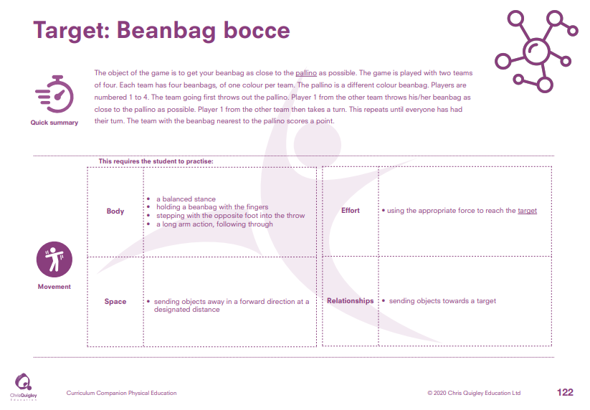

Slide 11
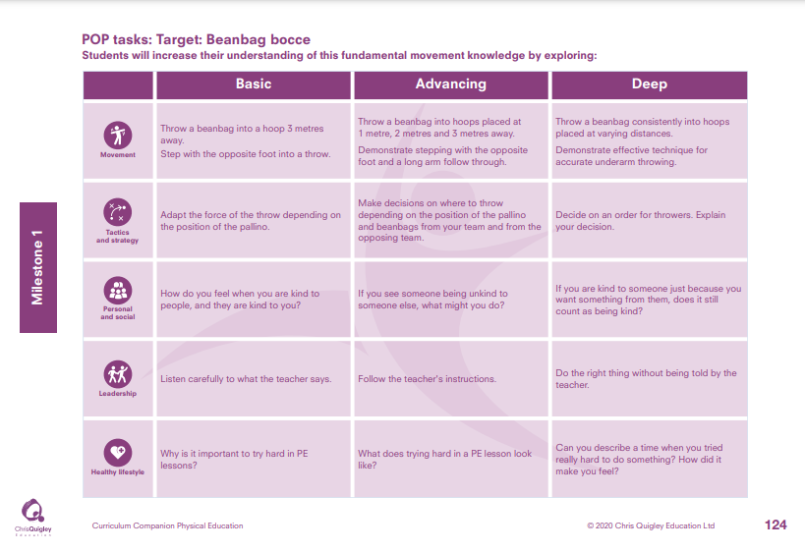

Slide 12
Target: Beanbag bocce
Decide how many lessons you will spend on the topic and use the information on the knowledge web to create the take-aways for each lesson
This table shows the knowledge that will be taught in each lesson
Year 1 | Throw a beanbag into a hoop 3 metres away. Step with the opposite foot into a throw. | Adapt the force of the throw depending on the position of the pallino. | How do you feel when you are kind to people, and they are kind to you? | Listen carefully to what the teacher says. | Why is it important to try hard in PE lessons?
Year 2 | Throw a beanbag into hoops placed at 1 metre, 2 metres and 3 metres away. Demonstrate stepping with the opposite foot and a long arm follow through. Throw a beanbag consistently into hoops placed at varying distances. Demonstrate effective technique for accurate underarm throwing. | Make decisions on where to throw depending on the position of the pallino and beanbags from your team and from the opposing team. Decide on an order for throwers. Explain your decision. | If you see someone being unkind to someone else, what might you do? If you are kind to someone just because you want something from them, does it still count as being kind? | Follow the teacher's instructions. Do the right thing without being told by the teacher. | What does trying hard in a PE lesson look like? Can you describe a time when you tried really hard to d something? How did it make you feel?

Slide 13
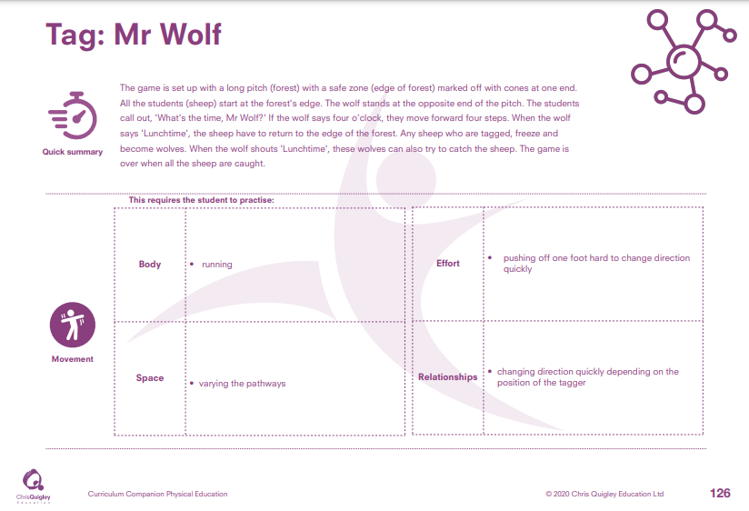

Slide 14
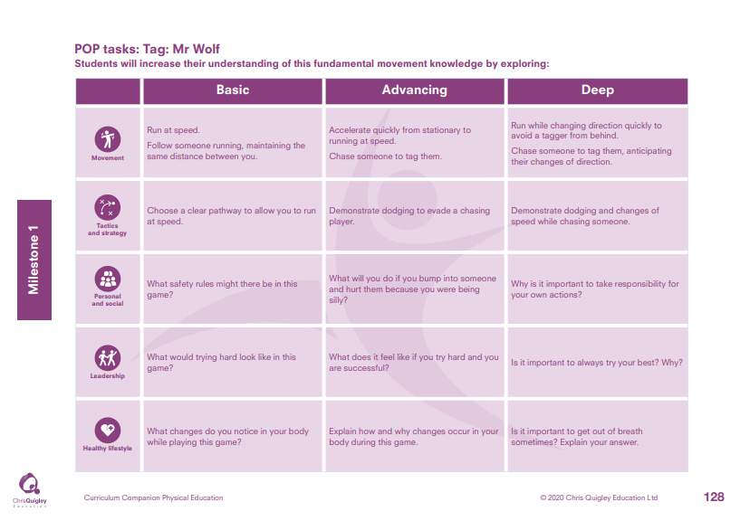

Slide 15
Tag: Mr Wolf
Decide how many lessons you will spend on the topic and use the information on the knowledge web to create the take-aways for each lesson
This table shows the knowledge that will be taught in each lesson
Year 1 | Run at speed. Follow someone running maintaining the same distance between you. | Choose a clear pathway to allow you to run at speed. | What safety rules might there be in this game? | What would trying hard look like in this game? | What changes do you notice in your body while playing this game?
Year 2 | Accelerate quickly from stationary to running at speed. Chase someone to tag them. Run while changing direction quickly to avoid a tagger from behind. Chase someone to tag them, anticipating their changes of direction. | Demonstrate dodging to evade a chasing player. Demonstrate dodging and changes of speed while chasing someone. | What will you do if you bump into someone and hurt them because you were being silly? Why is it important to take responsibility for your own actions? | What does it feel like if you try hard and you are successful? Is it important to always try your best? Why? | Explain how and why changes occur in your body during this game. Is it important to get out of breath sometimes? Explain your answer

Slide 16
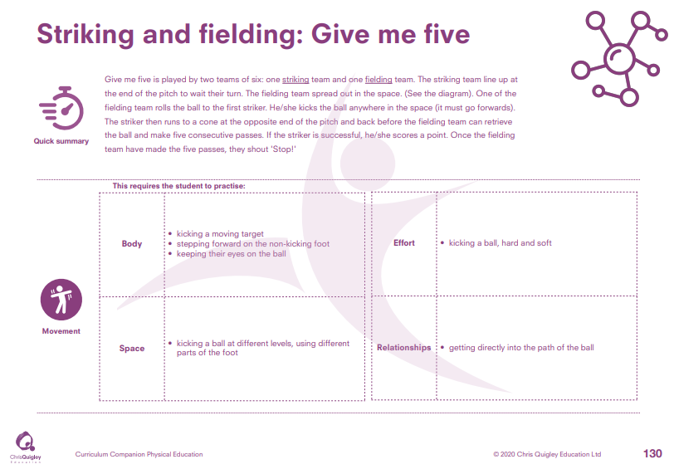

Slide 17
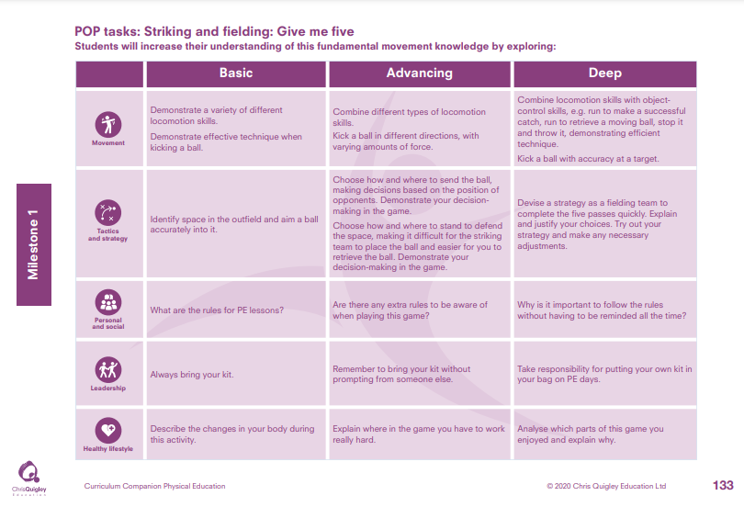

Slide 18
Striking and fielding: Give me five.
Decide how many lessons you will spend on the topic and use the information on the knowledge web to create the take-aways for each lesson
This table shows the knowledge that will be taught in each lesson
Year 1 | Demonstrate a variety of different locomotion skills. Demonstrate effective technique when kicking a ball. | Identify space in the outfield and aim a ball accurately into it. | What are the rules for PE lessons? | Always bring your kit. | Describe the changes in your body during this activity.
Year 2 | Combine different types of locomotion skills. Kick a ball in different directions, with varying amounts of force. Combine locomotion skills with object control skills, e.g. run to make a successful catch, run to retrieve a moving ball, stop it and throw it demonstrating efficient technique. Kick a ball with accuracy at a target. | Choose how and where to send the ball, making decisions based on the position of opponents. Demonstrate your decision-making in the game. Choose how and where to stand to defend the space, making it difficult for the striking team to place the ball and easier for you to retrieve the ball Demonstrate your decision-making in the game. Devise a strategy as a fielding team to complete the five passes quickly. Explain and justify your choices. Try out your strategy and make any necessary adjustments. | Are there any extra rules to be aware of when playing this game? Why is it important to follow the rules without having to be reminded all the time? | Remember to bring your kit without prompting from someone else. Take responsibility for putting your own kit in your bag on PE days. | Explain where in the game you have to work really hard. Analyse which parts of this game you enjoyed and explain why.

Slide 20
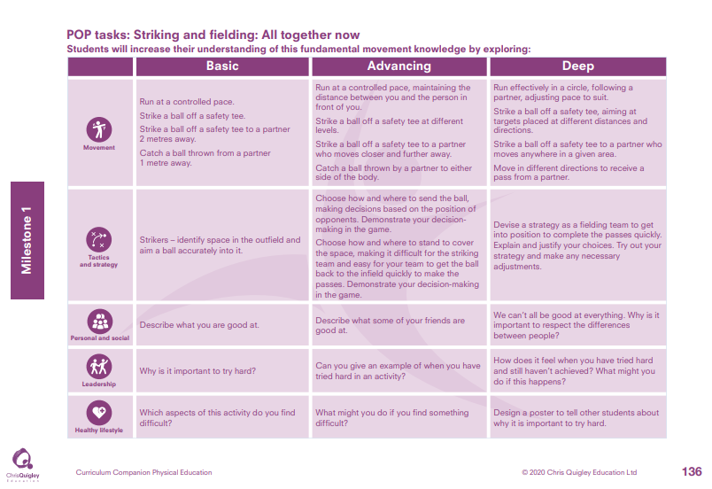

Slide 21
Striking and fielding: All together now.
Decide how many lessons you will spend on the topic and use the information on the knowledge web to create the take-aways for each lesson
This table shows the knowledge that will be taught in each lesson
Year 1 | Run at a controlled pace. Strike a ball off a safety tee. Strike a ball off a safety tee to a partner 2 metres away. Catch a ball thrown from a partner 1 metre away. | Strikers – identify space in the outfield and aim a ball accurately into it. | Describe what you are good at. | Why is it important to try hard? | Which aspects of this activity do you find difficult?
Year 2 | Run at a controlled pace, maintaining the distance between you and the person in front of you. Strike a ball off a safety tee at different levels. Strike a ball off a safety tee to a partner who moves closer and further away. Catch a ball thrown by a partner to either side of the body. Run effectively in a circle, following a partner, adjusting pace to suit. Strike a ball off a safety tee, aiming at targets placed at different distances and directions. Strike a ball off a safety tee to a partner who moves anywhere in a given area. Move in different directions to receive a pass from a partner. | Choose how and where to send the ball, making decisions based on the position of opponents. Demonstrate your decision-making in the game. Choose how and where to stand to cover the space, making it difficult for the striking team and easy for your team to get the ball back to the infield quickly to make the passes. Demonstrate your decision-making in the game. Devise a strategy as a fielding team to get into position to complete the passes quickly. Explain and justify your choices. Try out your strategy and make any necessary adjustments. | Describe what some of your friends are good at. We can’t all be good at everything. Why is it important to respect the differences between people? | Can you give an example of when you have tried hard in an activity? How does it feel when you have tried hard and still haven’t achieved? What might you do if this happens? | What might you do if you find something difficult? Design a poster to tell other students about why it is important to try hard.

Slide 22
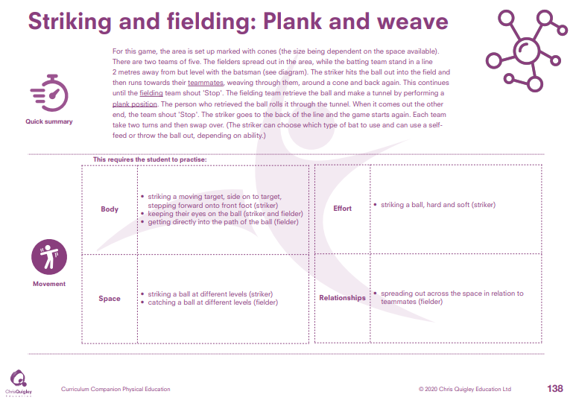

Slide 23
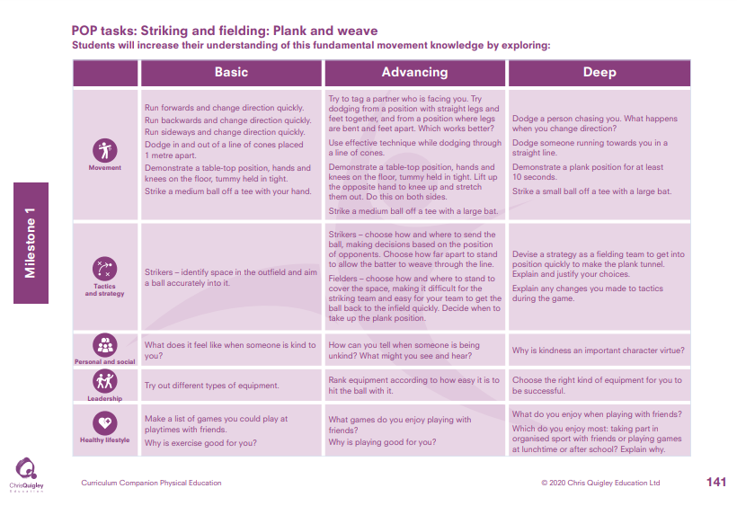

Slide 24
Striking and fielding: Plank and weave.
Decide how many lessons you will spend on the topic and use the information on the knowledge web to create the take-aways for each lesson
This table shows the knowledge that will be taught in each lesson
Year 1 | Run forwards and change direction quickly. Run backwards and change direction quickly. Run sideways and change direction quickly. Dodge in and out of a line of cones placed 1 metre apart. Demonstrate a table-top position, hands and knees on the floor, tummy held in tight. Strike a medium ball off a tee with your hand. | Strikers – identify space in the outfield and aim a ball accurately into it. | What does it feel like when someone is kind to you? | Try out different types of equipment. | Make a list of games you could play at playtimes with friends. Why is exercise good for you?
Year 2 | Try to tag a partner who is facing you. Try dodging from a position with straight legs and feet together, and from a position where legs are bent and feet apart. Which works better? Use effective technique while dodging through a line of cones. Demonstrate a table-top position, hands and knees on the floor, tummy held in tight. Lift up the opposite hand to knee up and stretch them out. Do this on both sides. Strike a medium ball off a tee with a large bat. Dodge a person chasing you. What happens when you change direction? Dodge someone running towards you in a straight line. Demonstrate a plank position for at least 10 seconds. Strike a small ball off a tee with a large bat | Strikers – choose how and where to send the ball, making decisions based on the position of opponents Choose how far apart to stand to allow the batter to weave through the line. Fielders – choose how and where to stand to cover the space, making it difficult for the striking team and easy for your team to get the ball back to the infield quickly. Decide when to take up the plank position. Devise a strategy as a fielding team to get into position quickly to make the plank tunnel. Explain and justify your choices. Explain any changes you made to tactics during the game. | How can you tell when someone is being unkind? What might you see and hear? Why is kindness an important character virtue? | Rank equipment according to how easy it is to hit the ball with it. Choose the right kind of equipment for you to be successful. | What games do you enjoy playing with friends? Why is playing good for you? What do you enjoy when playing with friends? Which do you enjoy most: taking part in organised sport with friends or playing games at lunchtime or after school? Explain why.

Slide 26
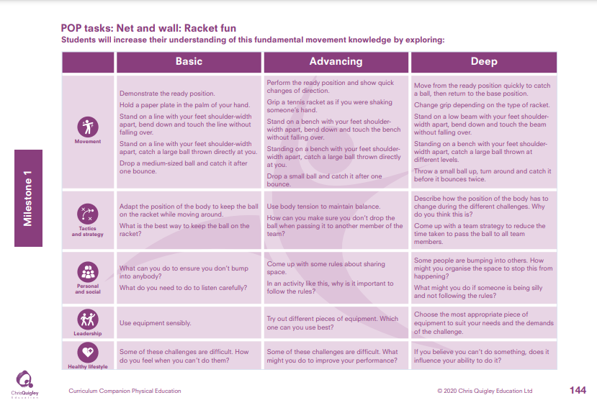

Slide 27
Net and wall: Racket fun.
Decide how many lessons you will spend on the topic and use the information on the knowledge web to create the take-aways for each lesson
This table shows the knowledge that will be taught in each lesson
Year 1 | Demonstrate the ready position. Hold a paper plate in the palm of your hand. Stand on a line with your feet shoulder-width apart, bend down and touch the line without falling over. Stand on a line with your feet shoulder-width apart, catch a large ball thrown directly a you. Drop a medium-sized ball and catch it after one bounce. | Adapt the position of the body to keep the ball on the racket while moving around. What is the best way to keep the ball on the racket? | What can you do to ensure you don’t bump into anybody? What do you need to do to listen carefully? | Use equipment sensibly. | Some of these challenges are difficult. How do you feel when you can’t do them?
Year 2 | Perform the ready position and show quick changes of direction. Grip a tennis racket as if you were shaking someone’s hand. Stand on a bench with your feet shoulder-width apart, bend down and touch the bench without falling over. Standing on a bench with your fee shoulder-width apart, catch a large ball thrown directly at you. Drop a small ball and catch it after one bounce. Move from the ready position quickly to catch a ball, then return to the base position. Change grip depending on the type of racket. Stand on a low beam with your feet shoulder-width apart, bend down and touch the beam without falling over. Standing on a bench with your feet shoulder-width apart, catch a large ball thrown at different levels. Throw a small ball up, turn around and catch it before it bounces twice. | Use body tension to maintain balance. How can you make sure you don’t drop the ball when passing it to another member of the team? Describe how the position of the body has to change during the different challenges. Why do you think this is? Come up with a team strategy to reduce the time taken to pass the ball to all team members. | Come up with some rules about sharing space. In an activity like this, why is it important to follow the rules? Some people are bumping into others. How might you organise the space to stop this from happening? What might you do if someone is being silly and not following the rules? | Try out different pieces of equipment. Which one can you use best? Choose the most appropriate piece of equipment to suit your needs and the demands of the challenge. | Some of these challenges are difficult. What might you do to improve your performance? If you believe you can’t do something, does it influence your ability to do it?

Slide 29
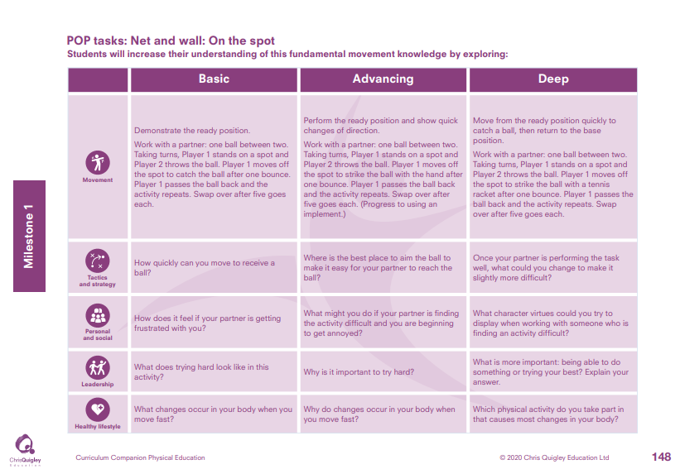

Slide 30
Net and wall: On the spot.
Decide how many lessons you will spend on the topic and use the information on the knowledge web to create the take-aways for each lesson
This table shows the knowledge that will be taught in each lesson
Year 1 | Demonstrate the ready position. Work with a partner: one ball between two. Taking turns, Player 1 stands on a spot and Player 2 throws the ball. Player 1 moves off the spot to catch the ball after one bounce. Player 1 passes the ball back and the activity repeats. Swap over after five goes each. | How quickly can you move to receive a ball? | How does it feel if your partner is getting frustrated with you? | What does trying hard look like in this activity? | What changes occur in your body when you move fast?
Year 2 | Perform the ready position and show quick changes of direction. Work with a partner: one ball between two. Taking turns, Player 1 stands on a spot and Player 2 throws the ball. Player 1 moves off the spot to strike the ball with the hand after one bounce. Player 1 passes the ball back and the activity repeats. Swap over after five goes each. (Progress to using an implement.) Move from the ready position quickly to catch a ball, then return to the base position. Work with a partner: one ball between two. Taking turns, Player 1 stands on a spot and Player 2 throws the ball. Player 1 moves off the spot to strike the ball with a tennis racket after one bounce. Player 1 passes the ball back and the activity repeats. Swap over after five goes each. | Where is the best place to aim the ball to make it easy for your partner t reach the ball? Once your partner is performing the task well, what could you change to make it slightly more difficult? | What might you do if your partner is finding the activity difficult and you are beginning to get annoyed? What character virtues could you try to display when working with someone who is finding an activity difficult? | Why is it important to try hard? What is more important: being able to do something or trying your best? Explain your answer. | Why do changes occur in your body when you move fast? Which physical activity do you take part in that causes most changes in your body?

Slide 32
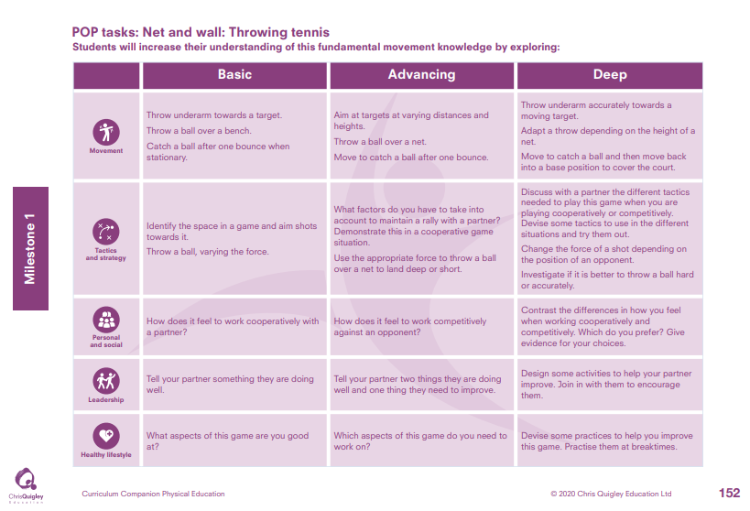

Slide 33
Net and wall: Throwing tennis.
Decide how many lessons you will spend on the topic and use the information on the knowledge web to create the take-aways for each lesson
This table shows the knowledge that will be taught in each lesson
Year 1 | Throw underarm towards a target. Throw a ball over a bench. Catch a ball after one bounce when stationary | Identify the space in a game and aim shots towards it. Throw a ball, varying the force. | How does it feel to work cooperatively with a partner? | Tell your partner something they are doing well. | What aspects of this game are you good at?
Year 2 | Aim at targets at varying distances and heights. Throw a ball over a net. Move to catch a ball after one bounce. Throw underarm accurately towards a moving target. Adapt a throw depending on the height of a net. Move to catch a ball and then move back into a base position to cover the court. | What factors do you have to take into account to maintain a rally with a partner? Demonstrate this in cooperative game situation. Use the appropriate force to throw a ball over a net to land deep or short. Discuss with a partner the different tactics needed to play this game when you are playing cooperatively or competitively. Devise some tactics to use in the different situations and try them out. Change the force of a shot depending on the position of an opponent. Investigate if it is better to throw a ball hard or accurately. | How does it feel to work competitively against an opponent? Contrast the differences in how you feel when working cooperatively and competitively. Which do you prefer? Give evidence for your choices. | Tell your partner two things they are doing well and one thing they need to improve. Design some activities to help your partner improve. Join in with them to encourage them. | Which aspects of this game do you need to work on? Devise some practices to help you improve this game. Practise them at breaktimes.

Slide 35
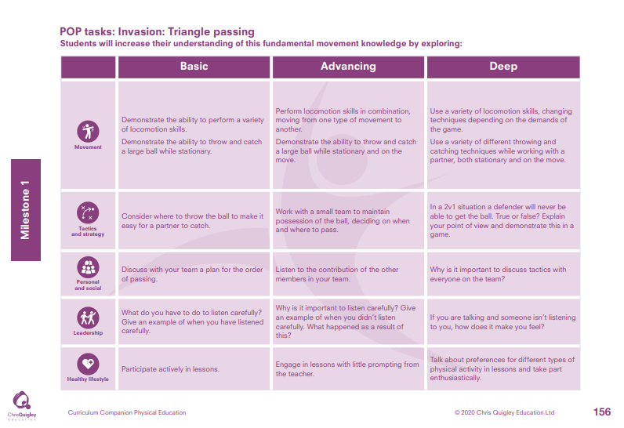

Slide 36
Invasion: Triangle passing.
Decide how many lessons you will spend on the topic and use the information on the knowledge web to create the take-aways for each lesson
This table shows the knowledge that will be taught in each lesson
Year 1 | Demonstrate the ability to perform variety of locomotion skills. Demonstrate the ability to throw and catch a large ball while stationary. | Consider where to throw the ball to make it easy for a partner to catch. | Discuss with your tea a plan for the order of passing. | What do you have to d to listen carefully? Give an example o when you have listened carefully. | Participate actively in lessons.
Year 2 | Perform locomotion skills in combination, moving from one type of movement to another. Demonstrate the ability to throw and catch a large ball while stationary and on the move. Use a variety of locomotion skills, changing techniques depending on the demands of the game. Use a variety of different throwing and catching techniques while working with a partner, both stationary and on the move. | Work with a small team to maintain possession of the ball, deciding on when and where to pass. In a 2v1 situation a defender will never be able to get the ball. True or false? Explain your point of view and demonstrate this in a game. | Listen to the contribution of the other members in your team. Why is it important to discuss tactics with everyone on the team? | Why is it important to listen carefully? Give an example of when you didn’t listen carefully. What happened as a result of this? If you are talking and someone isn’t listening to you, how does it make you feel? | Engage in lessons with little prompting from the teacher. Talk about preferences for different types of physical activity in lessons and take part enthusiastically.

Slide 38
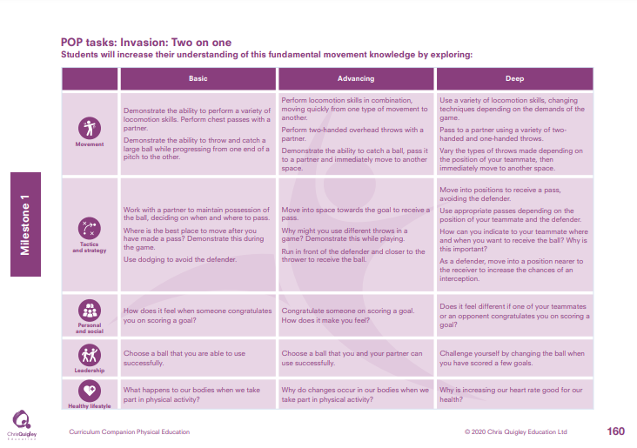

Slide 39
Invasion: Two on one.
Decide how many lessons you will spend on the topic and use the information on the knowledge web to create the take-aways for each lesson
This table shows the knowledge that will be taught in each lesson
Year 1 | Demonstrate the ability to perform a variety of locomotion skills. Perform chest passes with a partner. Demonstrate the ability to throw and catch a large ball while progressing from one end of a pitch to the other. | Work with a partner to maintain possession of the ball, deciding on when and where to pass. Where is the best place to move after you have made a pass? Demonstrate this during the game. Use dodging to avoid the defender. | How does it feel when someone congratulates you on scoring a goal? | Choose a ball that you are able to use successfully. | What happens to our bodies when we take part in physical activity?
Year 2 | Perform locomotion skills in combination, moving quickly from one type of movement to another. Perform two-handed overhead throws with a partner. Demonstrate the ability to catch a ball, pass it to a partner and immediately move to another space. Use a variety of locomotion skills, changing techniques depending on the demands of the game. Pass to a partner using a variety of twohanded and one-handed throws. Vary the types of throws made depending on the position of your teammate, then immediately move to another space. | Move into space towards the goal to receive a pass. Why might you use different throws in a game? Demonstrate this while playing. Run in front of the defender and closer to the thrower to receive the ball. Move into positions to receive a pass, avoiding the defender. Use appropriate passes depending on the position of your teammate and the defender. How can you indicate to your teammate where and when you want to receive the ball? Why is this important? As a defender, move into a position nearer to the receiver to increase the chances of an interception. | Congratulate someone on scoring a goal. How does it make you feel? Does it feel different if one of your teammates or an opponent congratulates you on scoring a goal? | Choose a ball that you and your partner can use successfully. Challenge yourself by changing the ball when you have scored a few goals. | Why do changes occur in our bodies when we take part in physical activity? Why is increasing our heart rate good for our health?

Slide 41
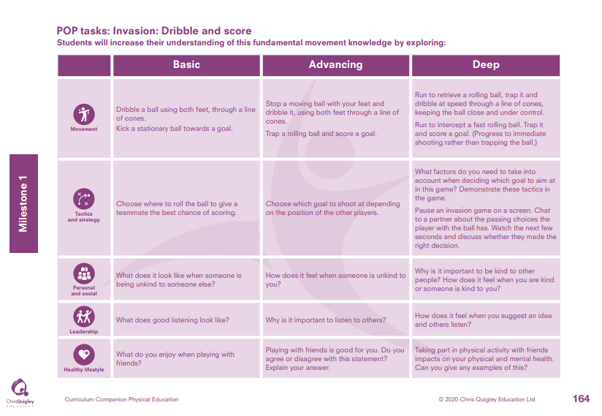

Slide 42
Invasion: Dribble and score.
Decide how many lessons you will spend on the topic and use the information on the knowledge web to create the take-aways for each lesson
This table shows the knowledge that will be taught in each lesson
Year 1 | Dribble a ball using both feet, through a line of cones. Kick a stationary ball towards a goal. | Choose where to roll the ball to give a teammate the best chance of scoring. | What does it look like when someone is being unkind to someone else? | What does good listening look like? | What do you enjoy when playing with friends?
Year 2 | Stop a moving ball with your feet and dribble it, using both feet through a line of cones. Trap a rolling ball and score a goal. Run to retrieve a rolling ball, trap it and dribble at speed through a line o cones, keeping the ball close and under control. Run to intercept a fast rolling ball. Trap it and score a goal. (Progress to immediate shooting rather than trapping th ball.) | Choose which goal to shoot at depending on the position of the other players. What factors do you need to take into account when deciding which goal to aim at in this game? Demonstrate these tactics in the game. Pause an invasion game on a screen. Chat to a partner about the passing choices the player with the ball has. Watch the next few seconds and discuss whether they made the right decision. | How does it feel when someone is unkind to you? Why is it important to be kind to other people? How does it feel when you are kind or someone is kind to you? | Why is it important to listen to others? How does it feel when you suggest an idea and others listen? | Playing with friends is good for you. Do you agree or disagree with this statement? Explain your answer. Taking part in physical activity with friends impacts on your physical and mental health. Can you give any examples of this?

Slide 44
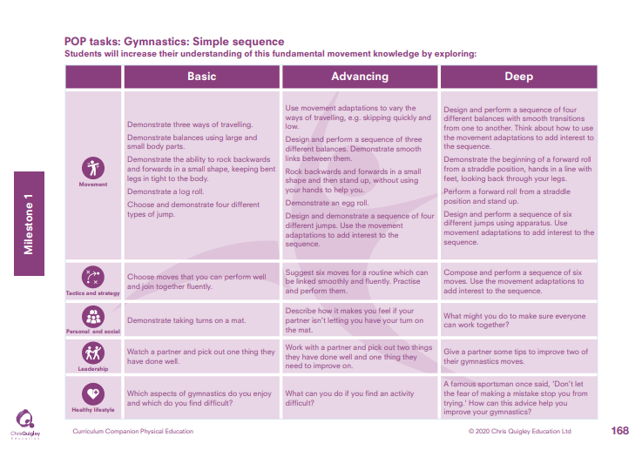

Slide 45
Gymnastics: Simple sequence.
Decide how many lessons you will spend on the topic and use the information on the knowledge web to create the take-aways for each lesson
This table shows the knowledge that will be taught in each lesson
Year 1 | Demonstrate three ways of travelling. Demonstrate balances using large and small body parts. Demonstrate the ability to rock backwards and forwards in a small shape, keeping bent legs in tight to the body. Demonstrate a log roll. Choose and demonstrate four different types of jump. | Choose moves that you can perform well and join together fluently. | Demonstrate taking turns on a mat. | Watch a partner and pick out one thing they have done well. | Which aspects of gymnastics do you enjoy and which do you find difficult?
Year 2 | Use movement adaptations to vary the ways of travelling, e.g. skipping quickly and low. Design and perform a sequence of three different balances. Demonstrate smooth links between them. Rock backwards and forwards in a small shape and then stand up, without using your hands to help you. Demonstrate an egg roll. Design and demonstrate a sequence of four different jumps. Use the movement adaptations to add interest to the sequence. Design and perform a sequence of four different balances with smooth transitions from one to another. Think about how to use the movement adaptations to add interest to the sequence. Demonstrate the beginning of a forward roll from a straddle position, hands in a line with feet, looking back through your legs. Perform a forward roll from a straddle position and stand up. Design and perform a sequence of six different jumps using apparatus. Use movement adaptations to add interest to the sequence. | Suggest six moves for a routine which can be linked smoothly and fluently. Practise and perform them. Compose and perform a sequence of six moves. Use the movement adaptations to add interest to the sequence. | Describe how it makes you feel if your partner isn’t letting you have your turn on the mat. What might you do to make sure everyone can work together? | Work with a partner and pick out two things they have done well and one thing they need to improve on. Give a partner some tips to improve two of their gymnastics moves. | What can you do if you find an activity difficult? A famous sportsman once said, 'Don’t let the fear of making a mistake stop you from trying.' How can this advice help you improve your gymnastics?

Slide 47
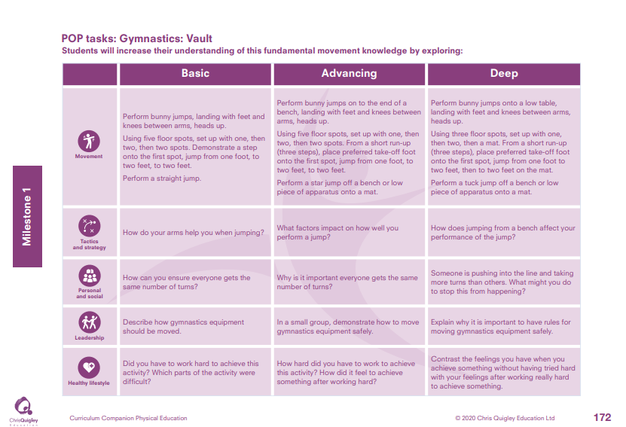

Slide 48
Gymnastics: Vault.
Decide how many lessons you will spend on the topic and use the information on the knowledge web to create the take-aways for each lesson
This table shows the knowledge that will be taught in each lesson
Year 1 | Perform bunny jumps, landing with feet and knees between arms, heads up. Using five floor spots, set up with one, then two, then two spots. Demonstrate a step onto the first spot, jump from one foot, to two feet, to two feet. Perform a straight jump. | How do your arms help you when jumping? | How can you ensure everyone gets the same number of turns? | Describe how gymnastics equipment should be moved. | Did you have to work hard to achieve this activity? Which parts of the activity were difficult?
Year 2 | Perform bunny jumps on to the end of a bench, landing with feet and knees between arms, heads up. Using five floor spots, set up with one, then two, then two spots. From a short run-up (three steps), place preferred take-off foot onto the first spot, jump from one foot, to two feet, to two feet. Perform a star jump off a bench or low piece of apparatus onto a mat. Perform bunny jumps onto a low table, landing with feet and knees between arms, heads up. Using three floor spots, set up with one, then two, then a mat. From a short run-up (three steps), place preferred take-off foot onto the first spot, jump from one foot to two feet, then to two feet on the mat. Perform a tuck jump off a bench or low piece of apparatus onto a mat. | What factors impact on how well you perform a jump? How does jumping from a bench affect you performance of the jump? | Why is it important everyone gets the same number of turns? Someone is pushing into the line and taking more turns than others What might you do to stop this from happening? | In a small group, demonstrate how to move gymnastics equipment safely. Explain why it is important to have rules for moving gymnastics equipment safely. | How hard did you have to work to achieve this activity? How did it feel to achieve something after working hard? Contrast the feelings you have when you achieve something without having tried hard with your feelings after working really hard to achieve something.

Slide 51
Gymnastics: Apparatus.
Decide how many lessons you will spend on the topic and use the information on the knowledge web to create the take-aways for each lesson
This table shows the knowledge that will be taught in each lesson
Year 1 | Perform a balance on a piece of apparatus. Perform a jump using apparatus: on, off or along. Use apparatus to demonstrate weight on hands. Compose a sequence of six movements using apparatus. | Choose which movements you will perform on apparatus. | What are the rules about sharing apparatus? | Choose which pieces of apparatus are most suitable for you.
Year 2 | Perform three balances on different pieces of apparatus, using a variety of body parts. Perform three jumps using different pieces of apparatus: on, off or along. Use different pieces of apparatus to demonstrate weight on hands. Compose a sequence of six movements using apparatus, linked with different ways of travelling. Choose and perform a balance specifically adapted to that piece of apparatus. Choose and perform jumps specifically chosen for a piece of apparatus: on, off or along. Use a specific type of apparatus to demonstrate different ways of taking weight on hands, including inversion. Plan a route around a room set up with different apparatus (e.g. benches, mats, gymnastics tables). Demonstrate six movements from the five categories, using different movement adaptations. Discuss with a partner your choices and refine your sequence. | Try out performing different types of movement on different pieces of apparatus. Use your findings to compose an effective sequence. Evaluate the movements you can perform most successfully and combine them into a sequence. | How can you ensure you share apparatus fairly? Evaluate any areas where congestion might occur in the apparatus set up. What might you do to avoid this? | Choose apparatus to suit the gymnastic moves you intend to use in your sequence. Evaluate which piece of apparatus provides the most opportunities for you to experiment with different movements.

Slide 53
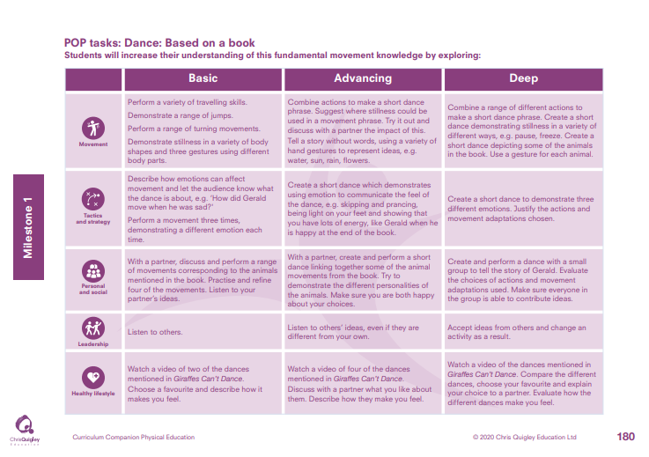

Slide 54
Dance: Based on a book.
Decide how many lessons you will spend on the topic and use the information on the knowledge web to create the take-aways for each lesson
This table shows the knowledge that will be taught in each lesson
Year 1 | Perform a variety of travelling skills. Demonstrate a range of jumps. Perform a range of turning movements. Demonstrate stillness in a variety of body shapes and three gestures using different body parts. | Describe how emotions can affect movement and let the audience know what the dance is about, e.g. ‘How did Gerald move when he was sad?' Perform a movement three times, demonstrating a different emotion each time. | With a partner, discuss and perform a range of movements corresponding to the animals mentioned in the book. Practise and refine four of the movements. Listen to your partner’s ideas. | Listen to others. | Watch a video of two of the dances mentioned InGiraffes Can’t Dance. Choose a favourite and describe how it makes you feel.
Year 2 | Combine actions to make a short dance phrase. Suggest where stillness could be used in a movement phrase. Try it out and discuss with a partner the impact of this. Tell a story without words, using a variety of hand gestures to represent ideas, e.g. water, sun, rain, flowers. Combine a range of different actions to make a short dance phrase. Create a short dance demonstrating stillness in a variety of different ways, e.g. pause, freeze. Create a short dance depicting some of the animals in the book. Use a gesture for each animal. | Create a short dance which demonstrates using emotion to communicate the feel of the dance, e.g. skipping and prancing, being light on your feet and showing that you have lots of energy, like Gerald when he is happy at the end of the book. Create a short dance to demonstrate three different emotions. Justify the actions and movement adaptations chosen. | With a partner, create and perform a short dance linking together some of the animal movements from the book. Try to demonstrate the different personalities of the animals. Make sure you are both happy about your choices. Create and perform a dance with a small group to tell the story of Gerald. Evaluate the choices of actions and movement adaptations used. Make sure everyone in the group is able to contribute ideas. | Listen to others’ ideas, even if they are different from your own. Accept ideas from others and change an activity as a result. | Watch a video of four of the dances mentioned in Giraffes Can’t Dance. Discuss with a partner what you like about them. Describe how they make you feel. Watch a video of the dances mentioned in Giraffes Can’t Dance. Compare the different dances, choose your favourite and explain your choice to a partner. Evaluate how the different dances make you feel.

Slide 55
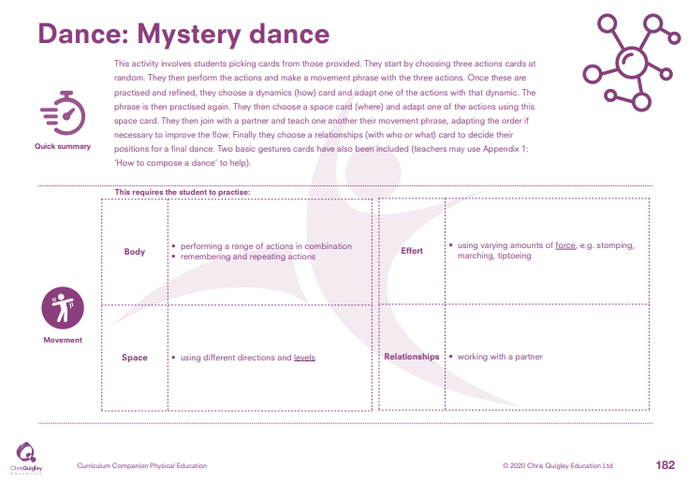

Slide 56
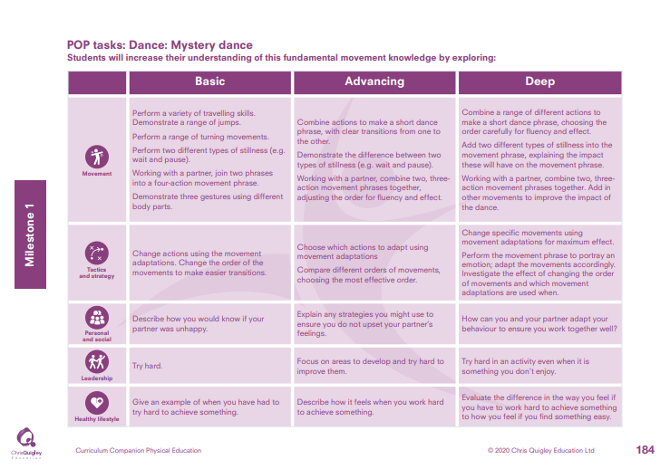

Slide 57
Dance: Mystery dance.
Decide how many lessons you will spend on the topic and use the information on the knowledge web to create the take-aways for each lesson
This table shows the knowledge that will be taught in each lesson
Year 1 | Perform a variety of travelling skills. Demonstrate a range of jumps. Perform a range of turning movements. Perform two different types of stillness (e.g. wait and pause). Working with a partner, join two phrases into a four-action movement phrase. Demonstrate three gestures using different body parts. | Change actions using the movement adaptations. Change the order of the movements to make easier transitions. | Describe how you would know if your partner was unhappy. | Try hard. | Give an example of when you have had to try hard to achieve something.
Year 2 | Combine actions to make a short dance phrase, with clear transitions from one to the other. Demonstrate the difference between two types of stillness (e.g. wait and pause). Working with a partner, combine two, three action movement phrases together, adjusting the order for fluency and effect. Combine a range of different actions to make a short dance phrase, choosing the order carefully for fluency an effect. Add two different types of stillness into the movement phrase, explaining the impact these will have on the movement phrase. Working with a partner, combine two, three action movement phrases together. Add in other movements to improve the impact of the dance. | Choose which actions to adapt using movement adaptations Compare different orders of movements, choosing the most effective order. Change specific movements using movement adaptations for maximum effect. Perform the movement phrase to portray an emotion; adapt the movements accordingly. Investigate the effect of changing the order of movements and which movement adaptations are used when. | Explain any strategies you might use to ensure you do not upset your partner’s feelings. How can you and your partner adapt your behaviour to ensure you work together well? | Focus on areas to develop and try hard to improve them. Try hard in an activity even when it is something you don’t enjoy. | Describe how it feels when you work hard to achieve something. Evaluate the difference in the way you feel if you have to work hard to achieve something to how you feel if you find something easy.

Slide 59
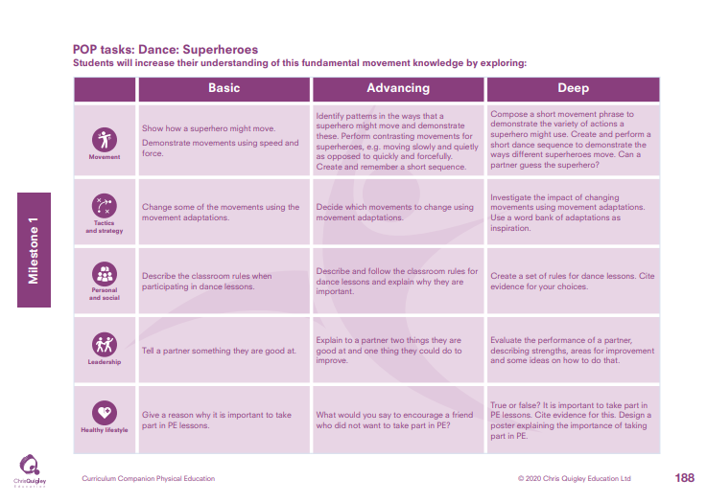

Slide 60
Dance: Superheroes.
Decide how many lessons you will spend on the topic and use the information on the knowledge web to create the take-aways for each lesson
This table shows the knowledge that will be taught in each lesson
Year 1 | Show how a superhero might move. Demonstrate movements using speed and force. | Change some of the movements using the movement adaptations. | Describe the classroom rules when participating in dance lessons. | Tell a partner something they are good at. | Give a reason why it is important to take part in PE lessons.
Year 2 | Identify patterns in the ways that a superhero might move and demonstrate these. Perform contrasting movements for superheroes, e.g. moving slowly and quietly as opposed to quickly and forcefully. Create and remember a short sequence. Compose a short movement phrase to demonstrate the variety of actions a superhero might use. Create and perform a short dance sequence to demonstrate the ways different superheroes move. Can a partner guess the superhero? | Decide which movements to change using movement adaptations. Investigate the impact of changing movements using movement adaptations. Use a word bank of adaptations as inspiration. | Describe and follow the classroom rules for dance lessons and explain why they are important. Create a set of rules for dance lessons. Cite evidence for your choices. | Explain to a partner two things they are good at and one thing they could do to improve. Evaluate the performance of a partner, describing strengths, areas for improvement and some ideas on how to do that. | What would you say to encourage a friend who did not want to take part in PE? True or false? It is important to take part in PE lessons. Cite evidence for this. Design a poster explaining the importance of taking part in PE.

