Slide 1
Lower Key Stage 2 Geography Curriculum
Together we Nurture, Inspire and Achieve

Slide 3
Geography topics overview
Geography topics are organised and referenced around a geographical schema. Each topic either introduces an aspect of the schema or references previous instances of it. Below is an overview of the topics we teach and which aspects of the schema it strengthens:
Location
Physical
features
Human features
Diversity
Physical
processes
Human
processes
Techniques
Describing maps of the world 1, 2 & 3 |  |  |  |  |  |  | .
Europe | . |  |  | .
Europe-population | . | .
Europe-rivers | . |  | . | .
Landscape-rivers |  | . | .
Erosion and deposition-rivers |  |  |  |  | .
Landscape-mountains |  |  |  |  | .
Transportation-national |  |  |  |  |  | . | .
Transportation-international |  |  |  |  |  | .
International trade-food | . |  |  | . |  | .
International trade-natural resources |  | . | . | .
Earthquakes and volcanoes-plate tectonics |  | . |  |  | .
Earthquakes and volcanoes-the Pacific Ring of Fire | . |  |  |  | .
Earthquakes and volcanoes-impact | . |  |  |  | .
The water cycle-the cycle |  |  |  |  | .
The water cycle-clouds and precipitation |  | .

Slide 7
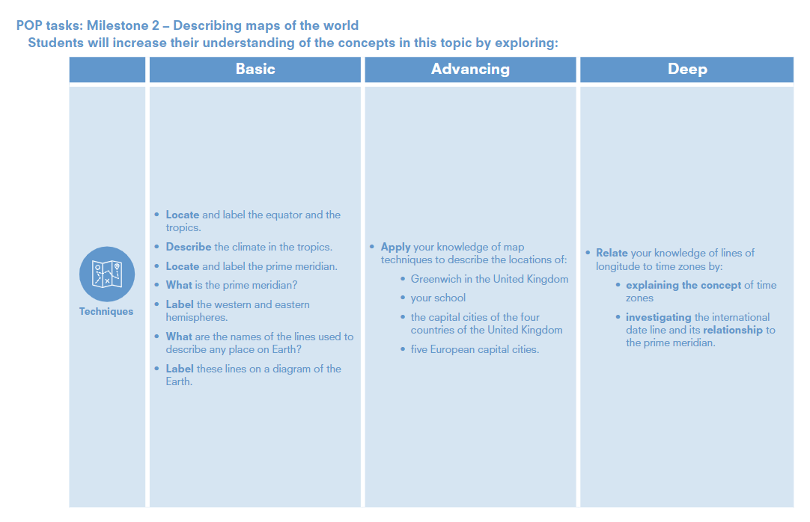

Slide 8
Describing the World
Decide how many lessons you will spend on the topic and use the information on the knowledge web to create the take-aways for each lesson​
This table shows the knowledge that will be taught in each lesson.
Techniques
Year 3 | • Locate and label the equator and the tropics. • Describe the climate in the tropics. • Locate and label the prime meridian. • What is the prime meridian? • Label the western and eastern hemispheres. • What are the names of the lines used to describe any place on Earth? • Label these lines on a diagram of the Earth.
Year 4 | • Apply your knowledge of map techniques to describe the locations of: • Greenwich in the United Kingdom • your school • the capital cities of the four countries of the United Kingdom • five European capital cities. • Relate your knowledge of lines oflongitude to time zones by: • explaining the concept of time zones • investigating the international date line and its relationship to the prime meridian.

Slide 9
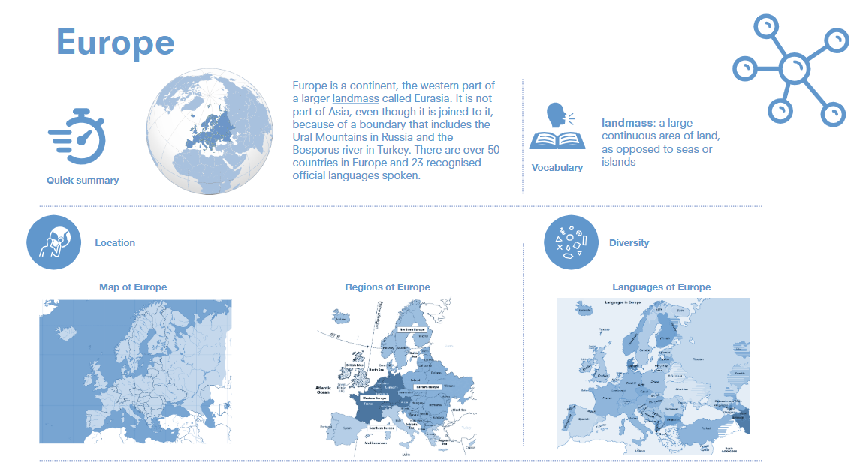

Slide 10
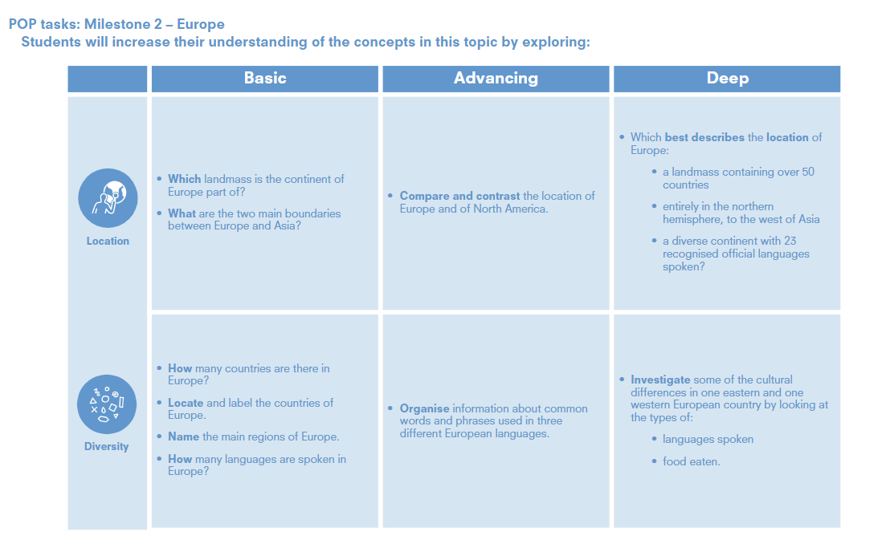

Slide 11
Europe
Location
Year 3 | • Which landmass is the continent of Europe part of? • What are the two main boundaries between Europe and Asia? | • How many countries are there in Europe? • Locate and label the countries of Europe. • Name the main regions of Europe. • How many languages are spoken in Europe?
Year 4 | • Compare and contrast the location of Europe and of North America. • Which best describes the location of Europe: • a landmass containing over 50 countries • entirely in the northern hemisphere, to the west of Asia • a diverse continent with 23 recognised official languages spoken? | Organise information about common words and phrases used in three different European languages • Investigate some of the cultural differences in one eastern and one western European country by looking at the types of: • languages spoken • food eaten. .

Slide 13
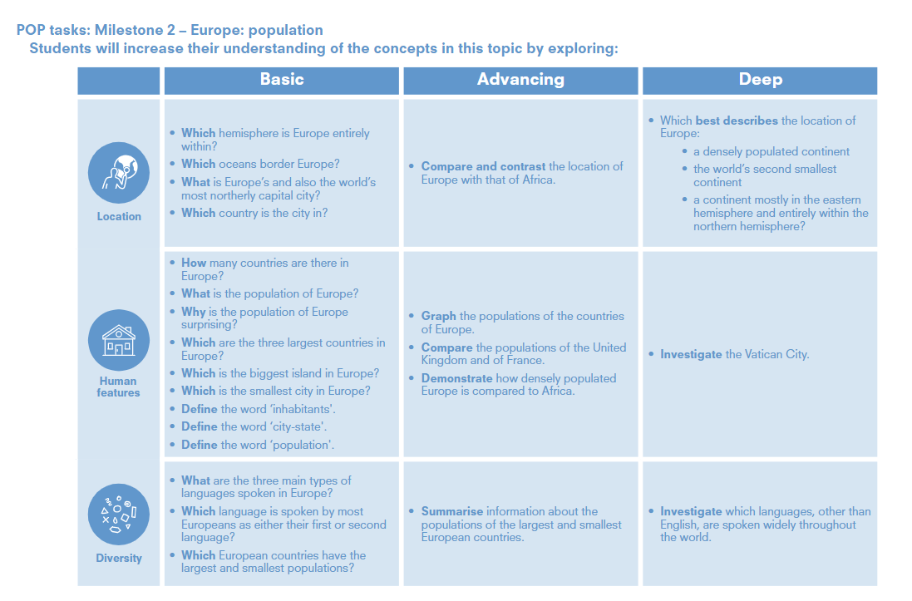

Slide 14
Europe: Population
Year 3 | Which hemisphere is Europe entirely within? • Which oceans border Europe? • What is Europe’s and also the world’s most northerly capital city? • Which country is the city in? | How many countries are there in Europe? • What is the population of Europe? • Why is the population of Europe surprising? • Which are the three largest countries in Europe? • Which is the biggest island in Europe? • Which is the smallest city in Europe? • Define the word ‘inhabitants'. • Define the word ‘city-state'. • Define the word ‘population'. | • What are the three main types of languages spoken in Europe? • Which language is spoken by most Europeans as either their first or second language? • Which European countries have the largest and smallest populations?
Year 4 | Compare and contrast the location of Europe with that of Africa. • Which best describes the location of Europe: • a densely populated continent • the world’s second smallest continent • a continent mostly in the eastern hemisphere and entirely within the northern hemisphere? | • Graph the populations of the countries of Europe. • Compare the populations of the United Kingdom and of France. • Demonstrate how densely populated Europe is compared to Africa. • Investigate the Vatican City. | Summarise information about the populations of the largest and smallest European countries. • Investigate which languages, other than English, are spoken widely throughout the world.

Slide 16
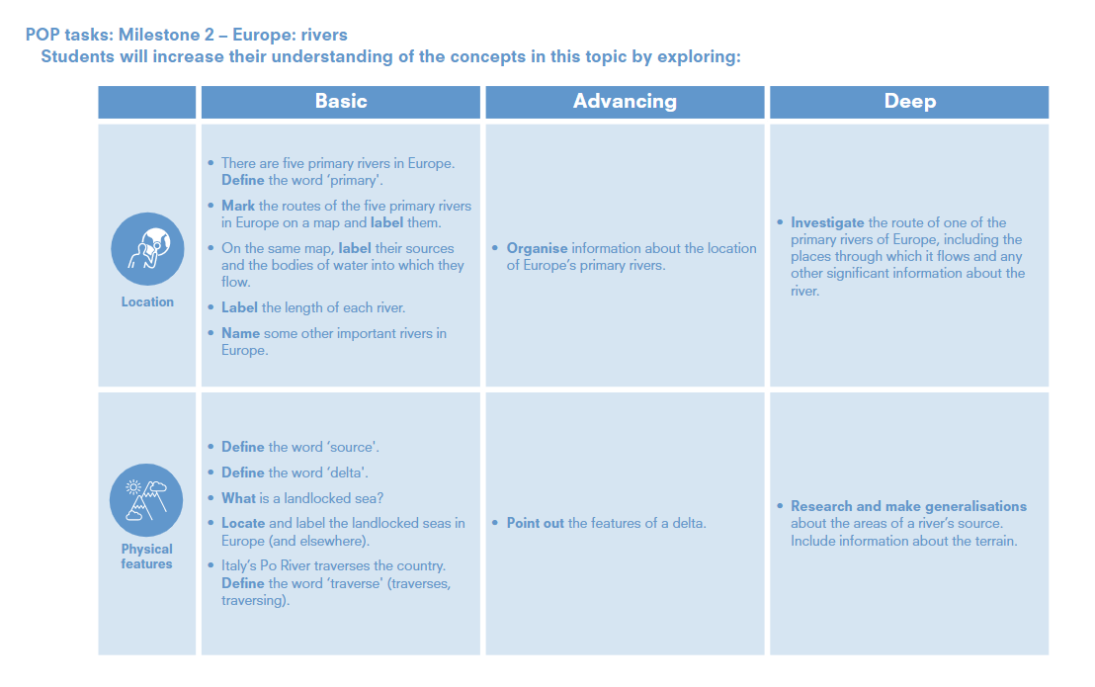

Slide 17
Europe: rivers
Location
Year 3 | • There are five primary rivers in Europe. Define the word ‘primary'. • Mark the routes of the five primary rivers in Europe on a map and label them. • On the same map, label their sources and the bodies of water into which they flow. • Label the length of each river. • Name some other important rivers in Europe | • Define the word ‘source'. • Define the word ‘delta'. • What is a landlocked sea? • Locate and label the landlocked seas in Europe (and elsewhere). • Italy’s Po River traverses the country. Define the word ‘traverse' (traverses, traversing).
Year 4 | Organise information about the location of Europe’s primary rivers. • Investigate the route of one of the primary rivers of Europe, including the places through which it flows and any other significant information about the river. | . • Point out the features of a delta. • Research and make generalisations about the areas of a river’s source. Include information about the terrain. .

Slide 19
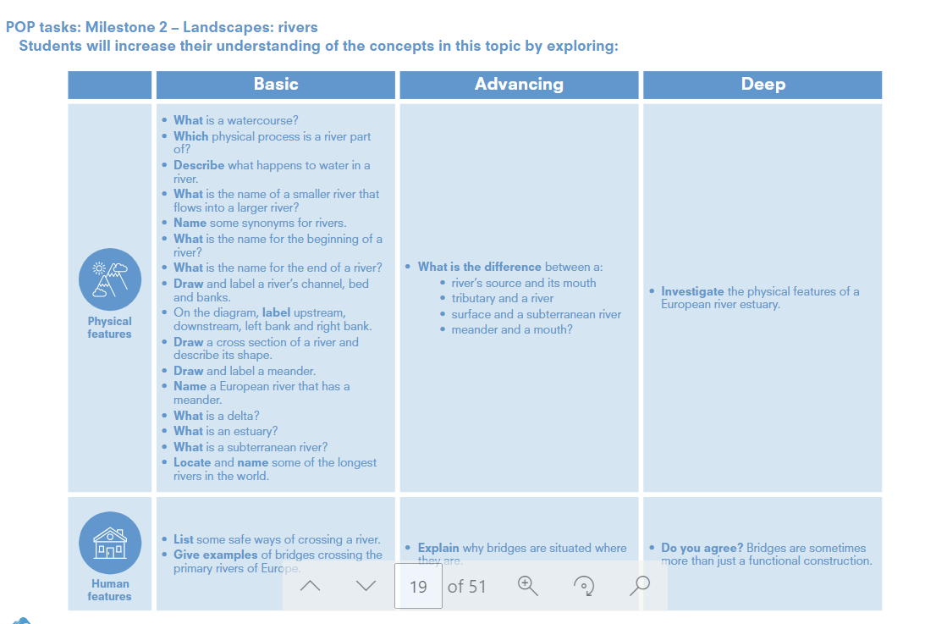

Slide 20
Landscape:rivers
Human features
Year 3 | • What is a watercourse? • Which physical process is a river part of? • Describe what happens to water in a river. • What is the name of a smaller river that flows into a larger river? • Name some synonyms for rivers. • What is the name for the beginning of ariver? • What is the name for the end of a river? • Draw and label a river’s channel, bed and banks. • On the diagram, label upstream, downstream, left bank and right bank. • Draw a cross section of a river and describe its shape. • Draw and label a meander. • Name a European river that has a meander. • What is a delta? • What is an estuary? • What is a subterranean river? • Locate and name some of the longest rivers in the world. | • List some safe ways of crossing a river. • Give examples of bridges crossing the primary rivers of Europe.
Year 4 | • What is the difference between a: • river’s source and its mouth • tributary and a river • surface and a subterranean river • meander and a mouth? • Investigate the physical features of a European river estuary. | • Explain why bridges are situated where they are. • Do you agree? Bridges are sometimes more than just a functional construction

Slide 22
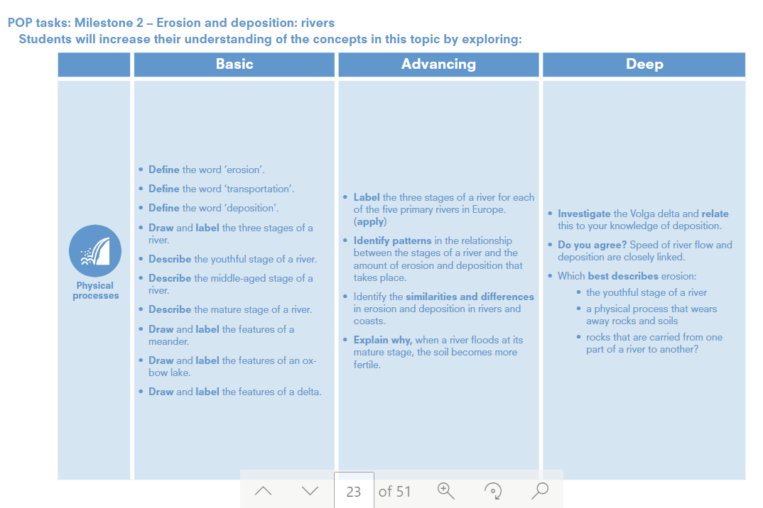

Slide 23
Erosion and deposition:rivers
Physical
processes
Year 3 | • Define the word ‘erosion’. • Define the word ‘transportation’. • Define the word ‘deposition'. • Draw and label the three stages of a river. • Describe the youthful stage of a river. • Describe the middle-aged stage of a river. • Describe the mature stage of a river. • Draw and label the features of a meander. • Draw and label the features of an oxbow lake. • Draw and label the features of a delta.
Year 4 | • Label the three stages of a river for each of the five primary rivers in Europe.(apply) • Identify patterns in the relationship between the stages of a river and the amount of erosion and deposition that takes place. • Identify the similarities and differences in erosion and deposition in rivers and coasts. • Explain why, when a river floods at its mature stage, the soil becomes more fertile. • Investigate the Volga delta and relate this to your knowledge of deposition. • Do you agree? Speed of river flow and deposition are closely linked. • Which best describes erosion: • the youthful stage of a river • a physical process that wearsaway rocks and soils • rocks that are carried from one part of a river to another?

Slide 25
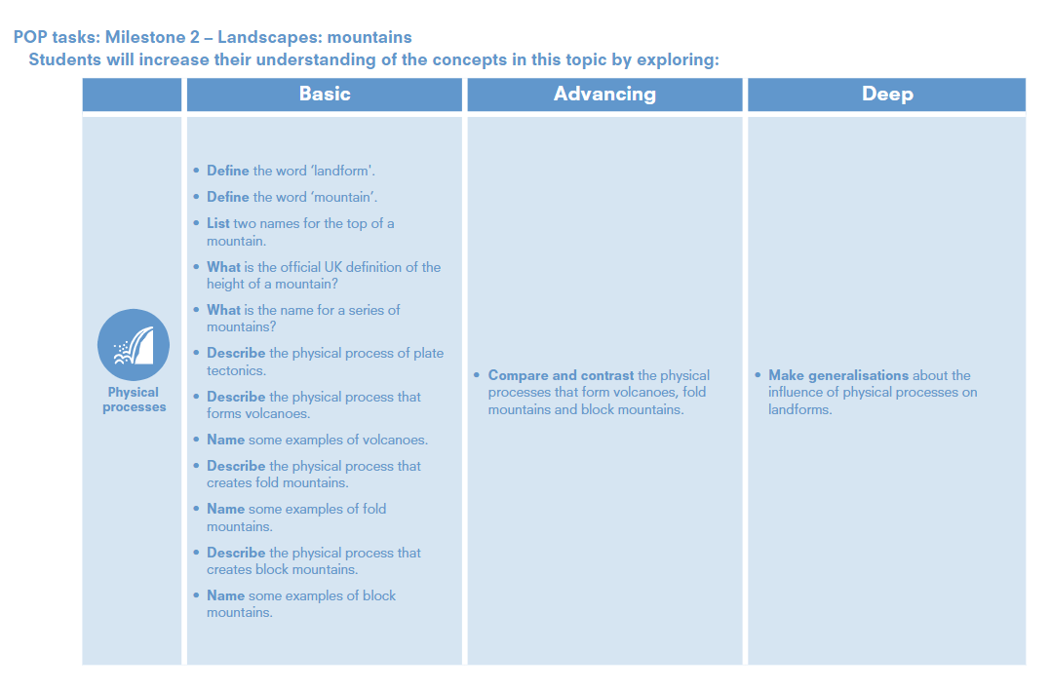

Slide 26
Landscapes: Mountains
Physical
processes
Year 3 | • Define the word ‘landform'. • Define the word ‘mountain’. • List two names for the top of a mountain. • What is the official UK definition of the height of a mountain? • What is the name for a series of mountains? • Describe the physical process of plate tectonics. • Describe the physical process that forms volcanoes. • Name some examples of volcanoes. • Describe the physical process that creates fold mountains. • Name some examples of fold mountains. • Describe the physical process that creates block mountains. • Name some examples of block mountains.
Year 4 | Compare and contrast the physical processes that form volcanoes, fold mountains and block mountains. • Make generalisations about the influence of physical processes on landforms.

Slide 28
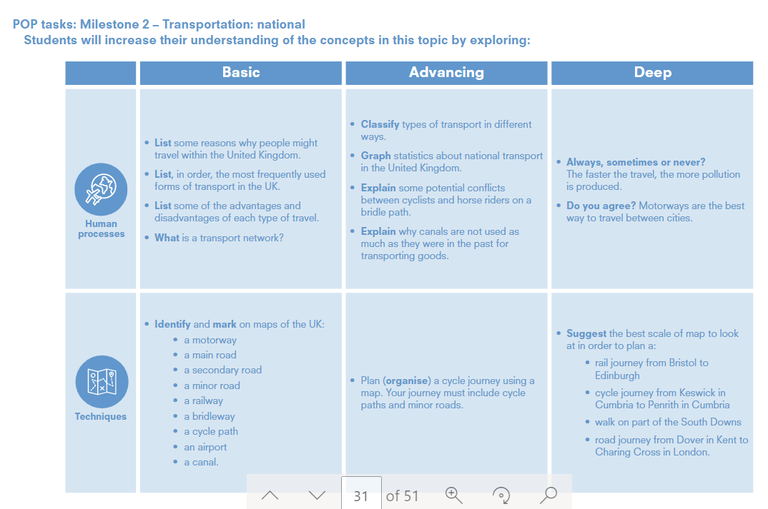

Slide 29
Transportation: national
Year 3 | List some reasons why people might travel within the United Kingdom. • List, in order, the most frequently used forms of transport in the UK. • List some of the advantages and disadvantages of each type of travel. • What is a transport network? | • Identify and mark on maps of the UK: • a motorway • a main road • a secondary road • a minor road • a railway • a bridleway • a cycle path • an airport • a canal.
Year 4 | . Classify types of transport in different ways. • Graph statistics about national transport in the United Kingdom. • Explain some potential conflicts between cyclists and horse riders on a bridle path. • Explain why canals are not used as much as they were in the past for transporting goods. Always, sometimes or never? The faster the travel, the more pollution is produced. • Do you agree? Motorways are the best way to travel between cities. | • Plan (organise) a cycle journey using a map. Your journey must include cycle paths and minor roads. Suggest the best scale of map to look at in order to plan a: • rail journey from Bristol to Edinburgh • cycle journey from Keswick in Cumbria to Penrith in Cumbria • walk on part of the South Downs • road journey from Dover in Kent toCharing Cross in London.

Slide 31
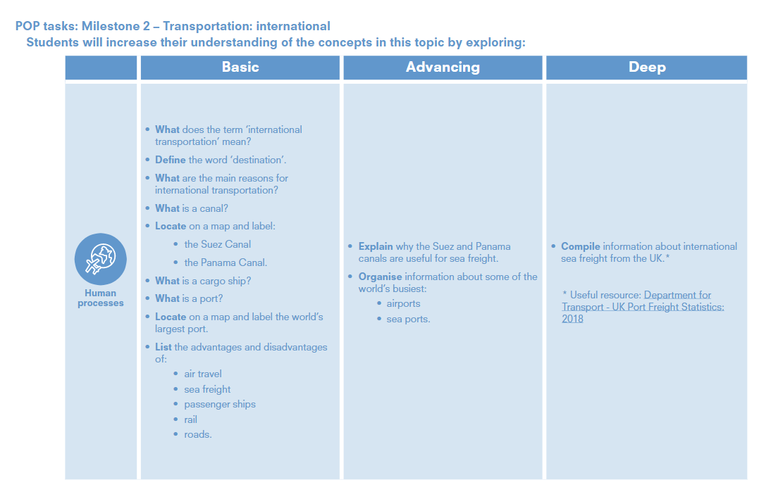

Slide 32
Transportation: International
Year 3 | • What does the term ‘international transportation’ mean? • Define the word ‘destination’. • What are the main reasons for international transportation? • What is a canal? • Locate on a map and label: • the Suez Canal • the Panama Canal. • What is a cargo ship? • What is a port? • Locate on a map and label the world’s largest port. • List the advantages and disadvantages of: • air travel • sea freight • passenger ships • rail • roads.
Year 4 | Explain why the Suez and Panama canals are useful for sea freight. • Organise information about some of the world’s busiest: • airports • sea ports. Compile information about international sea freight from the UK.* * Useful resource: Department forTransport - UK Port Freight Statistics: 2018

Slide 34
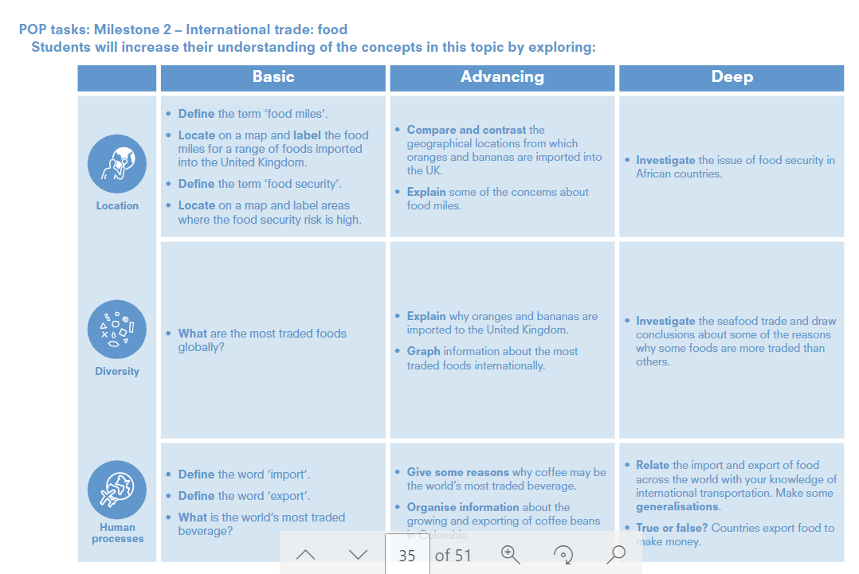

Slide 35
International trade: food
Year 3 | • Define the term ‘food miles'. • Locate on a map and label the food miles for a range of foods imported into the United Kingdom. • Define the term ‘food security’. • Locate on a map and label areas where the food security risk is high. | Define the word ‘import’. • Define the word ‘export’. • What is the world’s most traded beverage? | What are the most traded foods globally
Year 4 | Compare and contrast the geographical locations from which oranges and bananas are imported in to the UK. • Explain some of the concerns about food miles. • Investigate the issue of food security in African countries. | • Give some reasons why coffee may be the world’s most traded beverage. • Organise information about the growing and exporting of coffee beans in Colombia. Relate the import and export of food across the world with your knowledge of international transportation. Make some generalisations. • True or false? Countries export food tomake money. | • Explain why oranges and bananas are imported to the United Kingdom. • Graph information about the most iraded foods internationally. • Investigate the seafood trade and draw conclusions about some of the reasons why some foods are more traded than others.

Slide 37
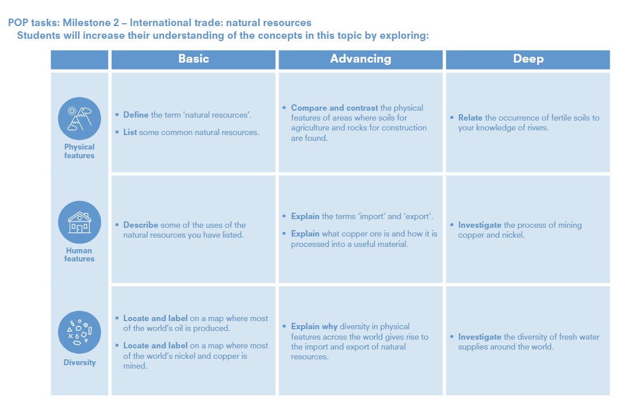

Slide 38
International trade: natural resources
Year 3 | Define the term 'natural resources’. • List some common natural resources. | • Describe some of the uses of the natural resources you have listed. | • Relate the occurrence of fertile soils to your knowledge of rivers.
Year 4 | • Compare and contrast the physical features of areas where soils for agriculture and rocks for construction are found. Relate the occurrence of fertile soils to your knowledge of rivers. | Explain the terms ‘import’ and ‘export’. • Explain what copper ore is and how it is processed into a useful material. Explain why diversity in physical features across the world gives rise to the import and export of natural resources | • Investigate the process of mining copper and nickel. • Investigate the diversity of fresh water supplies around the world.

Slide 40
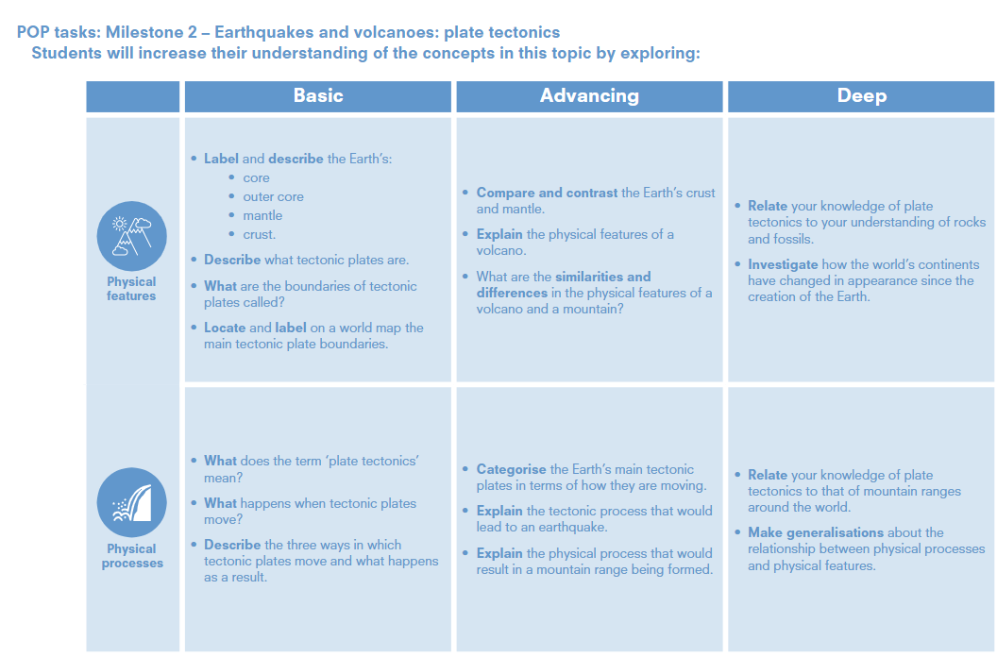

Slide 41
Earthquakes and volcanoes: plate tectonics
Year 3 | • Label and describe the Earth’s: • core • outer core • mantle • crust. • Describe what tectonic plates are. • What are the boundaries of tectonic plates called? • Locate and label on a world map the main tectonic plate boundaries | •• What does the term ‘plate tectonics’ mean? • What happens when tectonic plates move? • Describe the three ways in which tectonic plates move and what happens as a result.
Year 4 | • Compare and contrast the Earth’s crust and mantle. • Explain the physical features of a volcano. • What are the similarities and differences in the physical features of a volcano and a mountain? Relate your knowledge of plate tectonics to your understanding of rocks and fossils. • Investigate how the world’s continents have changed in appearance since the creation of the Earth. | • Categorise the Earth’s main tectonic plates in terms of how they are moving. • Explain the tectonic process that would lead to an earthquake. • Explain the physical process that would result in a mountain range being formed. Relate your knowledge of plate tectonics to that of mountain ranges around the world. • Make generalisations about the relationship between physical processes and physical features.

Slide 43
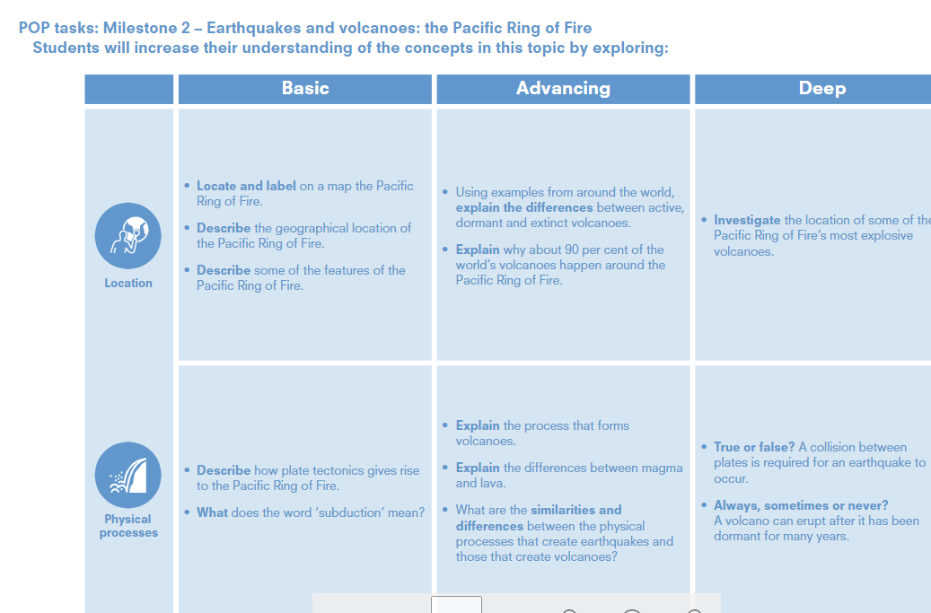

Slide 44
Earthquakes and volcanoes: The Pacific Ring of Fire
Year 3 | • Locate and label on a map the Pacific Ring of Fire. • Describe the geographical location of the Pacific Ring of Fire. • Describe some of the features of the Pacific Ring of Fire. | • Describe how plate tectonics gives rise to the Pacific Ring of Fire. • What does the word ‘subduction’ mean?
Year 4 | Using examples from around the world, explain the differences between active, dormant and extinct volcanoes. • Explain why about 90 per cent of the world’s volcanoes happen around the Pacific Ring of Fire. Investigate the location of some of the Pacific Ring of Fire’s most explosive volcanoes. | Explain the process that forms volcanoes. • Explain the differences between magma and lava. • What are the similarities and differences between the physical processes that create earthquakes and those that create volcanoes? • True or false? A collision between plates is required for an earthquake to occur. • Always, sometimes or never? A volcano can erupt after it has been dormant for many years.

Slide 45
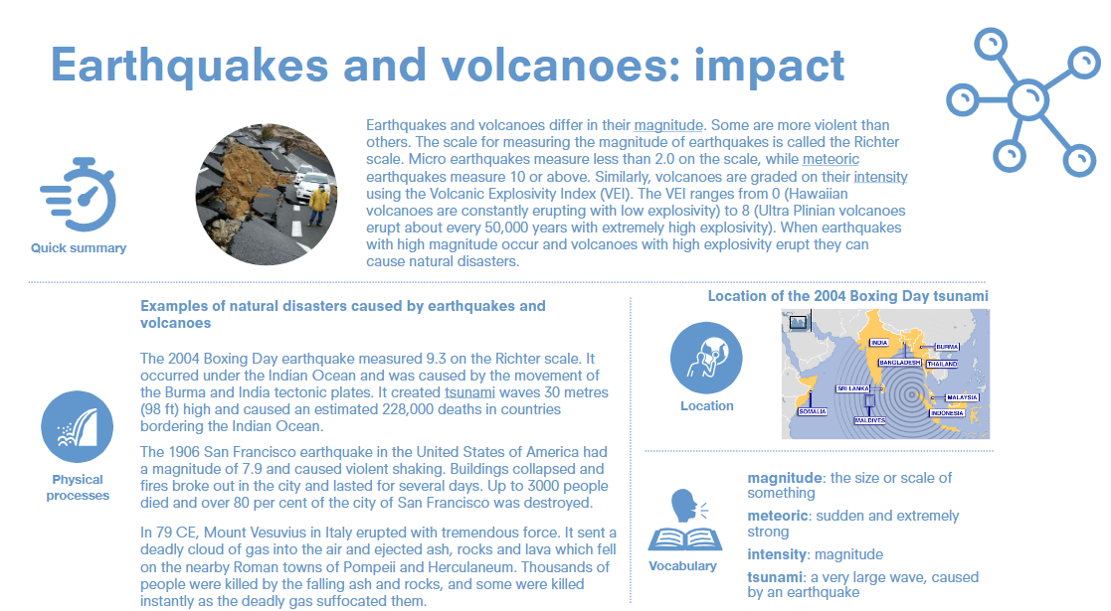

Slide 46
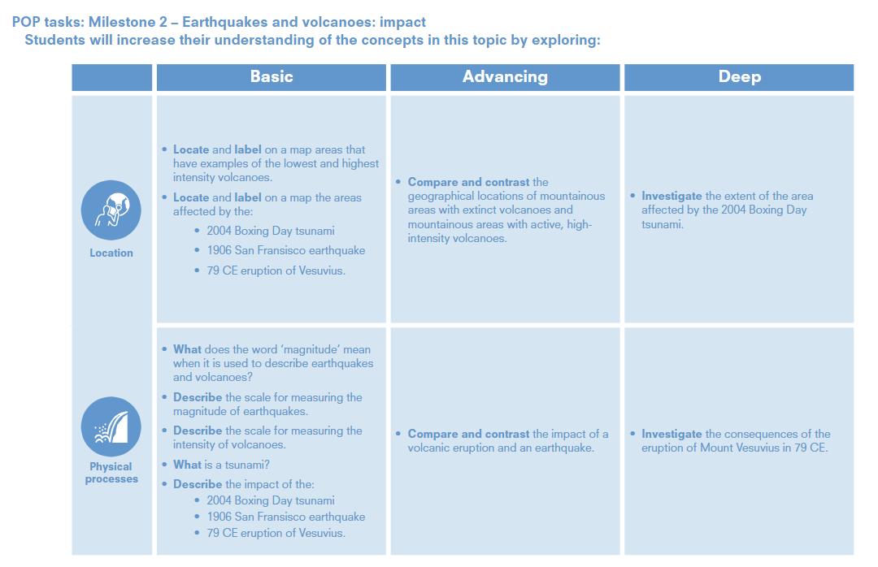

Slide 47
Earthquakes and volcanoes: impact
Year 3 | Locate and label on a map areas that have examples of the lowest and highest intensity volcanoes. • Locate and label on a map the areas affected by the: • 2004 Boxing Day tsunami • 1906 San Fransisco earthquake • 79 CE eruption of Vesuvius. | What does the word ‘magnitude’ mean when it is used to describe earthquakes and volcanoes? • Describe the scale for measuring the magnitude of earthquakes. • Describe the scale for measuring the intensity of volcanoes. • What is a tsunami? • Describe the impact of the: • 2004 Boxing Day tsunami • 1906 San Fransisco earthquake • 79 CE eruption of Vesuvius
Year 4 | Compare and contrast the geographical locations of mountainous areas with extinct volcanoes and mountainous areas with active, high intensity volcanoes. investigate the extent of the area affected by the 2004 Boxing Day tsunami. | • Compare and contrast the impact of a volcanic eruption and an earthquake. • Investigate the consequences of the eruption of Mount Vesuvius in 79 CE.

Slide 49
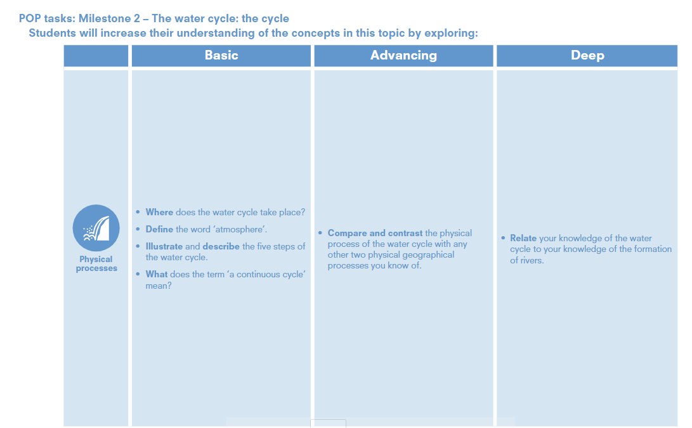

Slide 50
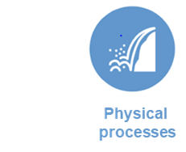
The water cycle: the cycle
Year 3 | Where does the water cycle take place? • Define the word ‘atmosphere’. • Illustrate and describe the five steps o the water cycle. • What does the term ‘a continuous cycle’ Mean
Year 4 | Compare and contrast the physical process of the water cycle with any other two physical geographical processes you know of. Relate your knowledge of the water cycle to your knowledge of the formation of rivers.

Slide 52
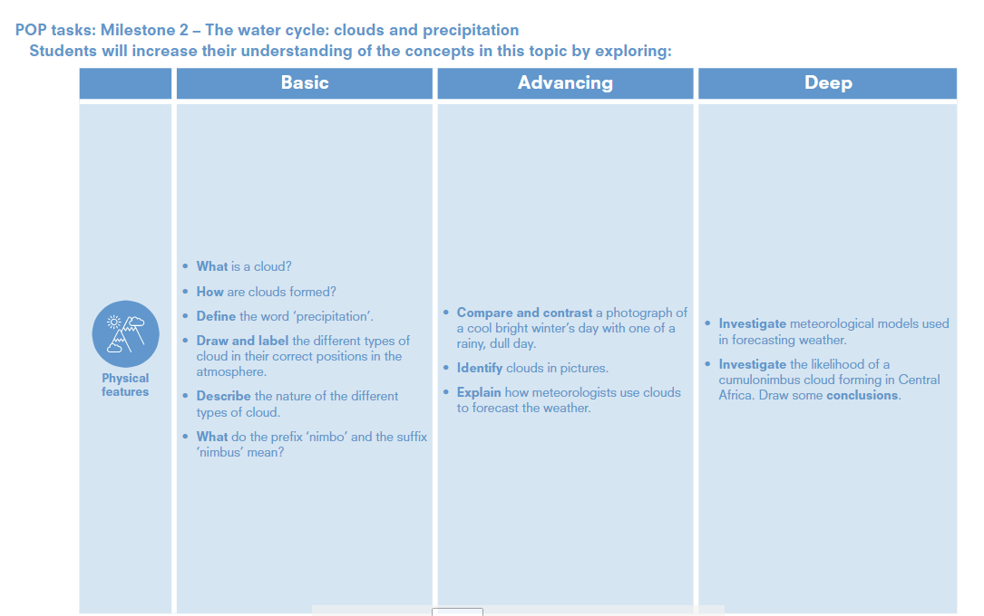

Slide 53
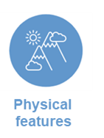
The water cycle: clouds and precipitation
Year 3 | • What is a cloud? • How are clouds formed? • Define the word ‘precipitation’. • Draw and label the different types of cloud in their correct positions in the atmosphere. • Describe the nature of the different types of cloud. • What do the prefix ‘nimbo’ and the suffix nimbus’ mean?
Year 4 | Compare and contrast a photograph of a cool bright winter’s day with one of a rainy, dull day. • Identify clouds in pictures. • Explain how meteorologists use clouds to forecast the weather. Investigate meteorological models used in forecasting weather. • Investigate the likelihood of a cumulonimbus cloud forming in Central Africa. Draw some conclusions.

