Slide 1
Lower Key Stage 2 Physical Education Curriculum
Together we Nurture, Inspire and Achieve

Slide 2
Physical Education topics overview
Physical Education topics are organised and referenced around a Physical Education schema. Each topic either introduces an aspect of the schema or references previous instances of it. Below is an overview of the topics we teach and which aspects of the schema it strengthens:
Target: Throw golf
Target: Corner bowls
Target: Bombardment
Tag: Shark tag
Striking and fielding: Quick pick up
Striking and fielding: Safe or sorry
Striking and fielding: Round the square
Net and wall: Pick up the trash
Net and wall: Keep it going
Net and wall: 3v3 volleyball
Invasion: End zone
Invasion: Too many goals

Slide 3
Invasion: Go to jail
Gymnastics: Partner sequence
Gymnastics: Vault
Gymnastics: Apparatus
Dance: Based on a picture
Dance: Mystery dance
Dance: traditional folk dance
Athletics: Take five jumps
Athletics: Throwing
Athletics: 9.58 seconds
Outdoor and adventurous: Counting cones
Outdoor and adventurous: Team building
Outdoor and adventurous: Night trail

Slide 5
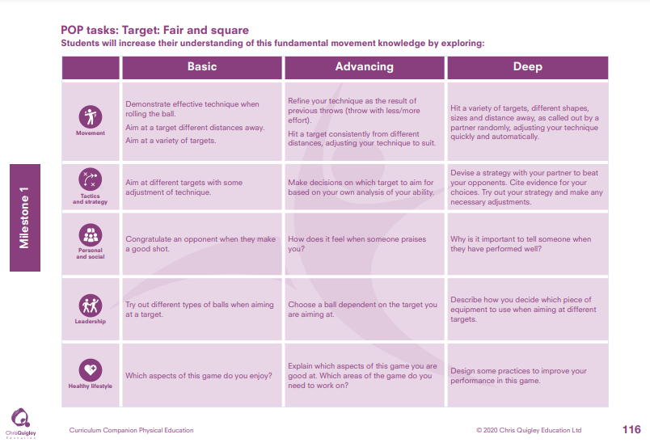
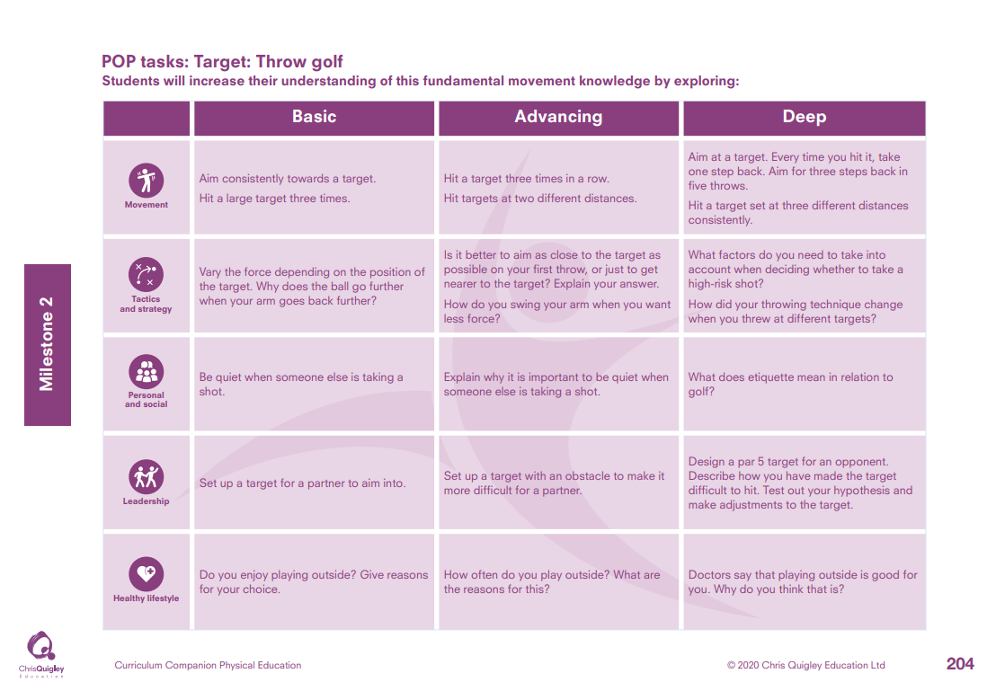

Slide 6
Target: Throw golf
Decide how many lessons you will spend on the topic and use the information on the knowledge web to create the take-aways for each lesson
This table shows the knowledge that will be taught in each lesson
Year 3 | Aim consistently towards a target. Hit a large target three times | Vary the force depending on the position of the target. Why does the ball go further when your arm goes back further? | Be quiet when someone else is taking a shot. | Set up a target for a partner to aim into. | Do you enjoy playing outside? Give reasons for your choice.
Year 4 | Hit a target three times in a row. Hit targets at two different distances. Aim at a target. Every time you hit it, take one step back. Aim for three steps back in five throws. Hit a target set at three different distances consistently. | Is it better to aim as close to the target as possible on your first throw, or just to get nearer to the target? Explain your answer. How do you swing your arm when you want less force? What factors do you need to take into account when deciding whether to take a high-risk shot? How did your throwing technique change when you threw at different targets? | Explain why it is important to be quiet when someone else is taking a shot. What does etiquette mean in relation to golf? | Set up a target with an obstacle to make it more difficult for a partner. Design a par 5 target for an opponent. Describe how you have made the target difficult to hit. Test out your hypothesis and make adjustments to the target. | How often do you play outside? What are the reasons for this? Doctors say that playing outside is good for you. Why do you think that is?

Slide 8
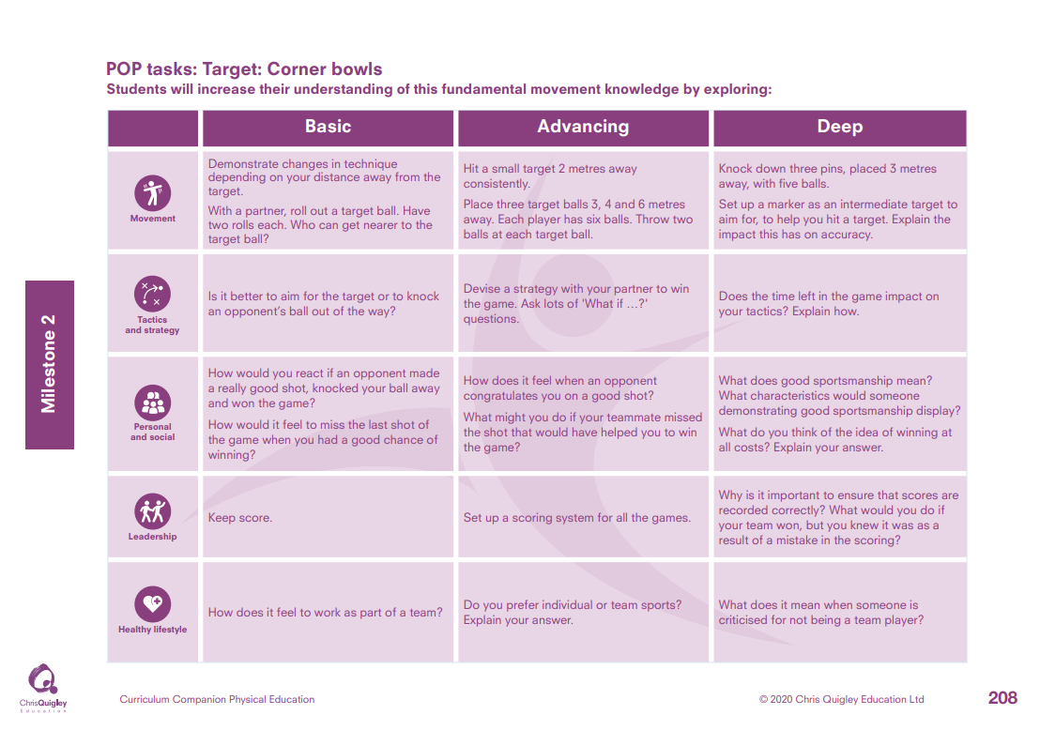

Slide 9
Target: Corner bowls
Decide how many lessons you will spend on the topic and use the information on the knowledge web to create the take-aways for each lesson
This table shows the knowledge that will be taught in each lesson
Year 3 | Demonstrate changes in technique depending on your distance away from the target. With a partner, roll out a target ball. Have two rolls each. Who can get nearer to the target ball? | Is it better to aim for the target or to knock an opponent’s ball out of the way? | How would you react if an opponent made a really good shot, knocked your ball away and won the game? How would it feel to miss the last shot of the game when you had a good chance of winning? | Keep score. | How does it feel to work as part of a team?
Year 4 | Hit a small target 2 metres away consistently. Place three target balls 3, 4 and 6 metres away. Each player has six balls. Throw two balls at each target ball. Knock down three pins, placed 3 metres away, with five balls. Set up a marker as an intermediate target to aim for, to help you hit a target. Explain the impact this has on accuracy. | Devise a strategy with your partner to win the game. Ask lots of 'What if …?’ questions. Does the time left in the game impact on your tactics? Explain how. | How does it feel when an opponent congratulates you on a good shot? What might you do if your teammate misses the shot that would have helped you to win the game? What does good sportsmanship mean? What characteristics would someone demonstrating good sportsmanship display? What do you think of the idea of winning at all costs? Explain your answer. | Set up a scoring system for all the games. Why is it important to ensure that scores are recorded correctly? What would you do if your team won, but you knew it was as a result of a mistake in the scoring? | Do you prefer individual or team sports? Explain your answer. What does it mean when someone is criticised for not being a team player?

Slide 12
Target: Bombardment
Decide how many lessons you will spend on the topic and use the information on the knowledge web to create the take-aways for each lesson
This table shows the knowledge that will be taught in each lesson
Year 3 | Demonstrate an overarm throw. Throw overarm at a variety of targets, placed at different heights and distances. Throw overarm at a large moving target (keep fit ball or large beach ball) rolled out by a partner 3 metres away. | Choose the best type of throw to move the ball. Explain your reasoning. | If you are constantly missing the target ball in this activity, how might that make you feel? | Make a list of things that could be hazards on a playing area. Use this list to identify and set up a safe area for playing. | What are your strengths in this game?
Year 4 | Throw overarm to hit a wall. Hit a target 3 metres away at least three out of five times. Throw overarm to hit a large, moving target consistently. Throw overarm to hit a large target 5 metres away. Throw overarm for at least 15 metres. Adapt the force and trajectory of the throw quickly, depending on the position of the moving target. | Does the position you make contact with the target ball impact on how far it rolls? How does your positioning in relation to the ball impact on your ability to move the ball? | What can you do to support someone who is finding the activity difficult? Wayne Gretzky, a member of the Hockey School of Fame, said 'You miss 100 per cent of the shots you don’t take.' What lessons can you take from that and how would you use that to inspire others? | What hazards might arise during the playing of the game? Ensure you keep a look-out for these during the lesson. Design a poster to help others be risk aware in PE lessons. How much does risk awareness depend on the behaviour of everyone in the class? | In which activities do your strengths lie? Identify patterns in the types of activities you have chosen. What does being proud feel like? Describe a time when you have felt proud.

Slide 14
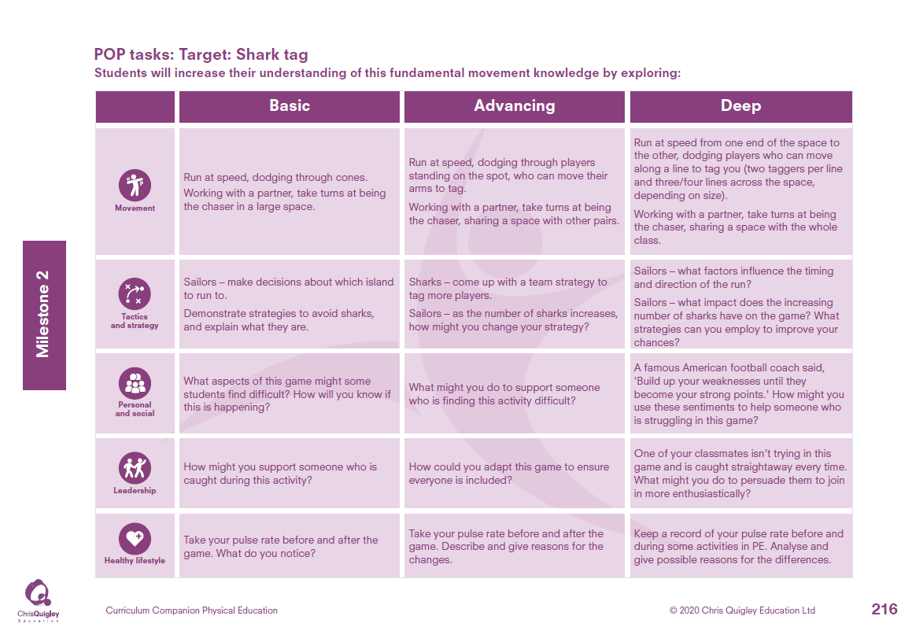

Slide 15
Tag: Shark tag
Decide how many lessons you will spend on the topic and use the information on the knowledge web to create the take-aways for each lesson
This table shows the knowledge that will be taught in each lesson
Year 3 | Run at speed, dodging through cones. Working with a partner, take turns at being the chaser in a large space. | Sailors – make decisions about which island to run to. Demonstrate strategies to avoid sharks, and explain what they are. | What aspects of this game might some students find difficult? How will you know if this is happening? | How might you support someone who is caught during this activity? | Take your pulse rate before and after the game. What do you notice?
Year 4 | Run at speed, dodging through players standing on the spot, who can move their arms to tag. Working with a partner, take turns at being the chaser, sharing a space with other pairs. Run at speed from one end of the space to the other, dodging players who can move along a line to tag you (two taggers per line and three/four lines across the space, depending on size). Working with a partner, take turns at being the chaser, sharing a space with the whole class. | Sharks – come up with a team strategy to tag more players. Sailors – as the number of sharks increases, how might you change your strategy? Sailors – what factors influence the timing and direction of the run? Sailors – what impact does the increasing number of sharks have on the game? What strategies can you employ to improve your chances? | What might you do to support someone who is finding this activity difficult? A famous American football coach said, 'Build up your weaknesses until they become your strong points.' How might you use these sentiments to help someone who is struggling in this game? | How could you adapt this game to ensure everyone is included? One of your classmates isn’t trying in this game and is caught straightaway every time. What might you do to persuade them to join in more enthusiastically? | Take your pulse rate before and after the game. Describe and give reasons for the changes. Keep a record of your pulse rate before and during some activities in PE. Analyse and give possible reasons for the differences.

Slide 17
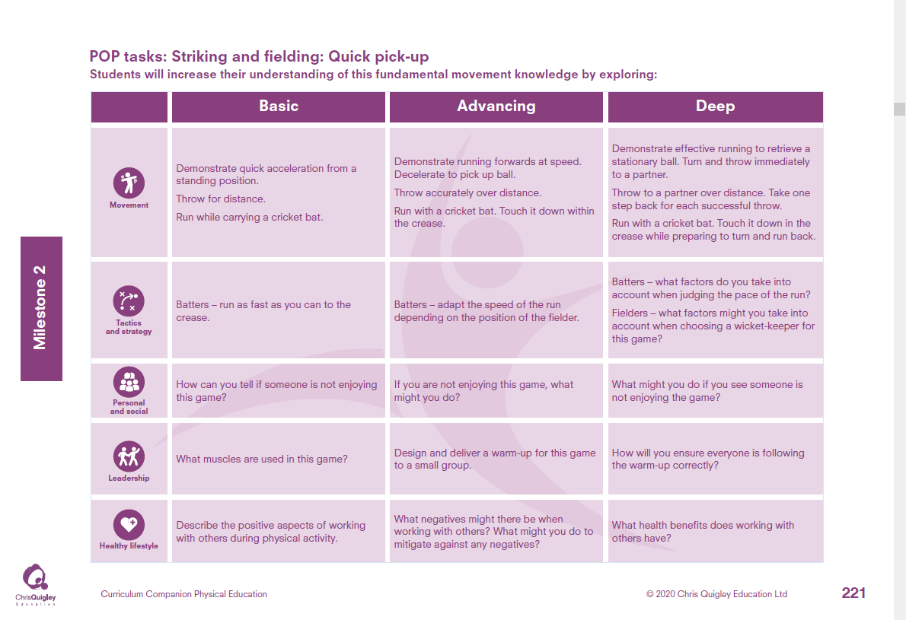

Slide 18
Striking and fielding: Quick pick up.
Decide how many lessons you will spend on the topic and use the information on the knowledge web to create the take-aways for each lesson
This table shows the knowledge that will be taught in each lesson
Year 3 | Demonstrate quick acceleration from a standing position. Throw for distance. Run while carrying a cricket bat. | Batters – run as fast as you can to the crease. | How can you tell if someone is not enjoying this game? | What muscles are used in this game? | Describe the positive aspects of working with others during physical activity.
Year 4 | Demonstrate running forwards at speed. Decelerate to pick up ball. Throw accurately over distance. Run with a cricket bat. Touch it down within the crease. Demonstrate effective running to retrieve a stationary ball. Turn and throw immediately to a partner. Throw to a partner over distance. Take one step back for each successful throw. Run with a cricket bat. Touch it down in the crease while preparing to turn and run back. | Batters – adapt the speed of the run depending on the position of the fielder.. Batters – what factors do you take into account when judging the pace of the run? Fielders – what factors might you take into account when choosing a wicket-keeper for this game? | If you are not enjoying this game, what might you do? What might you do if you see someone is not enjoying the game? | Design and deliver a warm-up for this game to a small group. How will you ensure everyone is following the warm-up correctly? | What negatives might there be when working with others? What might you do to mitigate against any negatives? What health benefits does working with others have?

Slide 19
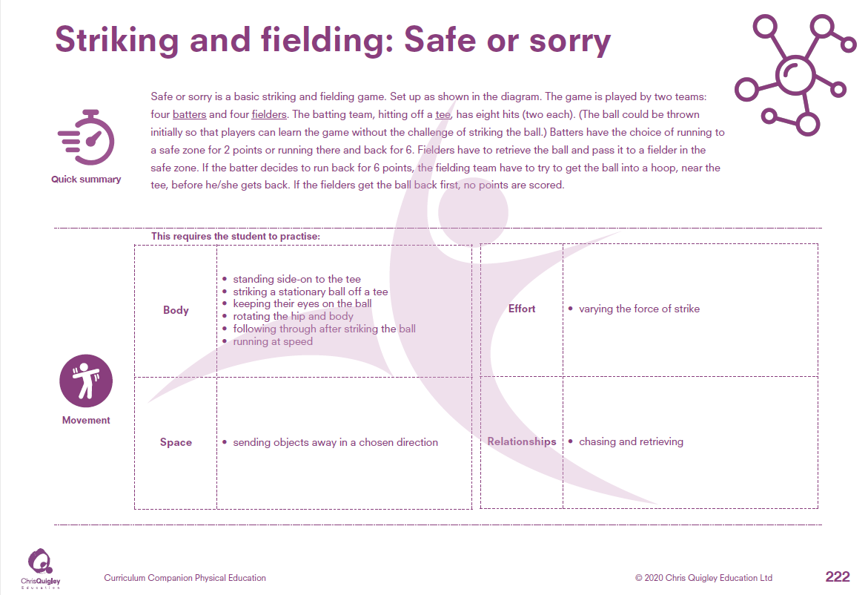

Slide 20
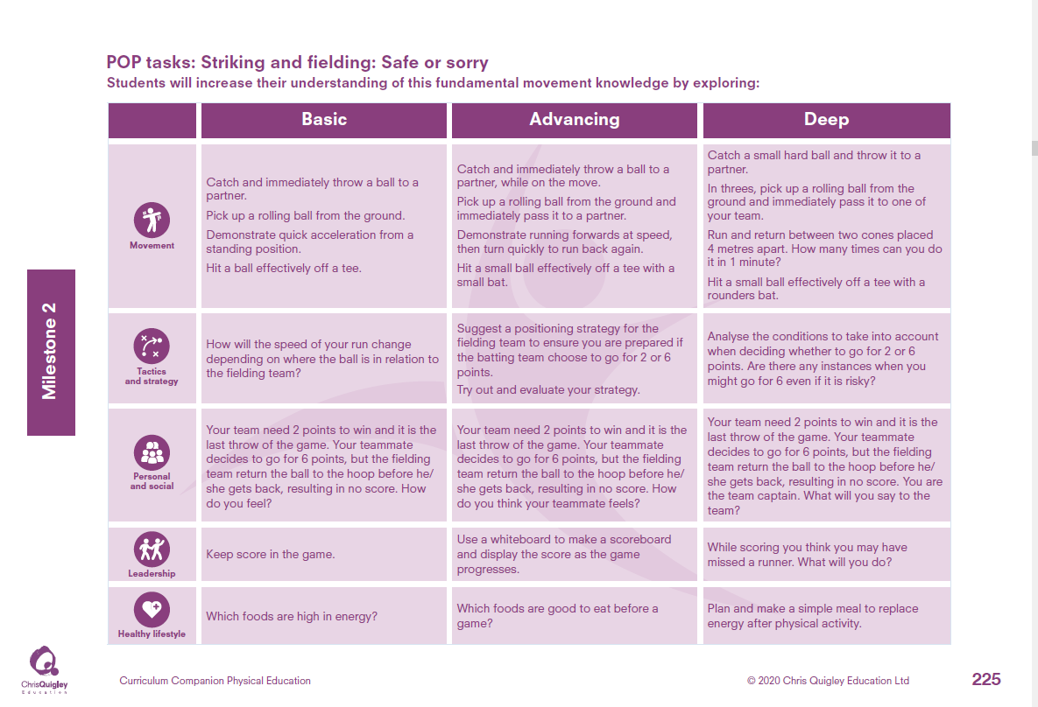

Slide 21
Striking and fielding: Safe or sorry.
Decide how many lessons you will spend on the topic and use the information on the knowledge web to create the take-aways for each lesson
This table shows the knowledge that will be taught in each lesson
Year 3 | Catch and immediately throw a ball to a partner. Pick up a rolling ball from the ground. Demonstrate quick acceleration from a standing position. Hit a ball effectively off a tee. | How will the speed of your run change depending on where the ball is in relation to the fielding team? | Your team need 2 points to win and it is the last throw of the game. Your teammate decides to go for 6 points, but the fielding team return the ball to the hoop before he/ she gets back, resulting in no score. How do you feel? | Keep score in the game. | Which foods are high in energy?
Year 4 | Catch and immediately throw a ball to a partner, while on the move. Pick up a rolling ball from the ground and immediately pass it to a partner. Demonstrate running forwards at speed, then turn quickly to run back again. Hit a small ball effectively off a tee with a small bat. Catch a small hard ball and throw it to a partner. In threes, pick up a rolling ball from the ground and immediately pass it to one of your team. Run and return between two cones placed 4 metres apart. How many times can you do it in 1 minute? Hit a small ball effectively off a tee with a rounders bat. | Suggest a positioning strategy for the fielding team to ensure you are prepared if the batting team choose to go for 2 or 6 points. Try out and evaluate your strategy. Analyse the conditions to take into account when deciding whether to go for 2 or 6 points. Are there any instances when you might go for 6 even if it is risky? | Your team need 2 points to win and it is the last throw of the game. Your teammate decides to go for 6 points, but the fielding team return the ball to the hoop before he/ she gets back, resulting in no score. How do you think your teammate feels? Your team need 2 points to win and it is the last throw of the game. Your teammate decides to go for 6 points, but the fielding team return the ball to the hoop before he/ she gets back, resulting in no score. You are the team captain. What will you say to the team? | Use a whiteboard to make a scoreboard and display the score as the game progresses. While scoring you think you may have missed a runner. What will you do? | Which foods are good to eat before a game? Plan and make a simple meal to replace energy after physical activity.

Slide 23
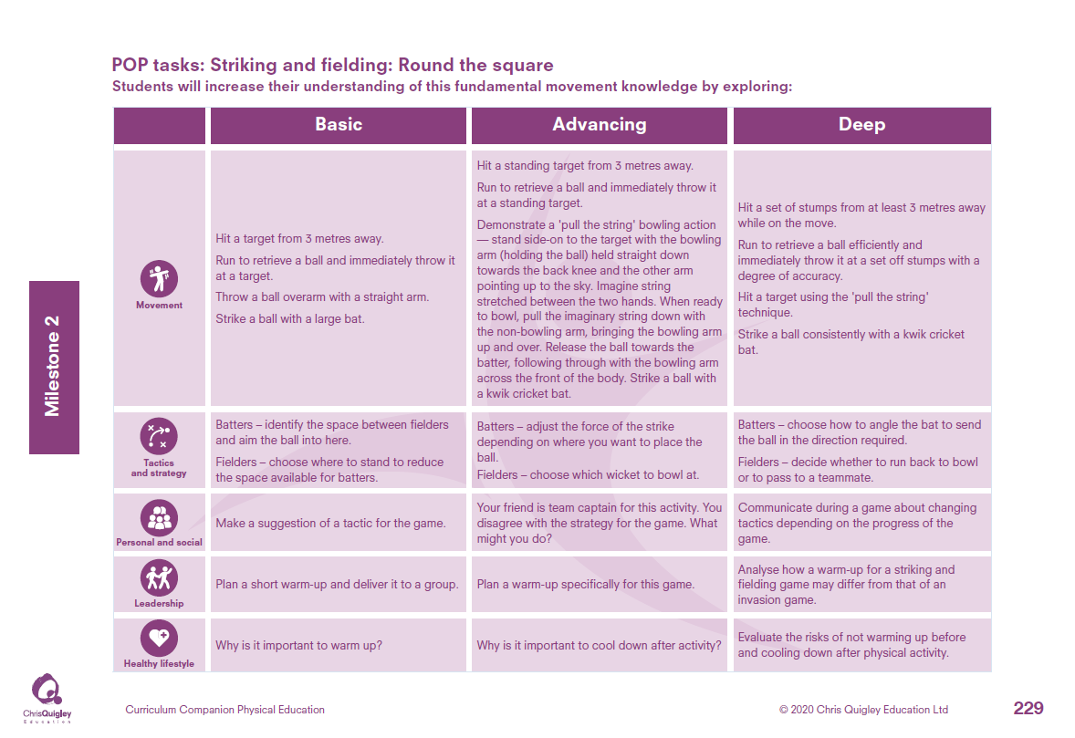

Slide 24
Striking and fielding: Round the square.
Decide how many lessons you will spend on the topic and use the information on the knowledge web to create the take-aways for each lesson
This table shows the knowledge that will be taught in each lesson
Year 3 | Hit a target from 3 metres away. Run to retrieve a ball and immediately throw it at a target. Throw a ball overarm with a straight arm. Strike a ball with a large bat. | Batters – identify the space between fielders and aim the ball into here. Fielders – choose where to stand to reduce the space available for batters. | Make a suggestion of a tactic for the game. | Plan a short warm-up and deliver it to a group. | Why is it important to warm up?
Year 4 | Hit a standing target from 3 metres away. Run to retrieve a ball and immediately throw it at a standing target. Demonstrate a 'pull the string' bowling action — stand side-on to the target with the bowling arm (holding the ball) held straight down towards the back knee and the other arm pointing up to the sky. Imagine string stretched between the two hands. When ready to bowl, pull the imaginary string down with the non-bowling arm, bringing the bowling arm up and over. Release the ball towards the batter, following through with the bowling arm across the front of the body. Strike a ball with a kwik cricket bat. Hit a set of stumps from at least 3 metres away while on the move. Run to retrieve a ball efficiently and immediately throw it at a set off stumps with a degree of accuracy. Hit a target using the 'pull the string‘ technique. Strike a ball consistently with a kwik cricket bat. | Batters – adjust the force of the strike depending on where you want to place the ball. Fielders – choose which wicket to bowl at. Batters – choose how to angle the bat to send the ball in the direction required. Fielders – decide whether to run back to bowl or to pass to a teammate. | Your friend is team captain for this activity. You disagree with the strategy for the game. What might you do? Communicate during a game about changing tactics depending on the progress of the game. | Plan a warm-up specifically for this game. Analyse how a warm-up for a striking and fielding game may differ from that of an invasion game. | Why is it important to cool down after activity? Evaluate the risks of not warming up before and cooling down after physical activity.

Slide 26
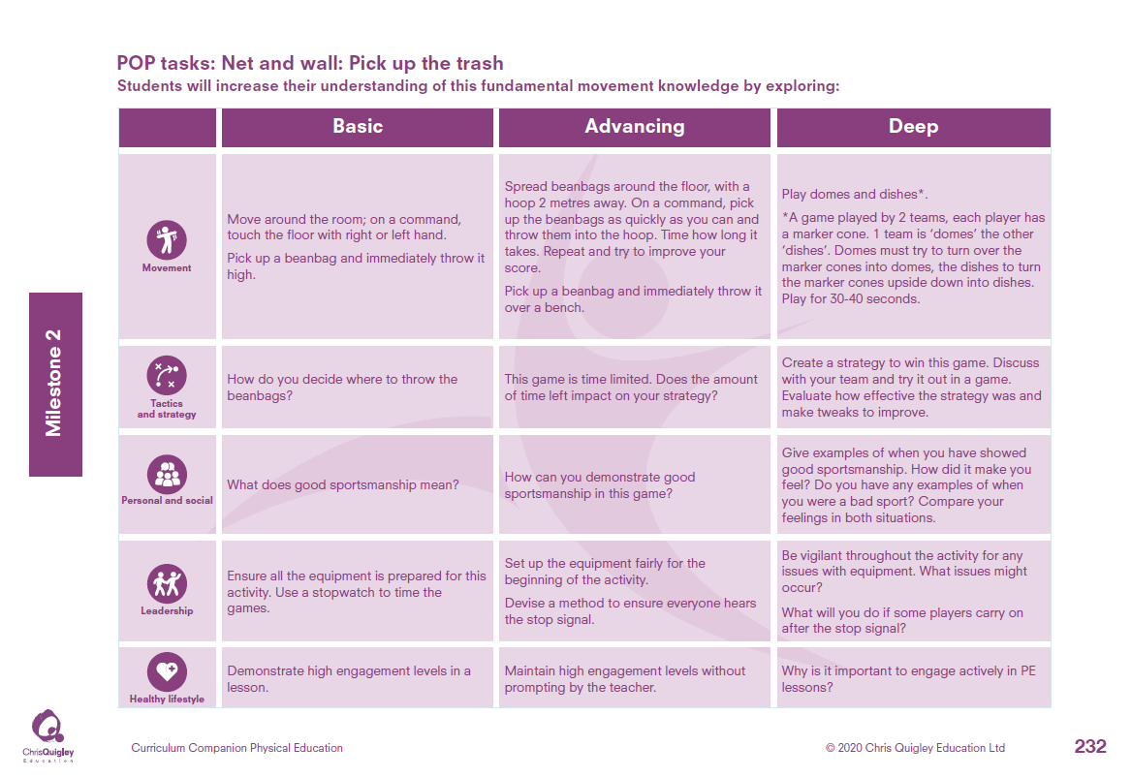

Slide 27
Net and wall: Pick up the trash.
Decide how many lessons you will spend on the topic and use the information on the knowledge web to create the take-aways for each lesson
This table shows the knowledge that will be taught in each lesson
Year 3 | Move around the room; on a command, touch the floor with right or left hand. Pick up a beanbag and immediately throw it high. | How do you decide where to throw the beanbags? | What does good sportsmanship mean? | Ensure all the equipment is prepared for this activity. Use a stopwatch to time the games. | Demonstrate high engagement levels in a lesson.
Year 4 | Spread beanbags around the floor, with a hoop 2 metres away. On a command, pick up the beanbags as quickly as you can and throw them into the hoop. Time how long it takes. Repeat and try to improve your score. Pick up a beanbag and immediately throw it over a bench. Play domes and dishes*. *A game played by 2 teams, each player has a marker cone. 1 team is ‘domes’ the other ‘dishes’. Domes must try to turn over the marker cones into domes, the dishes to turn the marker cones upside down into dishes. Play for 30-40 seconds. | This game is time limited. Does the amount of time left impact on your strategy? Create a strategy to win this game. Discuss with your team and try it out in a game. Evaluate how effective the strategy was and make tweaks to improve. | How can you demonstrate good sportsmanship in this game? Give examples of when you have showed good sportsmanship. How did it make you feel? Do you have any examples of when you were a bad sport? Compare your feelings in both situations. | Set up the equipment fairly for the beginning of the activity. Devise a method to ensure everyone hears the stop signal. Be vigilant throughout the activity for any issues with equipment. What issues might occur? What will you do if some players carry on after the stop signal? | Maintain high engagement levels without prompting by the teacher. Why is it important to engage actively in PE lessons?

Slide 29
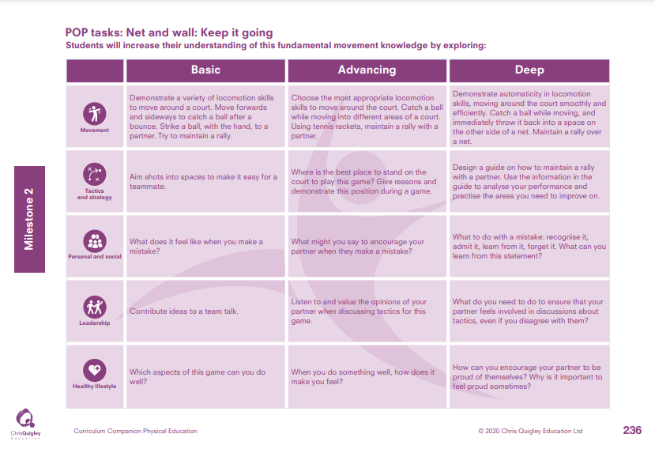

Slide 30
Net and wall: Keep it going
Decide how many lessons you will spend on the topic and use the information on the knowledge web to create the take-aways for each lesson
This table shows the knowledge that will be taught in each lesson
Year 3 | Demonstrate a variety of locomotion skills to move around a court. Move forwards and sideways to catch a ball after a bounce. Strike a ball, with the hand, to a partner. Try to maintain a rally. | Aim shots into spaces to make it easy for a teammate. | What does it feel like when you make a mistake? | Contribute ideas to a team talk. | Which aspects of this game can you do well?
Year 4 | Choose the most appropriate locomotion skills to move around the court. Catch a ball while moving into different areas of a court. Using tennis rackets, maintain a rally with a partner. Demonstrate automaticity in locomotion skills, moving around the court smoothly and efficiently. Catch a ball while moving, and immediately throw it back into a space on the other side of a net. Maintain a rally over a net. | Where is the best place to stand on the court to play this game? Give reasons and demonstrate this position during a game. Design a guide on how to maintain a rally with a partner. Use the information in the guide to analyse your performance and practise the areas you need to improve on. | What might you say to encourage your partner when they make a mistake? What to do with a mistake: recognise it, admit it, learn from it, forget it. What can you learn from this statement? | Listen to and value the opinions of your partner when discussing tactics for this game. What do you need to do to ensure that your partner feels involved in discussions about tactics, even if you disagree with them? | When you do something well, how does it make you feel? How can you encourage your partner to be proud of themselves? Why is it important to feel proud sometimes?

Slide 32
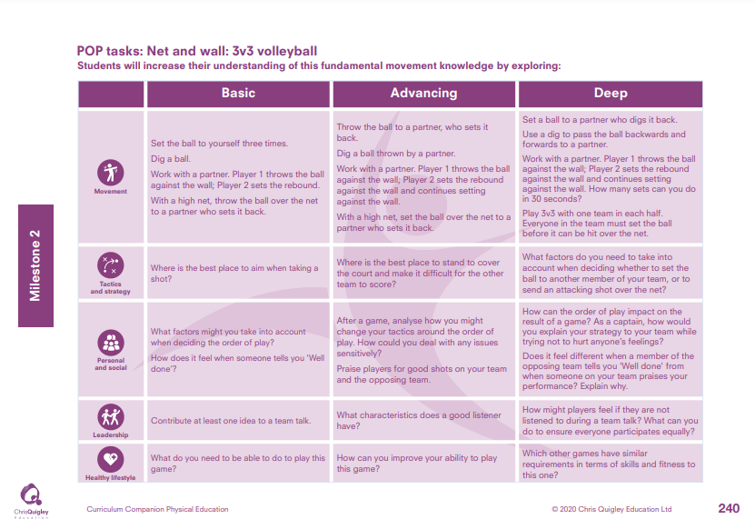

Slide 33
Net and wall: 3V3 volleyball.
Decide how many lessons you will spend on the topic and use the information on the knowledge web to create the take-aways for each lesson
This table shows the knowledge that will be taught in each lesson
Year 3 | Set the ball to yourself three times. Dig a ball. Work with a partner. Player 1 throws the ball against the wall; Player 2 sets the rebound. With a high net, throw the ball over the net to a partner who sets it back. | Where is the best place to aim when taking a shot? | What factors might you take into account when deciding the order of play? How does it feel when someone tells you 'Well done’? | Contribute at least one idea to a team talk. | What do you need to be able to do to play this game?
Year 4 | Throw the ball to a partner, who sets it back. Dig a ball thrown by a partner. Work with a partner. Player 1 throws the ball against the wall; Player 2 sets the rebound against the wall and continues setting against the wall. With a high net, set the ball over the net to a partner who sets it back. Set a ball to a partner who digs it back. Use a dig to pass the ball backwards and forwards to a partner. Work with a partner. Player 1 throws the ball against the wall; Player 2 sets the rebound against the wall and continues setting against the wall. How many sets can you do in 30 seconds? Play 3v3 with one team in each half. Everyone in the team must set the ball before it can be hit over the net. | Where is the best place to stand to cover the court and make it difficult for the other team to score? What factors do you need to take into account when deciding whether to set the ball to another member of your team, or to send an attacking shot over the net? | After a game, analyse how you might change your tactics around the order of play. How could you deal with any issues sensitively? Praise players for good shots on your team and the opposing team. Contrast the differences in how you feel when working cooperatively and competitively. Which do you prefer? Give evidence for your choices. | Tell your partner two things they are doing well and one thing they need to improve. Design some activities to help your partner improve. Join in with them to encourage them. | Which aspects of this game do you need to work on? Devise some practices to help you improve this game. Practise them at breaktimes.

Slide 34
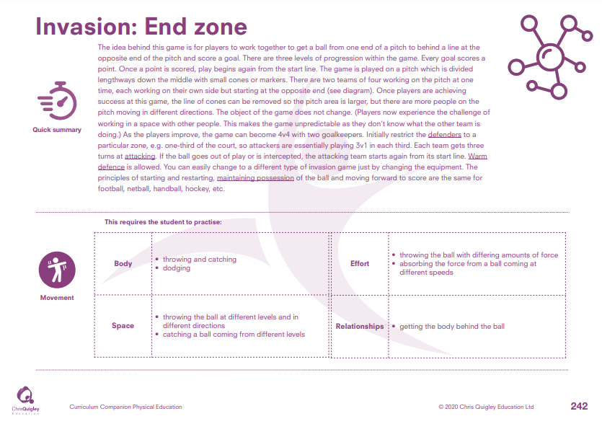

Slide 35
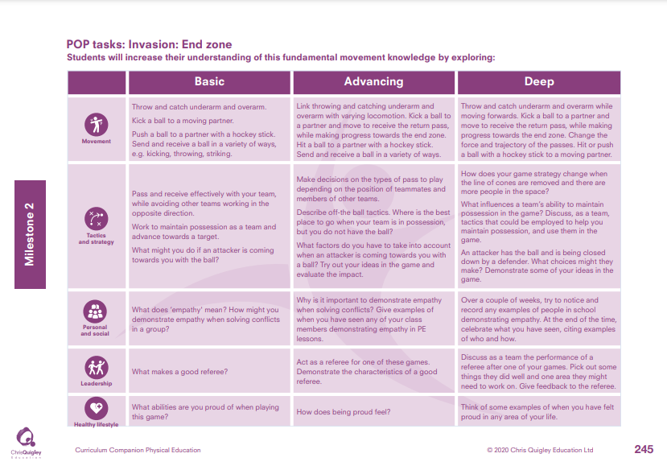

Slide 36
Invasion: End zone.
Decide how many lessons you will spend on the topic and use the information on the knowledge web to create the take-aways for each lesson
This table shows the knowledge that will be taught in each lesson
Year 3 | Throw and catch underarm and overarm. Kick a ball to a moving partner Push a ball to a partner with a hockey stick. Send and receive a ball in a variety of ways, e.g. kicking, throwing, striking. | Pass and receive effectively with your team, while avoiding other teams working in the opposite direction. Work to maintain possession as a team and advance towards a target. What might you do if an attacker is coming towards you with the ball? | What does ‘empathy' mean? How might you demonstrate empathy when solving conflicts in a group? | What makes a good referee? | What abilities are you proud of when playing this game?
Year 4 | Link throwing and catching underarm and overarm with varying locomotion. Kick a ball to a partner and move to receive the return pass, while making progress towards the end zone. Hit a ball to a partner with a hockey stick. Send and receive a ball in a variety of ways. Throw and catch underarm and overarm while moving forwards. Kick a ball to a partner and move to receive the return pass, while making progress towards the end zone. Change the force and trajectory of the passes. Hit or push a ball with a hockey stick to a moving partner. | Make decisions on the types of pass to play depending on the position of teammates and members of other teams. Describe off-the ball tactics. Where is the best place to go when your team is in possession but you do not have the ball? What factors do you have to take into account when an attacker is coming towards you with a ball? Try out your ideas in the game and evaluate the impact. How does your game strategy change when the line of cones are removed and there are more people in the space? What influences a team’s ability to maintain possession in the game? Discuss, as a team, tactics that could be employed to help you maintain possession, and use them in the game. An attacker has the ball and is being closed down by a defender. What choices might they make? Demonstrate some of your ideas in the game. | Why is it important to demonstrate empathy when solving conflicts? Give examples of when you have seen any of your class members demonstrating empathy in PE lessons. Over a couple of weeks, try to notice and record any examples of people in school demonstrating empathy. At the end of the time, celebrate what you have seen, citing examples of who and how. | Act as a referee for one of these games. Demonstrate the characteristics of a good referee. Discuss as a team the performance of a referee after one of your games. Pick out some things they did well and one area they might need to work on. Give feedback to the referee. | How does being proud feel? Think of some examples of when you have felt proud in any area of your life.

Slide 38
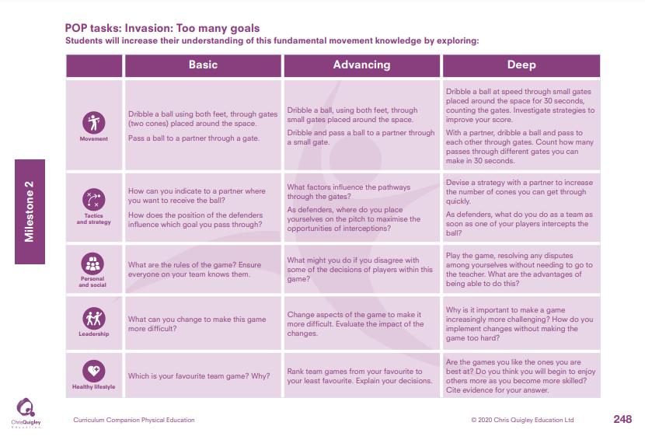

Slide 39
Invasion: Too many goals.
Decide how many lessons you will spend on the topic and use the information on the knowledge web to create the take-aways for each lesson
This table shows the knowledge that will be taught in each lesson
Year 3 | Dribble a ball using both feet, through gates (two cones) placed around the space. Pass a ball to a partner through a gate. | How can you indicate to a partner where you want to receive the ball? How does the position of the defenders influence which goal you pass through? | What are the rules of the game? Ensure everyone on your team knows them. | What can you change to make this game more difficult? | Which is your favourite team game? Why?
Year 4 | Dribble a ball, using both feet, through small gates placed around the space. Dribble and pass a ball to a partner through a small gate. Dribble a ball at speed through small gates placed around the space for 30 seconds, counting the gates. Investigate strategies to improve your score. With a partner, dribble a ball and pass to each other through gates. Count how many passes through different gates you can make in 30 seconds. | What factors influence the pathways through the gates? As defenders, where do you place yourselves on the pitch to maximise the opportunities of interceptions? Devise a strategy with a partner to increase the number of cones you can get through quickly. As defenders, what do you do as a team as soon as one of your players intercepts the ball? | What might you do if you disagree with some of the decisions of players within this game? Play the game, resolving any disputes among yourselves without needing to go to the teacher. What are the advantages of being able to do this? | Change aspects of the game to make it more difficult. Evaluate the impact of the changes. Why is it important to make a game increasingly more challenging? How do you implement changes without making the game too hard? | Rank team games from your favourite to your least favourite. Explain your decisions. Are the games you like the ones you are best at? Do you think you will begin to enjoy others more as you become more skilled? Cite evidence for your answer.

Slide 41
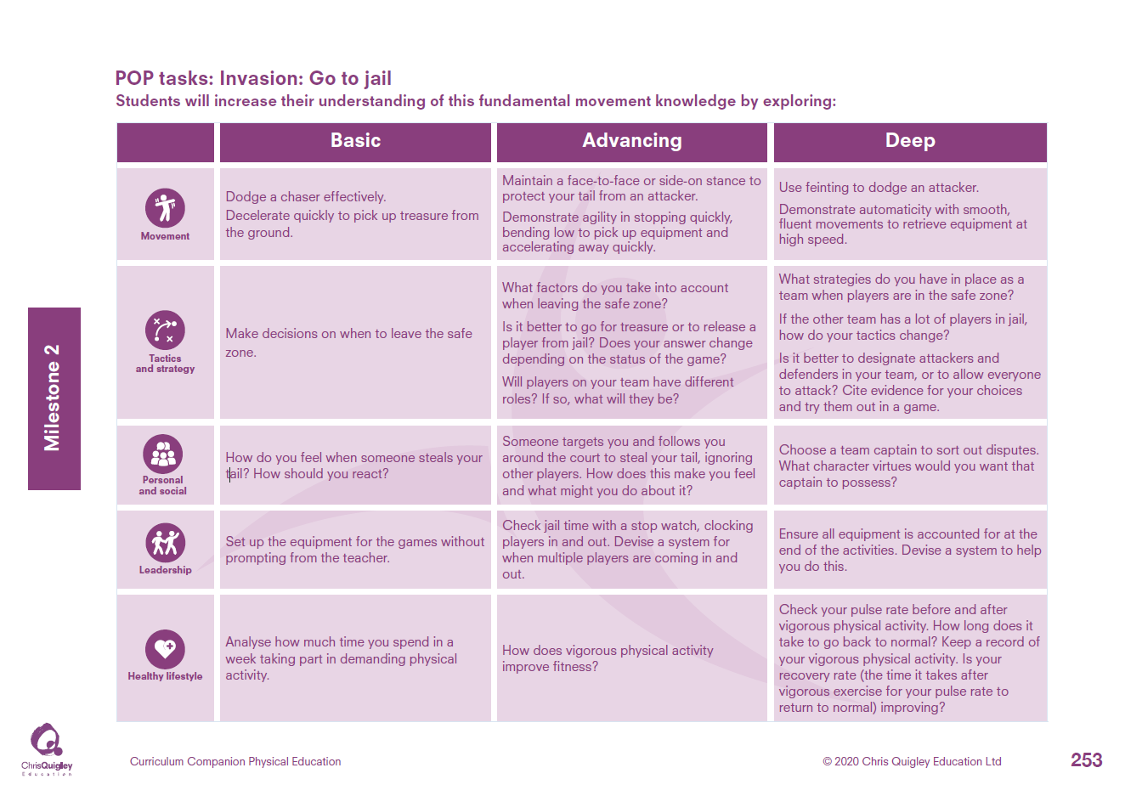

Slide 42
Invasion: Go to jail.
Decide how many lessons you will spend on the topic and use the information on the knowledge web to create the take-aways for each lesson
This table shows the knowledge that will be taught in each lesson
Year 3 | Dodge a chaser effectively. Decelerate quickly to pick up treasure from the ground. | Make decisions on when to leave the safe zone. | How do you feel when someone steals your tail? How should you react? | Set up the equipment for the games without prompting from the teacher. | Analyse how much time you spend in a week taking part in demanding physical activity.
Year 4 | Maintain a face-to-face or side-on stance to protect your tail from an attacker. Demonstrate agility in stopping quickly, bending low to pick up equipment and accelerating away quickly. Use feinting to dodge an attacker. Demonstrate automaticity with smooth, fluent movements to retrieve equipment at high speed. | What factors do you take into account when leaving the safe zone? Is it better to go for treasure or to release a player from jail? Does your answer change depending on the status of the game? Will players on your team have different roles? If so, what will they be? What strategies do you have in place as a team when players are in the safe zone? If the other team has a lot of players in jail, how do your tactics change? Is it better to designate attackers and defenders in your team, or to allow everyone to attack? Cite evidence for your choices and try them out in a game. | Someone targets you and follows you around the court to steal your tail, ignoring other players. How does this make you feel and what might you do about it? Choose a team captain to sort out disputes. What character virtues would you want that captain to possess? | Check jail time with a stop watch, clocking players in and out. Devise a system for when multiple players are coming in and out. Ensure all equipment is accounted for at the end of the activities. Devise a system to help you do this. | How does vigorous physical activity improve fitness? Check your pulse rate before and after vigorous physical activity. How long does it take to go back to normal? Keep a record of your vigorous physical activity. Is your recovery rate (the time it takes after vigorous exercise for your pulse rate to return to normal) improving?

Slide 44
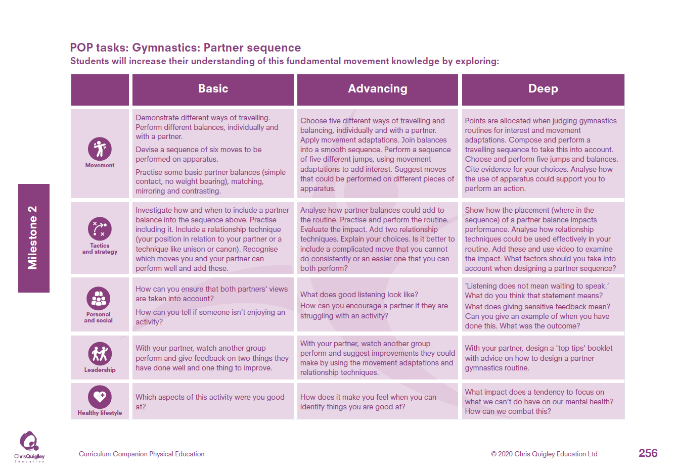

Slide 45
Gymnastics: Partner sequence.
Decide how many lessons you will spend on the topic and use the information on the knowledge web to create the take-aways for each lesson
This table shows the knowledge that will be taught in each lesson
Year 3 | Demonstrate different ways of travelling. Perform different balances, individually and with a partner. Devise a sequence of six moves to be performed on apparatus. Practise some basic partner balances (simple contact, no weight bearing), matching, mirroring and contrasting. | Investigate how and when to include a partner balance into the sequence above. Practise including it. Include a relationship technique (your position in relation to your partner or a technique like unison or canon). Recognise which moves you and your partner can perform well and add these. | How can you ensure that both partners' views are taken into account? How can you tell if someone isn’t enjoying an activity? | With your partner, watch another group perform and give feedback on two things they have done well and one thing to improve. | Which aspects of this activity were you good at?
Year 4 | Choose five different ways of travelling and balancing, individually and with a partner. Apply movement adaptations. Join balances into a smooth sequence. Perform a sequence of five different jumps, using movement adaptations to add interest. Suggest moves that could be performed on different pieces of apparatus. Points are allocated when judging gymnastics routines for interest and movement adaptations. Compose and perform a travelling sequence to take this into account. Choose and perform five jumps and balances. Cite evidence for your choices. Analyse how the use of apparatus could support you to perform an action. | Analyse how partner balances could add to the routine. Practise and perform the routine. Evaluate the impact. Add two relationship techniques. Explain your choices. Is it better to include a complicated move that you cannot do consistently or an easier one that you can both perform? Show how the placement (where in the sequence) of a partner balance impacts performance. Analyse how relationship techniques could be used effectively in your routine. Add these and use video to examine the impact. What factors should you take into account when designing a partner sequence? | What does good listening look like? How can you encourage a partner if they are struggling with an activity? ‘Listening does not mean waiting to speak.’ What do you think that statement means? What does giving sensitive feedback mean? Can you give an example of when you have done this. What was the outcome? | With your partner, watch another group perform and suggest improvements they could make by using the movement adaptations and relationship techniques. With your partner, design a 'top tips' booklet with advice on how to design a partners gymnastics routine. | How does it make you feel when you can identify things you are good at? What impact does a tendency to focus on what we can’t do have on our mental health? How can we combat this?

Slide 47
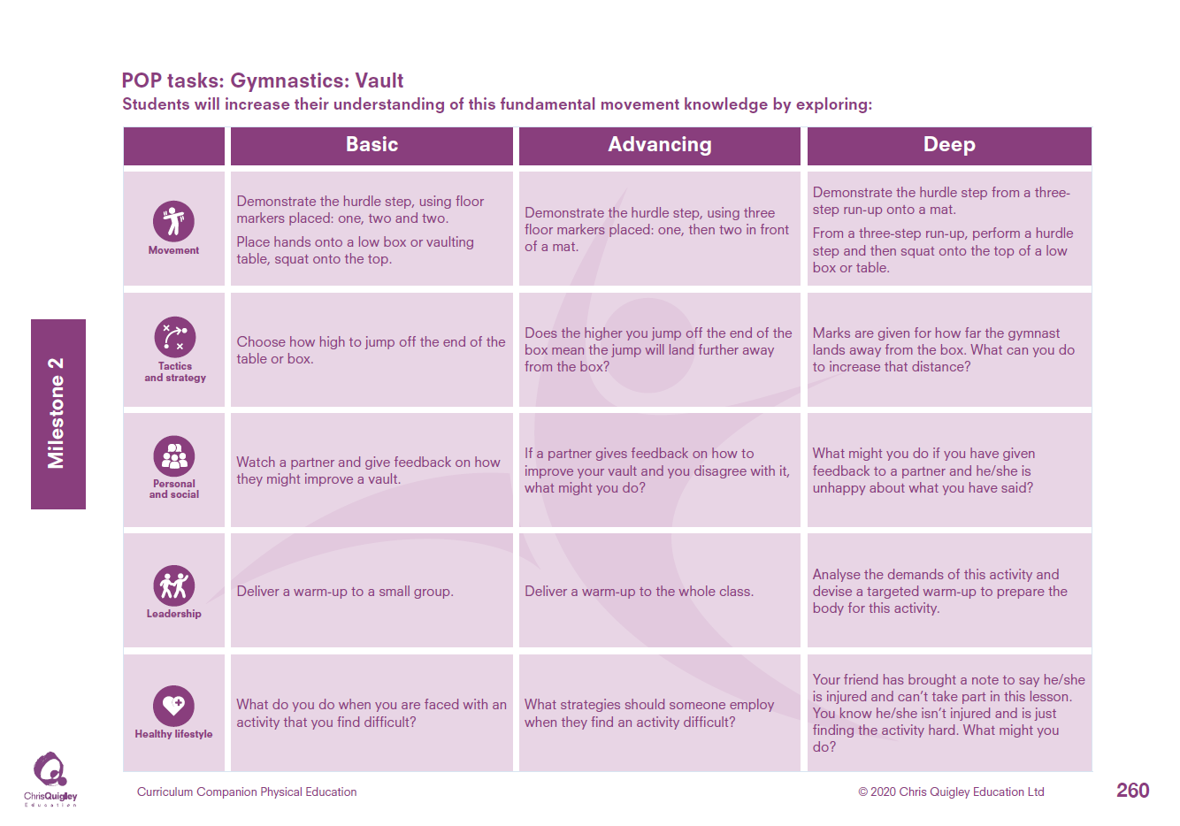

Slide 48
Gymnastics: Vault.
Decide how many lessons you will spend on the topic and use the information on the knowledge web to create the take-aways for each lesson
This table shows the knowledge that will be taught in each lesson
Year 3 | Demonstrate the hurdle step, using floor markers placed: one, two and two. Place hands onto a low box or vaulting table, squat onto the top. | Choose how high to jump off the end of the table or box. | Watch a partner and give feedback on how they might improve a vault. | Deliver a warm-up to a small group. | What do you do when you are faced with an activity that you find difficult?
Year 4 | Demonstrate the hurdle step, using three floor markers placed: one, then two in front of a mat. Demonstrate the hurdle step from a three step run-up onto a mat. From a three-step run-up, perform a hurdle step and then squat onto the top of a low box or table. | Does the higher you jump off the end of the box mean the jump will land further away from the box? Marks are given for how far the gymnast lands away from the box. What can you do to increase that distance? | If a partner gives feedback on how to improve your vault and you disagree with it, what might you do? What might you do if you have given feedback to a partner and he/she is unhappy about what you have said? | Deliver a warm-up to the whole class. Analyse the demands of this activity and devise a targeted warm-up to prepare the body for this activity. | What strategies should someone employ when they find an activity difficult? Your friend has brought a note to say he/she is injured and can’t take part in this lesson. You know he/she isn’t injured and is just finding the activity hard. What might you do?

Slide 50
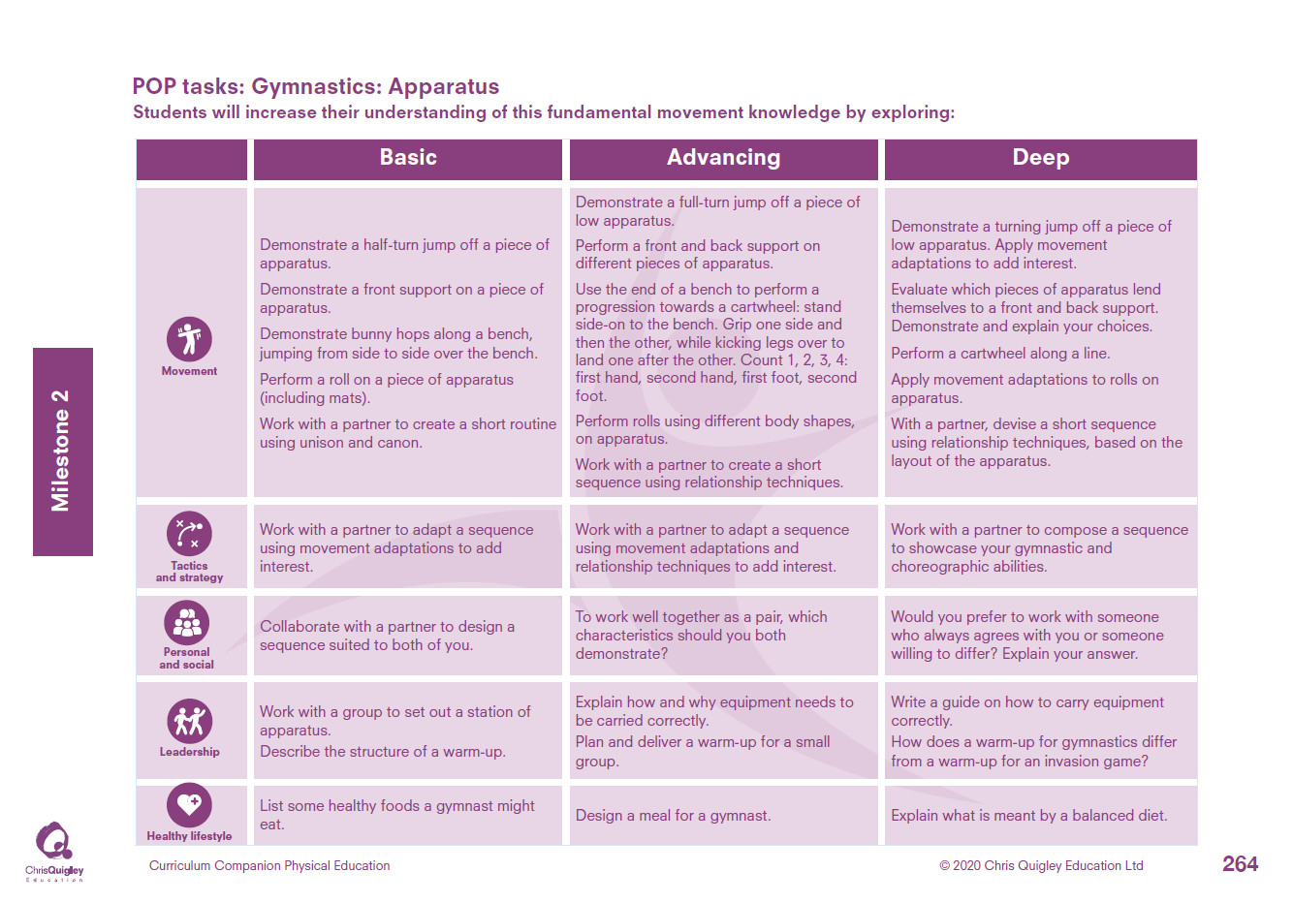

Slide 51
Gymnastics: Apparatus.
Decide how many lessons you will spend on the topic and use the information on the knowledge web to create the take-aways for each lesson
This table shows the knowledge that will be taught in each lesson
Year 3 | Demonstrate a half-turn jump off a piece of apparatus. Demonstrate a front support on a piece of apparatus. Demonstrate bunny hops along a bench, jumping from side to side over the bench. Perform a roll on a piece of apparatus (including mats). Work with a partner to create a short routine using unison and canon. | Work with a partner to adapt a sequence using movement adaptations to add interest. | Collaborate with a partner to design a sequence suited to both of you. | Work with a group to set out a station of apparatus. Describe the structure of a warm-up. | List some healthy foods a gymnast might eat.
Year 4 | Demonstrate a full-turn jump off a piece of low apparatus. Perform a front and back support on different pieces of apparatus. Use the end of a bench to perform a progression towards a cartwheel: stand side-on to the bench. Grip one side and then the other, while kicking legs over to land one after the other. Count 1, 2, 3, 4: first hand, second hand, first foot, second foot. Perform rolls using different body shapes, on apparatus. Work with a partner to create a short sequence using relationship techniques. Demonstrate a turning jump off a piece of low apparatus. Apply movement adaptations to add interest. Evaluate which pieces of apparatus lend themselves to a front and back support. Demonstrate and explain your choices. Perform a cartwheel along a line. Apply movement adaptations to rolls on apparatus. With a partner, devise a short sequence using relationship techniques, based on the layout of the apparatus. | Work with a partner to adapt a sequence using movement adaptations and relationship techniques to add interest. Work with a partner to compose a sequence to showcase your gymnastic and choreographic abilities. | To work well together as a pair, which characteristics should you both, demonstrate? Would you prefer to work with someone who always agrees with you or someone willing to differ? Explain your answer. | Explain how and why equipment needs to be carried correctly. Plan and deliver a warm-up for a small group. Write a guide on how to carry equipment correctly. How does a warm-up for gymnastics differ from a warm-up for an invasion game? | Design a meal for a gymnast. Explain what is meant by a balanced diet.

Slide 53
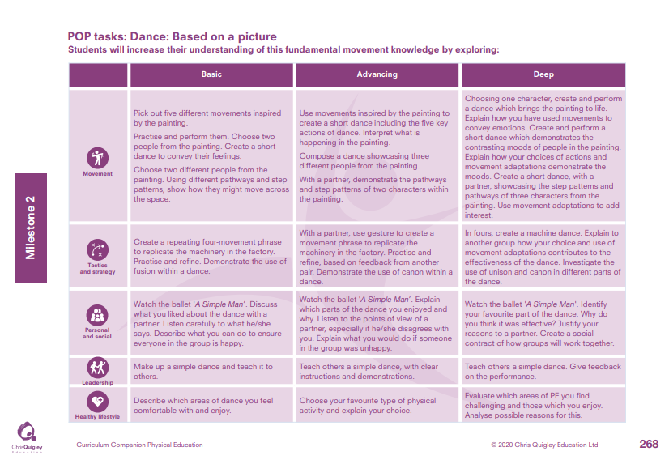

Slide 54
Dance: Based on a picture.
Decide how many lessons you will spend on the topic and use the information on the knowledge web to create the take-aways for each lesson
This table shows the knowledge that will be taught in each lesson
Year 3 | Pick out five different movements inspired by the painting. Practise and perform them. Choose two people from the painting. Create a short dance to convey their feelings. Choose two different people from the painting. Using different pathways and step patterns, show how they might move across the space. | Create a repeating four-movement phrase to replicate the machinery in the factory. Practise and refine. Demonstrate the use of fusion within a dance. | Watch the ballet 'A Simple Man’. Discuss what you liked about the dance with a partner. Listen carefully to what he/she says. Describe what you can do to ensure everyone in the group is happy. | Make up a simple dance and teach it to others. | Describe which areas of dance you feel comfortable with and enjoy
Year 4 | Use movements inspired by the painting to create a short dance including the five key actions of dance. Interpret what is happening in the painting. Compose a dance showcasing three different people from the painting. With a partner, demonstrate the pathways and step patterns of two characters within the painting. Choosing one character, create and perform a dance which brings the painting to life. Explain how you have used movements to convey emotions. Create and perform a short dance which demonstrates the contrasting moods of people in the painting. Explain how your choices of actions and movement adaptations demonstrate the moods. Create a short dance, with a partner, showcasing the step patterns and pathways of three characters from the painting. Use movement adaptations to add interest. | With a partner, use gesture to create a movement phrase to replicate the machinery in the factory. Practise and refine, based on feedback from another pair. Demonstrate the use of canon within a dance. In fours, create a machine dance. Explain to another group how your choice and use of movement adaptations contributes to the effectiveness of the dance. Investigate the use of unison and canon in different parts of the dance. | Watch the ballet 'A Simple Man’. Explain which parts of the dance you enjoyed and why. Listen to the points of view of a partner, especially if he/she disagrees with you. Explain what you would do if someone in the group was unhappy. Watch the ballet 'A Simple Man'. Identify your favourite part of the dance. Why do you think it was effective? Justify your reasons to a partner. Create a social contract of how groups will work together. | Teach others a simple dance, with clear instructions and demonstrations. Teach others a simple dance. Give feedback on the performance. | Choose your favourite type of physical activity and explain your choice. Evaluate which areas of PE you find challenging and those which you enjoy. Analyse possible reasons for this.

Slide 55
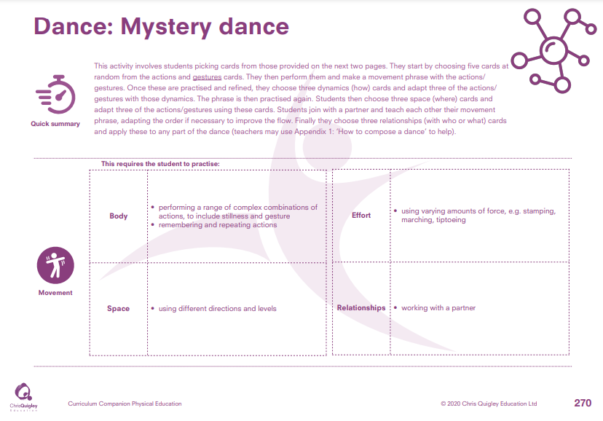

Slide 56
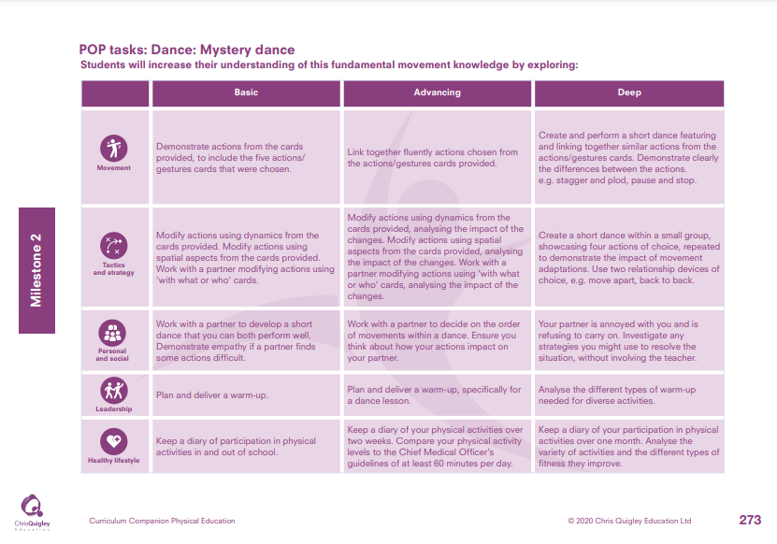

Slide 57
Dance: Mystery dance.
Decide how many lessons you will spend on the topic and use the information on the knowledge web to create the take-aways for each lesson
This table shows the knowledge that will be taught in each lesson
Year 3 | Demonstrate actions from the cards provided, to include the five actions/ gestures cards that were chosen. | Modify actions using dynamics from the cards provided. Modify actions using spatial aspects from the cards provided. Work with a partner modifying actions using 'with what or who' cards. | Work with a partner to develop a short dance that you can both perform well. Demonstrate empathy if a partner finds some actions difficult. | Plan and deliver a warm-up. | Keep a diary of participation in physical activities in and out of school.
Year 4 | Link together fluently actions chosen from the actions/gestures cards provided. Create and perform a short dance featuring and linking together similar actions from the actions/gestures cards. Demonstrate clearly the differences between the actions. e.g. stagger and plod, pause and stop. | Modify actions using dynamics from the cards provided, analysing the impact of the changes. Modify actions using spatial aspects from the cards provided, analysing the impact of the changes. Work with a partner modifying actions using 'with what or who' cards, analysing the impact of the changes. Create a short dance within a small group, showcasing four actions of choice, repeated to demonstrate the impact of movement adaptations. Use two relationship devices of choice, e.g. move apart, back to back. | Work with a partner to decide on the order of movements within a dance. Ensure you think about how your actions impact on your partner. Your partner is annoyed with you and is refusing to carry on. Investigate any strategies you might use to resolve the situation, without involving the teacher. | Plan and deliver a warm-up, specifically for a dance lesson. Analyse the different types of warm-up needed for diverse activities. | Keep a diary of your physical activities over two weeks. Compare your physical activity levels to the Chief Medical Officer’s guidelines of at least 60 minutes per day. Keep a diary of your participation in physical activities over one month. Analyse the variety of activities and the different types of fitness they improve.

Slide 59
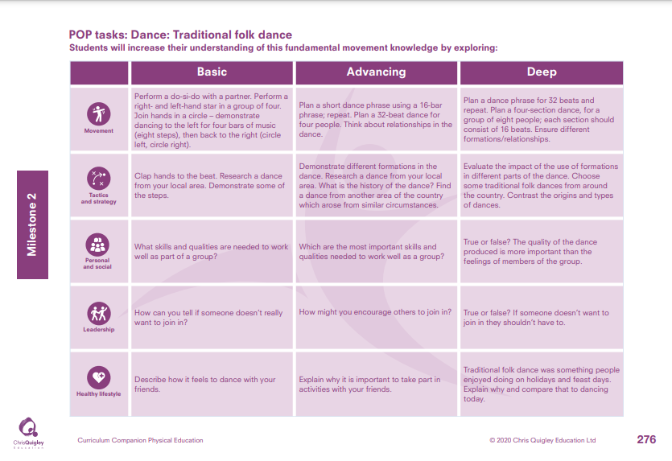

Slide 60
Dance: Traditional folk dance.
Decide how many lessons you will spend on the topic and use the information on the knowledge web to create the take-aways for each lesson
This table shows the knowledge that will be taught in each lesson
Year 3 | Perform a do-si-do with a partner. Perform a right- and left-hand star in a group of four. Join hands in a circle – demonstrate dancing to the left for four bars of music (eight steps), then back to the right (circle left, circle right). | Clap hands to the beat. Research a dance from your local area. Demonstrate some of the steps. | What skills and qualities are needed to work well as part of a group? | How can you tell if someone doesn’t really want to join in? | Describe how it feels to dance with your friends.
Year 4 | Plan a short dance phrase using a 16-bar phrase; repeat. Plan a 32-beat dance for four people. Think about relationships in the dance. Plan a dance phrase for 32 beats and repeat. Plan a four-section dance, for a group of eight people; each section should consist of 16 beats. Ensure different formations/relationships. | Demonstrate different formations in the dance. Research a dance from your local area. What is the history of the dance? Find a dance from another area of the country which arose from similar circumstances. Evaluate the impact of the use of formations in different parts of the dance. Choose some traditional folk dances from around the country. Contrast the origins and types of dances. | Which are the most important skills and qualities needed to work well as a group? True or false? The quality of the dance produced is more important than the feelings of members of the group. | How might you encourage others to join in? True or false? If someone doesn’t want to join in they shouldn’t have to. | Explain why it is important to take part in activities with your friends. Traditional folk dance was something people enjoyed doing on holidays and feast days. Explain why and compare that to dancing today.

Slide 62
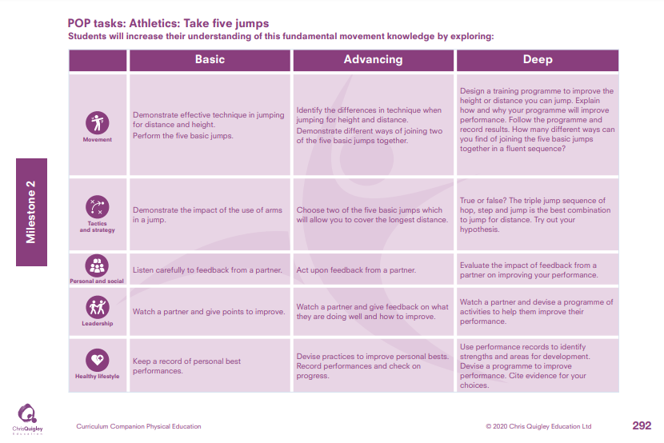

Slide 63
Athletics: Take five jumps.
Decide how many lessons you will spend on the topic and use the information on the knowledge web to create the take-aways for each lesson
This table shows the knowledge that will be taught in each lesson
Year 3 | Demonstrate effective technique in jumping for distance and height. Perform the five basic jumps. | Demonstrate the impact of the use of arms in a jump. | Listen carefully to feedback from a partner. | Watch a partner and give points to improve. | Keep a record of personal best performances.
Year 4 | Identify the differences in technique when jumping for height and distance. Demonstrate different ways of joining two of the five basic jumps together. Design a training programme to improve the height or distance you can jump. Explain how and why your programme will improve performance. Follow the programme and record results. How many different ways can you find of joining the five basic jumps together in a fluent sequence? | Choose two of the five basic jumps which will allow you to cover the longest distance. True or false? The triple jump sequence of hop, step and jump is the best combination to jump for distance. Try out your hypothesis. | Act upon feedback from a partner. Evaluate the impact of feedback from a partner on improving your performance. | e. Watch a partner and give feedback on what they are doing well and how to improve. Watch a partner and devise a programme of activities to help them improve their performance. | Devise practices to improve personal bests. Record performances and check on progress. Use performance records to identify strengths and areas for development. Devise a programme to improve performance. Cite evidence for your choices.

Slide 65
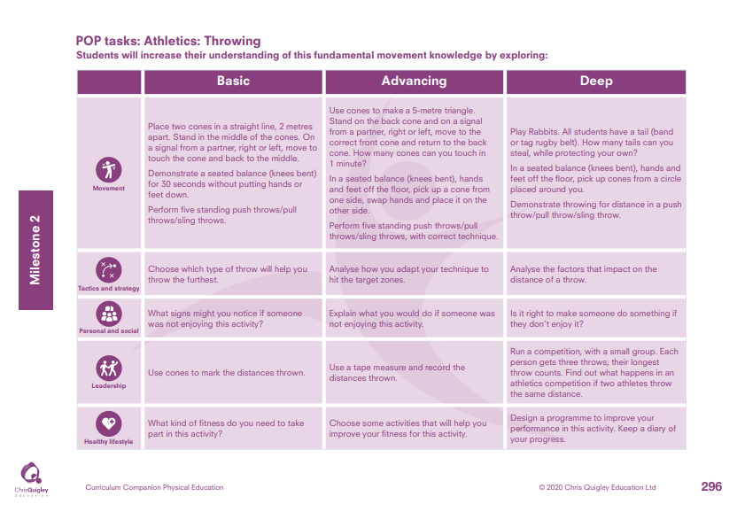

Slide 66
Athletics: Throwing.
Decide how many lessons you will spend on the topic and use the information on the knowledge web to create the take-aways for each lesson
This table shows the knowledge that will be taught in each lesson
Year 3 | Place two cones in a straight line, 2 metres apart. Stand in the middle of the cones. On a signal from a partner, right or left, move to touch the cone and back to the middle. Demonstrate a seated balance (knees bent) for 30 seconds without putting hands or feet down. Perform five standing push throws/pull throws/sling throws. | Choose which type of throw will help you throw the furthest. | What signs might you notice if someone was not enjoying this activity? | Use cones to mark the distances thrown. | What kind of fitness do you need to take part in this activity?
Year 4 | Use cones to make a 5-metre triangle. Stand on the back cone and on a signal from a partner, right or left, move to the correct front cone and return to the back cone. How many cones can you touch in 1 minute? In a seated balance (knees bent), hands and feet off the floor, pick up a cone from one side, swap hands and place it on the other side. Perform five standing push throws/pull throws/sling throws, with correct technique. Play Rabbits. All students have a tail (band or tag rugby belt). How many tails can you steal, while protecting your own? In a seated balance (knees bent), hands and feet off the floor, pick up cones from a circle placed around you. Demonstrate throwing for distance in a push throw/pull throw/sling throw. | Analyse how you adapt your technique to hit the target zones. Analyse the factors that impact on the distance of a throw | Explain what you would do if someone was not enjoying this activity Is it right to make someone do something if they don’t enjoy it? | Use a tape measure and record the distances thrown. Run a competition, with a small group. Each person gets three throws; their longest throw counts. Find out what happens in an athletics competition if two athletes throw the same distance. | Choose some activities that will help you improve your fitness for this activity. Design a programme to improve your performance in this activity. Keep a diary of your progress.

Slide 67
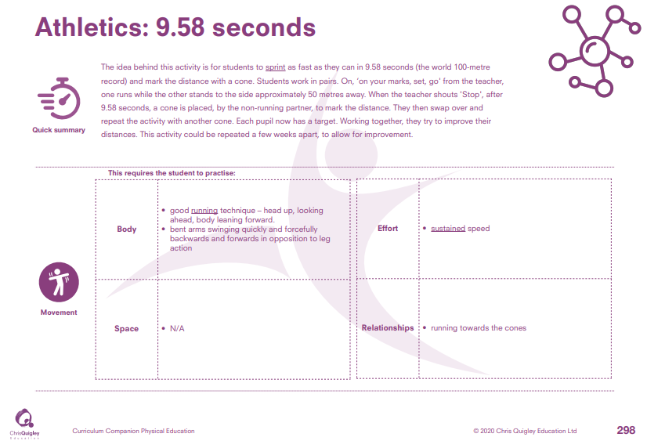

Slide 68
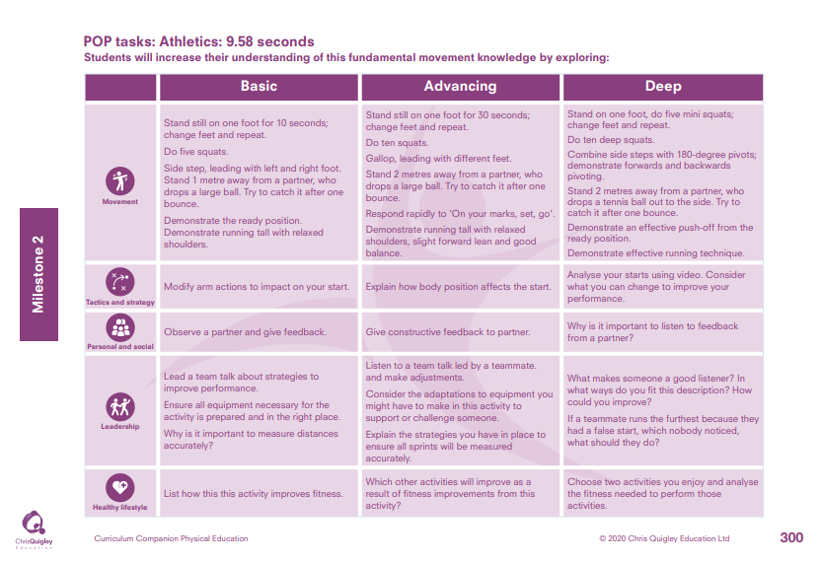

Slide 69
Athletics: 9.58 seconds.
Decide how many lessons you will spend on the topic and use the information on the knowledge web to create the take-aways for each lesson
This table shows the knowledge that will be taught in each lesson
Year 3 | Stand still on one foot for 10 seconds; change feet and repeat. Do five squats. Side step, leading with left and right foot. Stand 1 metre away from a partner, who drops a large ball. Try to catch it after one bounce. Demonstrate the ready position. Demonstrate running tall with relaxed shoulders. | Modify arm actions to impact on your start. | Observe a partner and give feedback. | Lead a team talk about strategies to improve performance. Ensure all equipment necessary for the activity is prepared and in the right place. Why is it important to measure distances accurately? | List how this this activity improves fitness.
Year 4 | Stand still on one foot for 30 seconds; change feet and repeat. Do ten squats. Gallop, leading with different feet. Stand 2 metres away from a partner, who drops a large ball. Try to catch it after one bounce. Respond rapidly to 'On your marks, set, go’. Demonstrate running tall with relaxed shoulders, slight forward lean and good balance. Stand on one foot, do five mini squats; change feet and repeat. Do ten deep squats. Combine side steps with 180-degree pivots; demonstrate forwards and backwards pivoting. Stand 2 metres away from a partner, who drops a tennis ball out to the side. Try to catch it after one bounce. Demonstrate an effective push-off from the ready position. Demonstrate effective running technique | Explain how body position affects the start. Analyse your starts using video. Consider what you can change to improve your performance. | Give constructive feedback to partner. Why is it important to listen to feedback from a partner? | Listen to a team talk led by a teammate. and make adjustments. Consider the adaptations to equipment you might have to make in this activity to support or challenge someone. Explain the strategies you have in place to ensure all sprints will be measured accurately. What makes someone a good listener? In what ways do you fit this description? How could you improve? If a teammate runs the furthest because they had a false start, which nobody noticed, what should they do? | Which other activities will improve as a result of fitness improvements from this activity? Choose two activities you enjoy and analyse the fitness needed to perform those activities.

Slide 71
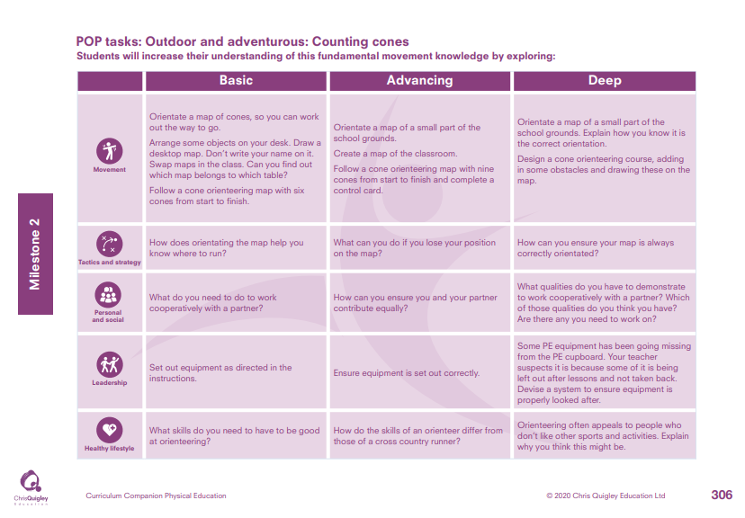

Slide 72
Outdoor and adventurous: Counting cones.
Decide how many lessons you will spend on the topic and use the information on the knowledge web to create the take-aways for each lesson
This table shows the knowledge that will be taught in each lesson
Year 3 | Orientate a map of cones, so you can work out the way to go. Arrange some objects on your desk. Draw a desktop map. Don’t write your name on it. Swap maps in the class. Can you find out which map belongs to which table? Follow a cone orienteering map with six cones from start to finish. | How does orientating the map help you know where to run? | What do you need to do to work cooperatively with a partner? | Set out equipment as directed in the instructions. | What skills do you need to have to be good at orienteering?
Year 4 | Orientate a map of a small part of the school grounds. Create a map of the classroom. Follow a cone orienteering map with nine cones from start to finish and complete a control card. Orientate a map of a small part of the school grounds. Explain how you know it is the correct orientation. Design a cone orienteering course, adding in some obstacles and drawing these on the map. | What can you do if you lose your position on the map? How can you ensure your map is always correctly orientated? | How can you ensure you and your partner contribute equally? What qualities do you have to demonstrate to work cooperatively with a partner? Which of those qualities do you think you have? Are there any you need to work on? | Ensure equipment is set out correctly. Some PE equipment has been going missing from the PE cupboard. Your teacher suspects it is because some of it is being left out after lessons and not taken back. Devise a system to ensure equipment is properly looked after. | How do the skills of an orienteer differ from those of a cross country runner? Orienteering often appeals to people who don’t like other sports and activities. Explain why you think this might be.

Slide 74
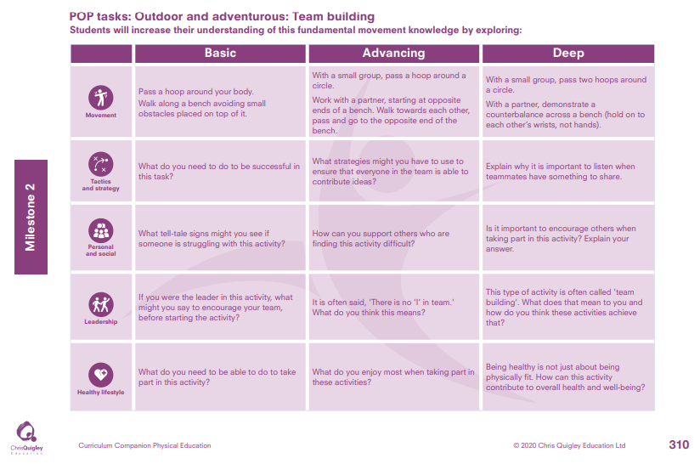

Slide 75
Outdoor and adventurous: Team building.
Decide how many lessons you will spend on the topic and use the information on the knowledge web to create the take-aways for each lesson
This table shows the knowledge that will be taught in each lesson
Year 3 | Pass a hoop around your body. Walk along a bench avoiding small obstacles placed on top of it. | What do you need to do to be successful in this task? | What tell-tale signs might you see if someone is struggling with this activity? | If you were the leader in this activity, what might you say to encourage your team, before starting the activity? | What do you need to be able to do to take part in this activity?
Year 4 | With a small group, pass a hoop around a circle. Work with a partner, starting at opposite ends of a bench. Walk towards each other, pass and go to the opposite end of the bench. With a small group, pass two hoops around a circle. With a partner, demonstrate a counterbalance across a bench (hold on to each other’s wrists, not hands). | What strategies might you have to use to ensure that everyone in the team is able to contribute ideas? Explain why it is important to listen when teammates have something to share. | How can you support others who are finding this activity difficult? Is it important to encourage others when taking part in this activity? Explain your answer. | It is often said, 'There is no ‘I’ in team.' What do you think this means? This type of activity is often called 'team building'. What does that mean to you and how do you think these activities achieve that? | What do you enjoy most when taking part in these activities? Being healthy is not just about being physically fit. How can this activity contribute to overall health and well-being?

Slide 77
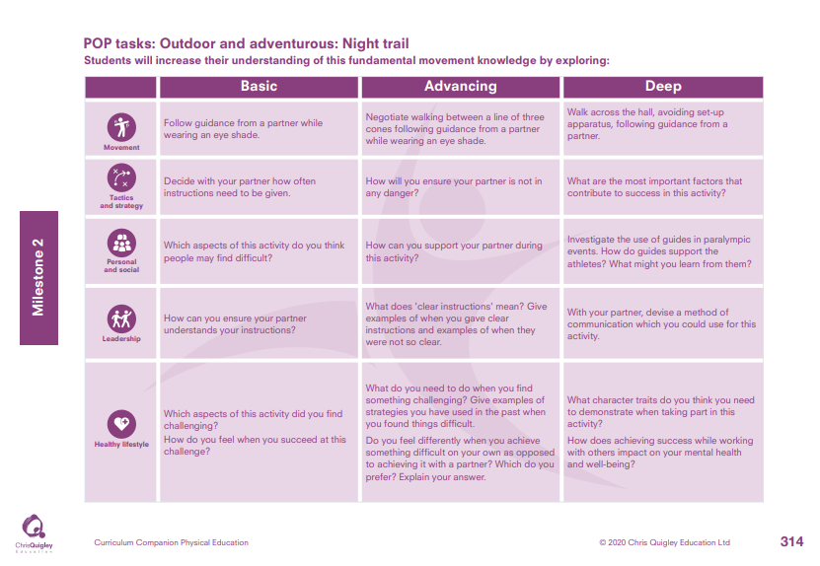

Slide 78
Outdoor and adventurous: Night trail.
Decide how many lessons you will spend on the topic and use the information on the knowledge web to create the take-aways for each lesson
This table shows the knowledge that will be taught in each lesson
Year 3 | Follow guidance from a partner while wearing an eye shade. | Decide with your partner how often instructions need to be given. | Which aspects of this activity do you think people may find difficult? | How can you ensure your partner understands your instructions? | Which aspects of this activity did you find challenging? How do you feel when you succeed at this challenge?
Year 4 | Negotiate walking between a line of three cones following guidance from a partner while wearing an eye shade. Walk across the hall, avoiding set-up apparatus, following guidance from a partner. | How will you ensure your partner is not in any danger? What are the most important factors that contribute to success in this activity? | How can you support your partner during this activity? Investigate the use of guides in Paralympic events. How do guides support the athletes? What might you learn from them? | What does 'clear instructions' mean? Give examples of when you gave clear instructions and examples of when they were not so clear. With your partner, devise a method of communication which you could use for this activity. | What do you need to do when you find something challenging? Give examples of strategies you have used in the past when you found things difficult. Do you feel differently when you achieve something difficult on your own as opposed to achieving it with a partner? Which do you prefer? Explain your answer. What character traits do you think you need to demonstrate when taking part in this activity? How does achieving success while working with others impact on your mental health and well-being?

