Slide 1
Upper Key Stage 2 Art Curriculum
Together we Nurture, Inspire and Achieve

Slide 2
Art topics overview
Art topics are organised and referenced around an artistic schema. Each topic either introduces an aspect of the schema or references previous instances of it. Below is an overview of the topics we teach and which aspects of the schema it strengthens:
ts
Study of Surrealism |  |  |  | * |  | * | * | *
Salvadore Dali |  | * | * |  | * |  |  | *
Explosion of pop art |  | * |  |  |  | * | * |  | *
Andy Warhol |  |  | * | * | * |  |  | *
Amazed by architecture | * | * |  |  | * | *
Zaha Hadid |  | * |  |  | * |  |  | * | *
Exploring Expressionism |  | * |  | * |  | * |  |  | *
Henry Matisse |  | * | * | * |  |  |  | *
Art and Fashion |  |  |  | * |  | * | * |  | *
Piet Mondrian | * |  | * |  |  |  | * | *
Futurism |  | * |  |  | * | * | *
Umberto Boccioni | * |  | * |  |  |  | * | *
Art and Religion | * |  |  | * |  |  |  | * | *
C l Greco |  | * |  |  |  |  | * | * | *
Cultural tradition |  |  |  | * |  |  | * | * | *
Richard Kimbo | * |  | * |  |  |  |  | * | *

Slide 4
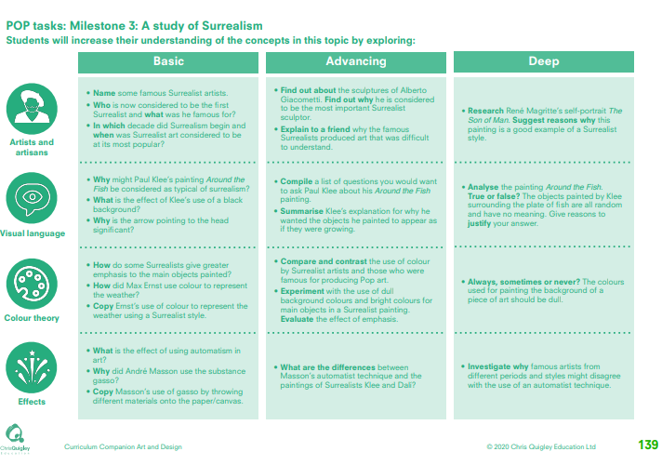

Slide 5
A study of Surrealism
This table shows the knowledge that will be taught in each lesson
Year 5 | Name some famous Surrealist artists. Who is now considered to be the first Surrealist and what was he famous for? In which decade did Surrealism begin and when was Surrealist art considered to be at its most popular? | Why might Paul Klee’s painting Around the Fish be considered as typical of surrealism? What is the effect of Klee’s use of a black background? Why is the arrow pointing to the head significant? | How do some Surrealists give greater emphasis to the main objects painted? How did Max Ernst use colour to represent the weather? Copy Ernst’s use of colour to represent the weather using a Surrealist style. | What is the effect of using automatism in art? Why did André Masson use the substance gasso? Copy Masson’s use of gasso by throwing different materials onto the paper/canvas.
Year 6 | Find out about the sculptures of Alberto Giacometti. Find out why he is considered to be the most important Surrealist sculptor. Explain to a friend why the famous Surrealists produced art that was difficult to understand. Research René Magritte’s self-portrait The Son of Man. Suggest reasons why this painting is a good example of a Surrealist style. | Compile a list of questions you would want to ask Paul Klee about his Around the Fish painting. Summarise Klee’s explanation for why he wanted the objects he painted to appear as if they were growing. Analyse the painting Around the Fish. True or false? The objects painted by Klee surrounding the plate of fish are all random and have no meaning. Give reasons to justify your answer. | Compare and contrast the use of colour by Surrealist artists and those who were famous for producing Pop art. Experiment with the use of dull background colours and bright colours for main objects in a Surrealist painting. Evaluate the effect of emphasis. Always, sometimes or never? The colours used for painting the background of a piece of art should be dull. | What are the differences between Masson’s automatist technique and the paintings of Surrealists Klee and Dalí? Investigate why famous artists from different periods and styles might disagree with the use of an automatist technique

Slide 6
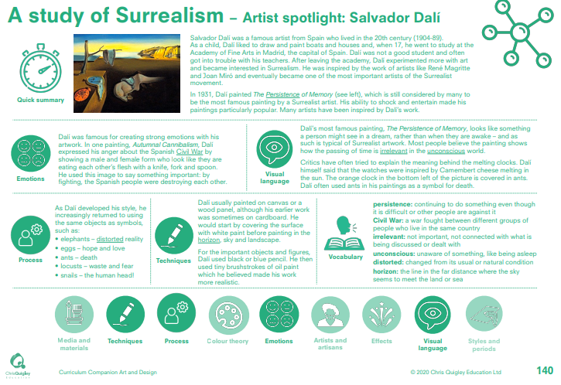

Slide 7
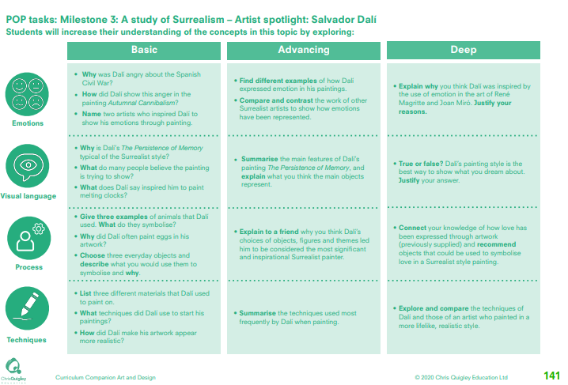

Slide 8
A study of Surrealism – Salvador Dali
This table shows the knowledge that will be taught in each lesson
Year 1 | Why was Dalí angry about the Spanish Civil War? How did Dalí show this anger in the painting Autumnal Cannibalism? Name two artists who inspired Dalí to show his emotions through painting. | Why is Dalí’s The Persistence of Memory typical of the Surrealist style? What do many people believe the painting is trying to show? What does Dalí say inspired him to paint melting clocks. | Give three examples of animals that Dalí used. What do they symbolise? Why did Dalí often paint eggs in his artwork? Choose three everyday objects and describe what you would use them to symbolise and why. | List three different materials that Dalí used to paint on. What techniques did Dalí use to start his paintings? How did Dalí make his artwork appear more realistic?
Year 2 | Find different examples of how Dalí expressed emotion in his paintings. Compare and contrast the work of other Surrealist artists to show how emotions have been represented. Explain why you think Dalí was inspired by the use of emotion in the art of René Magritte and Joan Miró. Justify your reasons. | Summarise the main features of Dalí’s painting The Persistence of Memory, and explain what you think the main objects represent. True or false? Dalí’s painting style is the best way to show what you dream about. Justify your answer. | Explain to a friend why you think Dalí’s choices of objects, figures and themes led him to be considered the most significant and inspirational Surrealist painter. Connect your knowledge of how love has been expressed through artwork (previously supplied) and recommend objects that could be used to symbolise love in a Surrealist style painting. | Summarise the techniques used most frequently by Dalí when painting. Explore and compare the techniques of Dalí and those of an artist who painted in a more lifelike, realistic style.

Slide 9
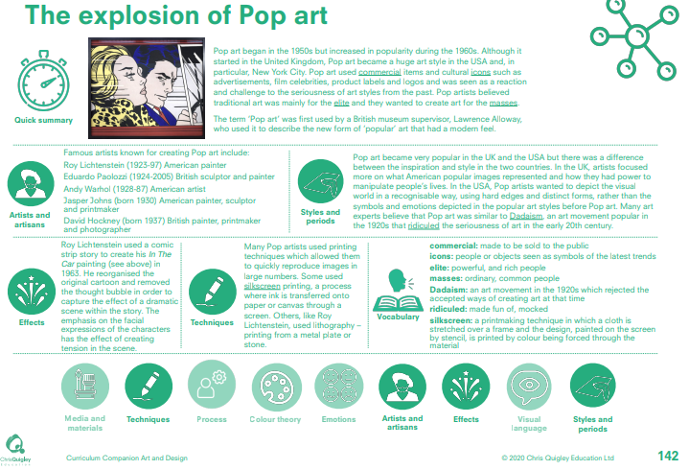

Slide 10
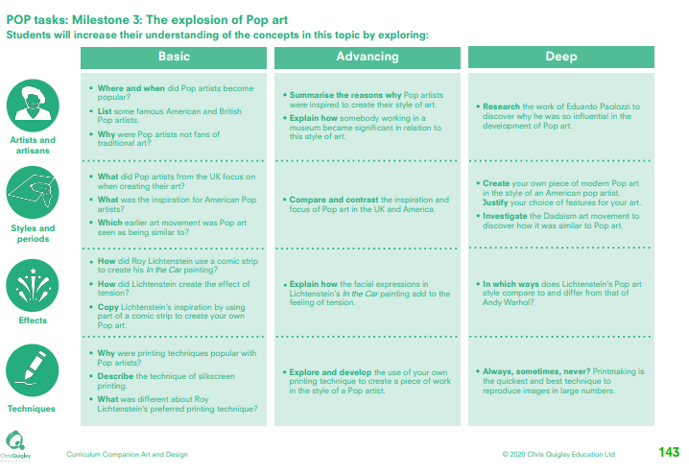

Slide 11
The explosion of Pop art
This table shows the knowledge that will be taught in each lesson
Year 1 | Where and when did Pop artists become popular? List some famous American and British Pop artists. Why were Pop artists not fans of traditional art? | What did Pop artists from the UK focus on when creating their art? What was the inspiration for American Pop artists? Which earlier art movement was Pop art seen as being similar to? | How did Roy Lichtenstein use a comic strip to create his In the Car painting? How did Lichtenstein create the effect of tension? Copy Lichtenstein’s inspiration by using part of a comic strip to create your own Pop art. | Why were printing techniques popular with Pop artists? Describe the technique of silkscreen printing. What was different about Roy Lichtenstein’s preferred printing technique?
Year 2 | Summarise the reasons why Pop artists were inspired to create their style of art. Explain how somebody working in a museum became significant in relation to this style of art. Research the work of Eduardo Paolozzi to discover why he was so influential in the development of Pop art. | Compare and contrast the inspiration and focus of Pop art in the UK and America. Create your own piece of modern Pop art in the style of an American pop artist. Justify your choice of features for your art. Investigate the Dadaism art movement to discover how it was similar to Pop art. | Explain how the facial expressions in Lichtenstein’s In the Car painting add to the feeling of tension. In which ways does Lichtenstein’s Pop art style compare to and differ from that of Andy Warhol? | Explore and develop the use of your own printing technique to create a piece of work in the style of a Pop artist. Always, sometimes, never? Printmaking is the quickest and best technique to reproduce images in large numbers.

Slide 12
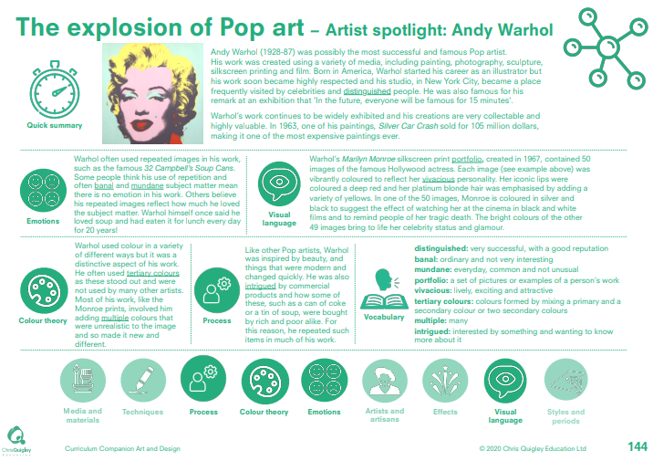

Slide 13
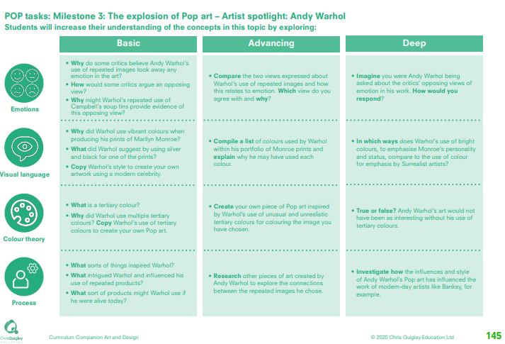

Slide 14
The explosion of Pop art – Andy Warhol
This table shows the knowledge that will be taught in each lesson
Year 1 | Why do some critics believe Andy Warhol’s use of repeated images took away any emotion in the art? How would some critics argue an opposing view? Why might Warhol’s repeated use of Campbell’s soup tins provide evidence of this opposing view? | Why did Warhol use vibrant colours when producing his prints of Marilyn Monroe? What did Warhol suggest by using silver and black for one of the prints? Copy Warhol’s style to create your own artwork using a modern celebrity. | What is a tertiary colour? Why did Warhol use multiple tertiary colours? Copy Warhol's use of tertiary colours to create your own Pop art. | What sorts of things inspired Warhol? What intrigued Warhol and influenced his use of repeated products? What sort of products might Warhol use if he were alive today?
Year 2 | Compare the two views expressed about Warhol’s use of repeated images and how this relates to emotion. Which view do you agree with and why? Imagine you were Andy Warhol being asked about the critics’ opposing views of emotion in his work. How would you respond? | Compile a list of colours used by Warhol within his portfolio of Monroe prints and explain why he may have used each colour. In which ways does Warhol’s use of bright colours, to emphasise Monroe’s personality and status, compare to the use of colour for emphasis by Surrealist artists? | Create your own piece of Pop art inspired by Warhol’s use of unusual and unrealistic tertiary colours for colouring the image you have chosen. True or false? Andy Warhol’s art would not have been as interesting without his use of tertiary colours. | Research other pieces of art created by Andy Warhol to explore the connections between the repeated images he chose. Investigate how the influences and style of Andy Warhol’s Pop art has influenced the work of modern-day artists like Banksy, for example.

Slide 16
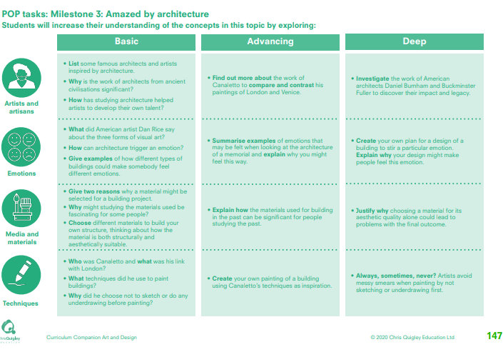

Slide 17
Amazed by architecture
This table shows the knowledge that will be taught in each lesson
Year 1 | List some famous architects and artists inspired by architecture. Why is the work of architects from ancient civilisations significant? How has studying architecture helped artists to develop their own talent? | What did American artist Dan Rice say about the three forms of visual art? How can architecture trigger an emotion? Give examples of how different types of buildings could make somebody feel different emotions. | Give two reasons why a material might be selected for a building project. Why might studying the materials used be fascinating for some people? Choose different materials to build your own structure, thinking about how the material is both structurally and aesthetically suitable | Who was Canaletto and what was his link with London? What techniques did he use to paint buildings? Why did he choose not to sketch or do any underdrawing before painting?
Year 2 | Find out more about the work of Canaletto to compare and contrast his paintings of London and Venice. Investigate the work of American architects Daniel Burnham and Buckminster Fuller to discover their impact and legacy. | Summarise examples of emotions that may be felt when looking at the architecture of a memorial and explain why you might feel this way. Create your own plan for a design of a building to stir a particular emotion. Explain why your design might make people feel this emotion. | Explain how the materials used for building in the past can be significant for people studying the past. Justify why choosing a material for its aesthetic quality alone could lead to problems with the final outcome | Create your own painting of a building using Canaletto’s techniques as inspiration. Always, sometimes, never? Artists avoid messy smears when painting by not sketching or underdrawing first.

Slide 18
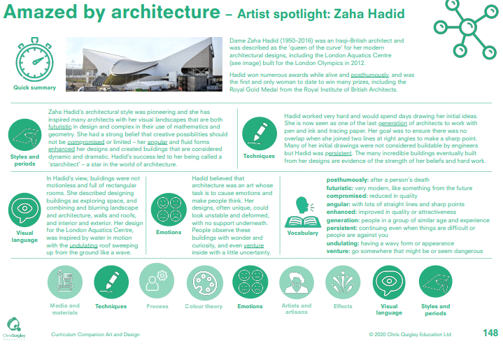

Slide 19
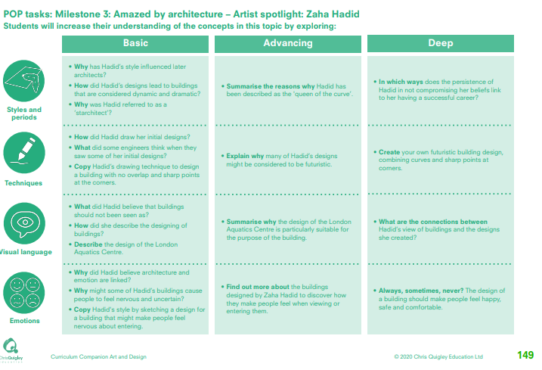

Slide 20
Amazed by architecture – Zaha Hadid
This table shows the knowledge that will be taught in each lesson
Year 1 | Why has Hadid’s style influenced later architects? How did Hadid’s designs lead to buildings that are considered dynamic and dramatic? Why was Hadid referred to as a ‘starchitect’? | How did Hadid draw her initial designs? What did some engineers think when they saw some of her initial designs? Copy Hadid’s drawing technique to design a building with no overlap and sharp points at the corners. | What did Hadid believe that buildings should not been seen as? How did she describe the designing of buildings? Describe the design of the London Aquatics Centre | Why did Hadid believe architecture and emotion are linked? Why might some of Hadid’s buildings cause people to feel nervous and uncertain? Copy Hadid's style by sketching a design for a building that might make people feel nervous about entering.
Year 2 | Summarise the reasons why Hadid has been described as the 'queen of the curve’. In which ways does the persistence of Hadid in not compromising her beliefs link to her having a successful career? | Explain why many of Hadid’s designs might be considered to be futuristic. Create your own futuristic building design, combining curves and sharp points at corners. | Summarise why the design of the London Aquatics Centre is particularly suitable for the purpose of the building. What are the connections between Hadid’s view of buildings and the designs she created? | Find out more about the buildings designed by Zaha Hadid to discover how they make people feel when viewing or entering them. Always, sometimes, never? The design of a building should make people feel happy, safe and comfortable.

Slide 21
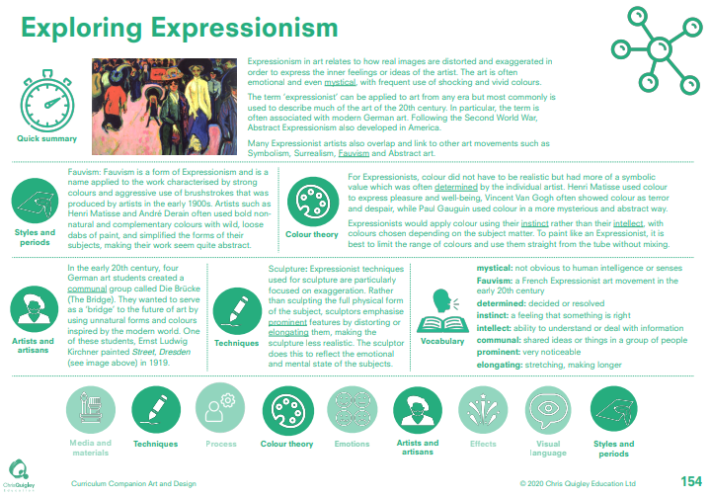

Slide 22
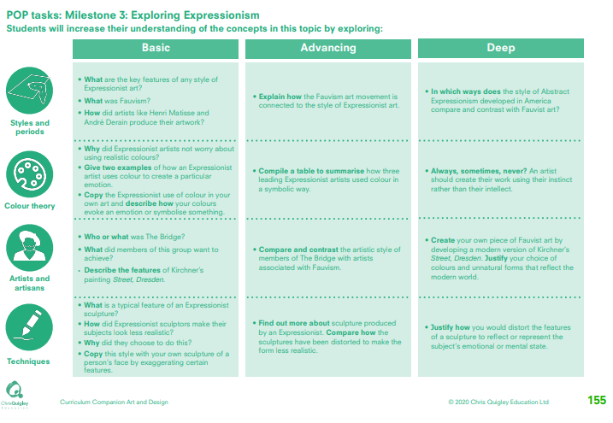

Slide 23
Exploring Expressionism
This table shows the knowledge that will be taught in each lesson
Year 1 | What are the key features of any style of Expressionist art? What was Fauvism? How did artists like Henri Matisse and André Derain produce their artwork? | Why did Expressionist artists not worry about using realistic colours? Give two examples of how an Expressionist artist uses colour to create a particular emotion. Copy the Expressionist use of colour in your own art and describe how your colours evoke an emotion or symbolise something. | Who or what was The Bridge? What did members of this group want to achieve? Describe the features of Kirchner’s painting Street, Dresden. | What is a typical feature of an Expressionist sculpture? How did Expressionist sculptors make their subjects look less realistic? Why did they choose to do this? Copy this style with your own sculpture of a person’s face by exaggerating certain features
Year 2 | Explain how the Fauvism art movement is connected to the style of Expressionist art. In which ways does the style of Abstract Expressionism developed in America compare and contrast with Fauvist art?. | Compile a table to summarise how three leading Expressionist artists used colour in a symbolic way. Always, sometimes, never? An artist should create their work using their instinct rather than their intellect. | Compare and contrast the artistic style of members of The Bridge with artists associated with Fauvism. Create your own piece of Fauvist art by developing a modern version of Kirchner’s Street, Dresden. Justify your choice of colours and unnatural forms that reflect the modern world. | Find out more about sculpture produced by an Expressionist. Compare how the sculptures have been distorted to make the form less realistic. Justify how you would distort the features of a sculpture to reflect or represent the subject’s emotional or mental state.

Slide 24
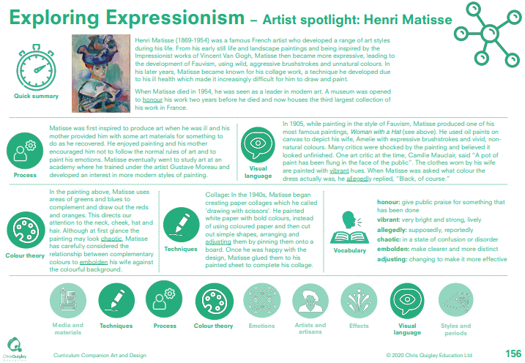

Slide 25
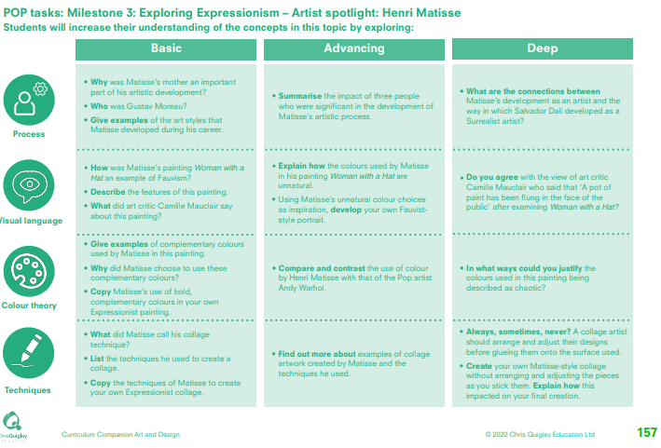

Slide 26
Exploring Expressionism – Henri Matisse
This table shows the knowledge that will be taught in each lesson
Year 1 | Why was Matisse’s mother an important part of his artistic development? Who was Gustav Moreau? Give examples of the art styles that Matisse developed during his career. | How was Matisse’s painting Woman with a Hat an example of Fauvism? Describe the features of this painting. What did art critic Camille Mauclair say about this painting? | Give examples of complementary colours used by Matisse in this painting. Why did Matisse choose to use these complementary colours? Copy Matisse’s use of bold, complementary colours in your own Expressionist painting. | What did Matisse call his collage technique? List the techniques he used to create a collage. Copy the techniques of Matisse to create your own Expressionist collage.
Year 2 | Summarise the impact of three people who were significant in the development of Matisse’s artistic process. What are the connections between Matisse’s development as an artist and the way in which Salvador Dalí developed as a Surrealist artist? | Explain how the colours used by Matisse in his painting Woman with a Hat are unnatural. Using Matisse’s unnatural colour choices as inspiration, develop your own Fauviststyle portrait. Do you agree with the view of art critic Camille Mauclair who said that ‘A pot of paint has been flung in the face of the public’ after examining Woman with a Hat? | Compare and contrast the use of colour by Henri Matisse with that of the Pop artist Andy Warhol. In what ways could you justify the colours used in this painting being described as chaotic? | Find out more about examples of collage artwork created by Matisse and the techniques he used. Always, sometimes, never? A collage artist should arrange and adjust their designs before glueing them onto the surface used. Create your own Matisse-style collage without arranging and adjusting the pieces as you stick them. Explain how this impacted on your final creation.

Slide 27
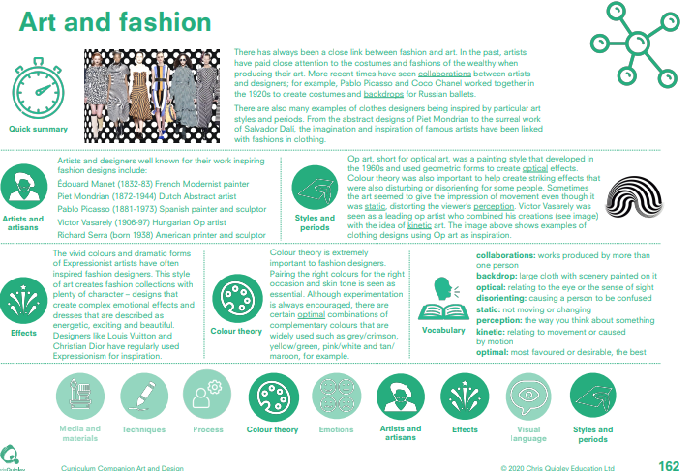

Slide 28
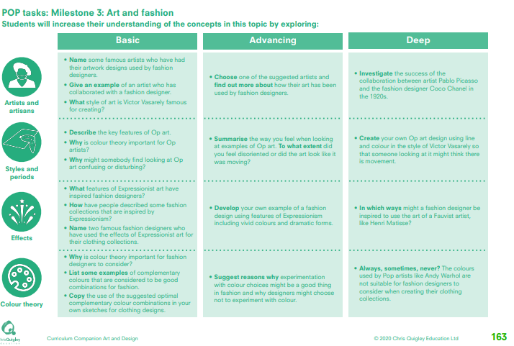

Slide 29
Art and fashion
This table shows the knowledge that will be taught in each lesson
Year 1 | Name some famous artists who have had their artwork designs used by fashion designers. Give an example of an artist who has collaborated with a fashion designer. What style of art is Victor Vasarely famous for creating? | Describe the key features of Op art. Why is colour theory important for Op artists? Why might somebody find looking at Op art confusing or disturbing? | What features of Expressionist art have inspired fashion designers? How have people described some fashion collections that are inspired by Expressionism? Name two famous fashion designers who have used the effects of Expressionist art for their clothing collections. | Why is colour theory important for fashion designers to consider? List some examples of complementary colours that are considered to be good combinations for fashion. Copy the use of the suggested optimal complementary colour combinations in your own sketches for clothing designs.
Year 2 | Choose one of the suggested artists and find out more about how their art has been used by fashion designers. Investigate the success of the collaboration between artist Pablo Picasso and the fashion designer Coco Chanel in the 1920s. | Summarise the way you feel when looking at examples of Op art. To what extent did you feel disoriented or did the art look like it was moving? Create your own Op art design using line and colour in the style of Victor Vasarely so that someone looking at it might think there is movement. | Develop your own example of a fashion design using features of Expressionism including vivid colours and dramatic forms. In which ways might a fashion designer be inspired to use the art of a Fauvist artist, like Henri Matisse? | Suggest reasons why experimentation with colour choices might be a good thing in fashion and why designers might choose not to experiment with colour. Always, sometimes, never? The colours used by Pop artists like Andy Warhol are not suitable for fashion designers to consider when creating their clothing collections.

Slide 31
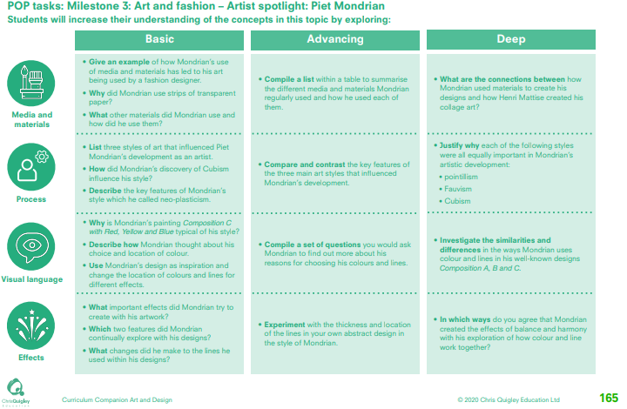

Slide 32
Art and fashion – Piet Mondrian
This table shows the knowledge that will be taught in each lesson
Year 1 | Give an example of how Mondrian’s use of media and materials has led to his art being used by a fashion designer. Why did Mondrian use strips of transparent paper? What other materials did Mondrian use and how did he use them? | List three styles of art that influenced Piet Mondrian’s development as an artist. How did Mondrian’s discovery of Cubism influence his style? Describe the key features of Mondrian’s style which he called neo-plasticism | Why is Mondrian’s painting Composition C with Red, Yellow and Blue typical of his style? Describe how Mondrian thought about his choice and location of colour. Use Mondrian’s design as inspiration and change the location of colours and lines for different effects | What important effects did Mondrian try to create with his artwork? Which two features did Mondrian continually explore with his designs? What changes did he make to the lines he used within his designs?
Year 2 | Compile a list within a table to summarise the different media and materials Mondrian regularly used and how he used each of them. What are the connections between how Mondrian used materials to create his designs and how Henri Mattise created his collage art? | Compare and contrast the key features of the three main art styles that influenced Mondrian’s development. Justify why each of the following styles were all equally important in Mondrian’s artistic development: • pointillism • Fauvism • Cubism. | Compile a set of questions you would ask Mondrian to find out more about his reasons for choosing his colours and lines. Investigate the similarities and differences in the ways Mondrian uses colour and lines in his well-known designs Composition A, B and C. | Experiment with the thickness and location of the lines in your own abstract design in the style of Mondrian. In which ways do you agree that Mondrian created the effects of balance and harmony with his exploration of how colour and line work together?

Slide 33
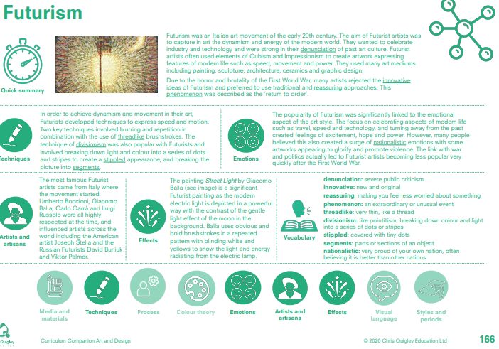

Slide 34
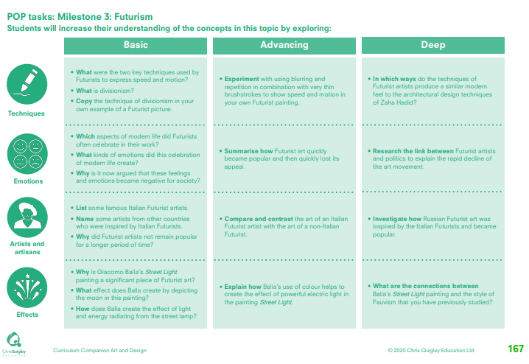

Slide 35
Futurism
This table shows the knowledge that will be taught in each lesson
Year 1 | What were the two key techniques used by Futurists to express speed and motion? What is divisionism? Copy the technique of divisionism in your own example of a Futurist picture. | Which aspects of modern life did Futurists often celebrate in their work? What kinds of emotions did this celebration of modern life create? Why is it now argued that these feelings and emotions became negative for society? | List some famous Italian Futurist artists. Name some artists from other countries who were inspired by Italian Futurists. Why did Futurist artists not remain popular for a longer period of time? | Why is Giacomo Balla’s Street Light painting a significant piece of Futurist art? What effect does Balla create by depicting the moon in this painting? How does Balla create the effect of light and energy radiating from the street lamp?
Year 2 | Experiment with using blurring and repetition in combination with very thin brushstrokes to show speed and motion in your own Futurist painting. In which ways do the techniques of Futurist artists produce a similar modern feel to the architectural design techniques of Zaha Hadid? | Summarise how Futurist art quickly became popular and then quickly lost its appeal. Research the link between Futurist artists and politics to explain the rapid decline of the art movement. | Compare and contrast the art of an Italian Futurist artist with the art of a non-Italian Futurist. Investigate how Russian Futurist art was inspired by the Italian Futurists and became popular. | Explain how Balla’s use of colour helps to create the effect of powerful electric light in the painting Street Light. What are the connections between Balla’s Street Light painting and the style of Fauvism that you have previously studied?

Slide 37
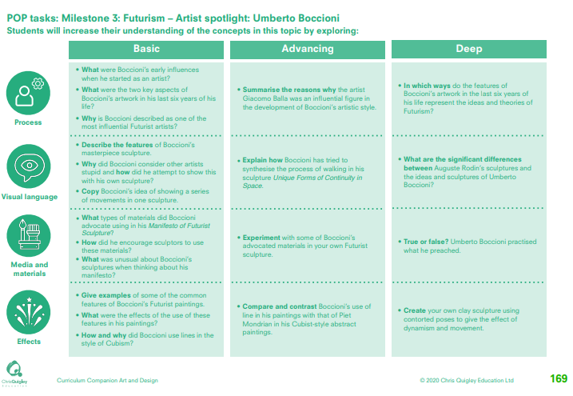

Slide 38
Futurism – Umberto Boccioni
This table shows the knowledge that will be taught in each lesson
Year 1 | What were Boccioni’s early influences when he started as an artist? What were the two key aspects of Boccioni’s artwork in his last six years of his life? Why is Boccioni described as one of the most influential Futurist artists? | Describe the features of Boccioni’s masterpiece sculpture. Why did Boccioni consider other artists stupid and how did he attempt to show this with his own sculpture? Copy Boccioni’s idea of showing a series of movements in one sculpture. | What types of materials did Boccioni advocate using in his Manifesto of Futurist Sculpture? How did he encourage sculptors to use these materials? What was unusual about Boccioni’s sculptures when thinking about his manifesto? | Give examples of some of the common features of Boccioni’s Futurist paintings. What were the effects of the use of these features in his paintings? How and why did Boccioni use lines in the style of Cubism?
Year 2 | Summarise the reasons why the artist Giacomo Balla was an influential figure in the development of Boccioni’s artistic style. In which ways do the features of Boccioni’s artwork in the last six years of his life represent the ideas and theories of Futurism? | Explain how Boccioni has tried to synthesise the process of walking in his sculpture Unique Forms of Continuity in Space. What are the significant differences between Auguste Rodin’s sculptures and the ideas and sculptures of Umberto Boccioni? | Experiment with some of Boccioni’s advocated materials in your own Futurist sculpture. True or false? Umberto Boccioni practised what he preached | Compare and contrast Boccioni’s use of line in his paintings with that of Piet Mondrian in his Cubist-style abstract paintings. Create your own clay sculpture using contorted poses to give the effect of dynamism and movement.

Slide 39
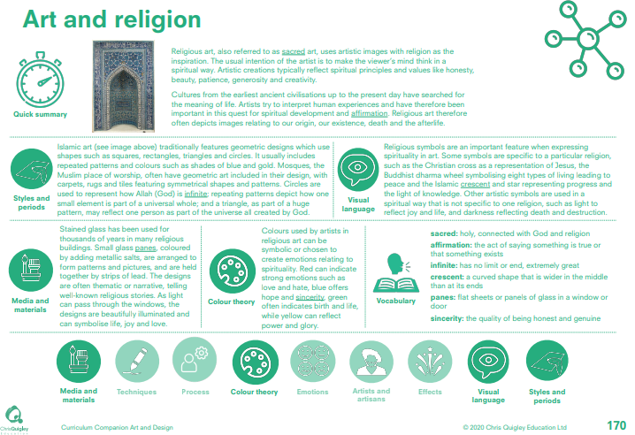

Slide 40
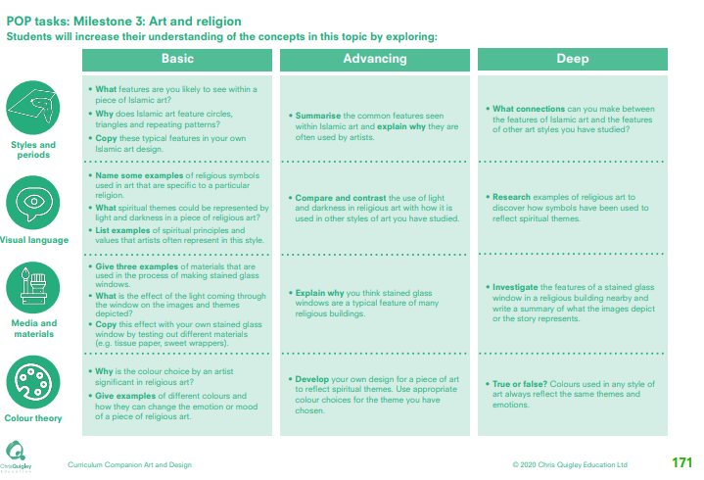

Slide 41
Art and religion
This table shows the knowledge that will be taught in each lesson
Year 1 | What features are you likely to see within a piece of Islamic art? Why does Islamic art feature circles, triangles and repeating patterns? Copy these typical features in your own Islamic art design. | Name some examples of religious symbols used in art that are specific to a particular religion. What spiritual themes could be represented by light and darkness in a piece of religious art? List examples of spiritual principles and values that artists often represent in this style. | Give three examples of materials that are used in the process of making stained glass windows. What is the effect of the light coming through the window on the images and themes depicted? Copy this effect with your own stained glass window by testing out different materials (e.g. tissue paper, sweet wrappers). | Why is the colour choice by an artist significant in religious art? Give examples of different colours and how they can change the emotion or mood of a piece of religious art.
Year 2 | Summarise the common features seen within Islamic art and explain why they are often used by artists. What connections can you make between the features of Islamic art and the features of other art styles you have studied? | Compare and contrast the use of light and darkness in religious art with how it is used in other styles of art you have studied. Research examples of religious art to discover how symbols have been used to reflect spiritual themes. | Explain why you think stained glass windows are a typical feature of many religious buildings. Investigate the features of a stained glass window in a religious building nearby and write a summary of what the images depict or the story represents. | Develop your own design for a piece of art to reflect spiritual themes. Use appropriate colour choices for the theme you have chosen. True or false? Colours used in any style of art always reflect the same themes and emotions.

Slide 42
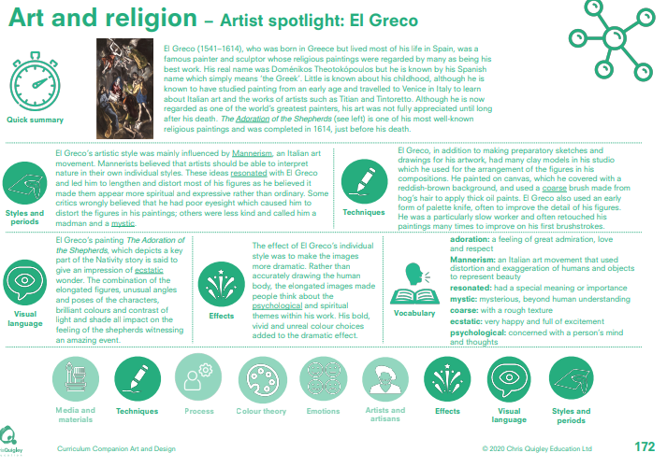

Slide 43
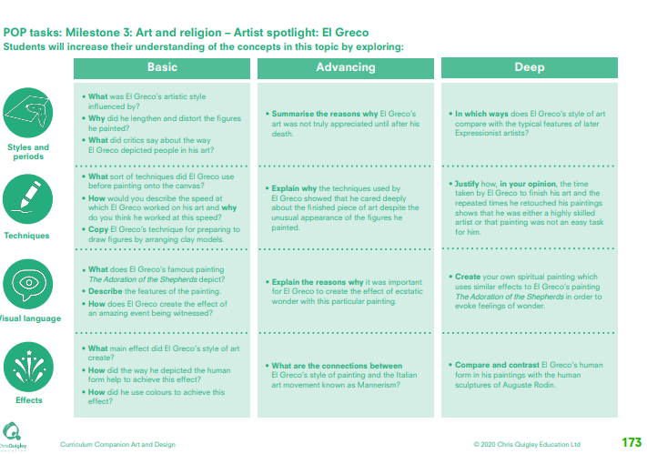

Slide 44
Art and religion – El Greco
This table shows the knowledge that will be taught in each lesson
Year 1 | What was El Greco’s artistic style influenced by? Why did he lengthen and distort the figures he painted? What did critics say about the way El Greco depicted people in his art? | What sort of techniques did El Greco use before painting onto the canvas? How would you describe the speed at which El Greco worked on his art and why do you think he worked at this speed? Copy El Greco’s technique for preparing | What does El Greco’s famous painting The Adoration of the Shepherds depict? Describe the features of the painting. How does El Greco create the effect of an amazing event being witnessed? | What main effect did El Greco’s style of art create? How did the way he depicted the human form help to achieve this effect? How did he use colours to achieve this effect?
Year 2 | Summarise the reasons why El Greco’s art was not truly appreciated until after his death. In which ways does El Greco’s style of art compare with the typical features of later Expressionist artists? | Explain why the techniques used by El Greco showed that he cared deeply about the finished piece of art despite the unusual appearance of the figures he painted. Justify how, in your opinion, the time taken by El Greco to finish his art and the repeated times he retouched his paintings shows that he was either a highly skilled artist or that painting was not an easy task for him. | Explain the reasons why it was important for El Greco to create the effect of ecstatic wonder with this particular painting. Create your own spiritual painting which uses similar effects to El Greco’s painting The Adoration of the Shepherds in order to evoke feelings of wonder. | What are the connections between El Greco’s style of painting and the Italian art movement known as Mannerism? Compare and contrast El Greco’s human form in his paintings with the human sculptures of Auguste Rodin.

Slide 46
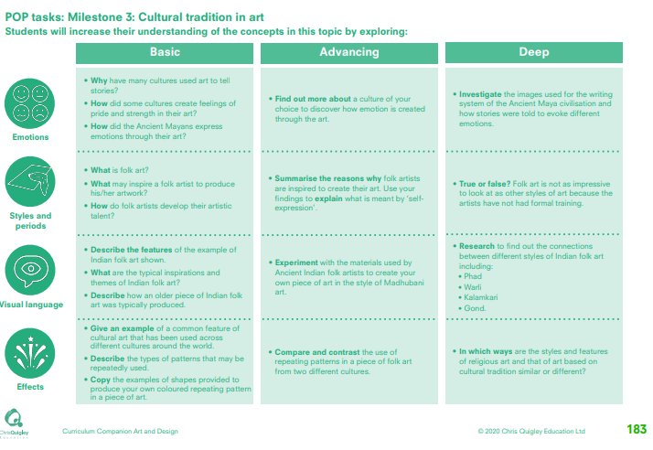

Slide 47
Cultural tradition in art
This table shows the knowledge that will be taught in each lesson
Year 1 | Why have many cultures used art to tell stories? How did some cultures create feelings of pride and strength in their art? How did the Ancient Mayans express emotions through their art? | What is folk art? What may inspire a folk artist to produce his/her artwork? How do folk artists develop their artistic talent? | Describe the features of the example of Indian folk art shown. What are the typical inspirations and themes of Indian folk art? Describe how an older piece of Indian folk art was typically produced. | Give an example of a common feature of cultural art that has been used across different cultures around the world. Describe the types of patterns that may be repeatedly used. Copy the examples of shapes provided to produce your own coloured repeating pattern in a piece of art.
Year 2 | Find out more about a culture of your choice to discover how emotion is created through the art. Investigate the images used for the writing system of the Ancient Maya civilisation and how stories were told to evoke different emotions. | Summarise the reasons why folk artists are inspired to create their art. Use your findings to explain what is meant by ‘selfexpression’. True or false? Folk art is not as impressive to look at as other styles of art because the artists have not had formal training. | Experiment with the materials used by Ancient Indian folk artists to create your own piece of art in the style of Madhubani art. Research to find out the connections between different styles of Indian folk art including: • Phad • Warli • Kalamkari • Gond | Compare and contrast the use of repeating patterns in a piece of folk art from two different cultures. In which ways are the styles and features of religious art and that of art based on cultural tradition similar or different?

Slide 48
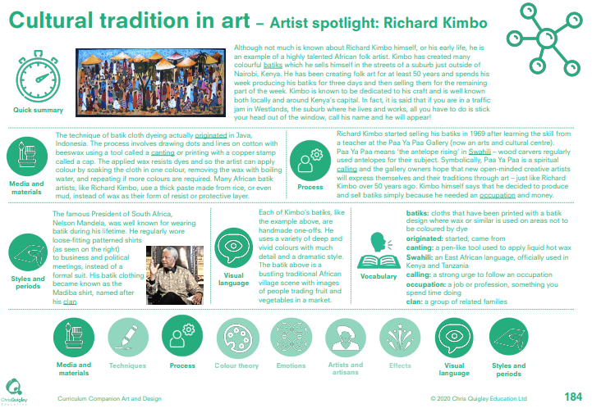

Slide 49
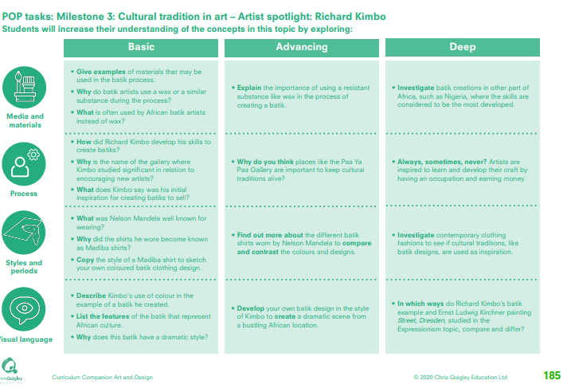

Slide 50
Cultural tradition in art – Richard Kimbo
This table shows the knowledge that will be taught in each lesson
Year 1 | Give examples of materials that may be used in the batik process. Why do batik artists use a wax or a similar substance during the process? What is often used by African batik artists instead of wax? | How did Richard Kimbo develop his skills to create batiks? Why is the name of the gallery where Kimbo studied significant in relation to encouraging new artists? What does Kimbo say was his initial inspiration for creating batiks to sell? | What was Nelson Mandela well known for wearing? Why did the shirts he wore become known as Madiba shirts? Copy the style of a Madiba shirt to sketch. | Describe Kimbo’s use of colour in the example of a batik he created. List the features of the batik that represent African culture. Why does this batik have a dramatic style?
Year 2 | • Explain the importance of using a resistant substance like wax in the process of creating a batik. Investigate batik creations in other part of Africa, such as Nigeria, where the skills are considered to be the most developed. | Why do you think places like the Paa Ya Paa Gallery are important to keep cultural traditions alive? Always, sometimes, never? Artists are inspired to learn and develop their craft by having an occupation and earning money. | Find out more about the different batik shirts worn by Nelson Mandela to compare and contrast the colours and designs. Investigate contemporary clothing fashions to see if cultural traditions, like batik designs, are used as inspiration. | Develop your own batik design in the style of Kimbo to create a dramatic scene from a bustling African location. In which ways do Richard Kimbo’s batik example and Ernst Ludwig Kirchner painting Street, Dresden, studied in the Expressionism topic, compare and differ?

