Slide 1
Upper Key Stage 2 Geography Curriculum
Together we Nurture, Inspire and Achieve

Slide 2
Geography topics overview
Geography topics are organised and referenced around a geographical schema. Each topic either introduces an aspect of the schema or references previous instances of it. Below is an overview of the topics we teach and which aspects of the schema it strengthens:
Techniques
Location
Physical
features
Human features
Diversity
Physical
processes
Human
processes
Using maps-features |  |  |  |  |  |  | .
Using maps-four figure and six figure grid references |  |  |  |  |  |  | .
Ocean currents |  |  | . |  | .
Biomes and climate zones | . | . |  | . |  | .
Tropical rainforest biome | . | . |  | . |  | .
Temperate deciduous forest biome | . | . |  | .
Desert biome | . | . |  | .
Tundra biome | . | . |  | . |  | .
Taiga biome | . | . |  | . |  | .
Grassland biome | . | . |  | . |  | .
Marine biome | . | . |  | . |  | .
Freshwater biome | . | . |  | . |  | .
Ice Biome | . | . |  | . |  | .
North America | . |  |  | .
North America-population |  |  | . | .
North America-rivers | . |  |  |  | .

Slide 3
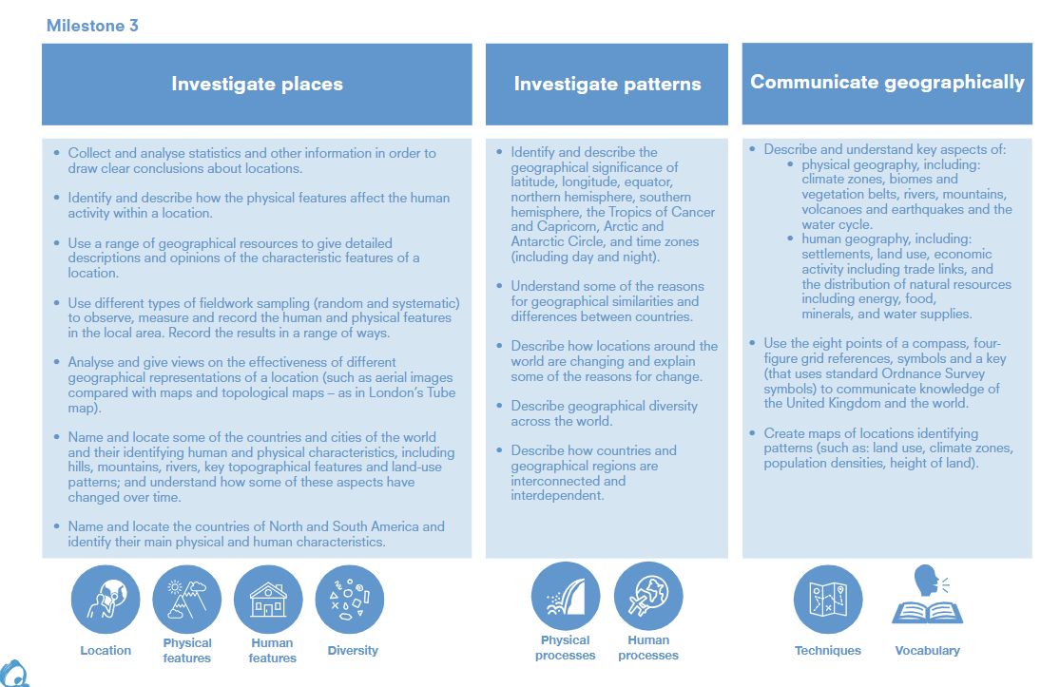

Slide 5
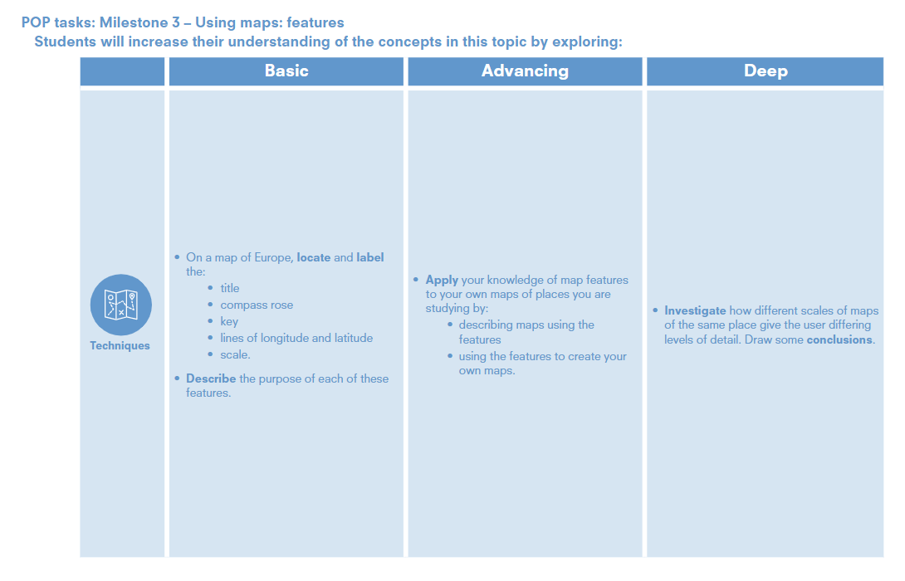

Slide 6
Using maps: features
Year 5 | • On a map of Europe, locate and label the: • title • compass rose • key • lines of longitude and latitude • scale. • Describe the purpose of each of these features.
Year 6 | • Apply your knowledge of map features to your own maps of places you are studying by: • describing maps using the features • using the features to create your own maps. • Investigate how different scales of mapsof the same place give the user differinglevels of detail. Draw some conclusions.

Slide 9
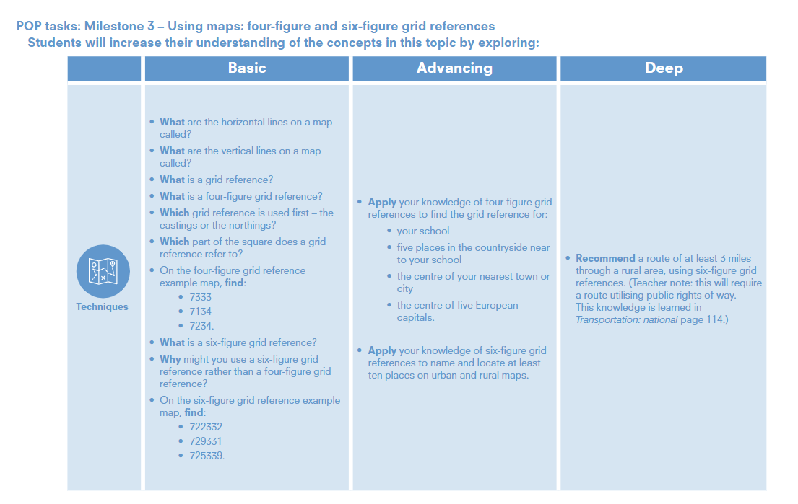

Slide 10
Using maps: four figure and six figure grid references
Year 5 | • What are the horizontal lines on a map called? • What are the vertical lines on a map called? • What is a grid reference? • What is a four-figure grid reference? • Which grid reference is used first – the eastings or the northings? • Which part of the square does a grid reference refer to? • On the four-figure grid referenceexample map, find: • 7333 • 7134 • 7234. • What is a six-figure grid reference? • Why might you use a six-figure grid reference rather than a four-figure grid reference? • On the six-figure grid reference example map, find: • 722332 • 729331 • 725339.
Year 6 | • Apply your knowledge of four-figure grid references to find the grid reference for: • your school • five places in the countryside near to your school • the centre of your nearest town or city • the centre of five European capitals. • Apply your knowledge of six-figure grid references to name and locate at least ten places on urban and rural maps. • Recommend a route of at least 3 miles through a rural area, using six-figure grid references. (Teacher note: this will require a route utilising public rights of way.This knowledge is learned in Transportation: national page 114.)

Slide 12
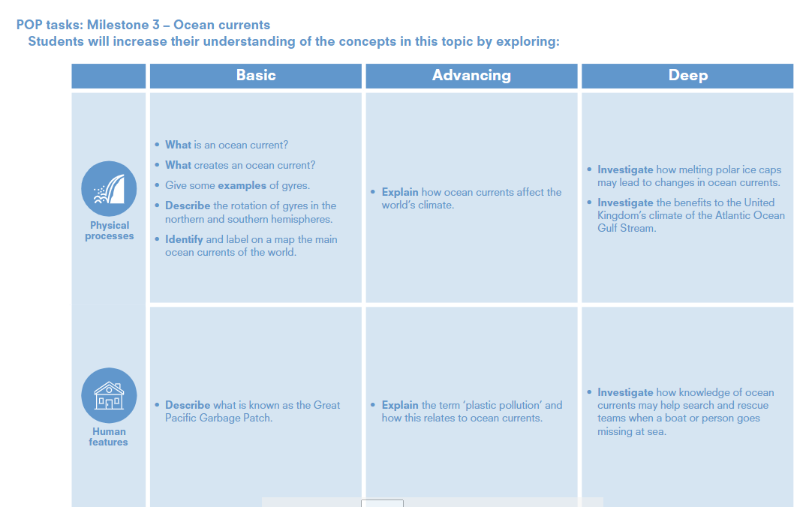

Slide 13
Ocean currents
Year 5 | • What is an ocean current? • What creates an ocean current? • Give some examples of gyres. • Describe the rotation of gyres in the northern and southern hemispheres. • Identify and label on a map the main ocean currents of the world. | Describe what is known as the Great Pacific Garbage Patch.
Year 6 | • Explain how ocean currents affect the world’s climate Investigate how melting polar ice caps may lead to changes in ocean currents. • Investigate the benefits to the United Kingdom’s climate of the Atlantic Ocean Gulf Stream. | • Explain the term ‘plastic pollution’ and how this relates to ocean currents. • Investigate how knowledge of ocean currents may help search and rescue teams when a boat or person goes missing at sea.

Slide 14
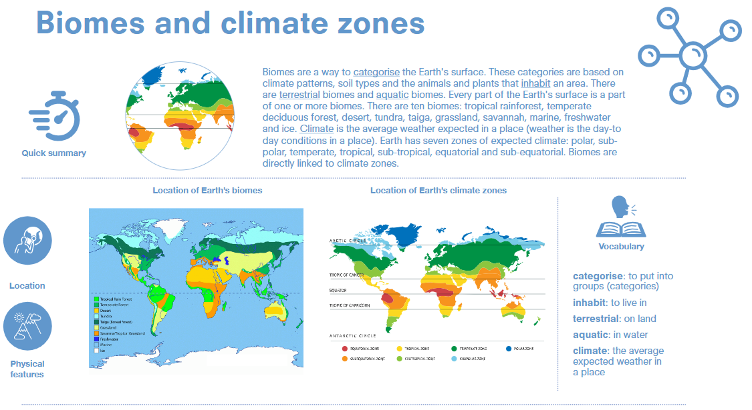

Slide 15
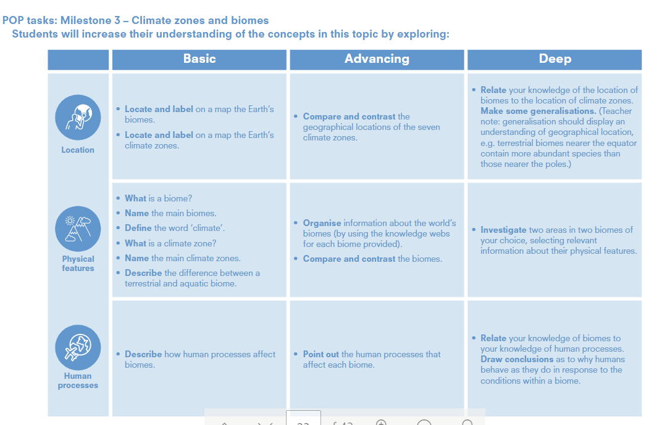

Slide 16
Biomes and climate zones
Location
Physical
features
Human
processes
Year 5 | • Locate and label on a map the Earth’s biomes. • Locate and label on a map the Earth’s climate zones. | • What is a biome? • Name the main biomes. • Define the word ‘climate’. • What is a climate zone? • Name the main climate zones. • Describe the difference between a terrestrial and aquatic biome. | •Describe how human processes affect biomes.
Year 6 | • Compare and contrast the geographical locations of the seven climate zones. • Relate your knowledge of the location of biomes to the location of climate zones. Make some generalisations. (Teacher note: generalisation should display an understanding of geographical location, e.g. terrestrial biomes nearer the equatorcontain more abundant species than those nearer the poles.) | Organise information about the world’s biomes (by using the knowledge webs for each biome provided). • Compare and contrast the biomes. • Investigate two areas in two biomes of your choice, selecting relevant information about their physical features. | •Point out the human processes that affect each biome. Relate your knowledge of biomes to your knowledge of human processes. Draw conclusions as to why humans behave as they do in response to the conditions within a biome.

Slide 17
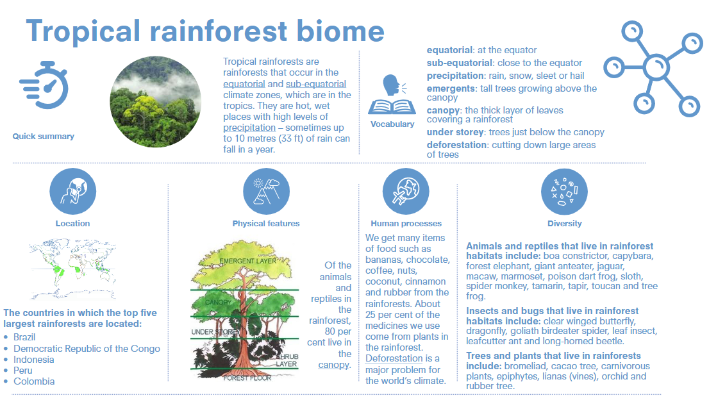

Slide 19
Tropical rainforest biome
Location
Physical
features
Human
processes
Year 5 | • Locate and label on a map the Earth’s biomes. • Locate and label on a map the Earth’s climate zones. | • What is a biome? • Name the main biomes. • Define the word ‘climate’. • What is a climate zone? • Name the main climate zones. • Describe the difference between a terrestrial and aquatic biome. | •Describe how human processes affect biomes.
Year 6 | • Compare and contrast the geographical locations of the seven climate zones. • Relate your knowledge of the location of biomes to the location of climate zones. Make some generalisations. (Teacher note: generalisation should display an understanding of geographical location, e.g. terrestrial biomes nearer the equatorcontain more abundant species than those nearer the poles.) | Organise information about the world’s biomes (by using the knowledge webs for each biome provided). • Compare and contrast the biomes. • Investigate two areas in two biomes of your choice, selecting relevant information about their physical features. | •Point out the human processes that affect each biome. Relate your knowledge of biomes to your knowledge of human processes. Draw conclusions as to why humans behave as they do in response to the conditions within a biome.

Slide 22
Temperate deciduous forest biome
Location
Physical
features
Human
processes
Year 5 | • Locate and label on a map the Earth’s biomes. • Locate and label on a map the Earth’s climate zones. | • What is a biome? • Name the main biomes. • Define the word ‘climate’. • What is a climate zone? • Name the main climate zones. • Describe the difference between a terrestrial and aquatic biome. | •Describe how human processes affect biomes.
Year 6 | • Compare and contrast the geographical locations of the seven climate zones. • Relate your knowledge of the location of biomes to the location of climate zones. Make some generalisations. (Teacher note: generalisation should display an understanding of geographical location, e.g. terrestrial biomes nearer the equatorcontain more abundant species than those nearer the poles.) | Organise information about the world’s biomes (by using the knowledge webs for each biome provided). • Compare and contrast the biomes. • Investigate two areas in two biomes of your choice, selecting relevant information about their physical features. | •Point out the human processes that affect each biome. Relate your knowledge of biomes to your knowledge of human processes. Draw conclusions as to why humans behave as they do in response to the conditions within a biome.

Slide 25
Desert biome
Location
Physical
features
Human
processes
Year 5 | • Locate and label on a map the Earth’s biomes. • Locate and label on a map the Earth’s climate zones. | • What is a biome? • Name the main biomes. • Define the word ‘climate’. • What is a climate zone? • Name the main climate zones. • Describe the difference between a terrestrial and aquatic biome. | •Describe how human processes affect biomes.
Year 6 | • Compare and contrast the geographical locations of the seven climate zones. • Relate your knowledge of the location of biomes to the location of climate zones. Make some generalisations. (Teacher note: generalisation should display an understanding of geographical location, e.g. terrestrial biomes nearer the equator contain more abundant species than those nearer the poles.) | Organise information about the world’s biomes (by using the knowledge webs for each biome provided). • Compare and contrast the biomes. • Investigate two areas in two biomes of your choice, selecting relevant information about their physical features. | •Point out the human processes that affect each biome. Relate your knowledge of biomes to your knowledge of human processes. Draw conclusions as to why humans behave as they do in response to the conditions within a biome.

Slide 28
Tundra biome
Location
Physical
features
Human
processes
Year 5 | • Locate and label on a map the Earth’s biomes. • Locate and label on a map the Earth’s climate zones. | • What is a biome? • Name the main biomes. • Define the word ‘climate’. • What is a climate zone? • Name the main climate zones. • Describe the difference between a terrestrial and aquatic biome. | •Describe how human processes affect biomes.
Year 6 | • Compare and contrast the geographical locations of the seven climate zones. • Relate your knowledge of the location of biomes to the location of climate zones. Make some generalisations. (Teacher note: generalisation should display an understanding of geographical location, e.g. terrestrial biomes nearer the equatorcontain more abundant species than those nearer the poles.) | Organise information about the world’s biomes (by using the knowledge webs for each biome provided). • Compare and contrast the biomes. • Investigate two areas in two biomes of your choice, selecting relevant information about their physical features. | •Point out the human processes that affect each biome. Relate your knowledge of biomes to your knowledge of human processes. Draw conclusions as to why humans behave as they do in response to the conditions within a biome.

Slide 31
Taiga biome
Location
Physical
features
Human
processes
Year 5 | • Locate and label on a map the Earth’s biomes. • Locate and label on a map the Earth’s climate zones. | • What is a biome? • Name the main biomes. • Define the word ‘climate’. • What is a climate zone? • Name the main climate zones. • Describe the difference between a terrestrial and aquatic biome. | •Describe how human processes affect biomes.
Year 6 | • Compare and contrast the geographical locations of the seven climate zones. • Relate your knowledge of the location of biomes to the location of climate zones. Make some generalisations. (Teacher note: generalisation should display an understanding of geographical location, e.g. terrestrial biomes nearer the equatorcontain more abundant species than those nearer the poles.) | Organise information about the world’s biomes (by using the knowledge webs for each biome provided). • Compare and contrast the biomes. • Investigate two areas in two biomes of your choice, selecting relevant information about their physical features. | •Point out the human processes that affect each biome. Relate your knowledge of biomes to your knowledge of human processes. Draw conclusions as to why humans behave as they do in response to the conditions within a biome.

Slide 34
Grassland biome
Location
Physical
features
Human
processes
Year 5 | • Locate and label on a map the Earth’s biomes. • Locate and label on a map the Earth’s climate zones. | • What is a biome? • Name the main biomes. • Define the word ‘climate’. • What is a climate zone? • Name the main climate zones. • Describe the difference between a terrestrial and aquatic biome. | •Describe how human processes affect biomes.
Year 6 | • Compare and contrast the geographical locations of the seven climate zones. • Relate your knowledge of the location of biomes to the location of climate zones. Make some generalisations. (Teacher note: generalisation should display an understanding of geographical location, e.g. terrestrial biomes nearer the equatorcontain more abundant species than those nearer the poles.) | Organise information about the world’s biomes (by using the knowledge webs for each biome provided). • Compare and contrast the biomes. • Investigate two areas in two biomes of your choice, selecting relevant information about their physical features. | •Point out the human processes that affect each biome. Relate your knowledge of biomes to your knowledge of human processes. Draw conclusions as to why humans behave as they do in response to the conditions within a biome.

Slide 37
Marine biome
Location
Physical
features
Human
processes
Year 5 | • Locate and label on a map the Earth’s biomes. • Locate and label on a map the Earth’s climate zones. | • What is a biome? • Name the main biomes. • Define the word ‘climate’. • What is a climate zone? • Name the main climate zones. • Describe the difference between a terrestrial and aquatic biome. | •Describe how human processes affect biomes.
Year 6 | • Compare and contrast the geographical locations of the seven climate zones. • Relate your knowledge of the location of biomes to the location of climate zones. Make some generalisations. (Teacher note: generalisation should display an understanding of geographical location, e.g. terrestrial biomes nearer the equatorcontain more abundant species than those nearer the poles.) | Organise information about the world’s biomes (by using the knowledge webs for each biome provided). • Compare and contrast the biomes. • Investigate two areas in two biomes of your choice, selecting relevant information about their physical features. | •Point out the human processes that affect each biome. Relate your knowledge of biomes to your knowledge of human processes. Draw conclusions as to why humans behave as they do in response to the conditions within a biome.

Slide 38
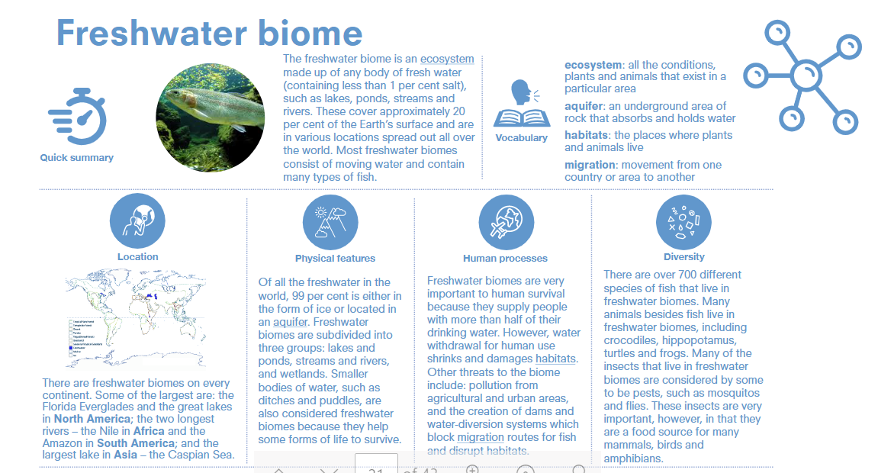

Slide 40
Freshwater biome
Location
Physical
features
Human
processes
Year 5 | • Locate and label on a map the Earth’s biomes. • Locate and label on a map the Earth’s climate zones. | • What is a biome? • Name the main biomes. • Define the word ‘climate’. • What is a climate zone? • Name the main climate zones. • Describe the difference between a terrestrial and aquatic biome. | •Describe how human processes affect biomes.
Year 6 | • Compare and contrast the geographical locations of the seven climate zones. • Relate your knowledge of the location of biomes to the location of climate zones. Make some generalisations. (Teacher note: generalisation should display an understanding of geographical location, e.g. terrestrial biomes nearer the equatorcontain more abundant species than those nearer the poles.) | Organise information about the world’s biomes (by using the knowledge webs for each biome provided). • Compare and contrast the biomes. • Investigate two areas in two biomes of your choice, selecting relevant information about their physical features. | •Point out the human processes that affect each biome. Relate your knowledge of biomes to your knowledge of human processes. Draw conclusions as to why humans behave as they do in response to the conditions within a biome.

Slide 41
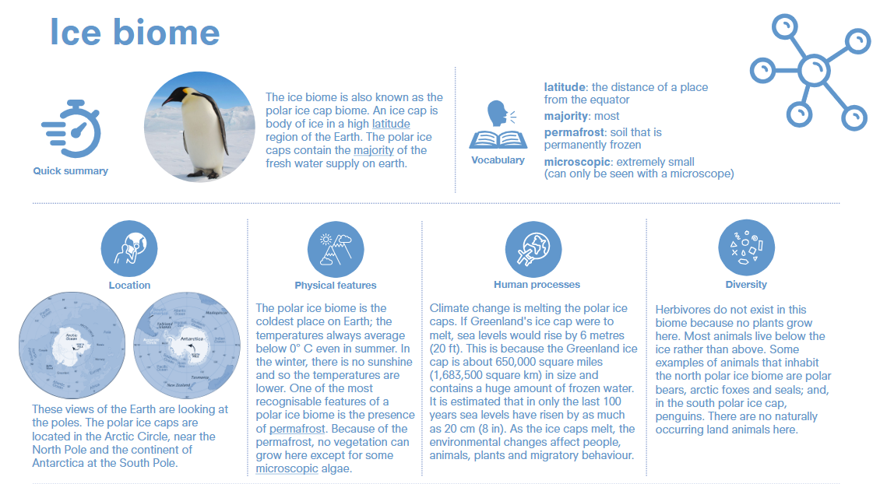

Slide 43
Ice biome
Location
Physical
features
Human
processes
Year 5 | • Locate and label on a map the Earth’s biomes. • Locate and label on a map the Earth’s climate zones. | • What is a biome? • Name the main biomes. • Define the word ‘climate’. • What is a climate zone? • Name the main climate zones. • Describe the difference between a terrestrial and aquatic biome. | •Describe how human processes affect biomes.
Year 6 | • Compare and contrast the geographical locations of the seven climate zones. • Relate your knowledge of the location of biomes to the location of climate zones. Make some generalisations. (Teacher note: generalisation should display an understanding of geographical location, e.g. terrestrial biomes nearer the equatorcontain more abundant species than those nearer the poles.) | Organise information about the world’s biomes (by using the knowledge webs for each biome provided). • Compare and contrast the biomes. • Investigate two areas in two biomes of your choice, selecting relevant information about their physical features. | •Point out the human processes that affect each biome. Relate your knowledge of biomes to your knowledge of human processes. Draw conclusions as to why humans behave as they do in response to the conditions within a biome.

Slide 45
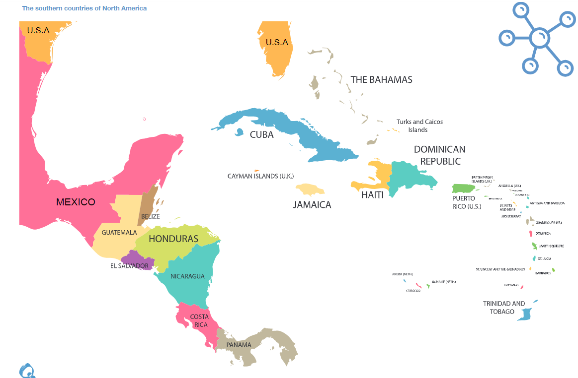

Slide 46
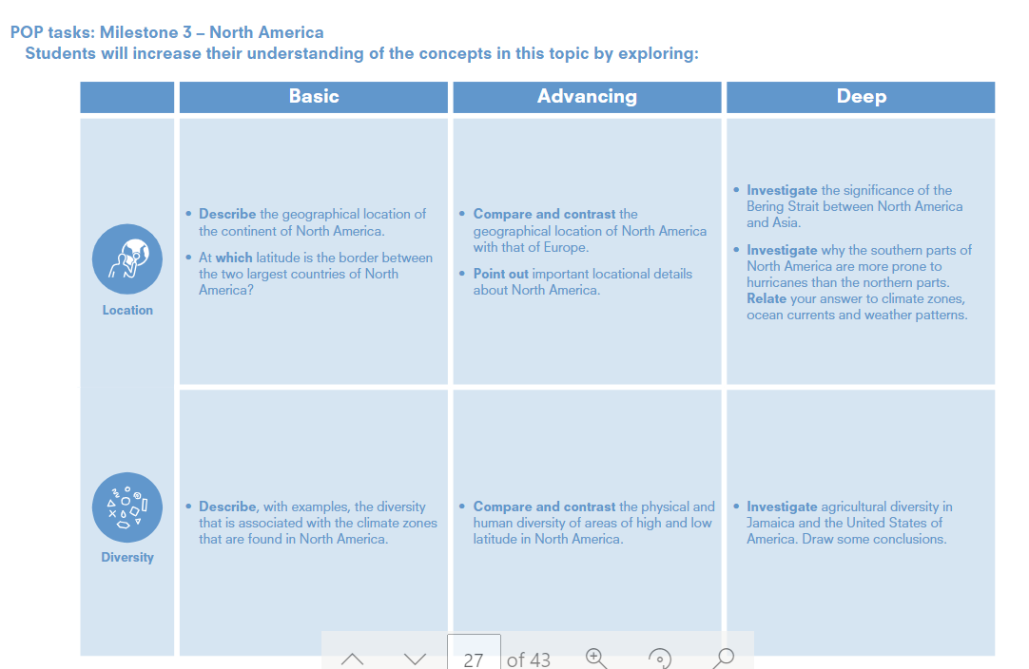

Slide 47
North America
Location
Diversity
Year 5 | • Describe the geographical location of the continent of North America. • At which latitude is the border between the two largest countries of North America? | • Describe, with examples, the diversity that is associated with the climate zones that are found in North America.
Year 6 | • Compare and contrast the geographical location of North America with that of Europe. • Point out important locational details about North America. • Investigate the significance of the Bering Strait between North America and Asia. • Investigate why the southern parts of North America are more prone to hurricanes than the northern parts. Relate your answer to climate zones, ocean currents and weather patterns | Compare and contrast the physical and human diversity of areas of high and low latitude in North America. • Investigate agricultural diversity in Jamaica and the United States of America. Draw some conclusions.

Slide 49
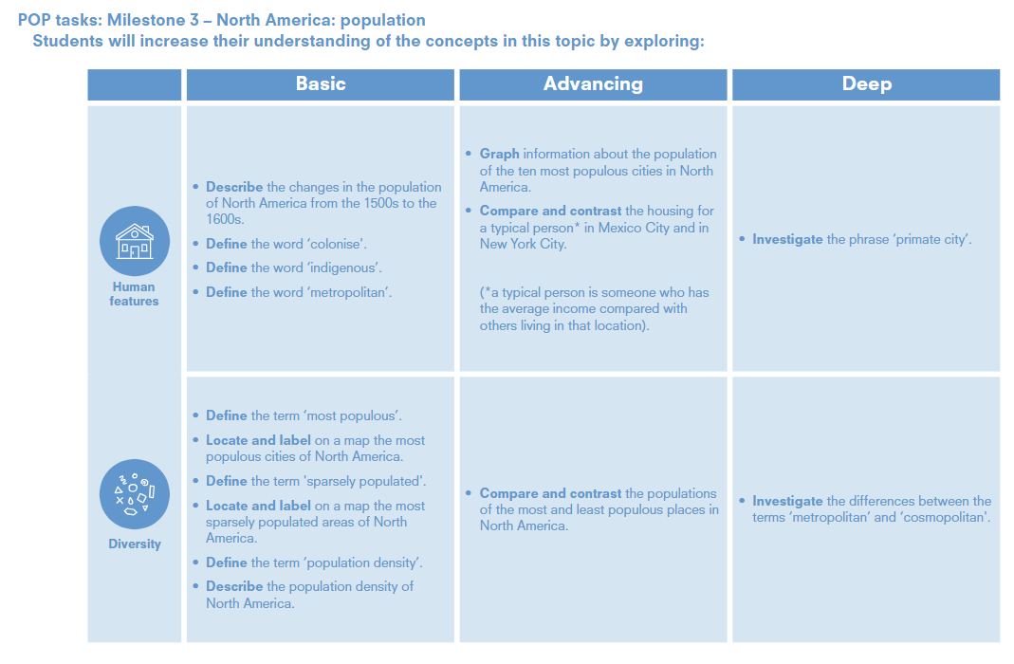

Slide 50
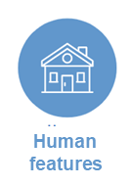
North America: population
Year 5 | • Describe the changes in the population of North America from the 1500s to the 1600s. • Define the word ‘colonise'. • Define the word ‘indigenous’. • Define the word ‘metropolitan’. | • Define the term ‘most populous’. • Locate and label on a map the mo populous cities of North America. • Define the term 'sparsely populated'. • Locate and label on a map the most sparsely populated areas of North America. • Define the term ‘population density’. • Describe the population density of North America.
Year 6 | Graph information about the population of the ten most populous cities in North America. • Compare and contrast the housing for a typical person* in Mexico City and in New York City. (*a typical person is someone who has the average income compared with others living in that location). • Investigate the phrase ‘primate city’. | • Compare and contrast the populations of the most and least populous places in North America. • Investigate the differences between the terms ‘metropolitan’ and ‘cosmopolitan'.

Slide 52
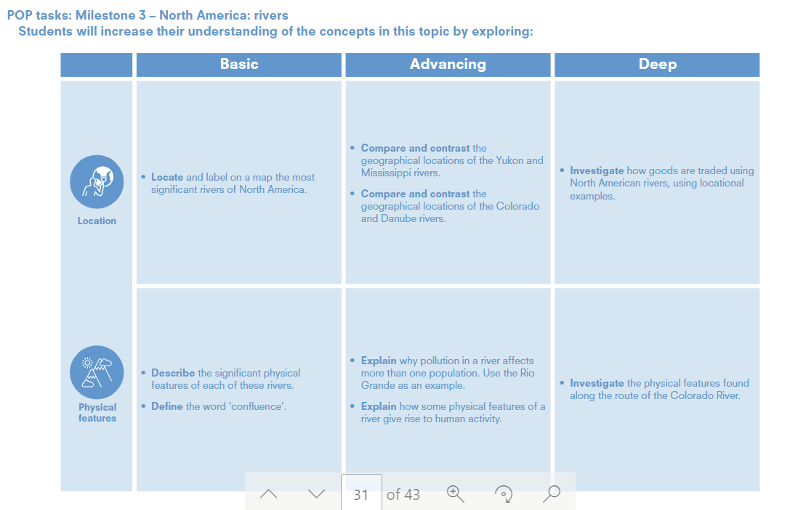

Slide 53
North America: rivers
Location
Physical
features
Year 5 | • Locate and label on a map the most significant rivers of North America. | • Describe the significant physical features of each of these rivers. • Define the word ‘confluence’.
Year 6 | • Compare and contrast the geographical locations of the Yukon and Mississippi rivers. • Compare and contrast the geographical locations of the Colorado and Danube rivers. Investigate how goods are traded using North American rivers, using locational examples. | • Explain why pollution in a river affects more than one population. Use the Rio Grande as an example. • Explain how some physical features of a river give rise to human activity. • Investigate the physical features found along the route of the Colorado River.

