Slide 1



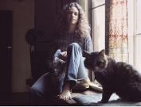








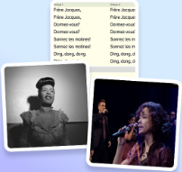

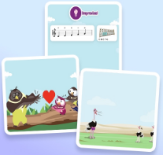


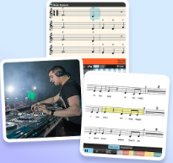
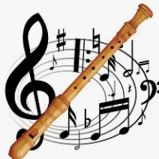
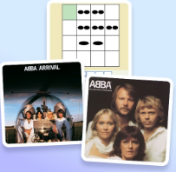



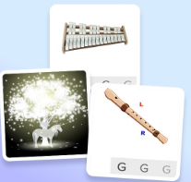

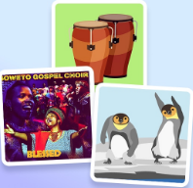
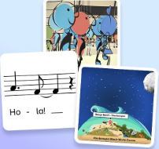
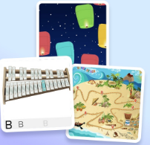
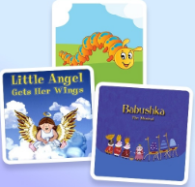
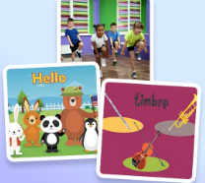
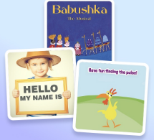
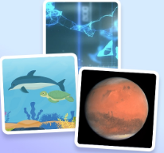
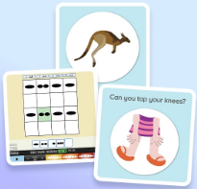

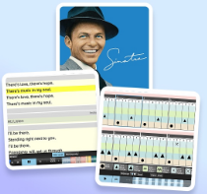
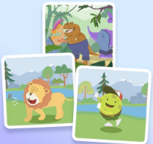
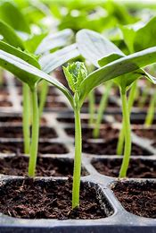

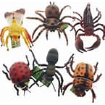

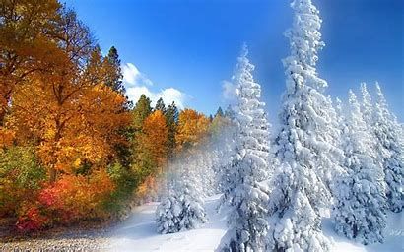
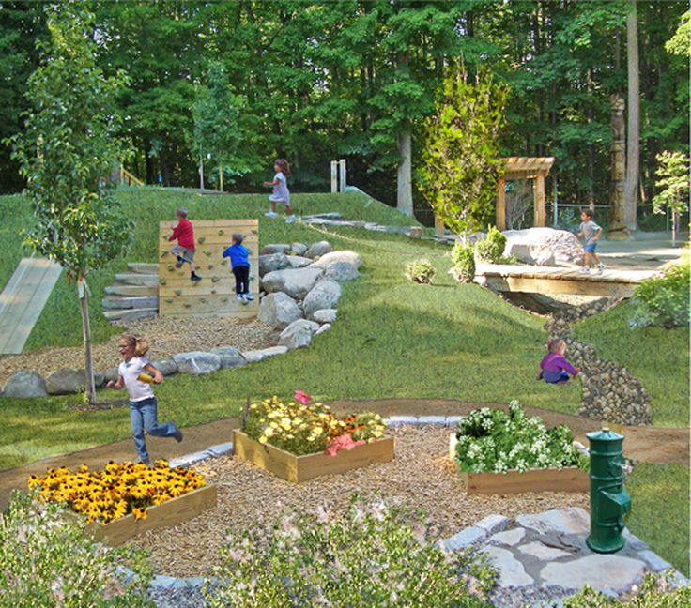
End of School Performance
Secondary School
Music
Curriculum Pathway
Garage Band (iPad)
Glockenspiel Stage 2
Happy
BBC Teach Ten pieces
You’ve got a friend
Discovering Grime
Livin on a Prayer
Make you feel my love
History of music- decades 50, 60, 70. 80, 90
UKS2
Year 5 & 6
Glockenspiel Stage 1
The Fresh Prince of Bel-Air
Round and round
Blackbird
Exploring musical contrasts
Recycling songs
Singing and Traditions
Create and notate
Travel Performance
You Gotta Try
Bringing us together
Sound exploration
Recorder music world course
Sing and move
The Power of Communication
Around the world
Sound and Symbol 2
A shining performance
LKS2
Year 3 & 4
Let’s keep singing
Sound and symbol 1
Music inspired by the world around us
Sound and pictures
Questions and answers
Let’s start singing
Highs and lows
Rhyming in time
Exploring rhythm patterns
8
KS1
Year 1 & 2
EYFS
How Thigs Change
All about me!
My Outdoor Environment
Plants and Seeds
Minibeasts
Autumn and Winter

