Slide 1

Knowledge progression grid

Slide 2
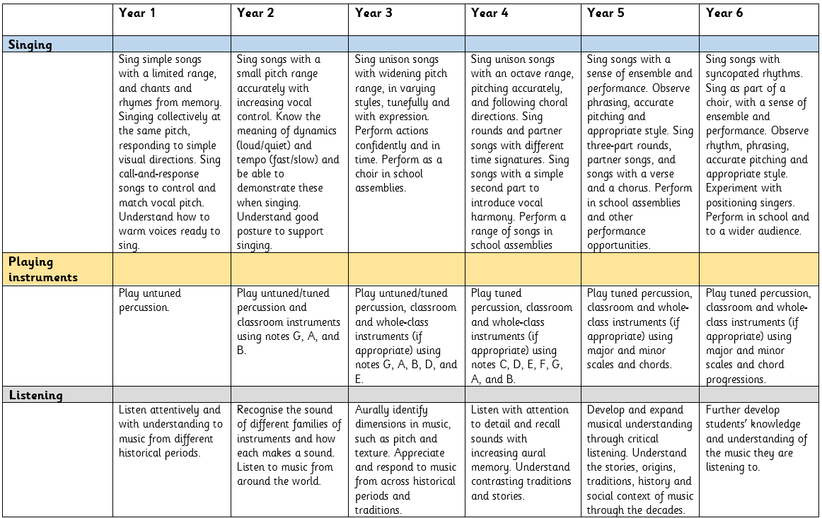

Slide 3
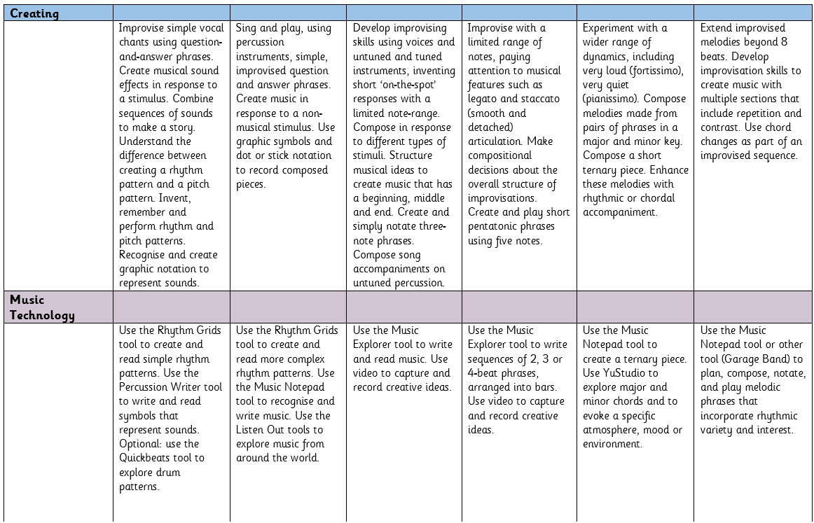

Slide 4
